Slide 1
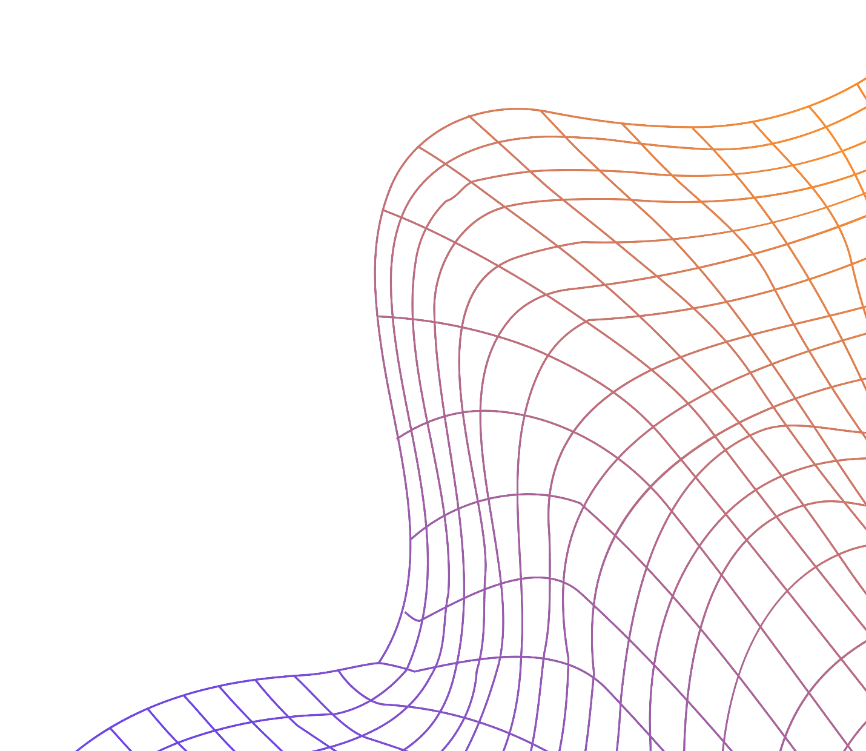
Microwave Resonator Design Optimization
Kevin Lie-Atjam

Slide 2
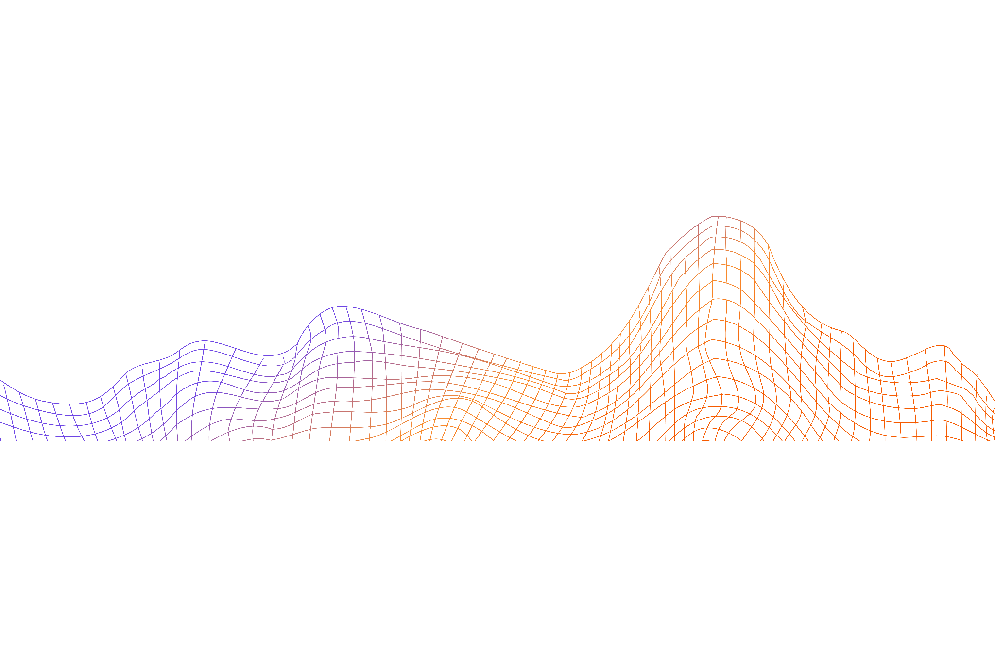
|↓↑>
Barrier & Perturbation
The main topic

Slide 3
The Barrier Method Explained
Iterative optimization method
Transform a constrained problem into an unconstrained one
Tightens the solution over time via a barrier function (Typically logarithmic)

Slide 4
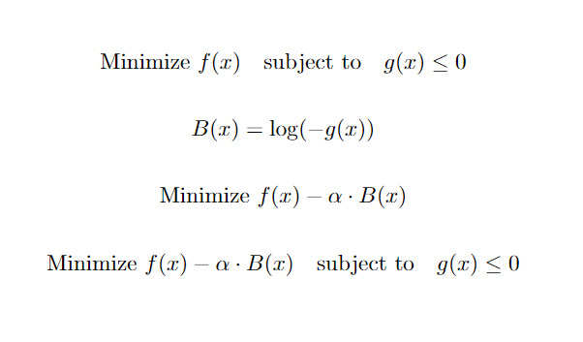
Example
Objective Function to minimize f(x)
Create a barrier function B(x) on the set of constraints g(x)
α starts off really large (Forgiving in the beginning) but gets smaller so the constraint gets tighter

Slide 5
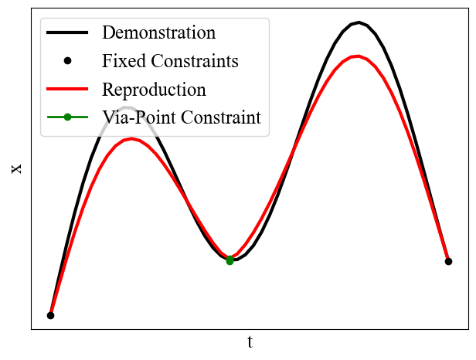
Sensitivity

Slide 6
|↑↓>
Transmon Design
Ah! There’s the quantum mayhem
Also what the hell is a transmon?

Slide 7
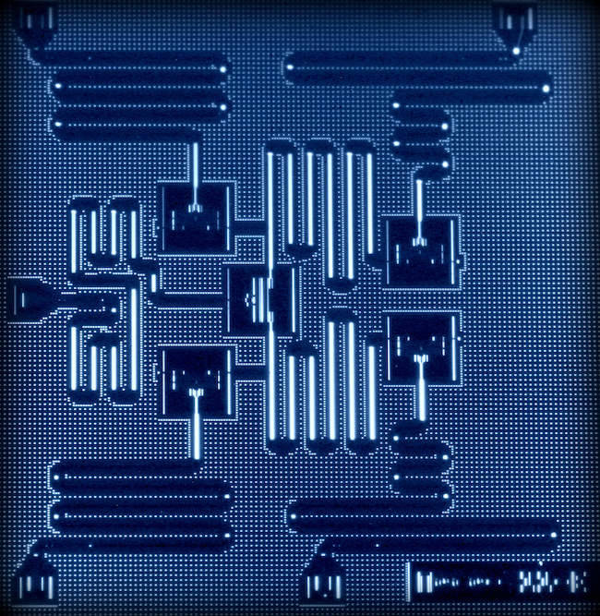
Inside a Quantum Processor

Slide 8
Noise is an issue
Find the proper dimensions to the resonator to get a high signal to noise ratio

Slide 9
Defining the conditions
Parameters
Necessary Functions
Rectangular Geometry
Material: Tantalum Based Transmon
Target SNR: 100 dB
Operating Frequency (𝞶): 5GHz
Coherence Time (T₂): 1 μs
Anharmonic Spacing (Δ⍵): 100 MHz
Speed of Light (c): 3 * 10⁸ m/s
Objective function: Minimize (l*w)/(SNR)
Constraint 1: min(l,w) ≥ c/𝞶
Constraint 2: T₂ ≥ 1 μs
Constraint 3: Δ⍵ ≥ 100 MHz

Slide 10
|↑↑>
Results
It only gets more handwavy

Slide 11
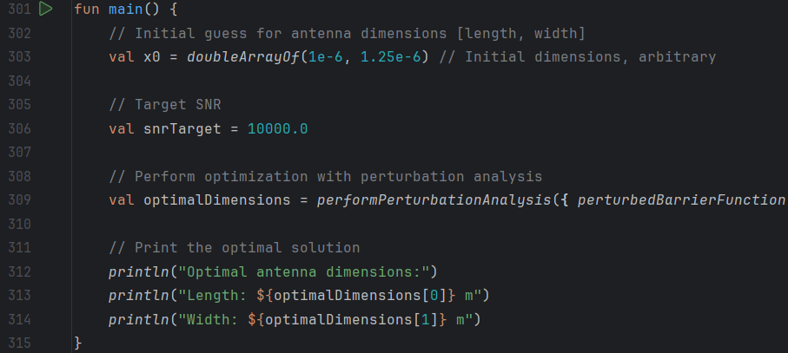

Slide 12
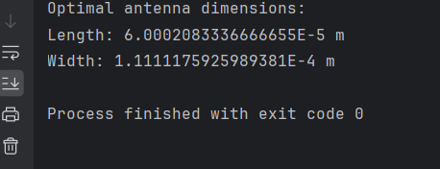
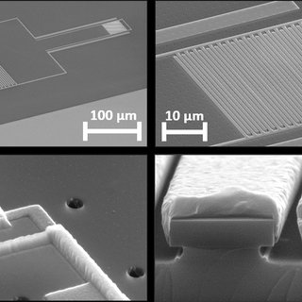
Benchmarking
Output dimensions are 60 μm by 111 μm
Top left image shows an electron microscope image of the readout resonator of an aluminum based qubit

Slide 13

Perturbation Analysis:
Initial Conditions Matter!
One drawback of the barrier method is that the initial conditions need to be well defined/reasonable
Constraint parameters affected the output, but not as much as initial dimensioning

Slide 14
Q.E.D.

