Slide 1
Modeling Smart Contracts using UPPAAL
UNDER THE SUPERVISION
OF
DR. SRINIVAS PINISETTY
Ashwin Kottapally
19CS01041

Slide 2
Case Study: Land Registration
Land-a-high valued asset should have records which identify the current owner and previous owners.
Storing, organizing and tracking all the information of property ownership records was challenging.
Challenges like,
Incidents of documents loss
Inefficient Verification
Delay due to cumbersome document-signing
Time taking process for registration and money transfer
Involvement of third parties or brokers
Using smart contracts, we can model the system for Land Registration process to avoid the above mentioned challenges.
Notes:
In real-estate business it is very important that the land-a-high valued asset to have accurate records which identify the current owner and also the all known previous owners’ history. Currently the existing solutions to trust the system are out of date. Storing, organizing and tracking all the information of property ownership records was challenging for the land registry agency when we have many land records to maintain and there might be many discrepancies within the paperwork such as forged documents and misinformation. Also, if the property owners want to buy any land they look into many aspects of all previous owners and history behind the land and area as they are going to buy for their future. In this way there are many challenges like, (a) Incidents of documents loss (b) Inefficient Verification (c) Delay due to cumbersome document-signing (d) Time taking process for registration and money transfer (e) Involvement of third parties or brokers

Slide 3
Solution
Developing a land registry model in UPPAAL using the similar lines of smart contracts in blockchain protocols.
Decentralized that enables buyers and sellers to deal directly without intermediaries.
Trace malicious parties and stop the activity before hand.
Property ownership transfer of documents, signature and transaction through blockchain.
Advantages are,
Incorporation of record integrity protection
Eliminating cost of third parties and brokers
Delivered transparency with smart contracts
Automated land registry and transaction process
Accelerated land registry and safer.
Notes:
If we can develop a land registry model in UPPAAL using the similar lines of smart contracts in bitcoin protocols we can reduce many before mentioned challenges. Solution developed must be decentralized that enables buyers and sellers to deal directly without intermediaries. And using UPPAAL we can trace the malicious parties involved and inform victim parties about malicious activity before happening. As it is a multi-agent system, we involve two parties that are buyer and seller and Land Inspector to verify the documents and initiates transfer of property. And it creates a channel between them for transaction that is done in blockchain. And electronic signature is used in between sellers and buyers to sign the property ownership transfer of documents and those signatures also stored in blockchain. Transactions are stored in blockchain to ensure authenticity and traceability. And the benefits of using smart contracts in land registration are, (a) Incorporation of record integrity protection (b) Eliminating cost of third parties and brokers (c) Delivered transparency with smart contracts (d) Automated land registry and transaction process (e) Accelerated land registry and safer.

Slide 4
Why
Hardware and software are widely used in applications where failure is unacceptable. Validation is necessary to ensure that design correctness at the early stage possible. Validation is an essential process in software engineering that ensures that a software system meets the needs and requirements of its users and stakeholders.
Validation is important for several reasons:
Quality assurance
Cost savings
Compliance
Improved Reliability
Customer Satisfaction
Notes:
Quality assurance: Validation helps to ensure that the software system is of high quality and meets the needs of its users. This can help to increase user satisfaction and reduce the likelihood of errors or defects.
Cost savings: Validation can help to identify errors or defects early in the development process, which can reduce the cost of fixing them later. This can result in significant cost savings over the lifetime of the software system.
Compliance: Validation can help to ensure that the software system complies with industry standards and regulations, such as safety or security standards. This can help to reduce the risk of legal or financial liabilities.
Improved reliability: Validation can help to identify potential errors or defects in the software system, which can improve its reliability and reduce the risk of system failure or downtime.
Customer satisfaction: Validation helps to ensure that the software system meets the needs and expectations of its users, which can improve customer satisfaction and loyalty.
Overall, validation is required in software engineering to ensure that the software system is of high quality, meets the needs of its users, complies with industry standards and regulations, and is reliable and cost-effective. Without validation, software systems may be prone to errors, defects, and other issues that can lead to user dissatisfaction, system failure, or financial and legal liabilities.

Slide 5
Types of Automated Analysis
There are several approaches to modeling and automated analysis, each has its own strengths and weaknesses. Some of most commonly used approaches are:
Formal methods: Formal methods uses mathematical logic and formal languages to create precise models of systems.
Simulation: Simulation creates a simplified model of a system and runs it under different conditions to observe its behavior.
Model checking: Model checking involves the automatic verification of a model against a set of properties or specifications. Model checking helps to identify potential problems or errors in the model and suggest improvements. Most commonly used are UPPAAL, SPIN, NuSMV, CBMC, PRISM, Alloy and VeriFast. UPPAAL is a tool for modeling and verifying real time systems. It supports several models including timed automata and networks of timed automata.
Statistical analysis: Statistical analysis uses statistical methods to analyze data and make predictions about the behavior of the system.
Machine learning: Machine learning uses algorithms and statistical models to learn the patterns in data and make predictions or decisions.
Notes:
Formal methods: Formal methods involve the use of mathematical logic and formal languages to create precise models of systems. These models can be analyzed using automated tools to verify their correctness and behavior. Formal methods are particularly useful for safety-critical systems, such as avionics or medical devices.
Simulation: Simulation involves creating a simplified model of a system and running it under different conditions to observe its behavior. Simulations can be used to test hypotheses, optimize system performance, or predict future behavior. Simulation is widely used in engineering, physics, and economics, among other fields.
Model checking: Model checking involves the automatic verification of a model against a set of properties or specifications. Model checking can help to identify potential problems or errors in the model and suggest improvements. Model checking is commonly used in software engineering and hardware design.
Statistical analysis: Statistical analysis involves the use of statistical methods to analyze data and make predictions about the behavior of a system. Statistical analysis is commonly used in fields such as finance, marketing, and social sciences.
Machine learning: Machine learning involves the use of algorithms and statistical models to learn patterns in data and make predictions or decisions. Machine learning is widely used in fields such as artificial intelligence, robotics, and data analysis

Slide 6
UPPAAL
UPPAAL is a model checking tool for validation and verification of real time systems.
It consists of two main parts:
Graphical User Interface (GUI)
Model checker engine
Jointly developed by Uppsala University in Sweden and Aalborg University in Denmark.

Slide 7
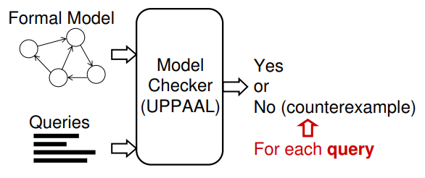
Steps
Build a model as an Automata.
Formalize the properties to be verified using expressions in a logic.
Use the model checker to generate all possible states and to exhaustively check whether the properties hold in every possible DYNAMIC BEHAVIOURS of the model
(source)

Slide 8
UPPAAL vs SPIN
UPPAAL | SPIN
1) Automata modeling language. | 1) Promela modeling language.
2) Graphical user interface (GUI) | 2) Command-line interface (CLI)
3) Faster for verifying timed automata models. | 3) Faster for concurrent systems
4) Symbolic and numeric methods to verify | 4) State-space exploration technique
5) Advanced features | 5) More flexible and extensible

Slide 9
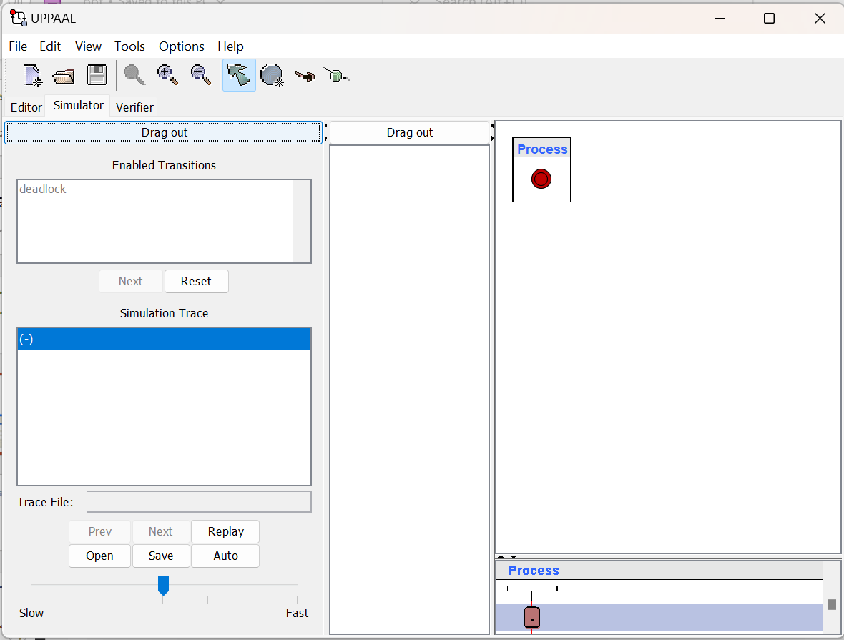
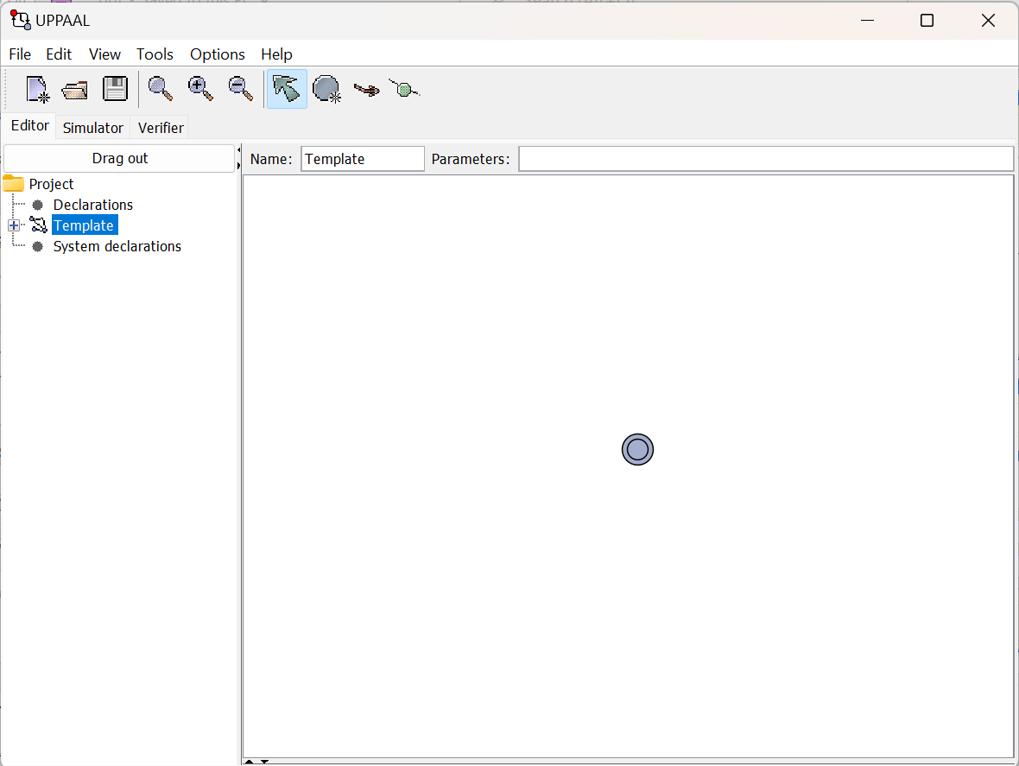
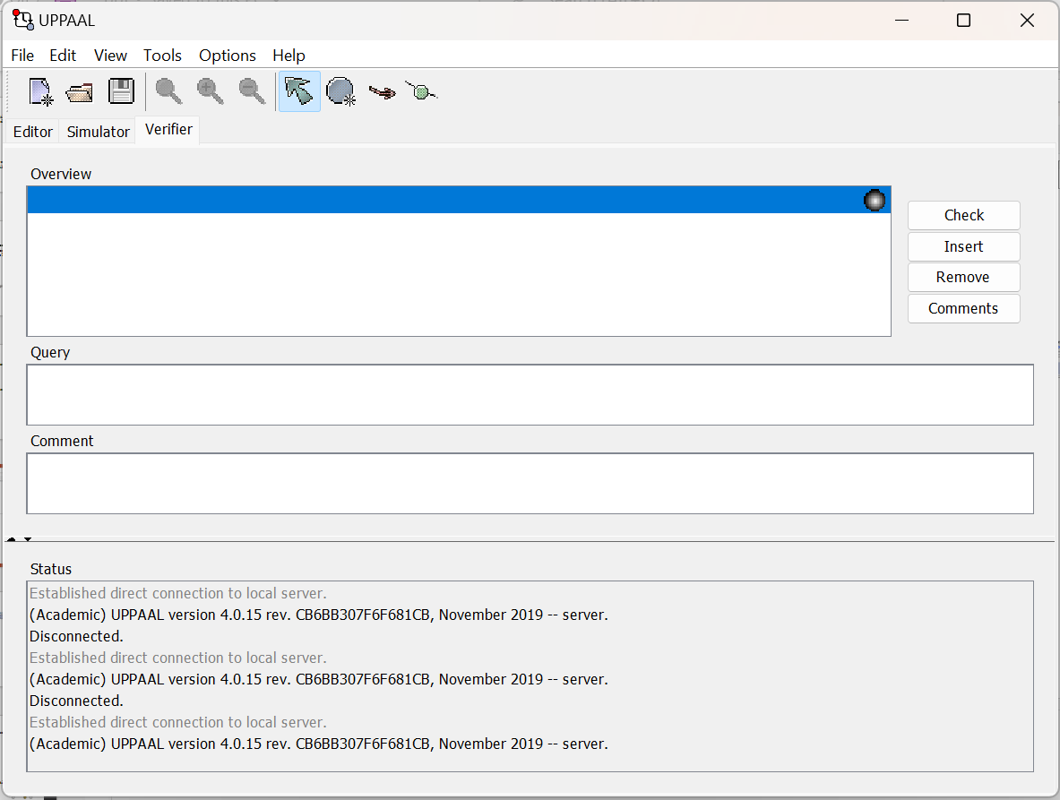
Different Windows

Slide 10
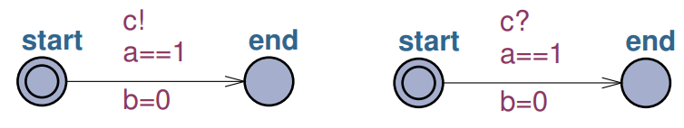
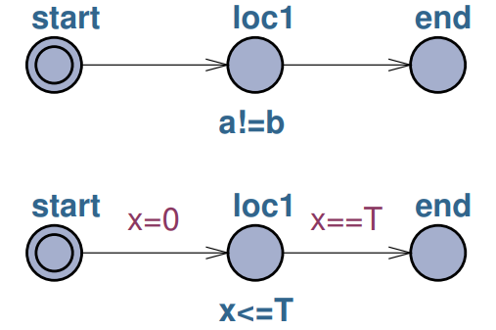
Structure of an UPPAAL Model
(source)
Notes:
Channels:-
Regular
Urgent
Broadcast
Locations:-
Initial
Urgent
Committed
Normal
Invariants

Slide 11
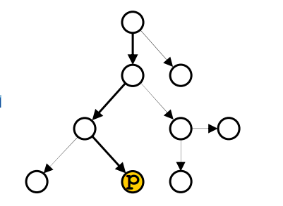
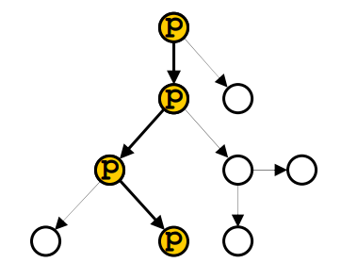
Reachability
E <> p - “Exists eventually p” meaning there exists a path in which p eventually holds
(source)
Safety Properties
E [] p - “Exists globally p” meaning there exists a path in which p holds for all the states of the path
(source)

Slide 12
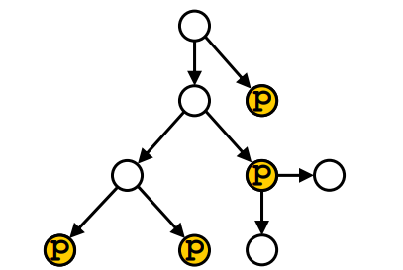
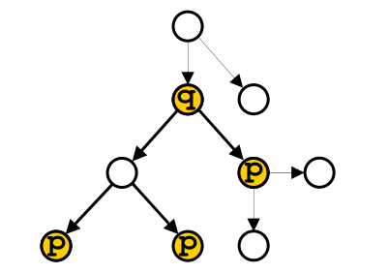
Liveness Properties
A<> p “Always eventually p” For all paths eventually p holds
q-->p “q always leads to p” Any path that “starts” with a state in which q holds reaches later a state in which p holds
(source)
(source)

Slide 13
Deadlock Properties
A state is in a deadlock if it is impossible that the model evolves to a successor state neither by waiting some time nor by a transition between locations.
Two typical examples:
E <> deadlock = “Exists deadlock”
A [] not deadlock = “There is no deadlock”

Slide 14
Modeling & Verification
Case-1: LandInspector, ALICE (Seller), BOB (Buyer), Adversary
Case-2: LandInspector, Seller1, Seller2, Seller3, Seller4, Seller5, Buyer, Adversary
Land Inspector does the task of inspecting the blockchain. It analyzes the transactions that are added into the blockchain and make sure transaction happen correctly.
Seller is the one that sells its land.
Buyer is the one that buys the land from seller for a price.
Adversary is the third party which tries to disturb the transactions happening between seller and buyer by introducing malicious transactions to confuse the blockchain.

Slide 15
Case-1: Global Declarations
typedef struct
{
PartyId Id;
int balance;
bool own_land[LAND_NUM]; //bool of land owned
int secretkey;
int publickey;
} Party;
//Different states of transaction
const Status CONFIRMED = 0;
const Status SPENT = 1;
const Status CANCELED = 2;
typedef struct
{
PartyId fromId;
PartyId toId;
int amnt;
LANDID landId;
Status status;
int signature1;
int signature2;
} Tx;
Tx blockchain[TX_NUM];
typedef struct
{
PartyId Id;
int amnt;
LANDID landId;
int signature;
} smart_contract;

Slide 16
Global Declarations
void sell_land(PartyId id, int amount, LANDID landid)
{
smart_contract contract;
contract.Id = id;
contract.amnt = amount;
contract.landId = landid;
contract.signature = parties[id].secretkey * parties[id].publickey;
sc[sc_curr] = contract;
sc_curr++;
}
void add_trans(PartyId fromid, PartyId toid, int amount, LANDID landid, int Signature1, int Signature2)
{
Tx transaction;
transaction.fromId = fromid;
transaction.toId = toid;
transaction.amnt = amount;
transaction.landId = landid;
transaction.status = 0;
transaction.signature1 = Signature1;
transaction.signature2 = Signature2;
blockchain[bc_curr] = transaction;
bc_curr++;
}

Slide 17
LandInspector
// Place local declarations here.
int secretkeys[3] = {90,88,22};
int publickeys[3] = {16,8,18};
void initialize()
{
for(i : PartyId)
{
parties[i].Id = i;
parties[i].balance = INIT_AMNT;
parties[i].secretkey = secretkeys[i];
parties[i].publickey = publickeys[i];
for(j : LANDID)
{
if(i == 0)
{
if(j%2 == 0)
{
parties[i].own_land[j] = true;
}
else
{
parties[i].own_land[j] = false;
}
}
else if(i == 1)
{
if(j%2 == 0)
{
parties[i].own_land[j] = false;
}
else
{
parties[i].own_land[j] = true;
}
}
else if(i == 2)
{
parties[i].own_land[j] = false;
}
}
}
}

Slide 18
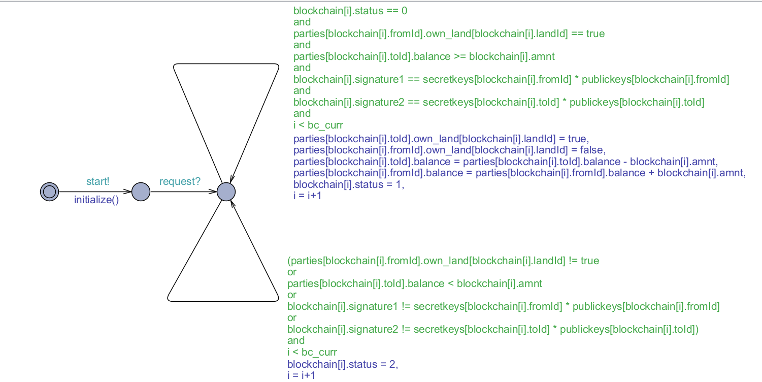
LandInspector

Slide 19
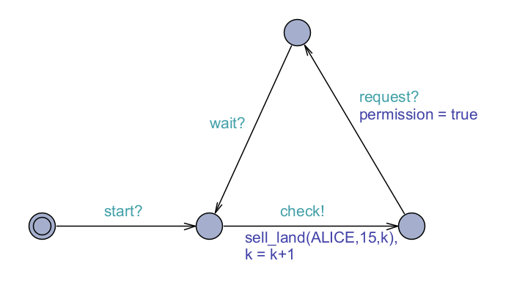
ALICE

Slide 20
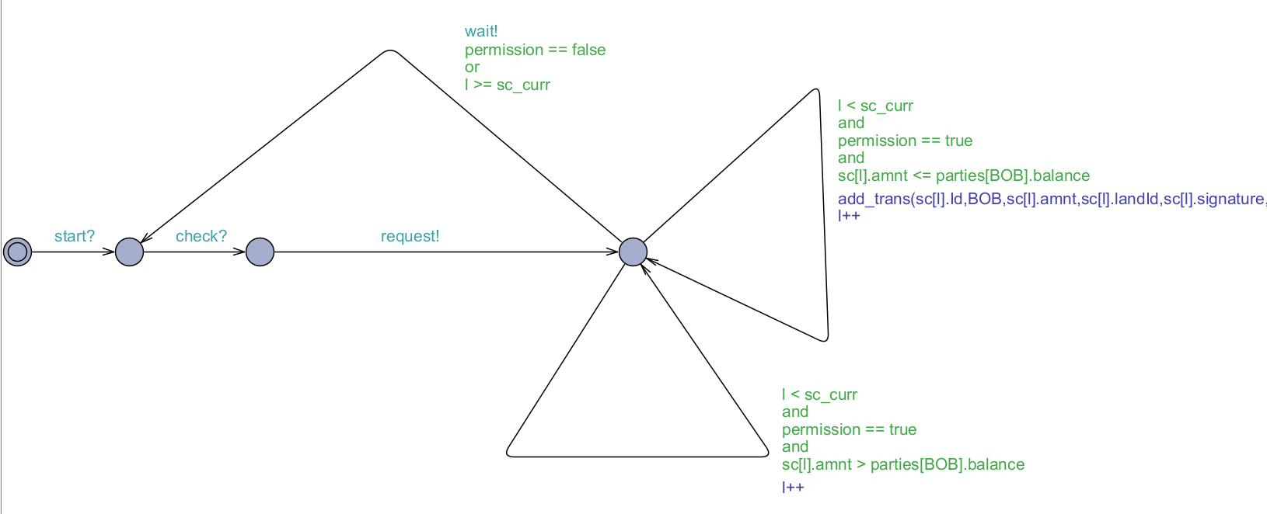
BOB

Slide 21
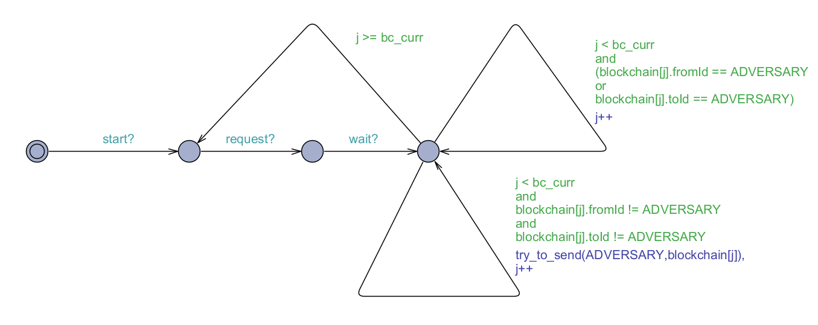
Adversary
void try_to_send(PartyId id, Tx transaction)
{
add_trans(transaction.fromId,id,transaction.amnt,transaction.landId,transaction.signature1,transaction.signature2);
add_trans(id,transaction.toId,transaction.amnt,transaction.landId,transaction.signature1,transaction.signature2);
}

Slide 22
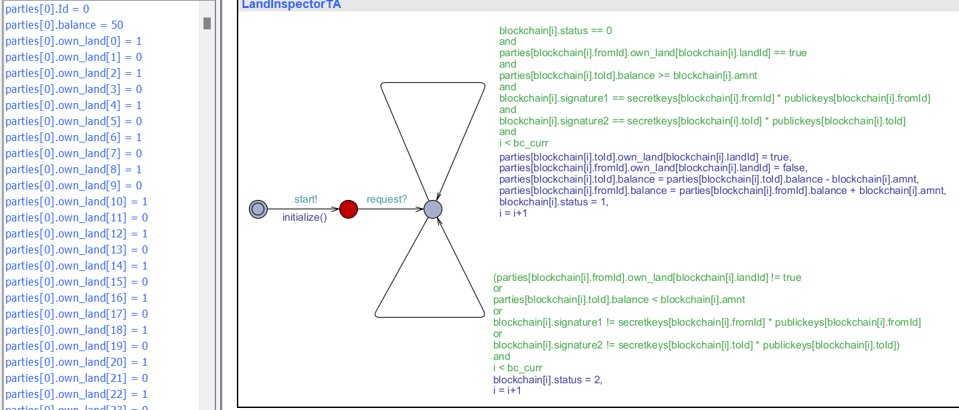
Simulation Results
Initially the party are initialized using initialize function to assign some values and data to them. All parties are assigned with 50 balance and ALICE is given even lands and BOB with odd lands and ADVERSARY with no lands.

Slide 23
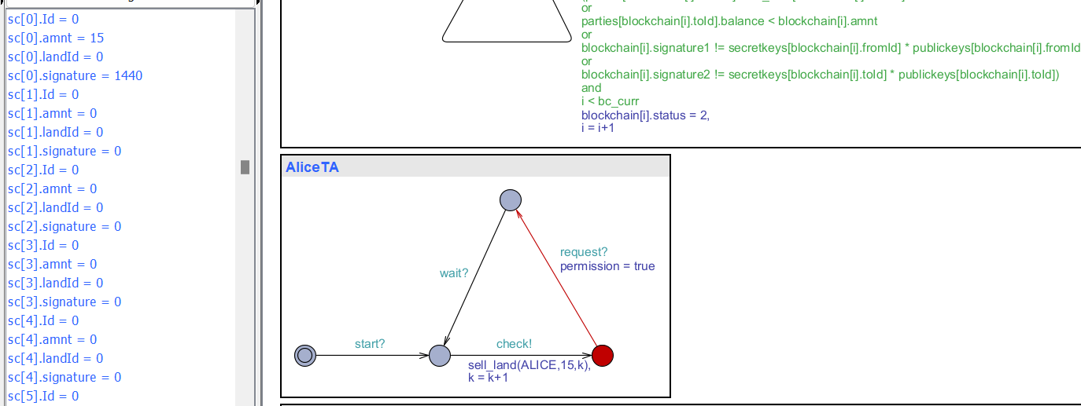
Simulation Results
Next ALICE adds the smart contract into array of smart contracts using sell_land function.

Slide 24
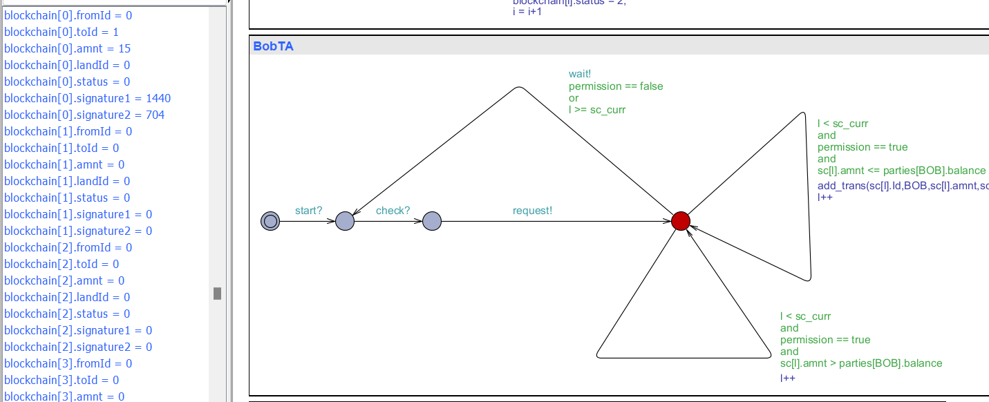
Simulation Results
Later BOB checks from smart contracts that whether it has enough balance to purchase and its asks permission. After getting permission it adds the transaction into blockchain using add_trans function.

Slide 25
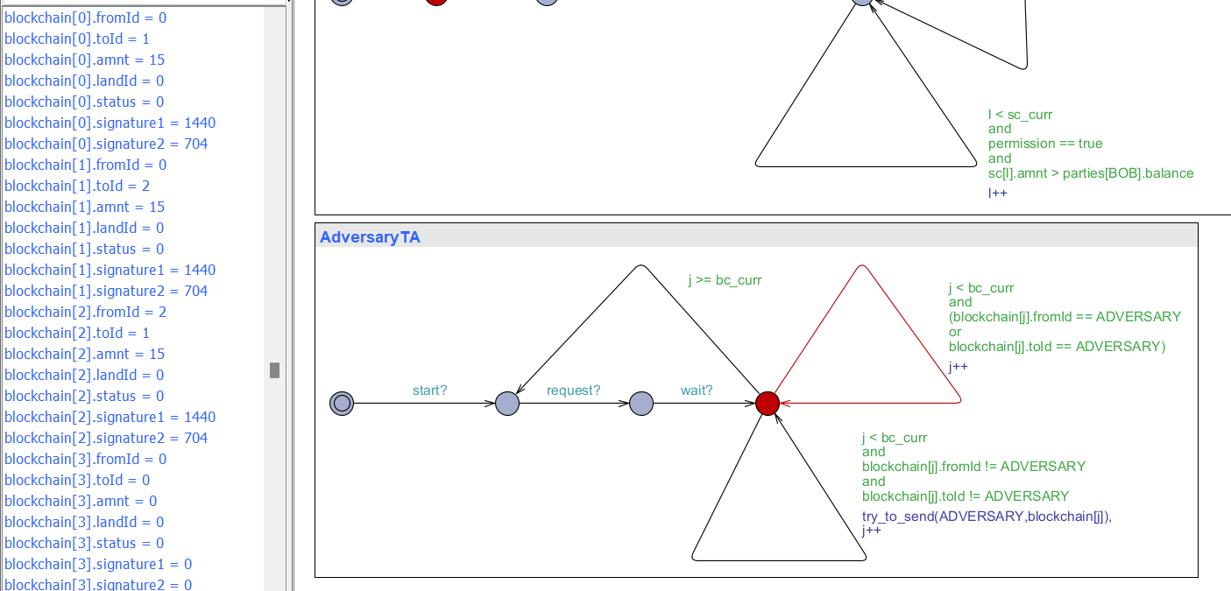
Simulation Results
Then ADVERSARY tries to add the manipulated transactions into the blockchain using try_to_send function.

Slide 26
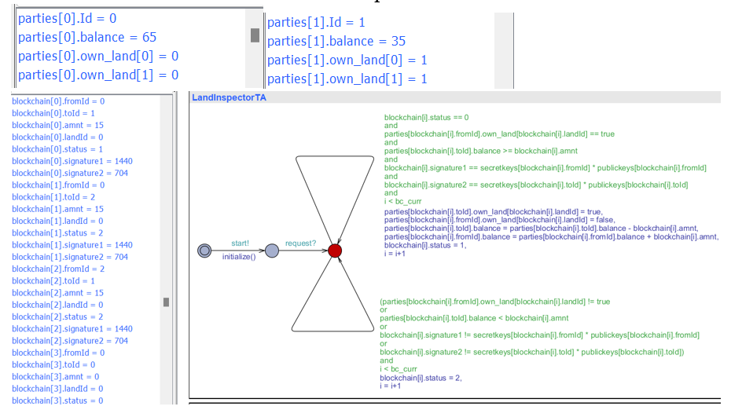
Simulation Results
Then LandInspector does the task of verifying the transactions and correct transactions are SPENT and manipulated are CANCELED

Slide 27
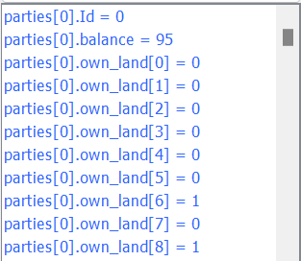
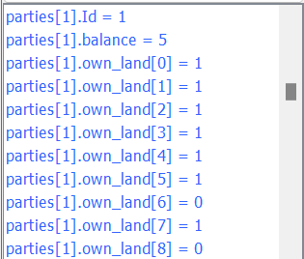
Simulation Results
BOB (Buyer) can buy 3 lands as its has only 50 balance at first and 3*15 = 45 is spent on buying the lands from ALICE and ALICE has a balance of 50 + 3*15 = 95.

Slide 28
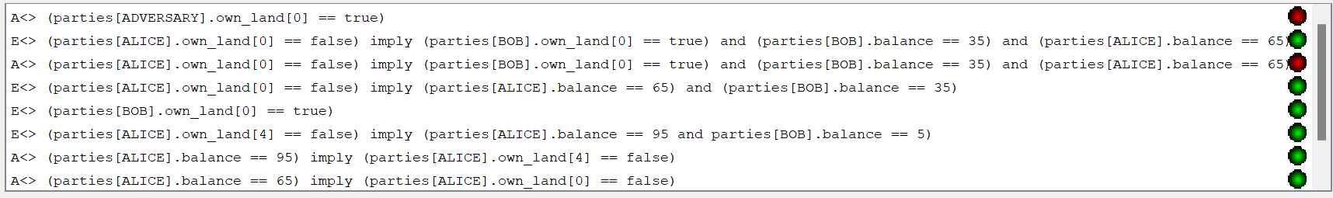
Verifier Results
A[] (parties[ADVERSARY].own_land[0] == true) - Adversary will not be able to own any lands even introducing malicious transactions. The query should result in false because for “All the paths eventually adversary owns landId 0” is completely false because we made sure that blockchain won’t allow adversary transactions and it cancels its transactions.

Slide 29
Verifier Results
E<> (parties[ALICE].own_land[0] == false) imply (parties[BOB].own_land[0] == true) and (parties[BOB].balance == 35) and (parties[ALICE].balance == 65) – “There exists a path eventually if ALICE won’t own landId 0 imply that BOB owns it and BOB has balance of 35 and ALICE has 65” which is completely true because if alice buys its land bob must buy it for 15 amount and adversary is eliminated by blockchain.
A<> (parties[ALICE].own_land[0] == false) imply (parties[BOB].own_land[0] == true) and (parties[BOB].balance == 35) and (parties[ALICE].balance == 65) – “All paths eventually if ALICE won’t own landId 0 imply that BOB owns it and BOB has balance of 35 and ALICE has 65” which is completely false because not for all paths it is true as the maximum number of transactions are limited and alice can keep on adding its transactions into blockchain which finally occupies maximum limit and it will go into deadlock.
E<> (parties[ALICE].own_land[0] == false) imply (parties[ALICE].balance == 65) and (parties[BOB].balance == 35) – Similar to 2nd query which is also true.
E<> (parties[BOB].own_land[0] == true) – “There exists a path eventually BOB owns landId 0” which is completely true because there exists a path and eventually BOB owns landId 0 because ALICE is ready to buy its land.
E<> (parties[ALICE].own_land[4] == false) imply (parties[ALICE].balance == 95 and parties[BOB].balance == 5) – “There exists a path eventually if ALICE doesn’t own landId 4 imply ALICE has a balance of 95 and BOB has 5” which is completely true because as ALICE owns all even lands at first then it sells it land one by one that it owns which are 0,2,4 landIds. Eventually after selling its land 4 its balance must be 50 + 3(15) = 95. And that means BOB balance must be 50 – 3(15) = 5 which means further BOB won’t be able to buy any land even though ALICE broadcasts to sell its all even lands into smart contract.

Slide 30
Verifier Results
A<> (parties[ALICE].balance == 95) imply (parties[ALICE].own_land[4] == false) – “All paths eventually if ALICE balance is 95 imply that ALICE doesn’t own landId 4” which is completely true because for all paths if ALICE balance is 95 means ALICE doesn’t own landId 4 and ADVERSARY also doesn’t own any land because BOB buys the lands from ALICE.
A<> (parties[ALICE].balance == 65) imply (parties[ALICE].own_land[0] == false) – Similar to 7th query which is also true.
A<> (parties[ALICE].balance == 95) – “All paths eventually ALICE balance is 95” which is completely false because as there is a limit to number of transactions in blockchain the ALICE can keep on adding its transactions into blockchain without giving LandInspector chance to perform its operations through loop as a result the system will reach deadlock after it reaches maximum limit of transactions.
A<> (parties[ADVERSARY].own_land[0] == true or parties[ADVERSARY].own_land[2] == true or parties[ADVERSARY].own_land[4] == true) – “All paths eventually ADVERSARY owns landId 0 or 2 or 4” which is completely false because adversary is not allowed to own land at first and later as well it may confuse the blockchain on introducing malicious transactions but blockchain will cancel all its transactions and in all paths at least it won’t even own a single land.

Slide 31
Case-2: Global Declarations
const int LAND_NUM = 100; //Maximum lands allowed
const int TX_NUM = 100; //Maximum transactions allowed
const int SC_NUM = 100; //Maximum contracts allowed
const int PARTIES_NUM = 7; //6 Parties + 1 Adversary
const int INIT_AMNT = 100; //Initial amount provided to all parties
typedef int[0,PARTIES_NUM-1] PartyId;
typedef int[0,LAND_NUM-1] LANDID;
typedef int[0,TX_NUM-1] TXID;
typedef int[0,2] Status;
//Different parties
const PartyId SELLER1 = 0;
const PartyId SELLER2 = 1;
const PartyId SELLER3 = 2;
const PartyId SELLER4 = 3;
const PartyId SELLER5 = 4;
const PartyId BUYER = 5;
const PartyId ADVERSARY = 6;

Slide 32
LandInspector
// Place local declarations here.
int secretkeys[7] = {90,88,22,34,18,6,26};
int publickeys[7] = {16,8,18,9,4,11,12};
void initialize()
{
for(i : PartyId)
{
parties[i].Id = i;
parties[i].balance = INIT_AMNT;
parties[i].secretkey = secretkeys[i];
parties[i].publickey = publickeys[i];
for(j : LANDID)
{
if(i == BUYER or i == ADVERSARY)
{
parties[i].own_land[j] = false;
}
if(j%5 == i)
{
parties[i].own_land[j] = true;
}
}
}
}

Slide 33
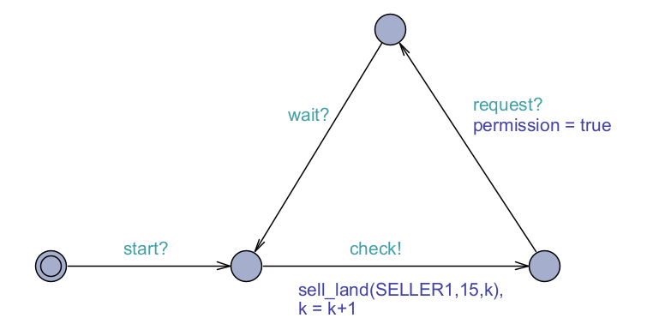
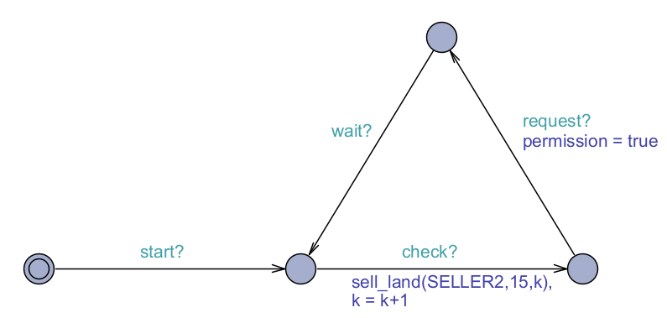
SELLERS

Slide 34

BUYER

Slide 35
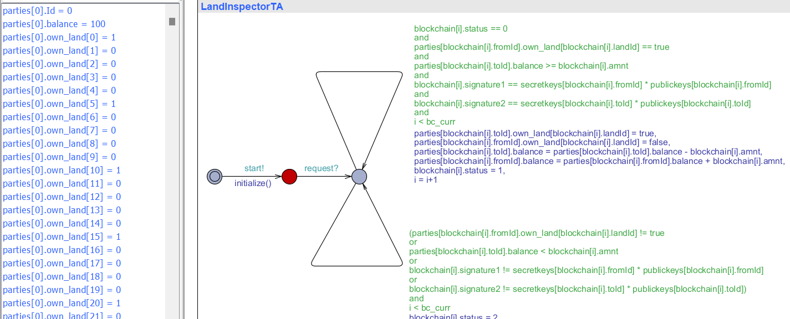
Simulation Results
Initially the party are initialized using initialize function to assign some values and data to them. All parties are assigned with 100 balance and each SELLER will get ownership over %5 of landIds (for every five lands they get one land based on remainder of its landId same as partyId) and BUYER, ADVERSARY with no lands.

Slide 36
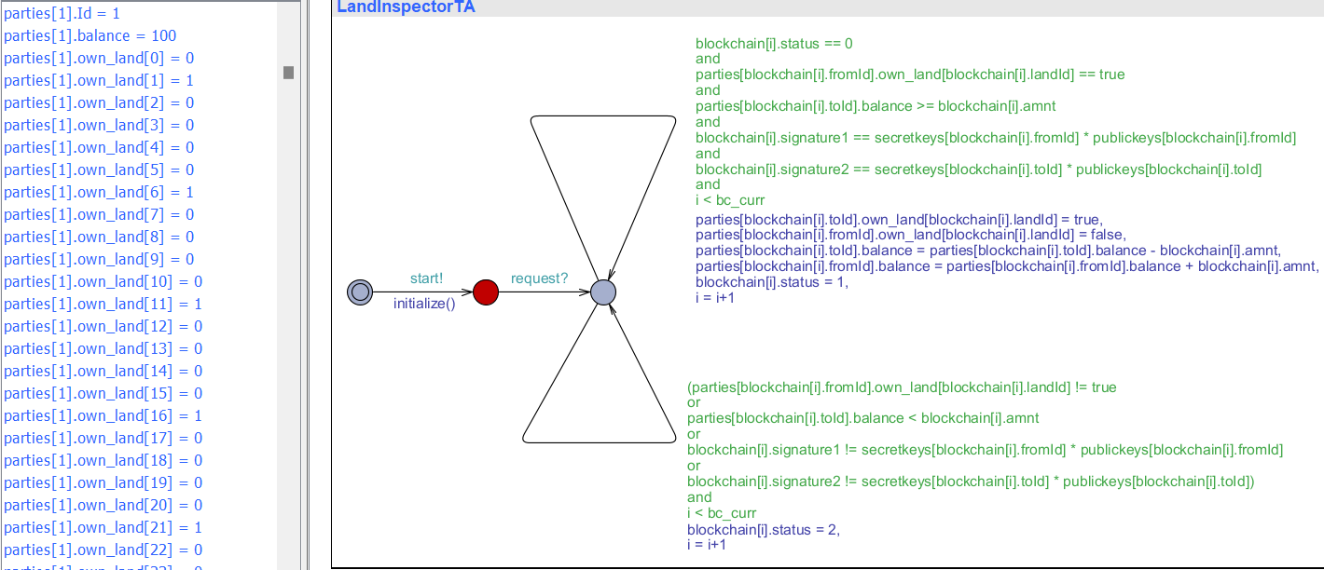
Simulation Results

Slide 37
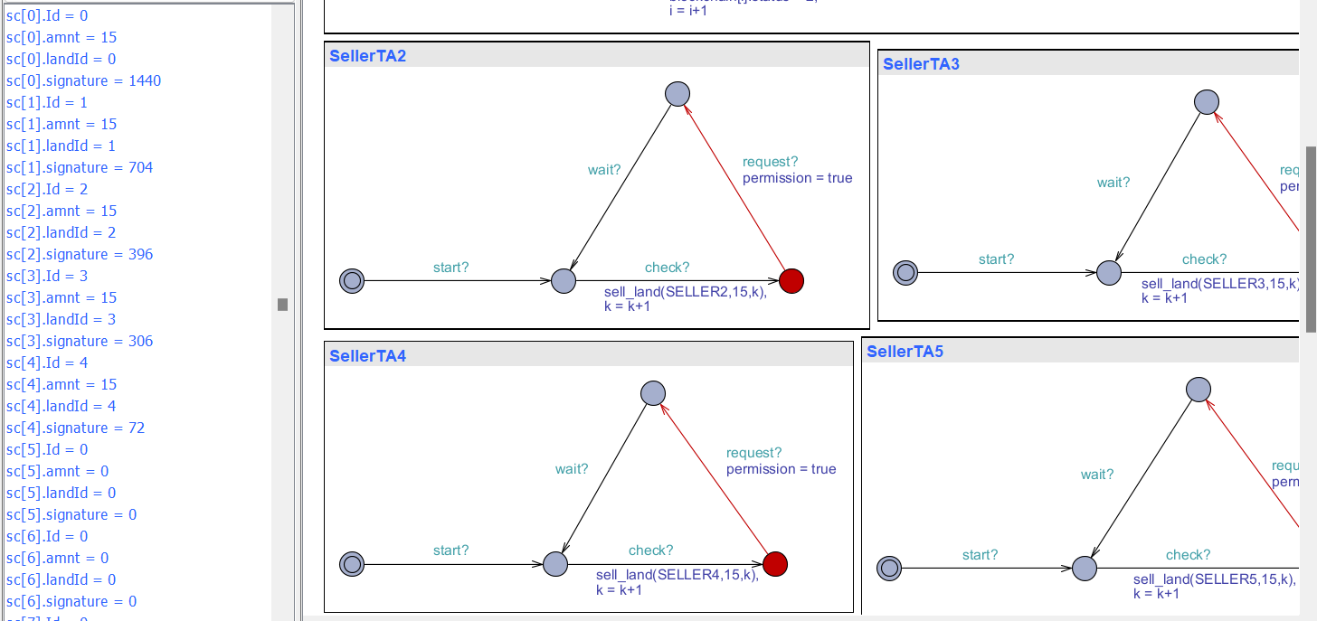
Simulation Results
Next SELLERs add the smart contract into array of smart contracts using sell_land function.

Slide 38
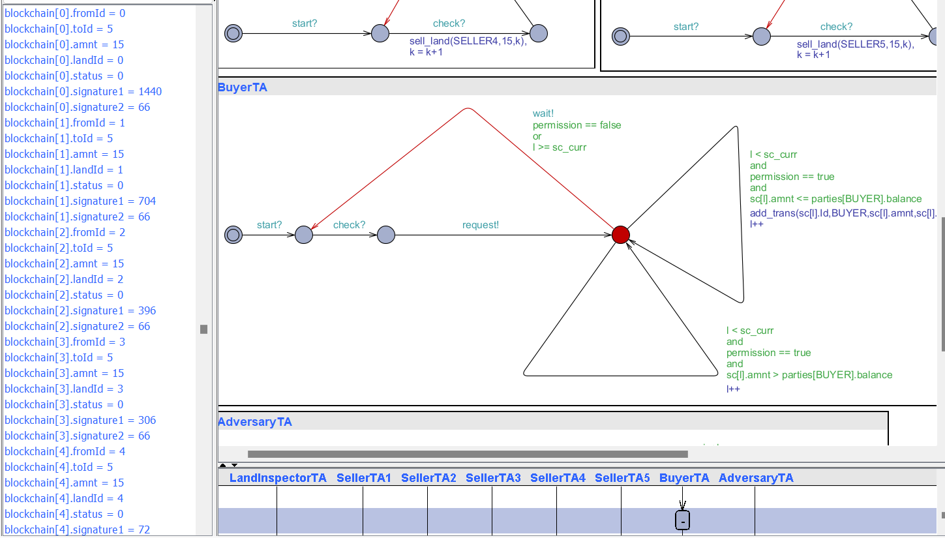
Simulation Results
Later BUYER checks from smart contracts that whether it has enough balance to purchase and its asks permission. After getting permission it adds the transaction into blockchain using add_trans function.

Slide 39
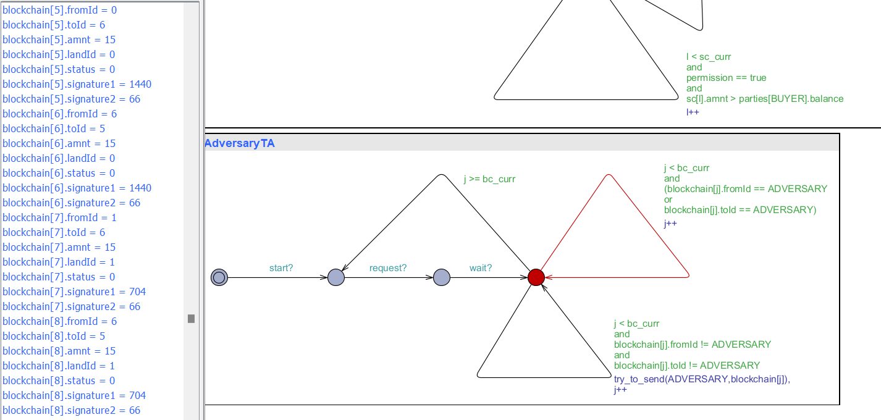
Simulation Results
Then ADVERSARY tries to add the manipulated transactions into the blockchain using try_to_send function. As we have 5 SELLERs in the model each will add a transaction of their own and each transaction gets manipulated by ADVERSARY that adds two more transactions of each transaction of SELLER. Total after execution of ADVERSARY we will see 5*(1+2) = 15 transactions in the blockchain from 0 to 14 indices.

Slide 40
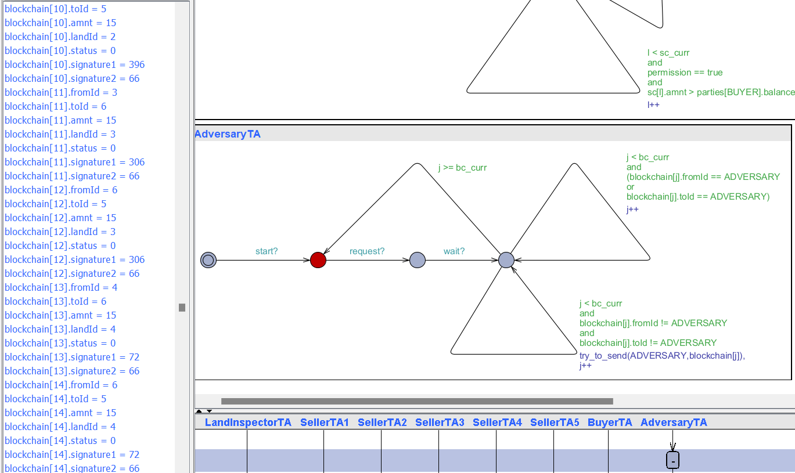
Simulation Results

Slide 41
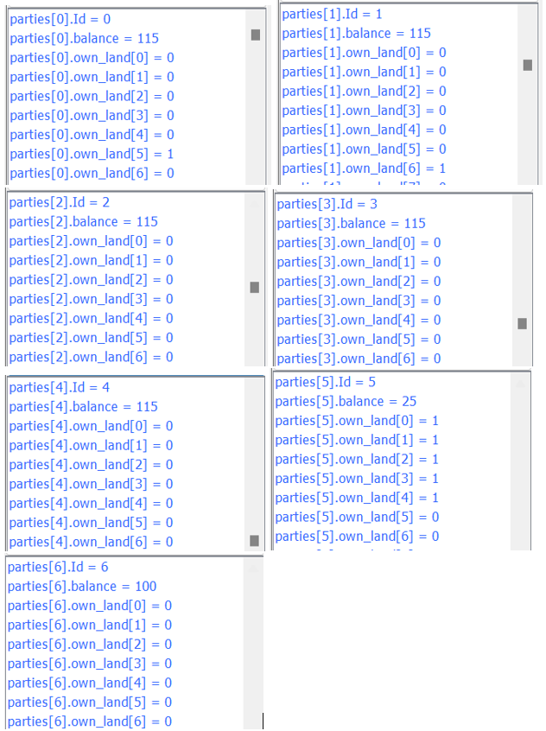
Simulation Results
Then LandInspector does the task of verifying the transactions and correct transactions are SPENT and manipulated are CANCELED.

Slide 42
Conclusion
Blockchain technology can be used for record integrity protection, eliminating cost of third parties and brokers, transparency with smart contracts automated land registry, transaction process, accelerated land registry and safer. As the research is continuing in this domain, I think the above work will help in some basic way to automate the real-life model using UPPAAL.
Signature generation can be done using complicated encoding and decoding functions were only the parties only know the encoding function whereas blockchain knows the decoding function, secret and public keys of all parties.

Slide 43
References
https://uppaal.org/
https://en.wikipedia.org/wiki/Bitcoin
https://en.wikipedia.org/wiki/Uppaal_Model_Checker
Blockchain-based Land Registry Platform (thegatewaydigital.com)
Modeling Bitcoin Contracts by Timed Automata - Marcin Andrychowicz, Stefan Dziembowski, Daniel Malinowski and Łukasz Mazurek - Cryptology and Data Security Group - University of Warsaw – 2014
The UPPAAL Model Checker - Julián Proenza - Systems, Robotics and Vision Group - UIB. SPAIN - 2008

