Slide 1



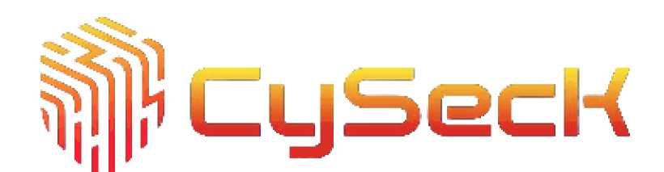

*S AGAMYA / CYBER TECH
<0>
IEEE
COMPUTER
SOCIETY
KLE INSTITUTE OF TECHNOLOGY
MEETING ACTION TRACKER
"ELEVEN”
MEMBER LIST
JAGRUTI NARVEKAR POOJA NARVEKAR
RUCHA KARAV
Organized under Agamya Tech Summit 2025 | Managed by IEEE Computer Society - KLEIT | In Partnership with CySeck

Slide 2

*S AGAMYA / CYBER TECH
<0>
IEEE
COMPUTER
SOCIETY
KLE INSTITUTE OF TECHNOLOGY
Meeting Action Tracker
Build a system that processes meeting notes and extracts action items, assigning them to
the right people with deadlines.
-Who faces this problem?
1. Team Members: They often leave meetings without clarity about who is doing what.
Tasks get missed or duplicated.
2. Team Leaders / Manager: Hard to keep track of who was assigned which task.
Difficult to follow up on deadlines.
^ In simple words: Everyone who attends meetings — from employees to managers — faces this problem when tasks are not clearly recorded and tracked.
Organized under Agamya Tech Summit 2025 | Managed by IEEE Computer Society - KLEIT | In Partnership with CySeck

Slide 3



<e>
IEEE
COMPUTER
SOCIETY
KLE INSTITUTE OF TECHNOLOGY
-Why it matters (impact)?
1. Meetings without follow-up are wasted time
People discuss a lot, but if tasks aren't captured, nothing gets done.
2. Clarity of responsibilities
Everyone knows exactly who needs to do what and by when.
3. Improves accountability
Tasks are tracked, so no one can say "I didn't know I had to do it."
4. Saves time and effort
Less back-and-forth after meetings because everything is clear.
5. Boosts productivity
Ensures that meetings lead to results, not just conversations.
Organized under Agamya Tech Summit 2025 | Managed by IEEE Computer Society - KLEIT | In Partnership with CySeck

Slide 4

*S AGAMYA / CYBER TECH
©
IEEE
COMPUTER
SOCIETY
KLE INSTITUTE OF TECHNOLOGY
-Current limitations / pain points
1. Tasks get forgotten
Important action items discussed in meetings are often missed or overlooked.
2. Unclear responsibilities
It's not always obvious who is supposed to do what, leading to confusion.
3. Missed deadlines
Without proper tracking, tasks are delayed or deadlines are missed.
4. Manual tracking is time-consuming
Writing minutes, assigning tasks, and following up manually takes a lot of effort.
5. Lack of accountability
No clear system to monitor progress; people may assume others will do the work.
Organized under Agamya Tech Summit 2025 | Managed by IEEE Computer Society - KLEIT | In Partnership with CySeck

Slide 5
*S AGAMYA / CYBER TECH
<0>
IEEE
COMPUTER
SOCIETY
KLE INSTITUTE OF TECHNOLOGY
PROPOSED SOLUTION
-Short description of the solution:
Proposed Solution: A Meeting Action Tracker is a system that automatically extracts action items from meeting notes, assigns them to the responsible people, and tracks deadlines. It ensures that every important discussion point becomes a clear, actionable task, improving accountability and team productivity.
In one line: "It turns meeting discussions into a clear to-do list with assigned owners and deadlines.
tt
Organized under Agamya Tech Summit 2025 | Managed by IEEE Computer Society - KLEIT | In Partnership with CySeck

Slide 6
*S AGAMYA / CYBER TECH
<0>
IEEE
COMPUTER
SOCIETY
KLE INSTITUTE OF TECHNOLOGY
-Key features / innovations:
1. Automated Action Item Extraction
Converts meeting discussions into clear, actionable tasks automatically. Highlights responsibilities, deadlines, and priorities.
2. Smart Assignment
Assigns tasks to relevant team members based on roles, expertise, or availability. Sends reminders and updates to ensure accountability.
3. Integrated Tracking Dashboard
Centralized view of all action items, progress, and pending tasks.
Allows filtering by project, team member, or urgency.
Organized under Agamya Tech Summit 2025 | Managed by IEEE Computer Society - KLEIT | In Partnership with CySeck

Slide 7
*S AGAMYA / CYBER TECH
<0>
IEEE
COMPUTER
SOCIETY
KLE INSTITUTE OF TECHNOLOGY
INNOVATION:
1. AI-Powered Understanding
Uses natural language processing (NLP) to interpret meeting notes and context accurately. Detects implicit tasks or follow-ups that might be missed manually.
2. Predictive Task Suggestions
Suggests next steps or potential risks based on past meetings and trends.
3. Context-Aware Prioritization
Automatically ranks tasks based on urgency, deadlines, and dependencies.
4. Seamless Integration
Connects effortlessly with existing tools (calendar, email, project software), reducing manual effort.
5. Adaptive Learning
Continuously improves task identification and assignment accuracy by learning from user feedback.
Organized under Agamya Tech Summit 2025 | Managed by IEEE Computer Society - KLEIT | In Partnership with CySeck

Slide 8
*S AGAMYA / CYBER TECH
<0>
IEEE
COMPUTER
SOCIETY
KLE INSTITUTE OF TECHNOLOGY
-Why is it better than alternatives?
1. Higher Accuracy in Capturing Action Items
Unlike manual note-taking or basic task trackers, it uses AI/NLP to understand meeting context and extract tasks automatically. Reduces human error and missed follow-ups.
2. Smart Task Assignment
Automatically assigns tasks to the right person based on role, workload, or expertise.
Alternatives often require manual allocation, which is time-consuming and prone to mistakes.
3. Real-Time Tracking and Updates
Provides live dashboards for task status and progress.
Traditional methods rely on emails or spreadsheets, which can get lost or outdated.
4. Predictive and Context-Aware Features
Suggests next steps, identifies potential risks, and prioritizes tasks intelligently.Competing solutions typically lack proactive guidance, offering only basic task management.
Organized under Agamya Tech Summit 2025 | Managed by IEEE Computer Society - KLEIT | In Partnership with CySeck

Slide 9
*S AGAMYA / CYBER TECH
<0>
IEEE
COMPUTER
SOCIETY
KLE INSTITUTE OF TECHNOLOGY
FEATURES:
1. Automated Action Item Extraction
Converts meeting notes into clear tasks with deadlines and priorities.
2. Smart Task Assignment
Assigns tasks to team members based on roles, workload, or expertise.
3. Real-Time Tracking Dashboard
Centralized view of task progress, pending items, and deadlines.
4. Collaboration and Communication
Enables comments, updates, and notifications within tasks.
Organized under Agamya Tech Summit 2025 | Managed by IEEE Computer Society - KLEIT | In Partnership with CySeck

Slide 10
*S AGAMYA / CYBER TECH
<0>
IEEE
COMPUTER
SOCIETY
KLE INSTITUTE OF TECHNOLOGY
UNDERLYING TECHNOLOGY:
1. Front-End
-Frameworks/Libraries: React.js or Angular for responsive web interfaces.
-UI Components: Tailwind CSS or Material-UI for clean, modern design.
-Real-Time Updates: WebSockets or Firebase for live dashboards.
2. Back-End
Server: Node.js with Express.js or Python with Django/Flask.
API Development: RESTful or GraphQL APIs for integration with other tools. Authentication & Authorization: OAuth 2.0 / JWT for secure login and role-based access
Organized under Agamya Tech Summit 2025 | Managed by IEEE Computer Society - KLEIT | In Partnership with CySeck

Slide 11


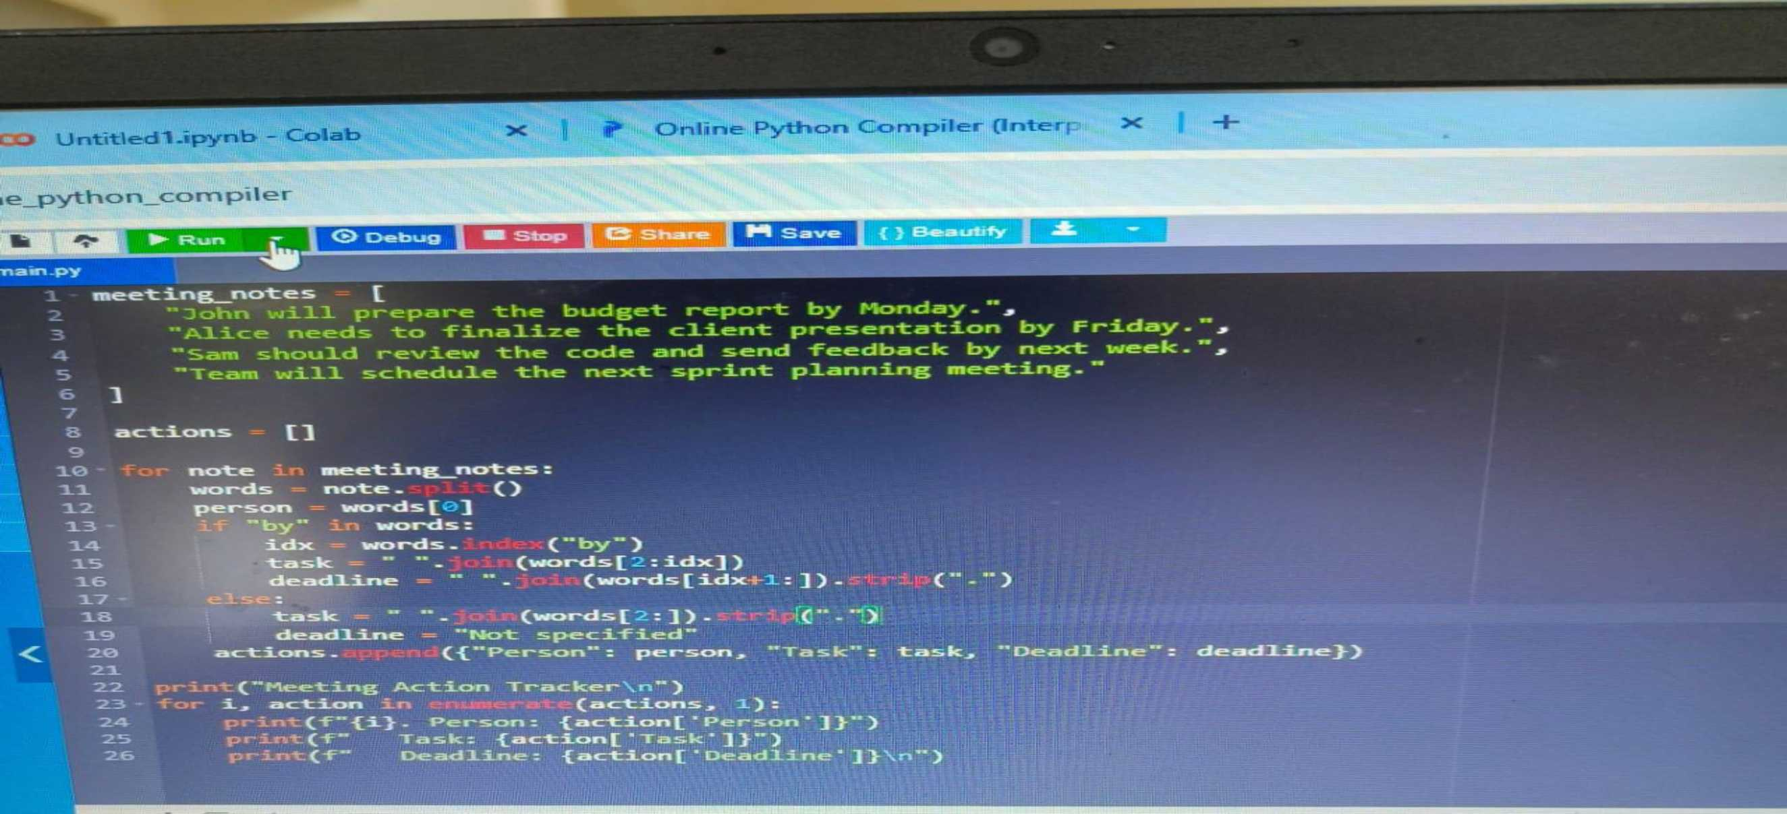
*S AGAMYA / CYBER TECH
<0>
IEEE
COMPUTER
SOCIETY
KLE INSTITUTE OF TECHNOLOGY
DEMO / PROTOTYPE
Organized under Agamya Tech Summit 2025 | Managed by IEEE Computer Society - KLEIT | In Partnership with CySeck

Slide 12

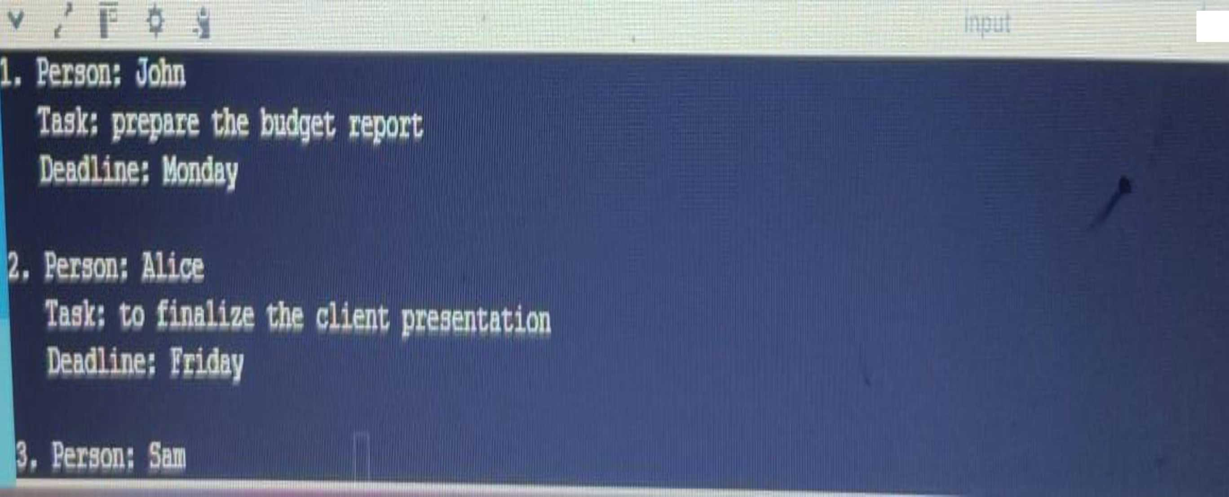
<e>
IEEE
COMPUTER
/
SOCIETY
KLE INSTITUTE OF TECHNOLOGY
Organized under Agamya Tech Summit 2025 | Managed by IEEE Computer Society - KLEIT | In Partnership with CySeck

Slide 13
*S AGAMYA / CYBER TECH
©
IEEE
COMPUTER
SOCIETY
KLE INSTITUTE OF TECHNOLOGY
IMPACT & FUTURE SCOPE
-Who benefits?
1. Team Members:
- Receive clear, prioritized tasks without ambiguity.
- Get automatic reminders and updates, reducing missed deadlines.
- Can collaborate easily on tasks in real-time.
Organized under Agamya Tech Summit 2025 | Managed by IEEE Computer Society - KLEIT | In Partnership with CySeck

Slide 14

I/v| AGAMYA AGAMYA* f ^#9/ CYBER TECH TECH SUMMIT ®
<e>
IEEE
COMPUTER
SOCIETY
KLE INSTITUTE OF TECHNOLOGY
2. Team Leaders / Manager:
- Can track progress of multiple team members at a glance. - Identify bottlenecks or workload imbalances quickly.
- Spend less time manually following up on tasks.
Organized under Agamya Tech Summit 2025 | Managed by IEEE Computer Society - KLEIT | In Partnership with CySeck

Slide 15
*S AGAMYA / CYBER TECH
<0>
IEEE
COMPUTER
SOCIETY
KLE INSTITUTE OF TECHNOLOGY
-Short-term & long-term impact:
Short-Term Impact:
1. Improved Meeting Efficiency
-Action items are captured automatically, reducing manual effort. -Meetings result in clear, actionable outcomes.
2. Better Task Management
-Tasks are assigned correctly and tracked in real-time.
-Reduces confusion, missed deadlines, and follow-up emails.
3. Enhanced Team Accountability
-Everyone knows their responsibilities immediately.
-Managers can monitor progress without micromanaging.
Organized under Agamya Tech Summit 2025 | Managed by IEEE Computer Society - KLEIT | In Partnership with CySeck

Slide 16

AGAMYA / CYBER TECH
©
IEEE
COMPUTER
SOCIETY
KLE INSTITUTE OF TECHNOLOGY
LONG TERM IMPACT:
Long-Term Impact
1. Increased Productivity
-Teams consistently complete tasks on time, improving overall workflow. -Reduces wasted time in repetitive manual follow-ups.
2. Data-Driven Decision Making
-Analytics and insights reveal bottlenecks and process inefficiencies. -Helps organizations optimize strategies and resource allocation.
3. Improved Collaboration Culture
-Encourages transparent communication and responsibility-sharing. -Leads to stronger team cohesion and long-term engagement.
Organized under Agamya Tech Summit 2025 | Managed by IEEE Computer Society - KLEIT | In Partnership with CySeck

Slide 17
*S AGAMYA / CYBER TECH
<0>
IEEE
COMPUTER
SOCIETY
KLE INSTITUTE OF TECHNOLOGY
-Roadmap / scaling ideas:
1. Roadmap (Phased Development)
Phase 1 - MVP (Minimum Viable Product)
Core feature: Automatic extraction of action items from meeting notes. Basic task assignment to team members.
Simple dashboard showing tasks and deadlines.
Manual integrations with email or calendar.
Phase 2 - Enhanced Functionality
AI/NLP improvements for better context understanding.
Predictive task suggestions based on past meetings.
Real-time notifications and reminders.
Integration with Slack, Teams, Jira, Trello.
Organized under Agamya Tech Summit 2025 | Managed by IEEE Computer Society - KLEIT | In Partnership with CySeck

Slide 18

AGAMYA / CYBER TECH
AGAMYAK
©
IEEE
COMPUTER
SOCIETY
TECH SUMMIT ®
KLE INSTITUTE OF TECHNOLOGY
Phase 3 - Analytics & Insights
Task completion analytics and performance reports.
Trend detection: recurring bottlenecks or delays.
Priority ranking and smart scheduling based on deadlines and workload.
Phase 4 - Enterprise / Full-Scale Multi-team and multi-project support.
Advanced AI: sentiment analysis, meeting summarization. Mobile apps for iOS and Android.
Role-based access, security compliance, and data governance.
Organized under Agamya Tech Summit 2025 | Managed by IEEE Computer Society - KLEIT | In Partnership with CySeck

Slide 19
*S AGAMYA / CYBER TECH
©
IEEE
COMPUTER
SOCIETY
KLE INSTITUTE OF TECHNOLOGY
2. Scaling Ideas 1. User Scaling
Support larger teams, multiple departments, and cross-organization collaboration. Cloud-based architecture ensures smooth handling of more users.
2. Data Scaling
Use distributed databases like MongoDB or DynamoDB for storing large volumes of meeting transcripts. Implement data archiving and partitioning for performance.
3. Feature Scaling
Add AI-driven voice-to-text transcription for meetings.
Integrate task dependency mapping and automated follow-ups.
Organized under Agamya Tech Summit 2025 | Managed by IEEE Computer Society - KLEIT | In Partnership with CySeck

Slide 20
*S AGAMYA / CYBER TECH
<e>
IEEE
COMPUTER
SOCIETY
KLE INSTITUTE OF TECHNOLOGY
4. Geographic Scaling
Multi-region cloud deployment for global teams.
Localization: support multiple languages for meetings and notes.
5. Integration Scaling
Connect with more third-party tools: CRMs, ERP systems, or other collaboration platforms. Open API for external developers to extend functionality.
Organized under Agamya Tech Summit 2025 | Managed by IEEE Computer Society - KLEIT | In Partnership with CySeck

Slide 21
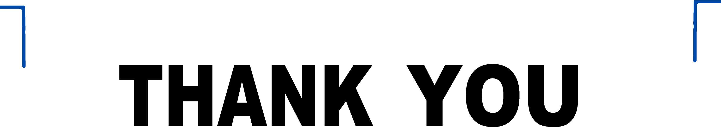
*S AGAMYA / CYBER TECH
<0>
IEEE
COMPUTER
SOCIETY
KLE INSTITUTE OF TECHNOLOGY
Organized under Agamya Tech Summit 2025 | Managed by IEEE Computer Society - KLEIT | In Partnership with CySeck

