Slide 1


KL Deemed to be a UNIVERSITY
DEPARTMENT OF ECE
E-KIRANA APP
NAME OF STUDENT | REGISTRATION NO | REASEARCH GROUP
D.MOHAN VAMSI | 150040191 | Open Source
H.UDAY BHASKAR | 150040295 | Open Source
N.JAYA SIMHA REDDY | 150040588 | Open Source
K.DEEPAK | 150040403 | Open Source
Name of the Supervisor: MR.SRIPATH ROY
Designation/Department: ECE
Research Group: Open Source

Slide 2
INTRODUCTION
Now-a-days with the introduction and wide usage of smart phone and internet mobile apps have become very useful.
Every retailer now-a-days want to improve their sales by selling their products online using mobile apps.
But the small shop keepers cannot afford for development of apps and also purchaser cannot use many apps for purchasing products.
This app E-kirana app allows small shopkeepers to sell their products online for free of cost and also allows purchasers to purchase using single app
This app is also available in multiple platforms like ios, android, windows.

Slide 3
OBJECTIVES OF THE PROJECT WORK (APP DEVELOPMENT)
To Learn how to Develop mobile Apps.
To Allow Small Shopkeepers to sell and Purchase products online with a single interface
To Allow Purchasers to purchase products from near by shops online within 1 km range.
1

Slide 4
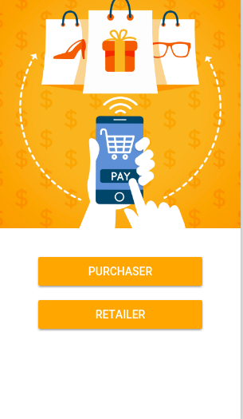
SELECT SCREEN
SELECT IF YOU WANT TO BUY
SELECT IF YOU WANT TO SELL

Slide 5
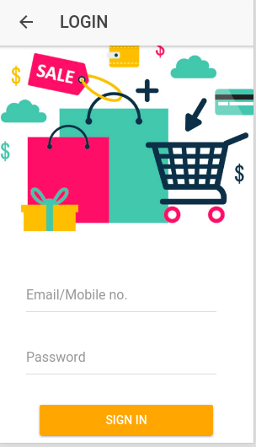
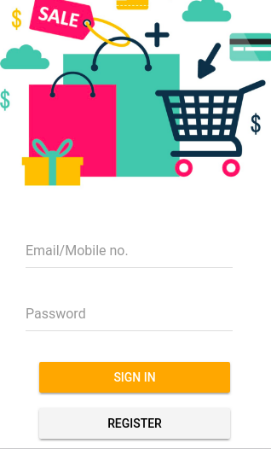
LOGIN SCREEN
ENTER YOUR MAIL
ENTER YOUR KEY

Slide 6
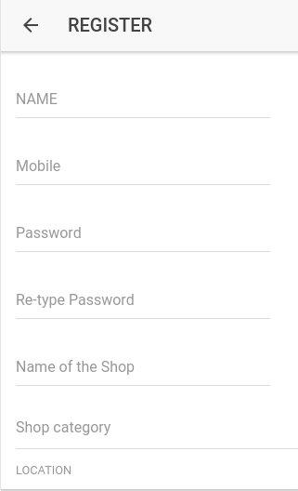
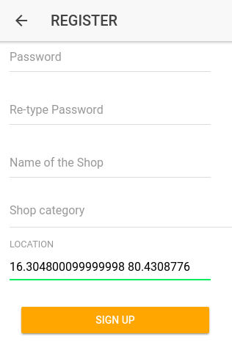
REGISTRATION PAGE
TRACKS YOUR LOCATION AUTOMATICALLY AND STORES IT IN DATABASE

Slide 7
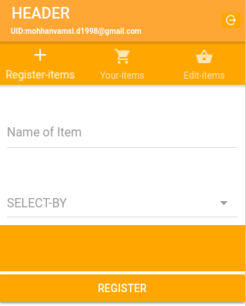
REGISTER PAGE(PER KGS)
3-TABS
REGISTER ITEMS-REGISTER YOUR ITEM
YOUR ITEMS-TRACK YOUR REGISTERED ITEMS
PIECES
KGS

Slide 8
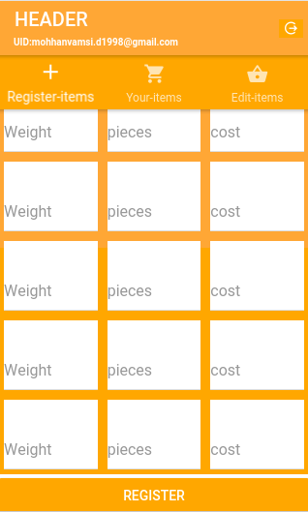
REGISTER ITEMS
(PER PIECES)
DISPLAYS YOUR UID
WEIGHT-ENTER WEIGHT OF THE PRODUCT
PIECES-ENTER NO OF PIECES YOU WANT TO SELL
COST-ENTER COST PER ITEM

Slide 9
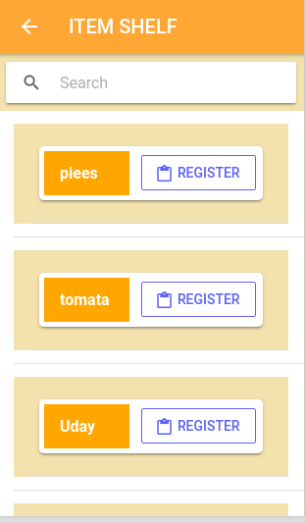
Items list
Add your new items or view the items in your store.

Slide 10
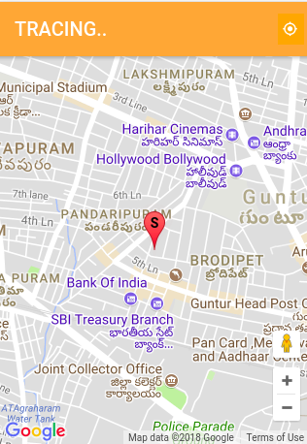
MAP PAGE
TRACKS YOUR LOCATION AND SHOWS ON YOUR MAP AND ALSO LOCATION OF NEAR BY SHOPS IN 1KM RANGE

Slide 11
THANK YOU

