Slide 1
KL UNIVERSITY
DEPARTMENT OF ECE
Open Cores
Name of the Student Register No. Section Research Group/Batch.No
B.Nikhil Prabhat
Name of the Supervisor
Designation/Department
Research Group

Slide 2
OVERVIEW OF THE PRESENTATION
Introduction
  Objectives of the project
  Abstract
Literature Review
Description of the Project work
  Problem identified
  Methodology
  Results and Discussion
Conclusion and Contribution to the society
References

Slide 3
INTRODUCTION
The main aim of the project is to develop.
Development of the free and open source tools for the VLSI domain
Open source tools- accessible for everyone
Open cores which are replacement for the IP cores
Reduction in development costs

Slide 4
LITERATURE REVIEW-Minimum 5 papers should be discussed for literature review.The Litearture review should be done by the following format.(Example is enclosed)
1.Name of the Author/Title of the Paper/Vol.No.
Contribution by the author to the Research
Inference from the Paper
Limitations

Slide 5
DESCRIPTION OF THE PROJECT WORK
  To develop the open cores we need some tools like
      Open source verilog compiler
      Tool for visualising the timing diagram
      Tool for generating bit files for the implementation
  What we did till date
          Fetched a tool iverilog which is a open source verilog compiler
          Gtkwave, for timing diagrams

Slide 6
EXPLANATION OF THE METHODOLOGY
We came across a new technique while going through the work
  Partial Reconfiguration
      Used for changing the functionality of the hardware during run time
Supported Boards
  Xilinx FPGAs
  Altera FPGAs

Slide 7
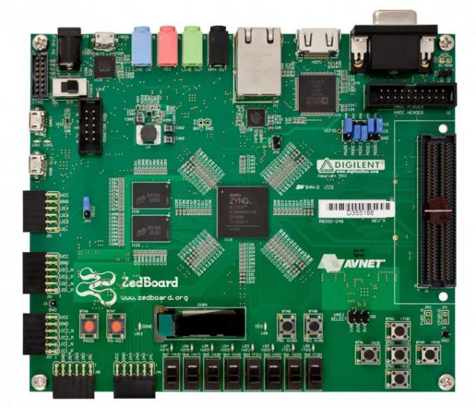

Slide 8
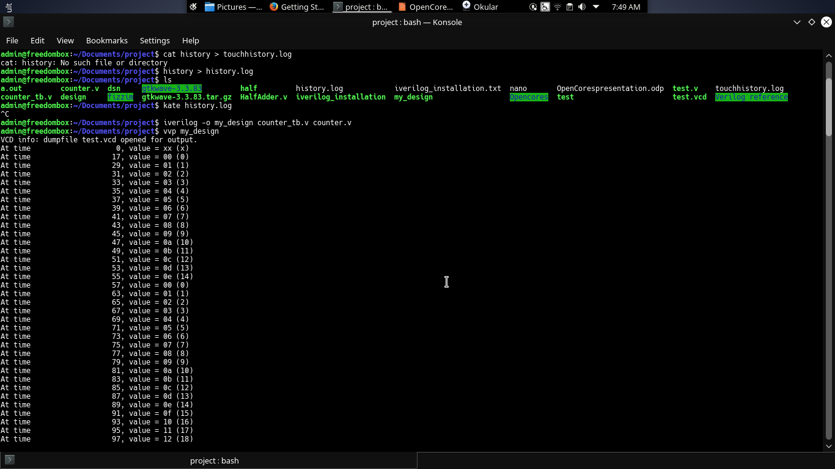
RESULTS AND DISCUSSION

Slide 9
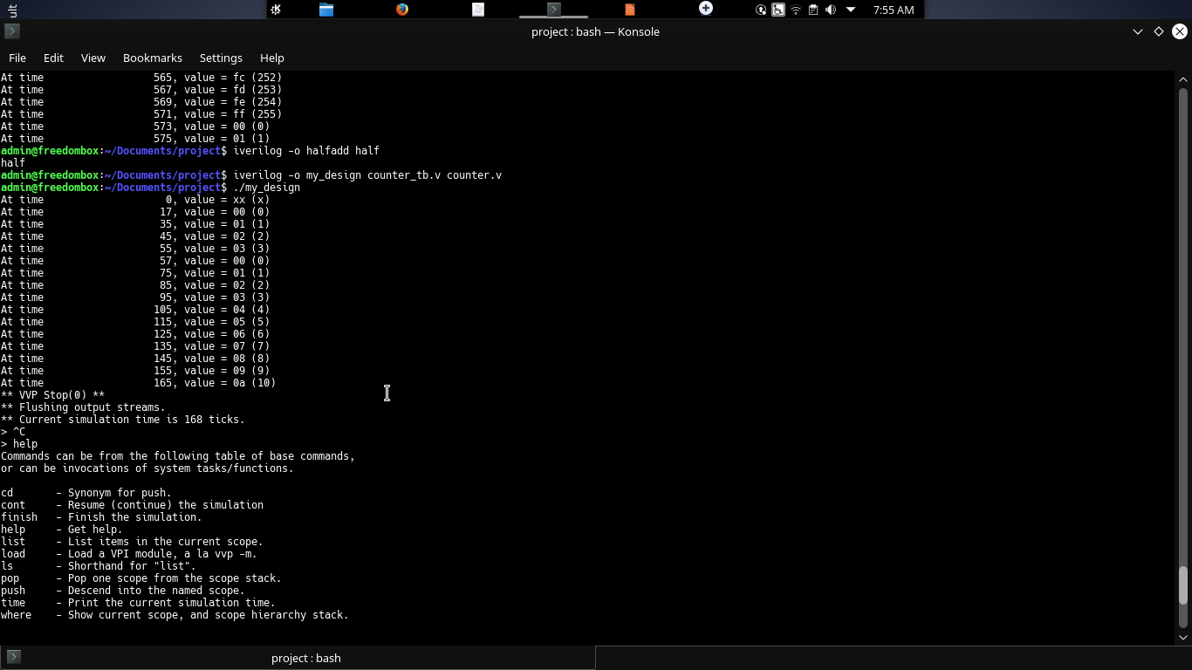

Slide 10
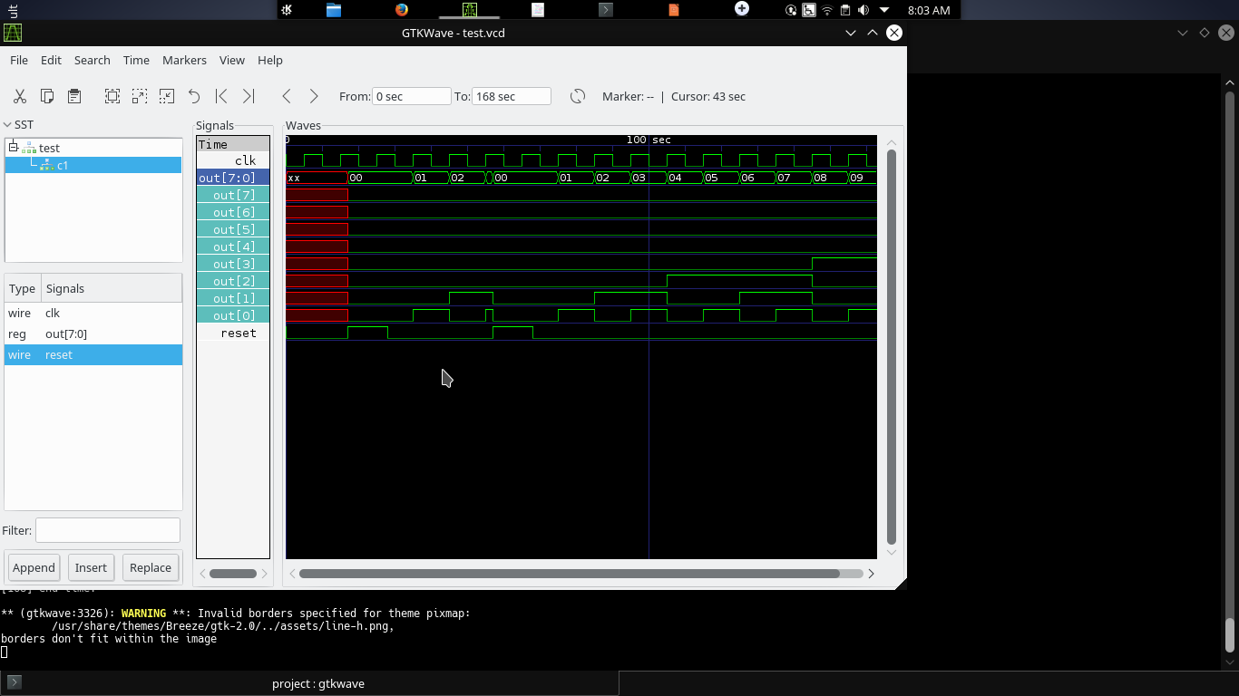

Slide 11
CONCLUSION AND CONTRIBUTION TO THE SOCIETY
Till date we came across verilog compilers , partial reconfiguration scheme which is implemented on the Xilinx FPGA(Zed Board)
This is implemented using Xiling suite
Now we are going to fetch open source tools for the implementation of the partial reconfiguration

Slide 12
REFERENCES
www.opencores.org
]http://iverilog.wikia.com/wiki/GTKWAVE
http://iverilog.wikia.com/wiki/Getting_Started
https://www.altera.com/products/design-software/fpga-design/quartus-prime/features/partial-reconfiguration.html
https://en.wikipedia.org/wiki/Reconfigurable_computing

Slide 13
THANK YOU

