Slide 1
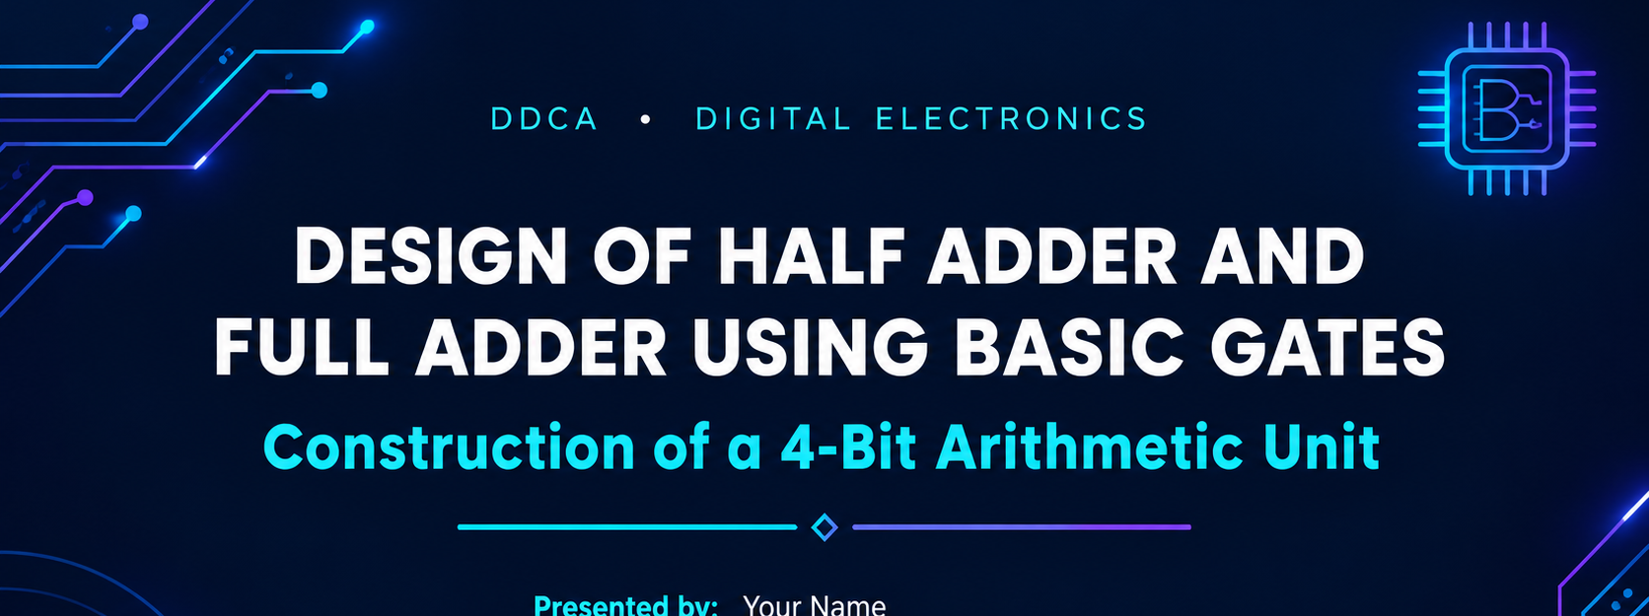
PRESENTED BY:
Harini – 2620030050
Meghana – 2620030053
Shashank – 2620030057
Charan – 2620030058

Slide 2
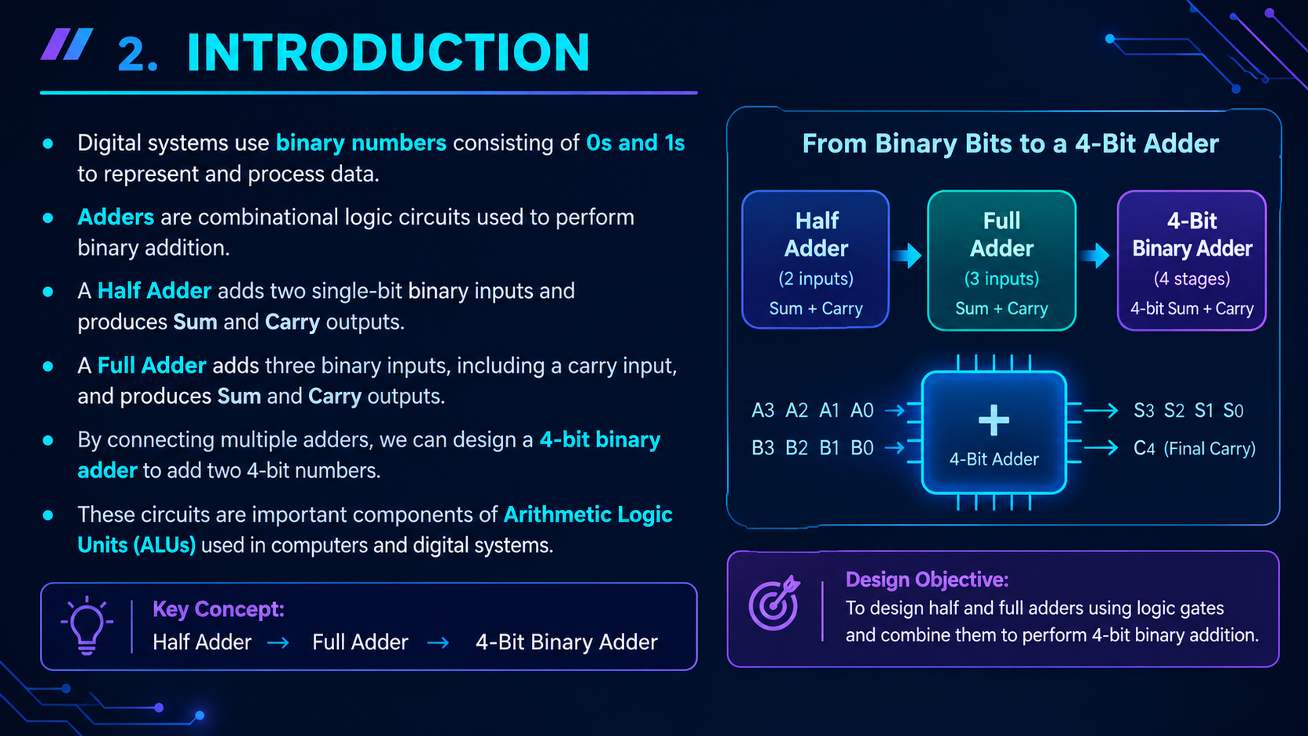
INTRODUCTION

Slide 3
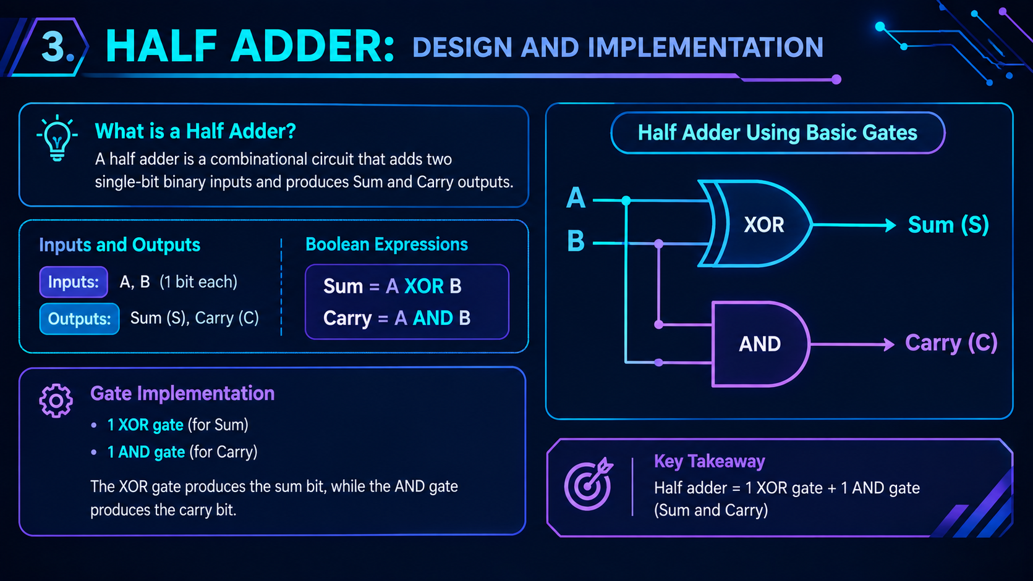
Half Adder: Design And Implementation

Slide 4
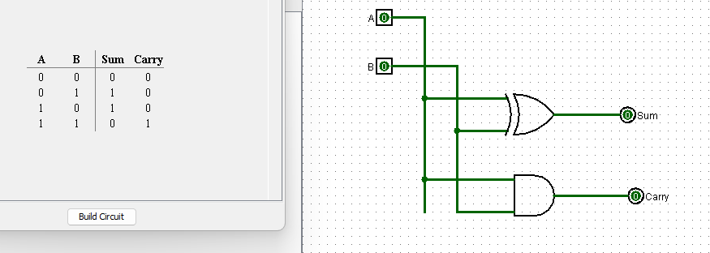
LOGISIM IMPLEMENTATION OF HALF ADDER

Slide 5
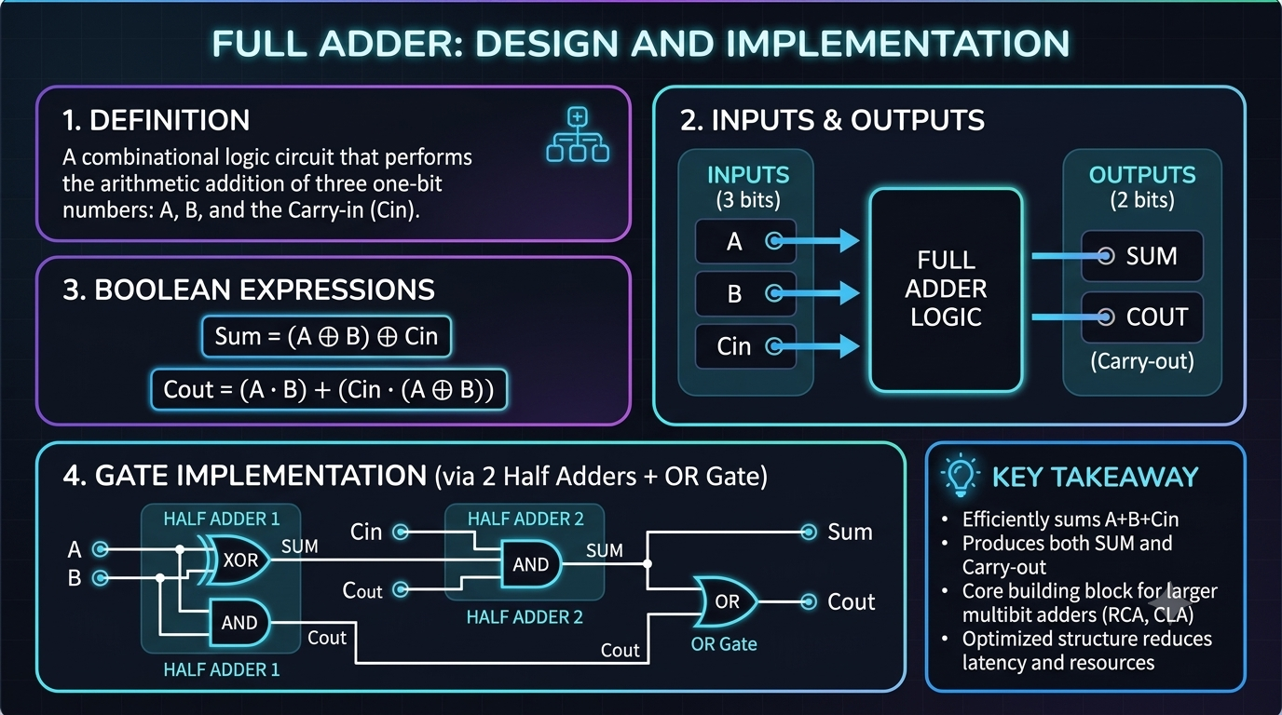
FULL ADDER:DESIGN AND IMPLEMENTATION

Slide 6
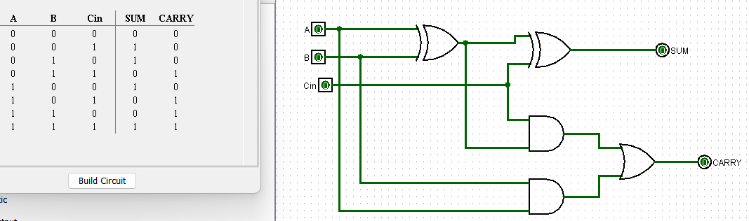
LOGISIM IMPLEMENTATION OF FULL ADDER

Slide 7
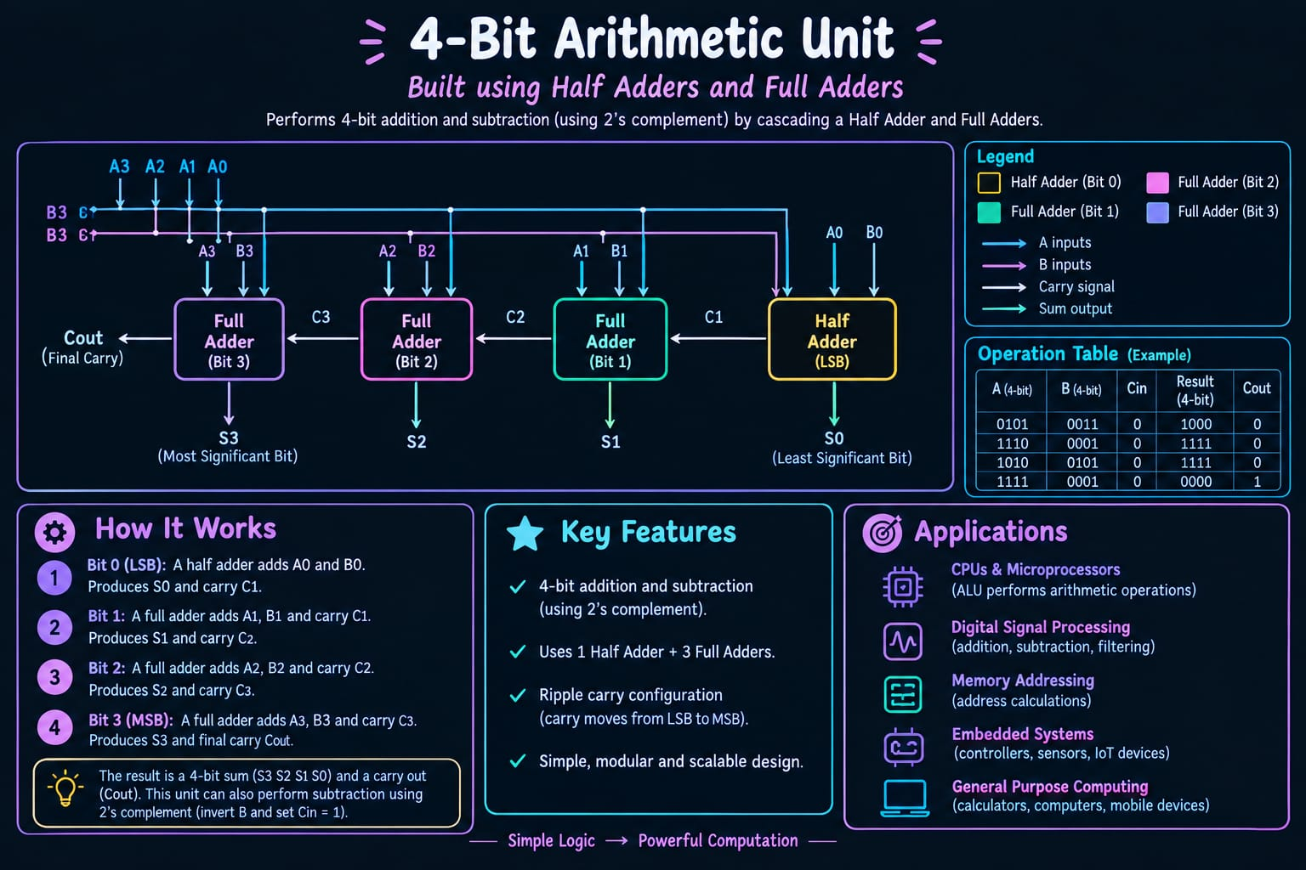
DESIGN OF A 4-BIT ARITHMETIC UNIT

Slide 8
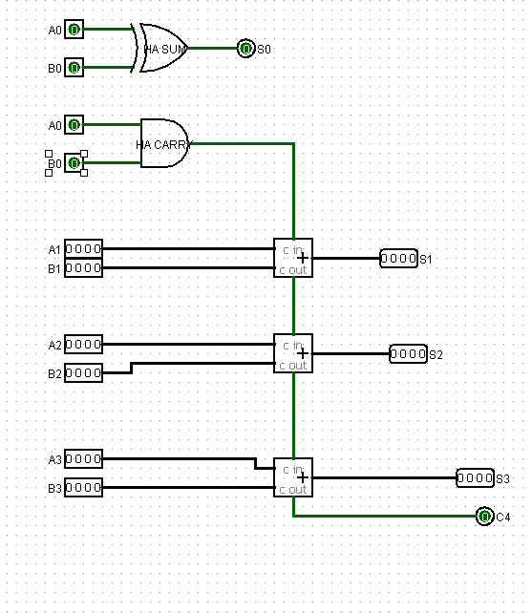
LOGISIM IMPLEMENTATION OF 4 – BIT ARITHMETIC UNIT

Slide 9
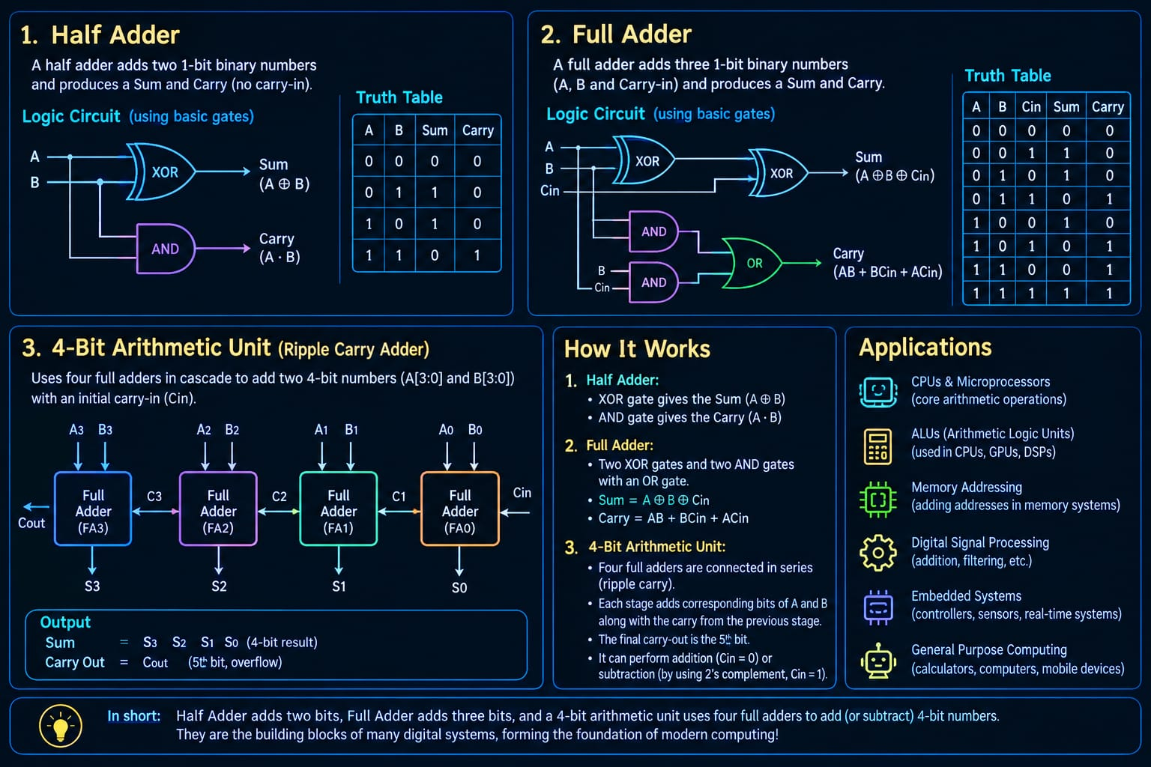
WORKING AND APPLICATIONS

Slide 10
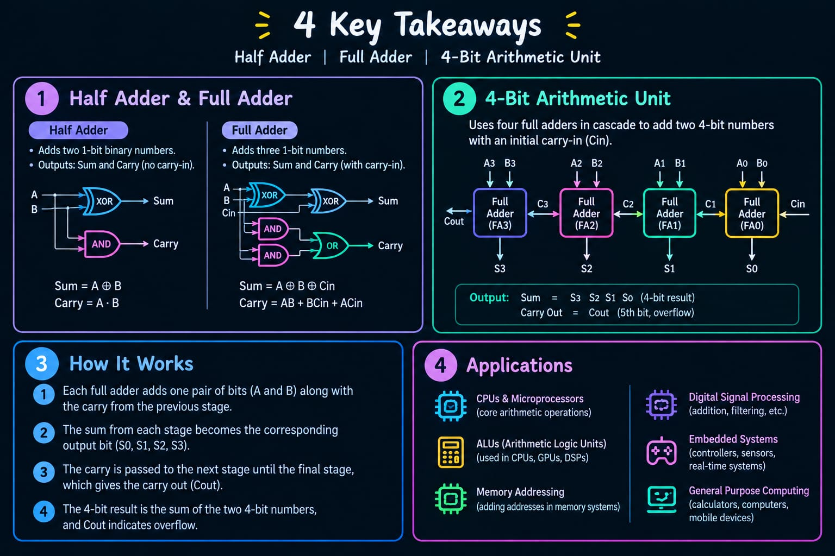
4 KEY TAKEAWAYS

Slide 11


