Slide 1
4-Bit Adder / Subtractor with Overflow Detection
FA0
FA1
FA2
Digital Design & Computer Architecture
Project Expo
TEAM MEMBERS
D.PRANAVI 2620030497
M.LAKSHMI VINAYA 2620030498
B.BHAVANI BAI 2620030465
M.VEDA SAMHITHA 2620030480
FA3
Notes:
Introduce the team and the project: a single 4-bit circuit that adds, subtracts and flags overflow.

Slide 2
Problem & Methodology
The problem
Our problem statement is about designing a 4-bit signed adder-subtractor circuit.
Processors need to perform both addition and subtraction on positive and negative binary numbers. If we use separate circuits for these operations, it requires more hardware.
To solve this problem, we can design a single circuit that performs both addition and subtraction using a control input and 2's complement.
Another important problem is overflow. A 4-bit signed number can represent values only from minus 8 to plus 7. If the result goes outside this range, the answer may be incorrect.
Therefore, our objective is to design a combined adder-subtractor circuit that reduces hardware and detects overflow.
4-bit
Inputs A and B
−8 to +7
Signed result range
Our goal
1 circuit
Add, subtract, flag overflow
Design one 4-bit circuit that adds, subtracts using 2’s complement, and raises an overflow flag.
1. Full Adder
2. Ripple Carry
3. Add / Subtract
4. Overflow
5. Verify
One-bit adder with Sum and Carry-out logic.
Chain four full adders; each carry feeds the next bit.
XOR gates on B with Cin = M give A − B using 2’s complement.
V = C3 ⊕ C4 flags signed results outside −8 to +7.
Simulate add, subtract and overflow test cases.
Notes:
State the need, then walk through the five design steps from the single full adder to verification.

Slide 3
Architecture & How It Works
A0
B0
A1
B1
A2
B2
A3
B3
Add / Subtract (M)
XOR
XOR
XOR
XOR
M = 0: B passes through, Cin = 0, so A + B
M = 1: XOR gates invert B, Cin = 1, so A + ~B + 1 = A − B
Each full adder: S = A ⊕ B ⊕ Cin, Cout = AB + Cin(A ⊕ B)
Cin = M
FA0
C1
FA1
C2
FA2
C3
FA3
C4
S0
S1
S2
S3
Overflow Detection
V = C3 ⊕ C4
C3 is the carry into the MSB, C4 is the carry out
If they differ, the signed result does not fit in 4 bits
V = 1 flags an invalid result; V = 0 means valid
V (overflow)
FA0 is the LSB, FA3 is the MSB
A − B = A + ~B + 1
V = C3 ⊕ C4
Notes:
A and B feed four full adders. M controls the XOR gates and is also the first carry-in. Overflow happens when the carry into the MSB differs from the carry out.

Slide 4
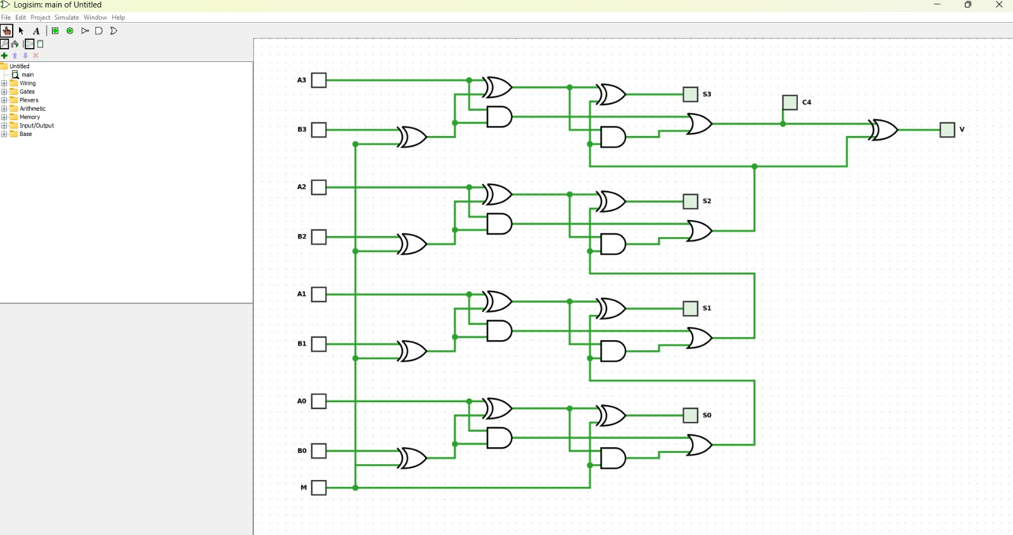
Truth Tables
Full adder
Overflow: carries
A | B | Cin | Sum | Cout
0 | 0 | 0 | 0 | 0
0 | 0 | 1 | 1 | 0
0 | 1 | 0 | 1 | 0
0 | 1 | 1 | 0 | 1
1 | 0 | 0 | 1 | 0
1 | 0 | 1 | 0 | 1
1 | 1 | 0 | 0 | 1
1 | 1 | 1 | 1 | 1
C3 | C4 | V | Meaning
0 | 0 | 0 | Valid result
0 | 1 | 1 | Overflow (neg + neg)
1 | 0 | 1 | Overflow (pos + pos)
1 | 1 | 0 | Valid result
V = C3 ⊕ C4
C3 = carry into MSB, C4 = carry out of MSB
Overflow: sign bits
A3 | 0 | 0 | 0 | 0 | 1 | 1 | 1 | 1
B3′ | 0 | 0 | 1 | 1 | 0 | 0 | 1 | 1
S3 | 0 | 1 | 0 | 1 | 0 | 1 | 0 | 1
V | 0 | 1 | 0 | 0 | 0 | 0 | 1 | 0
Sum = A ⊕ B ⊕ Cin
Cout = AB + Cin(A ⊕ B)
Notes:
Each bit is one full adder. Two ways to see overflow: carries (V = C3 XOR C4) or sign bits. B3-prime is B3 after the XOR gate.

Slide 5
Algorithm Flowchart
Yes
B′ = ~B, Cin = 1 (Subtract)
Ripple-carry add through 4 full adders: S = A + B′ + Cin
M = 1 ?
Start
Input A, B, M
B′ = B, Cin = 0 (Add)
No
End
Output S[3:0], C4 and V (V = 1 means overflow)
Overflow check: V = C3 ⊕ C4
Notes:
Read the flowchart from Start: choose add or subtract with M, run the ripple-carry add, check overflow, then output the result.

Slide 6
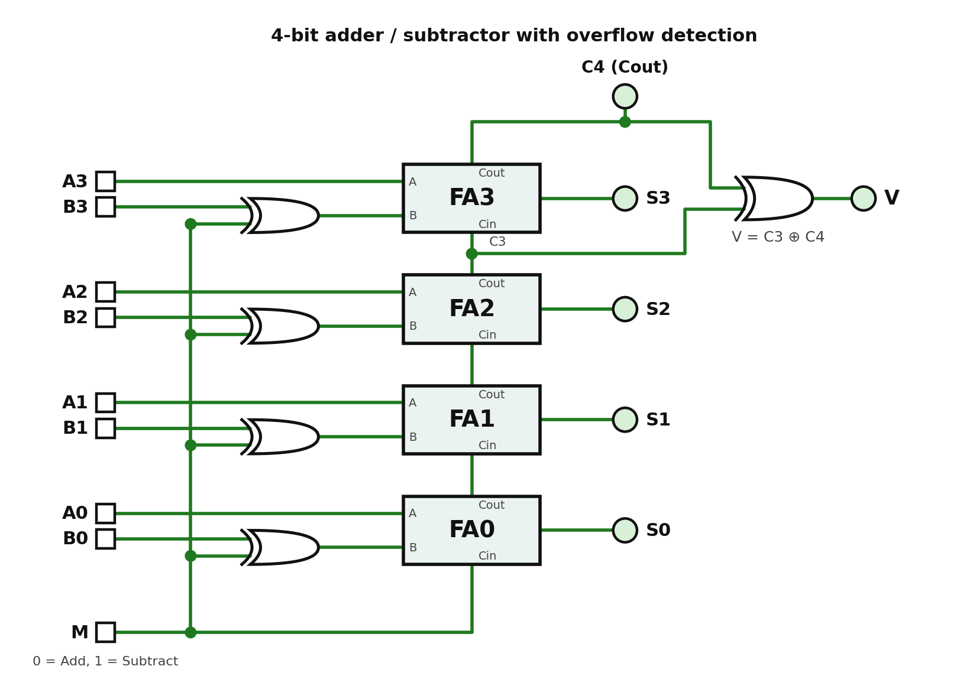
Logisim Circuit & Demo
Demo & test cases
A | B | Op | Result | V
0100 (4) | 0010 (2) | ADD | 0110 (6) | 0
0101 (5) | 0011 (3) | ADD | 1000 (−8) | 1
0111 (7) | 0011 (3) | SUB | 0100 (4) | 0
0011 (3) | 0101 (5) | SUB | 1110 (−2) | 0
1000 (−8) | 0001 (1) | SUB | 0111 (+7) | 1
Signed 4-bit values. Shaded rows show overflow (V = 1).
Inputs: A[3:0], B[3:0], M
Outputs: S[3:0], C4 and V
XOR gates on B, with M as Cin
Four full adders in a ripple chain
V = C3 ⊕ C4
Paste your simulation screenshot or waveform here
Replace this picture with your own Logisim screenshot.
Notes:
Show the Logisim circuit, set M, A and B with the Poke tool, and read S, C4 and V. Rows 2 and 5 of the table are the overflow cases.

Slide 7






Applications
CPU / ALU
Signal Processing
Calculators
Core arithmetic unit inside every processor
Filters and math on signed sample data
Add and subtract in digital calculators
Address Calculation
Embedded & IoT
Graphics & Gaming
Program counter and memory offset math
Microcontroller sensor and control logic
Coordinate and pixel arithmetic
Notes:
The same add/subtract-with-overflow block appears wherever signed arithmetic is done in hardware.

Slide 8

GitHub Repository
What’s inside
Design source code
Testbench and simulation files
README with run instructions
Screenshots and waveforms
github.com/[your-username]/4bit-adder-subtractor
Add your repository link here
Notes:
Point the judges to the repository for the full source and simulation files.

Slide 9
Thank You
Questions?

