Slide 1


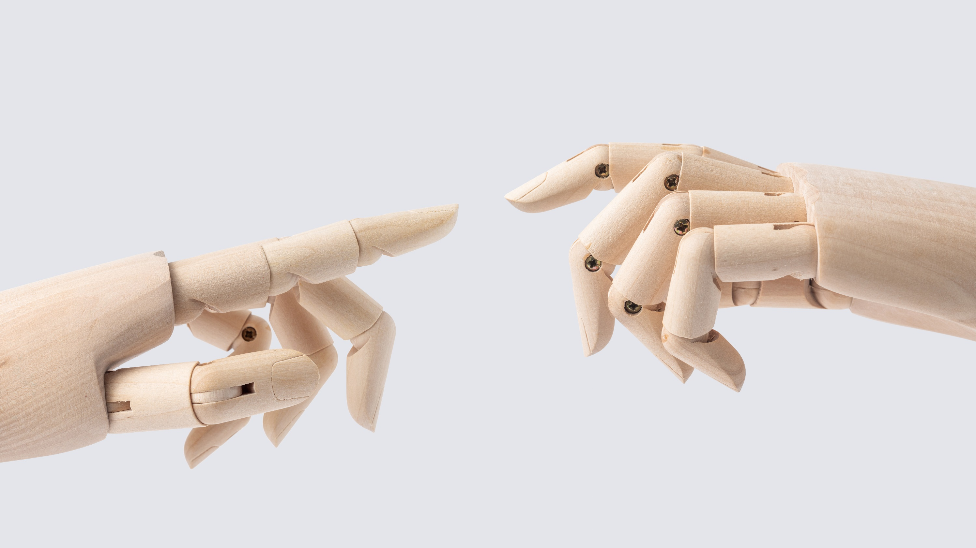
Analysis of hand Gestures and Sign language Recognition.
Guide: Dr. Arpita Gupta
Presenters:
Abhiram Sharma [2010030523]
N.Hemanth Srivathsav [2010030113]
Peri Vishwanadha Sastry [2010030470]
Vinay Kumar [2010030469]

Slide 2

Outline
Introduction
Motivation
Problem Statement
Objectives
Literature Review
Dataset
Models
Techniques
Conclusion
Analysis of hand Gestures and Sign language Recognition 2

Slide 3
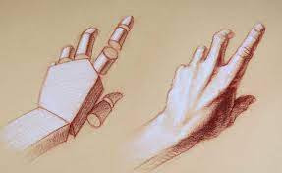
Introduction
Hand gestures are used as a way for people to express thoughts and feelings, it serves to reinforce information delivered in our daily conversation. Sign language is a structured form of hand gestures involving visual motions and signs, which are used as a communication system. For the deaf and speech-impaired community, sign language serves as useful tools for daily interaction. Sign language involves the use of diﬀerent parts of body namely ﬁngers, hand, arm, head, body and facial expression to deliver information.
Analysis of hand Gestures and Sign language Recognition 3

Slide 4

Motivation
By doing this project we would like to help the deaf and speech-impaired community , they are usually deprived of normal communication with other people in the society, normal people find it difficult to understand and communicate with them and visual communication is mostly difficult to understand. We hope that the outcome of this project will be of help for them to communicate with everyone and give instructions to machines.
Analysis of hand Gestures and Sign language Recognition 4

Slide 5
Problem Statement
Development of ubiquitous computing, current user interaction approaches with keyboard, mouse and pen are not sufficient. Due to the limitation of these devices the useable command set is also limited. Direct use of hands can be used as an input device for providing natural interaction.
Analysis of hand Gestures and Sign language Recognition 5

Slide 6

Objectives
To develop an automatic sign language recognition system with the help of image processing and computer vision techniques.
To use natural image sequences, without the signer having to wear data gloves or colored gloves, and to be able to recognize many signs.
To efficiently and accurately recognize signed words, from Indian Sign Language, using a minimal number of training examples.
The words converted can be used for communication with people and work as instructions for a machine.
Analysis of hand Gestures and Sign language Recognition 6

Slide 7
Literature Survey
S.no | Authors | Title | Publishing | Techniques & dataset | Pros | Cons
1. | Pansare, J.R, Gawande | Real Time Static Hand Gesture Recognition for ASL in Complex Background. | Scientific Research - An Academic Publisher | T: RGB Threshold and edge detection D: A-Z hand gesture | 90.19% Recognition rate. | Only 26 static gestures.
2. | Pan et al. | Real time Sign Language recognition in complex background. | IEEE Publishing | T: SVM D: SIFT,Hu-moments and FD | ->99.8% Accuracy with CSL ->94% Accuracy with ASL | Based on Hierarchical clustering Classification Method
Analysis of hand Gestures and Sign language Recognition 7

Slide 8
Literature Survey
S.no | Authors | Title | Publishing | Techniques & dataset | Pros | Cons
3. | Xiao Yan Wu | Hand Gesture Recognition algo based on DC-CNN. | Springer Link Publishers. | T:Canny Operator edge detection (DC-CNN) D:NAO Cam Hand posture database (NCD) | 98.02% Recognition rate. | Complex CNN layers and parameters.
4. | Tsoli, A.; Argyros | Joint 3D tracking of a deformable object in interaction with hand. | European conference on Computer Vision. | T: Bounding Box around the hand & hand Mask. D: Synthetic Dataset by blender modelling software. | Interaction with deformable object and tracking. | % of template vertices overall frames.
Analysis of hand Gestures and Sign language Recognition 8

Slide 9
Literature Survey
S.no | Authors | Title | Publishing | Techniques & dataset | Pros | Cons
5. | Javier Molina, Jose Antonio Pajuelo & Jose M. Martinez | Real time Motion based Hand Gestures Recognition from Time of Flight. | Journal of Signal Processing Systems -Springer Link Publishers. | T:Depth info, motion patterns. D:cardinal direction Dataset. | Interaction with virtual environments | Depth range Limitation
Analysis of hand Gestures and Sign language Recognition 9

Slide 10
NOTE:
Currently, there is no Standard benchmark dataset dedicated to automated Indian Sign Language gesture recognition using two hands.
Analysis of hand Gestures and Sign language Recognition 10

Slide 11
Dataset
Name | Characteristics | Publisher | Accuracy
Custom Made dataset of gesture images. | Implemented alphabets (A-Z) and numbers(0-9) Total classes = 35. Each class has 1200 images Train-Test ratio of 70:30. | Karthikeyu https://www.iosrjournals.org/iosr-jce/papers/Vol22-issue3/Series-1/B2203011419.pdf | 98% accuracy approximately.
 | Implemented alphabets (A-Z) 800 images to Train and 200 images to test. Train-Test ratio 80:20. |  | 98% accuracy approximately.
 | Dual mode of recognition is implemented. all the alphabets (A-Z) and digits (0-9). Train-Test ratio of 80:20.
Analysis of hand Gestures and Sign language Recognition 11

Slide 12
Models
Image segmentation (masking to get raw skin and edges in the image)
SURF Feature detection (finding feature descriptors for all data)
K-means clustering (Codebook generation: to cluster all features and to get visual words (bow))
Histograms computation (Using visual words (bow) compute histograms for each image
SVM model for classification (input: histograms, output: prediction for test data)
CNN
Analysis of hand Gestures and Sign language Recognition 12

Slide 13
Techniques
We convert our input images (RGB) into grayscale and apply gaussian blur to remove unnecessary noise. We apply adaptive threshold to extract our hand from the background and resize our images to 640x640.
We feed the input images after pre-processing to our model for testing after applying all the operations mentioned above.
Estimating how likely the image will fall under one of the classes.
Analysis of hand Gestures and Sign language Recognition 13

Slide 14
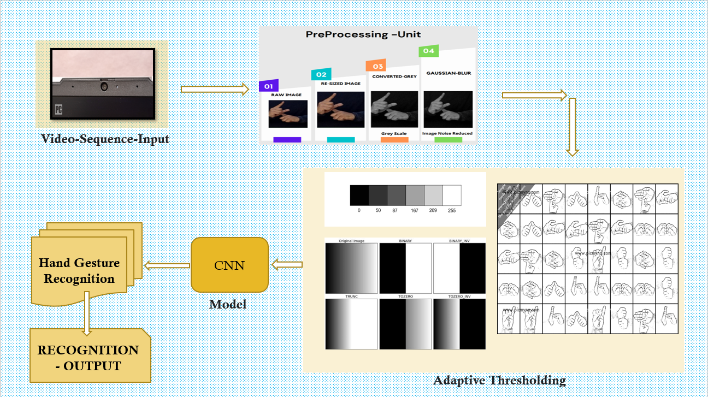
Pre Processing FLOW CHART

Slide 15
Adaptive Thresholding:
CODE:
import numpy as np import cv2 vid = cv2.VideoCapture(0) # while True: sucess, img = vid.read() # use if want in GRAY scale gray = cv2.cvtColor(img, cv2.COLOR_BGR2GRAY) # hsv =cv2.cvtColor(img,cv2.COLOR_BGR2HSV_FULL) # edges = cv2.Canny(gray,100,200)
#ADAPTIVE THRESHOLDING
----------------------------------------------------------------------------------------------------------------------------------------------------------- thresh = cv2.adaptiveThreshold(gray, 255, cv2.ADAPTIVE_THRESH_GAUSSIAN_C, cv2.THRESH_BINARY_INV, 21, 4) ret, res = cv2.threshold(thresh, 10, 255, cv2.THRESH_BINARY_INV + cv2.THRESH_OTSU)
-------------------------------------------------------------------------------------------------------------------------------------------------------------
cv2.imshow("Video", res) # use gray here then

Slide 16
Converting obtained dataset using Adaptive Thresholding:
import os from os import listdir from os.path import isfile, join from this import d import numpy import cv2 d = 0 mypath = "D:\WorkSpace\....." # Enter your dataset images path here onlyfiles = [f for f in listdir(mypath) if isfile(join(mypath, f))] images = numpy.empty(len(onlyfiles), dtype=object) # To take image from file for n in range(0, len(onlyfiles)): images[n] = cv2.imread(join(mypath, onlyfiles[n])) for i in images: scale_percent = 500 # percent of original size width = int(i.shape[1] * scale_percent / 100) height = int(i.shape[0] * scale_percent / 100) dim = (width, height) resiz = cv2.resize(i, dim, interpolation=cv2.INTER_AREA) # resize images gray = cv2.cvtColor(resiz, cv2.COLOR_BGR2GRAY) # converting to gray scale blur = cv2.GaussianBlur(gray, (9, 9), sigmaX=8, sigmaY=8) thresh = cv2.adaptiveThreshold(blur, 255, cv2.ADAPTIVE_THRESH_GAUSSIAN_C, cv2.THRESH_BINARY_INV, 21, 4) ret, res = cv2.threshold(thresh, 10, 255, cv2.THRESH_BINARY_INV + cv2.THRESH_OTSU) path = 'data\....' # Enter the path to store the converted images cv2.imwrite(os.path.join(path, '%d.jpg' % d), res) d += 1 # names the stored images with 0,1,2,3...... cv2.waitKey(0)

Slide 17
Conclusion
Sign language is an alternative method used by people who are unable to communicate with others by speech. Alternatively, it may involve uncovered hand interaction with the camera, using computer vision techniques to identify the gesture. Hand gesture recognition addresses a fault in interaction systems. Controlling things by hand is more natural, easier, more flexible and cheaper, and there is no need to fix problems caused by hardware devices, since none is required.
Analysis of hand Gestures and Sign language Recognition 14

Slide 18
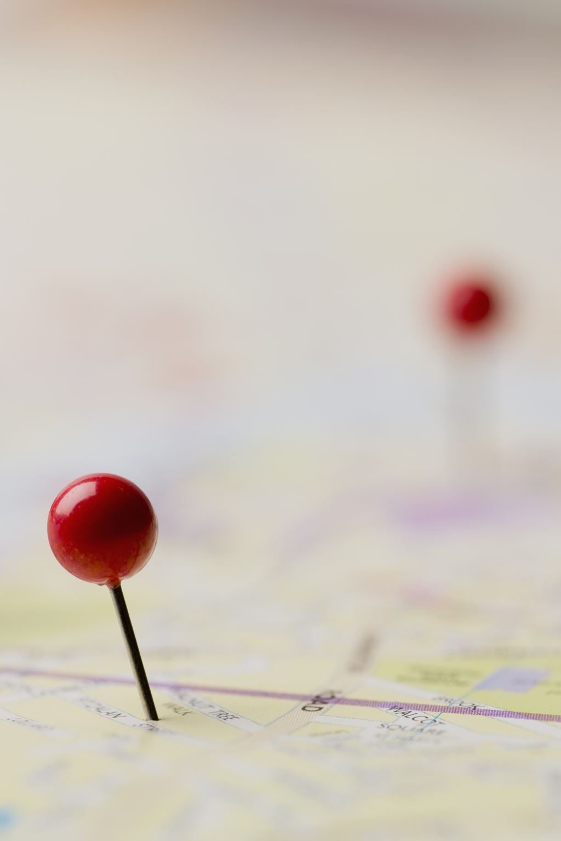
REFERENCES
[1]. S. C. Agrawal, A. S. Jalal, and C. Bhatnagar. Recognition of indian sign language using feature fusion. In 2012 4th International Conference on Intelligent Human Computer Interaction (IHCI), pages 1–5, 2012.
[2]. Herbert Bay, TinneTuytelaars, and Luc Van Gool. Surf: Speeded up robust features. In AleˇsLeonardis, Horst Bischof, and Axel Pinz, editors, Computer Vision – ECCV 2006, pages 404–417, Berlin, Heidelberg, 2006. Springer Berlin Heidelberg.
[3]. J. Canny. A computational approach to edge detection. IEEE Transactions on Pattern Analysis and Machine Intelligence, PAMI8(6):679–698, 1986.
[4]. K. Dixit and A. S. Jalal. Automatic indian sign language recognition system. In 2013 3rd IEEE International Advance Computing Conference (IACC), pages 883–887, 2013.
[5]. B. Gupta, P. Shukla, and A. Mittal. K-nearest correlated neighbor classification for Indian sign language gesture recognition using feature fusion. In 2016 International Conference on Computer Communication and Informatics (ICCCI), pages 1–5, 2016.

Slide 19
[6]. Yu-Gang Jiang, Jun Yang, Chong-Wah Ngo, and Alexander Hauptmann. Representations of keypoint-based semantic concept detection: A comprehensive study. Multimedia, IEEE Transactions on, 12:42 – 53, 02 2010
[7] Kapur, R.: The Types of Communication. MIJ. 6, (2020).
[8] Suharjito, Anderson, R., Wiryana, F., Ariesta, M.C., Kusuma, G.P.: Sign Language Recognition Application Systems for Deaf-Mute People: A Review Based on InputProcess-Output. Procedia Comput. Sci. 116, 441–448 (2017).
[9] Starner, T., Pentland, A. (1997). Real-time American Sign Language recognition from video using hidden markov models. In Motion-Based Recognition (pp. 227-243). Springer, Dordrecht.
[10] Singha, J., Das, K. (2013). Indian sign language recognition using eigen value weighted euclidean distance based classification technique. arXiv preprint arXiv:1303.0634.
[11]. Yu-Gang Jiang, Jun Yang, Chong-Wah Ngo, and Alexander Hauptmann. Representations of keypoint-based semantic concept detection: A comprehensive study. Multimedia, IEEE Transactions on, 12:42 – 53, 02 2010.
[12]. David G. Lowe. Distinctive image features from scale-invariant keypoints. Int. J. Comput. Vision, 60(2):91–110, November 2004

Slide 20
THANK YOU

