Slide 1
Colour analysis and image processing applied in fruit analysis
2010030017-Bellam Keerthana
2010030095-Mallayla Nissie
2010030104-M.Sravani Chowdary
2010030485-P.Mounika Reddy
Guide:
Chanda Raj Kumar

Slide 2
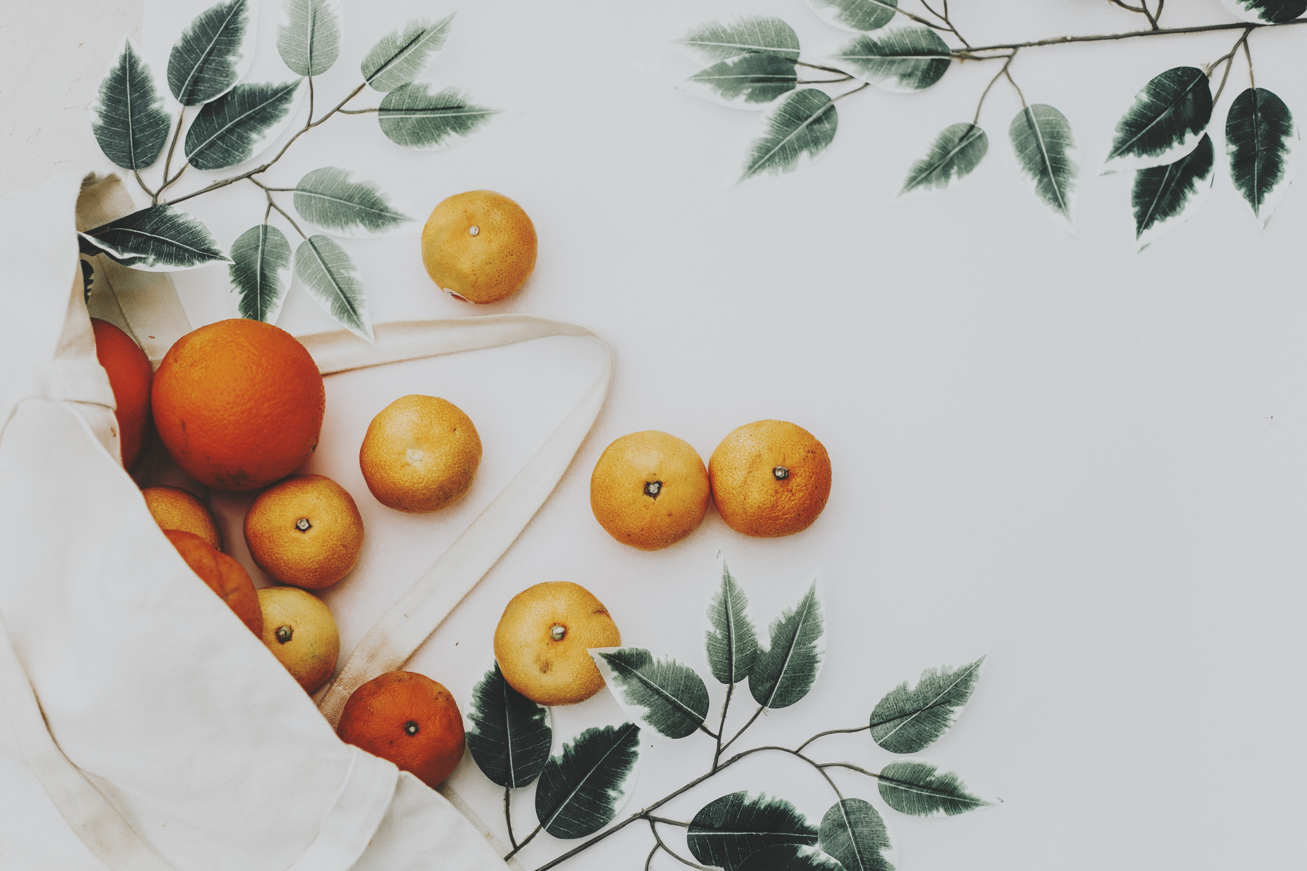
Abstract
Autonomous robotic harvesting is a rising trend in agricultural applications, like the automated harvesting of fruit and vegetables. Farmers continuously look for solutions to upgrade their production, at reduced running costs and with less personnel. This is where harvesting robots come into play. During recent years a lot of research on this topic has been performed, either using basic computer vision techniques, like Colour based segmentation. Recent advances in computer vision present a broad range of advanced object detection techniques that could improve the quality of fruit detection from RGB images drastically. In this project I will show how ripe fruits can be identified Pre-installed OpenCV image processing library is used for the project. The concept can be implemented in robotics for ripe fruits harvesting. OpenCV Python is used to identify the ripe fruit. Several Python modules are required like matplotlib, NumPy, pandas, etc.

Slide 3
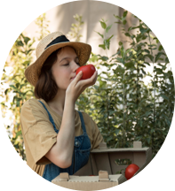
Introduction
Images are an important source of data and information in the agricultural sciences. The use of image-processing techniques has outstanding implications for the analysis of agricultural operations. Fruit colours and their ripeness classification is one of the major applications that can be utilized in supermarkets to automatically detect the kinds of fruit colours and their ripeness state purchased by customers. We explored various methods used in addressing fruit colours and their ripeness classification and in recognizing. We surveyed image-processing approaches used for fruit disease detection, segmentation.

Slide 4
Colour Image Segmentation
Literature survey-1
1
Akshay P. Vartak¹, Dr. Vijay Mankar
International Journal of Emerging Technology and Advanced Engineering
A basic assumption of any colour image segmentation algorithm.
Physics-based approaches try to overcome the problem of misclassifying highlighted and shaded areas in the image.

Slide 5
Application of Image Processing in Fruit and Vegetable Analysis: A Review
Literature survey-2
2
Shiv Ram Dubey and Anand Singh Jalal
Journal of Intelligent Systems
Most studies on fruit colour recognition or fruit ripeness detection considered colour and texture properties for the categorization. Most investigations on fruit recognition were done with the fruits located on trees, but we restrict our review to those approaches proposed for the classification of different types of fruits.

Slide 6
Colour Object Tracking On Embedded Platform
Using Open CV
Literature survey-3
3
Krutika A Veerapur, Ganesh V. Bhat
International Journal of Recent Technology and Engineering
colour object tracking using OpenCV software
CAMShift algorithm is used for object tracking which is based on the Meanshift algorithm. The proposed approach is demonstrated for a real-time multiple object tracking systems.

Slide 7
Colour image segmentation: A State-of-the-Art Survey
Literature survey-4
4
color image segmentation: State-Of-The-Art survey
L.Lucchese and S.K.Mitra
In this paper they provided us an overview of algorithms for color image segmentation . there is no universal algorithm for segmentation images. Most of the techniques are been tailored on applications and they may work only under certain hypothesis .

Slide 8
Methods
Step 1: OPENCV
Computer vision, machine learning, and image processing and now it plays a major role in real-time operation which is very important in today’s systems. By using it, one can process images and videos to identify objects, faces, or even handwriting of a human.
Step 2: RESIZING IMAGE
Machine learning models work with a fixed sized input. The same idea applies to computer vision models as well. The images we use for training our model must be of the same size.
Step 3: OBJECT DETECTION
Object detection is an important task, yet challenging vision task. It is a critical part of many applications such as image search, image auto-annotation and scene understanding, object tracking
Step 4: IMAGE PROCESSING
It focuses on image manipulation. Image processing is a method to perform some operations on an image, in order to get an enhanced image or to extract some useful information from it.
Step 5: PATTERN RECOGNIZATION
It explains various techniques to classify patterns. Pattern recognition is the automated recognition of patterns and regularities in data

Slide 9
Results
In this study we found that The fast and non-destructive measurement of quality parameters is very important for the food industry either for receiving raw material or for on-line quality control.

Slide 10
Discussion
Image-processing-based solutions that use colour and texture features for automatic recognition and classify the fruits Colour and their ripeness

Slide 11
Conclusion
The identification of ripeness fruits based on Colour using OPENCV/PYTHON is successfully done with accuracy. The use of image processing for identifying the Colour can be applied not only to any fruit. We can also apply this method to identifying in real time the ripeness of a fruit with more accuracy. Thus, this will enable the technology to be applied in many products. To replace manual inspection of food, computer vision system is used which provide authentic, equitable and non-destructive rating

Slide 12
Suggestions

Slide 13
Thank you

