Slide 1

Color analysis and image processing applied to fruit analysis
Batch Members:
B.Keerthana (2010030017)
M.Nissie (2010030095)
M. Sravani (2010030104)
P.Mounika (2010030485)
Supervisor:
Name : Mr. Chanda Rajkumar
Designation: Assistant Professor, CSE

Slide 2
Abstract
India is also known as Agricultural Country. Fruit and Vegetable play a vital role in the Indian economy. color and appearance are the first attributes that attract us to a fruit or vegetable.
By using the image Processing Technique the rotten part of fruits and vegetables is detected effetely to separate unhealthy from a good one.
This method of detecting a defective object is carried out by using different library functions Python Software. Finally, the notification of the spoiled fruits and vegetables is intimated to the user by displaying the message on the display.
The purpose of this project is to give an overview of the recent development of image processing applied to color analysis from horticultural products, more specifically the practical usage of color image analysis in agriculture.

Slide 3
Introduction
The features are one of the key parameters to define the quality of an agricultural product. The color is probably the first factor that consumers use to determine the appearance of a product; appearance is a subjective factor that leads the consumer to accept or reject a food product.
Fruits can be classified based on their appearance and parameters like color, size, shape, etc. These parameters can be used to determine their quality and classify them.
The adaptation of the human eye to slight changes in color and the effect of the background on the perceived color and color intensity are the major drawbacks of visual inspection. To make decisions consistent, machine vision technology based on image analysis using color has proved to be the best technique to determine the quality of fruits.
A considerable effort has been made in the area of automation to improve the quality of agricultural products in the food industry to decrease losses. We are trying to find out whether the considered dataset is useful or not.

Slide 4
Literature Survey
Title of the Paper | Description | Publication Details | Web Link
Analysis and Recognition Based on Citrus Color Grading Model considering Computer Vision Technology | In this paper, the characteristics of fruit images under three different lighting conditions, that is, front lighting, back lighting, and normal lighting, are identified based on exploratory data analysis by using the computer vision technology. The results of the experiment in the study indicate that based on the color threshold selected, the mature citrus fruits can be can effectively identified, and the overall recognition rate has exceeded 98%, which can meet the requirements for intelligent harvesting. | Hindawi Volume 2021 |Article ID 6426163 | Chongqing Municipal Education Commission | Analysis and Recognition Based on Citrus Color Grading Model considering Computer Vision Technology (hindawi.com)

Slide 5
Title of the Paper | Description | Publication Details | Web Link
A Framework with OTSU’S Thresholding Method for Fruits and Vegetables Image Segmentation | In this paper they have presented the related work of all type of image segmentation method. For background subtraction Otsu's algorithms are used which are based on thresholding image segmentation method. This approach is evaluating on database of different category of fruits and vegetables. In the data set we have not consider the combination of different fruits and vegetables. They have considered same kind of fruits and vegetables with different pose and also variability in number. For future enhancement they are trying to identify fruits and vegetables based on color and texture methods | International Journal of Computer Applications (0975 – 8887) Volume 179 – No.52, June 2018 | (PDF) A Framework with OTSU’S Thresholding Method for Fruits and Vegetables Image Segmentation (researchgate.net)

Slide 6
Title of the Paper | Description | Publication Details | Web Link
Design And Detection Of Fruits And Vegetable Spoiled Detection System | The identification of normal and defective fruits based on quality using OPENCV/PYTHON is successfully done with accuracy. The use of image processing for identifying the quality can be applied not only to any particular fruit. We can apply this method to identify quality of vegetables with more accuracy. The system is operated in two different scenarios in first the image is captured then all the image processing is done All the process are shown on monitor and based on decision taken by control module. The conveyor assembly is operated. this can be extracted in future as the fruit or vegetables is affected by its inside or not. | International Journal of Application or Innovation in Engineering & Management (IJAIEM) Volume 10, Issue 6, June 2021 | IJAIEM-2021-06-17-8.pdf

Slide 7
Title of the Paper | Description | Publication Details | Web Link
Food Quality Inspection and Grading Using Efficient Image Segmentation and Machine Learning-Based System | In this first Gaussian elimination method is used on photos to remove noise. After that, histogram equalization is employed to enhance the image’s quality. The K-means clustering algorithm is used to segment the images. The following stage utilizes machine learning methods such as KNN, SVM, and C4.5 to classify fruit photos. These algorithms determine whether fruits are healthy or unhealthy. Three factors are considered in a comparative study: accuracy, specificity, and sensitivity. future researchers in determining the most appropriate machine learning technique for food grading and quality assurance. | Hindawi Volume 2022 |Article ID 5262294 | s40595-014-0028-3.pdf (springer.com)

Slide 8
Existing System
K-Means
Nowadays, overseas commerce has increased drastically in many countries. Plenty fruits are imported from the other nations such as oranges, apples etc. Manual identification of defected fruit is very time consuming. A novel defect segmentation of fruits based on color features with K-means clustering unsupervised algorithm. They used color images of fruits for defect segmentation. Defect segmentation is carried out into two stages. At first, the pixels are clustered based on their color and spatial features, where the clustering process is accomplished. Then the clustered blocks are merged to a specific number of regions. Using this two step procedure, it is possible to increase the computational efficiency avoiding feature extraction for every pixel in the image of fruits. Although the color is not commonly used for defect segmentation, it produces a high discriminative power for different regions of image. This approach thus provides a feasible robust solution for defect segmentation of fruits.

Slide 9
Proposed System
As K-Means can not handle noisy data and outliers It is not suitable to identify clusters with non-convex shapes so we use CNN for fruit quality detection.
Deep Learning has proved to be a very powerful tool because of its ability to handle large amounts of data.
The interest to use hidden layers has surpassed traditional techniques, especially in pattern recognition.
One of the most popular deep neural networks is the Convolutional Neural network.
CNN is a type of neural network model which allow us to extract higher representation for the image content.
Unlike classical image recognition where you define the image features yourself, CNN takes the image’s raw pixel data, trains the model, then extracts the features automatically for better classification.

Slide 10
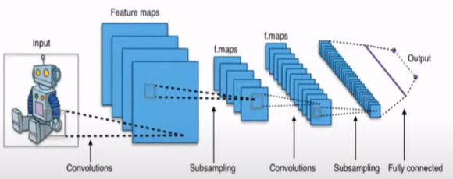
Methodology
Convolution Neural network (CNN)
CNN is a type of neural network model which allow us to extract higher representation for the image content.
unlike classical image recognition where you define the image features yourself, CNN takes the image’s raw
pixel data, trains the model, then extracts the features automatically for better classification. Convolutional
neural networks are composed of multiple layers of artificial neurons. Artificial neurons, a rough imitation of
their biological counterparts, are mathematical functions that calculate the weighted sum of multiple inputs
and output an activation value. When you input an image in a Convent, each layer generates several activation
functions that are passed on to the next layer.

Slide 11
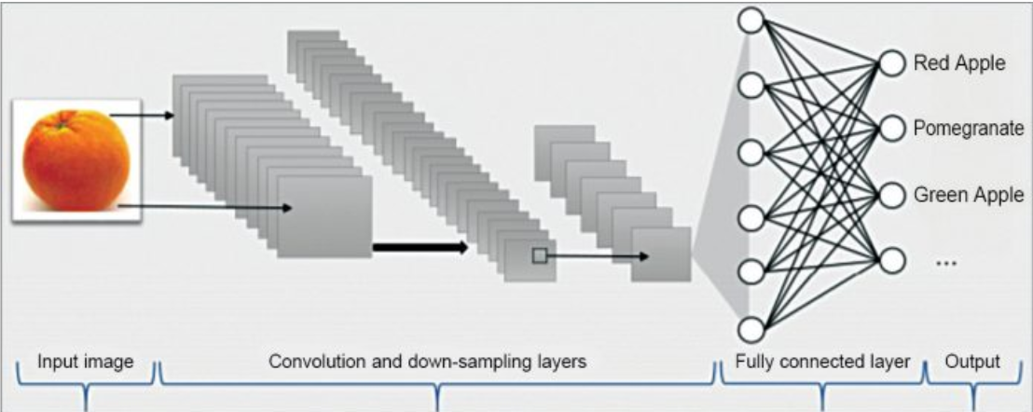

Slide 12
Software and Hardware Requirements
Software requirements :
Operating System: Windows10 Ultimate which supports networking.
Python development toolkit.
Python tool kit 3.7.1 and 3.8.0
Hardware requirements :
Hardware requirements for fruit and vegetables ripeness detection will be the same for both parties which are as follows:
Processor: Dual Core
RAM: 2 GB
Hard Disk: 320 GB
NIC: For each party

Slide 13
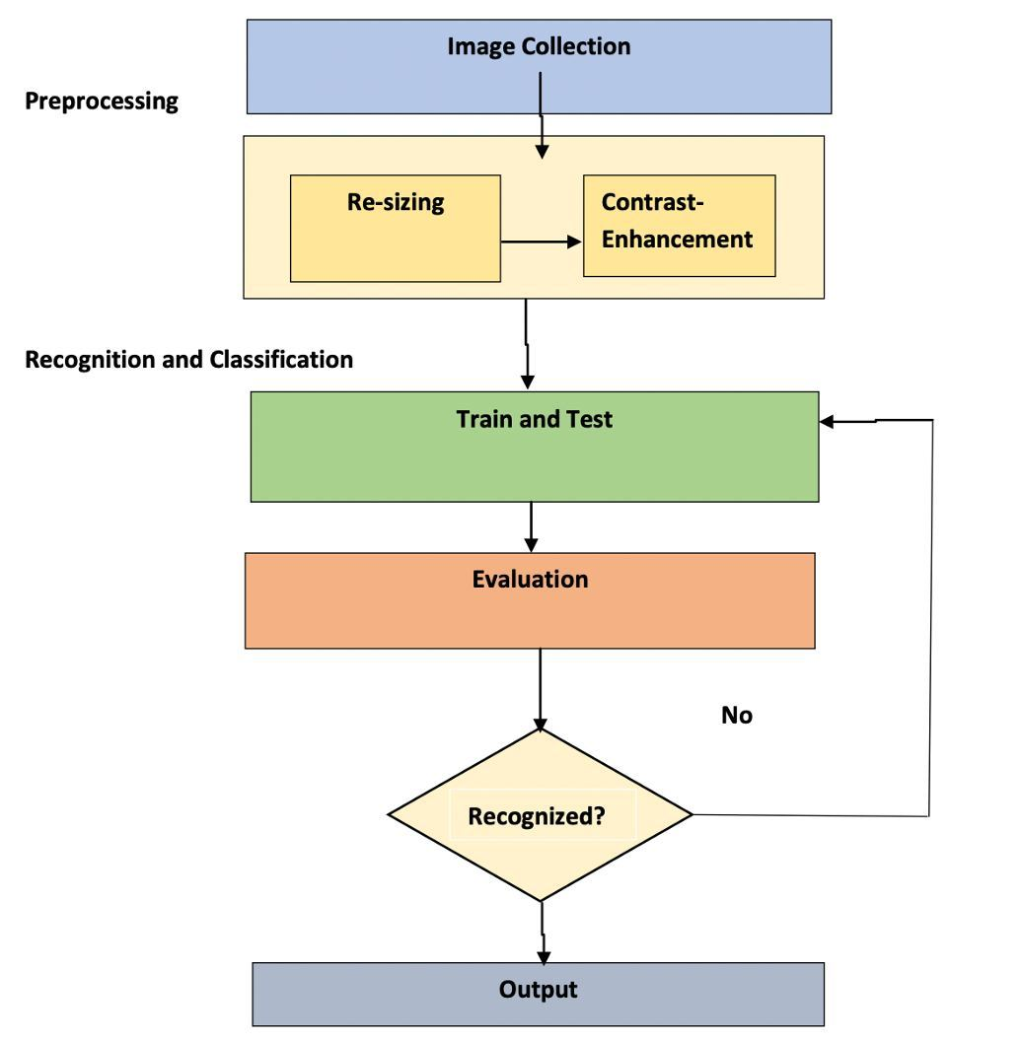
Block Diagram/Architecture

Slide 14
Results
This is a simple Flask app fitted with Deep Conv. The neural network model is able to distinguish between real-world images of Apples, Bananas, and Oranges by predicting whether the fruit in the image is Fresh or Rotten with respective probabilities.

Slide 15
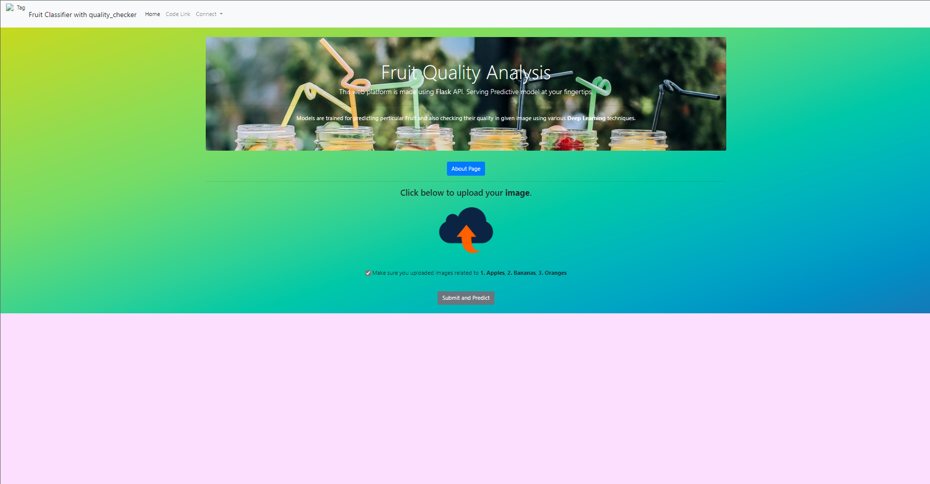
Results

Slide 16
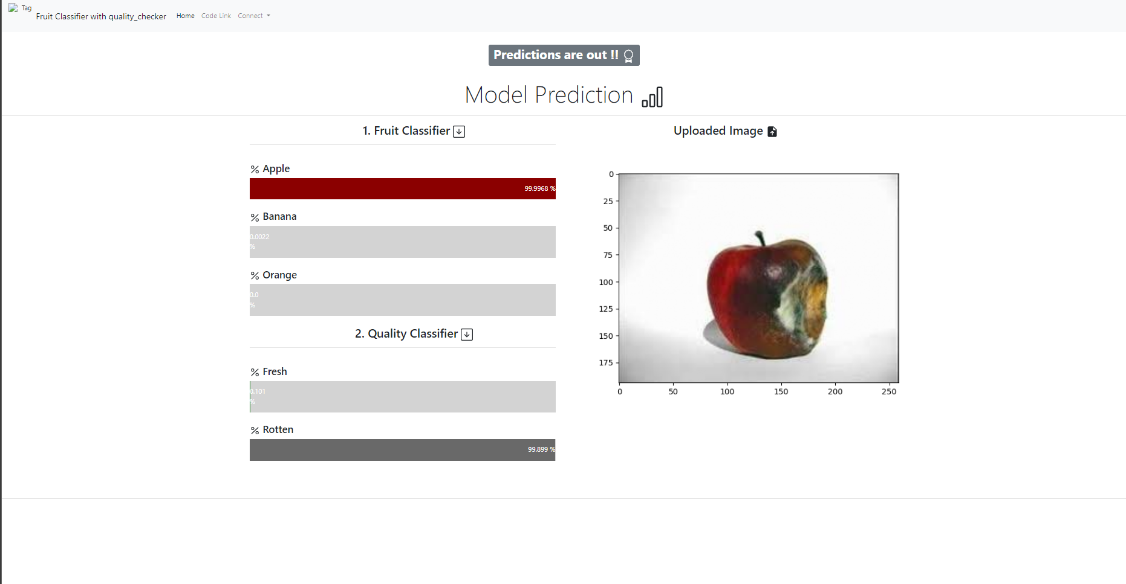
Results

Slide 17
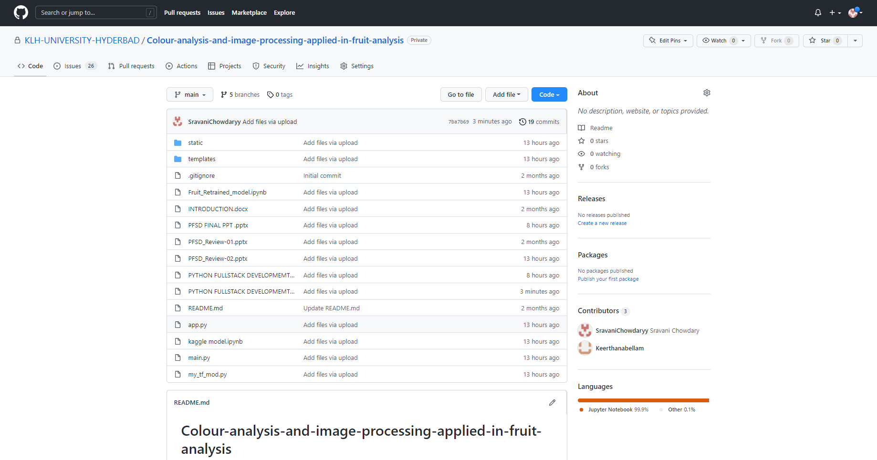
GitHub Setup

Slide 18
Applications
Fruit and vegetable classification is one of the major applications that can be utilized in supermarkets to automatically detect the kinds of fruits or vegetables purchased by customers and to determine the appropriate price for the produce.
An early detection system of fruit diseases can aid in decreasing such losses and can halt further spread of diseases.

Slide 19
Conclusion
This project explores a fruit recognition classifier based on the CNN algorithm. The accuracy and loss curves were generated by using various combinations of hidden layers for five cases using the fruits-360 dataset. The recognition rate has greatly improved throughout the experiment. This type of higher accuracy will cooperate to stimulate the overall performance of the machine more adequately in fruit recognition.

Slide 20
Future Scope
This in future can be implemented in the supermarkets. where the user can analyze the quality just by scanning it with this system and the work of looking for a bad quality fruit keenly won’t be necessary.
Further design can be modified by increasing the size of the conveyor belt so that it is possible to perform quality inspection of large fruit than tomato, and increasing the accuracy of the system so that it can differentiate between artificial, hybrid colors from original fruit color.

Slide 21
References
[1] Vartak, Akshay P., and Vijay Mankar. "Colour image segmentation-a survey." International Journal of Emerging Technology and Advanced Engineering 3, no. 2 (2013): 681-688.
[2] Dubey, Shiv Ram, and Anand Singh Jalal. "Application of image processing in fruit and vegetable analysis: a review." Journal of Intelligent Systems 24, no. 4 (2015): 405-424.
[3] Veerapur, Krutika A., and Ganesh V. Bhat. "Colour Object Tracking On Embedded Platform Using Open CV." International Journal of Recent Technology and Engineering (IJRTE) 2, no. 3 (2013).
[4] Xiaoyang Liu, Dean Zhao, Weikuan jia, Wei Ji, Yueping Sun, “A Detection Method for Apple Fruits Based on Color and Shape Features”, IEEE Access, 22 May 2019.

Slide 22
Thank You

