Slide 1
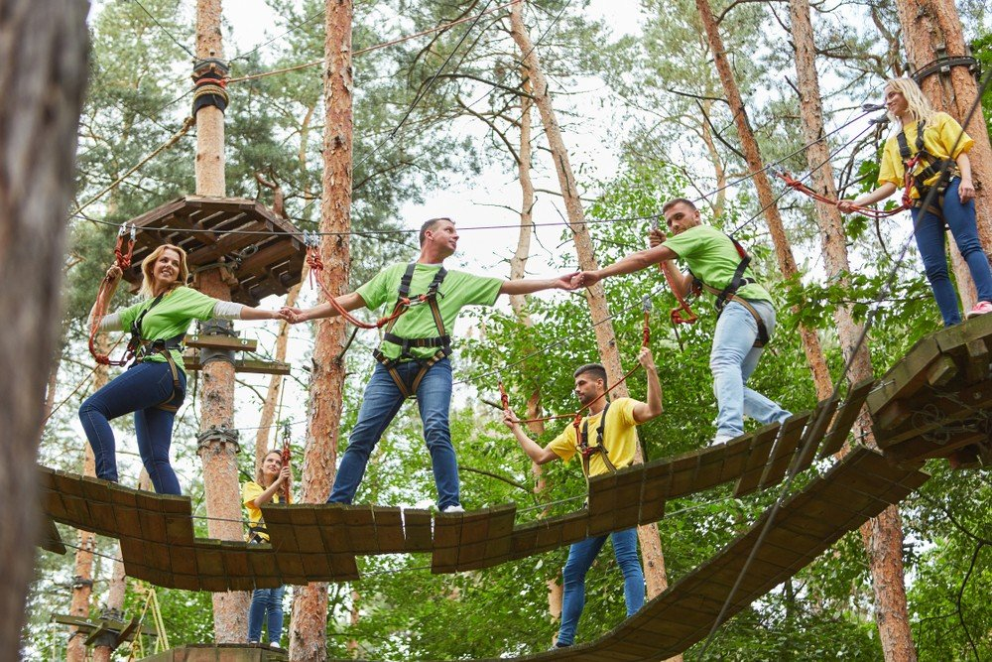

GROUP 4 | PRESENTATION
ADVENTURE
ESCAPE SA
A digital gateway to outdoor experiences across the Western Cape.
PRESENTED BY
Kabelo Kokeletso Litheko
Bongiwe Thandiwe Karabo Motona
Thando Vuyani Shongwe
Thandazile Lungile Xaba
2026

Slide 2
01 / INTRODUCTION
CONTENTS
The experience starts before the adventure
INTRODUCTION
Introducing Adventure Escape SA, a Western Cape outdoor-experience SME.
THE BRIEF
PROBLEM STATEMENT
E
O
W
PROPOSED SOLUTION
Established
What it offers
Where
KEY FEATURES
Founded in 2024. A small and medium-sized enterprise owned by Liam Daniels.
Professionally guided outdoor experiences for visitors of all ages and experience levels.
Experiences and activities throughout the Western Cape province.
FUNCTIONAL REQUIREMENTS
NON-FUNCTIONAL REQUIREMENTS
OUR PURPOSE
WIREFRAMES
Make discovering the outdoors simple, exciting and accessible, from browsing to booking.
VISUAL IDENTITY
INFRASTRUCTURE
02 | Adventure Escape SA | Group 4
Introduction
ADVENTURE ESCAPE SA

Slide 3
02 / THE BRIEF
CONTENTS
One connected digital experience
INTRODUCTION
Liam Daniels tasked Group 4 with developing a mobile application and a website.
THE BRIEF
01
Advertise
PROBLEM STATEMENT
Showcase the business, experiences and activities in an engaging way.
DESIGN PRINCIPLE
PROPOSED SOLUTION
Excitement, clarity and an adventurous identity across both platforms.
KEY FEATURES
02
Receive bookings
FUNCTIONAL REQUIREMENTS
Allow potential customers to submit booking requests through either platform.
NON-FUNCTIONAL REQUIREMENTS
03
Provide quotations
WIREFRAMES
Generate quotations based on the customer's selected experiences and activities.
VISUAL IDENTITY
INFRASTRUCTURE
03 | Adventure Escape SA | Group 4
The brief
ADVENTURE ESCAPE SA

Slide 4
03 / PROBLEM STATEMENT
CONTENTS
Problem statement
INTRODUCTION
Why the business needs a central digital platform.
THE BRIEF
PROBLEM STATEMENT
Adventure Escape SA has no central platform to advertise experiences, take bookings, or provide quotations.
PROPOSED SOLUTION
KEY FEATURES
Customers rely on slow manual enquiries, which causes:
FUNCTIONAL REQUIREMENTS
NON-FUNCTIONAL REQUIREMENTS
1
2
3
WIREFRAMES
Confusion over pricing
Lost bookings
Extra admin for the owner
VISUAL IDENTITY
INFRASTRUCTURE
04 | Adventure Escape SA | Group 4
Problem statement
ADVENTURE ESCAPE SA

Slide 5
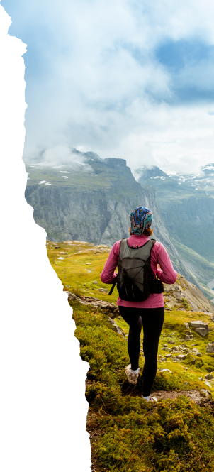
04 / PROPOSED SOLUTION
CONTENTS
Proposed solution
INTRODUCTION
A responsive website and mobile application for Adventure Escape SA.
THE BRIEF
B
Explore, compare and book online
PROBLEM STATEMENT
Customers can explore, compare and book outdoor adventure activities and packages online.
PROPOSED SOLUTION
KEY FEATURES
C
One convenient platform
FUNCTIONAL REQUIREMENTS
Individuals, families, tourists and corporate groups can access information in one place.
NON-FUNCTIONAL REQUIREMENTS
V
No visit required
WIREFRAMES
Information about available adventure activities is available without visiting the business physically.
VISUAL IDENTITY
INFRASTRUCTURE
05 | Adventure Escape SA | Group 4
Proposed solution
ADVENTURE ESCAPE SA

Slide 6
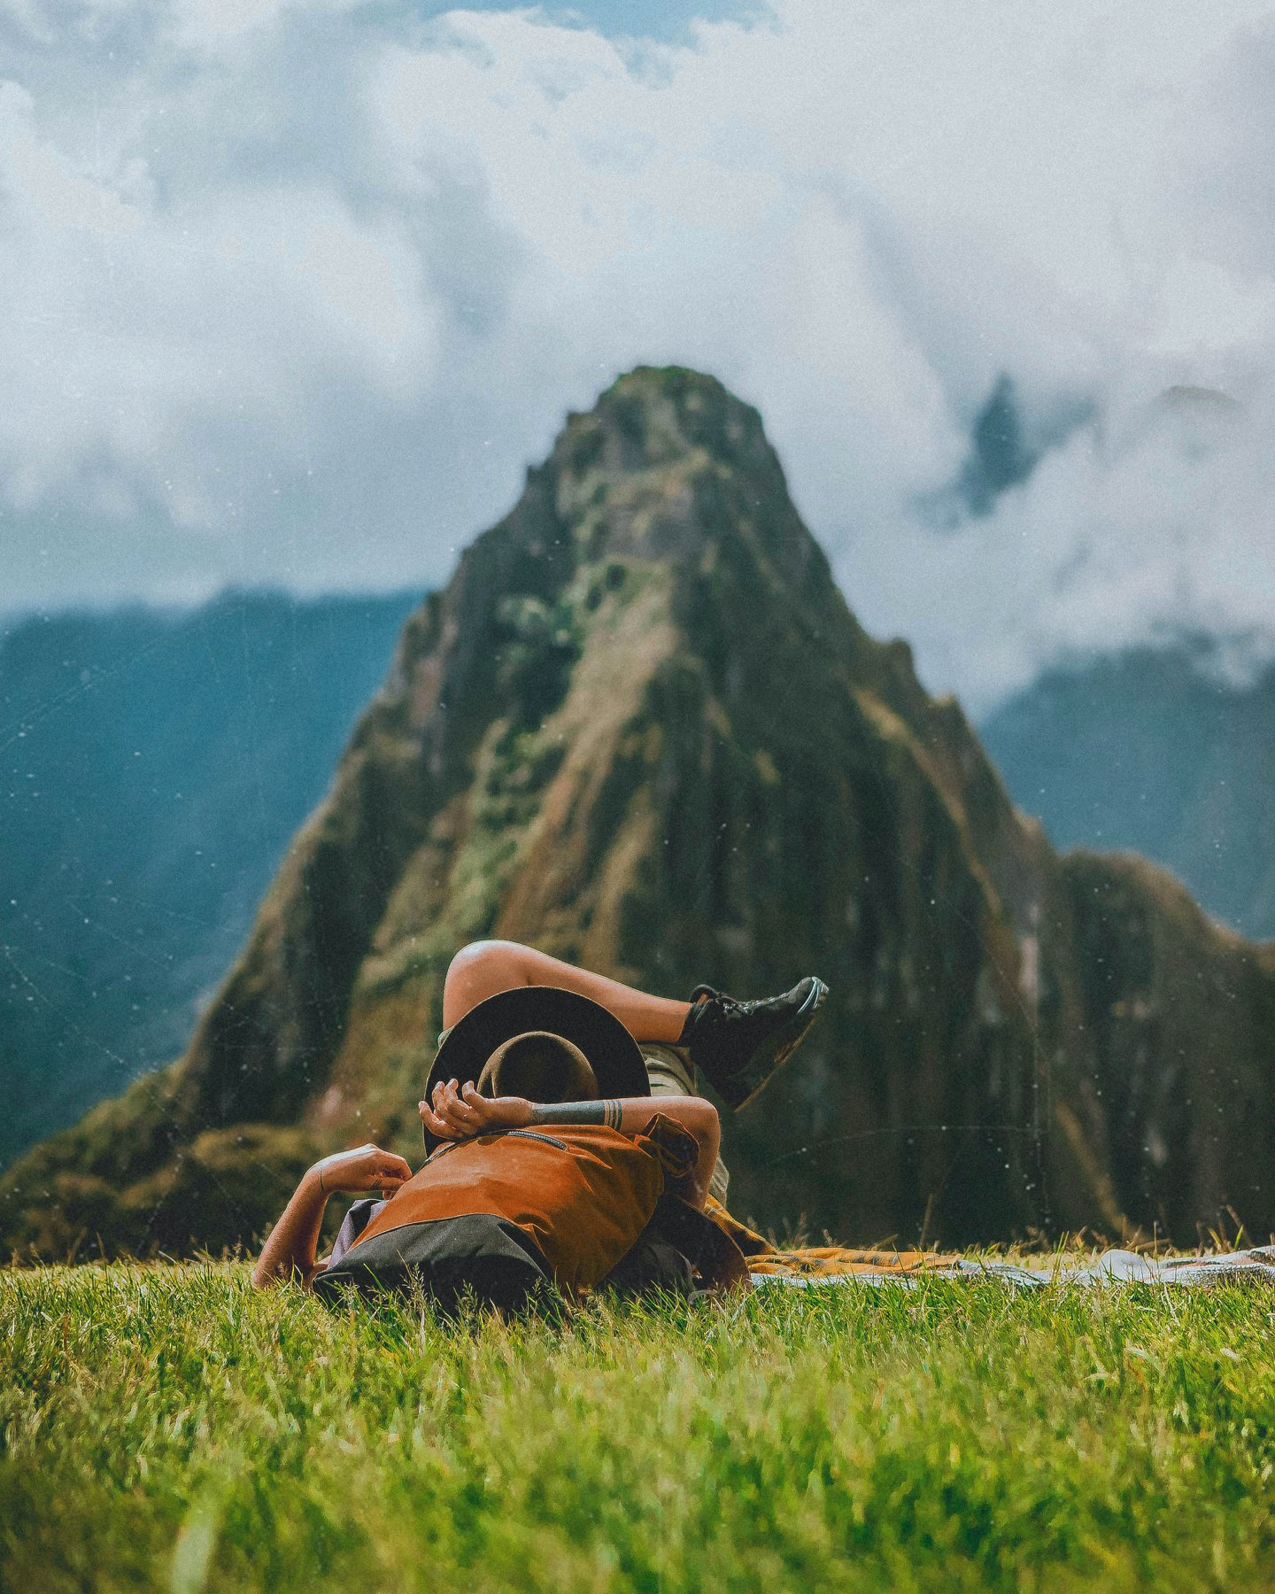
05 / KEY FEATURES
CONTENTS
Website and mobile application features
INTRODUCTION
What the website and mobile app do for a customer.
THE BRIEF
A
Adventure activities
PROBLEM STATEMENT
Display different outdoor activities such as hiking, camping, kayaking, mountain climbing and zip lining.
PROPOSED SOLUTION
KEY FEATURES
P
Adventure packages
FUNCTIONAL REQUIREMENTS
Customers can view available packages, descriptions, prices and activity details.
NON-FUNCTIONAL REQUIREMENTS
B
Online booking
WIREFRAMES
Customers can select one or more adventure packages and submit booking requests.
VISUAL IDENTITY
INFRASTRUCTURE
06 | Adventure Escape SA | Group 4
Key features
ADVENTURE ESCAPE SA

Slide 7
06 / FUNCTIONAL REQUIREMENTS
CONTENTS
Functional requirements
INTRODUCTION
What the system must do.
THE BRIEF
Functional requirement | Description
Customer registration | The system must allow new customers to create an account.
Customer login | The system must allow registered customers to log in securely.
View activities | Customers must be able to view available adventure activities.
View packages | Customers must be able to browse adventure packages, descriptions and prices.
Booking requests | The system must allow customers to submit booking requests online.
Contact form | Customers must be able to send enquiries through the website.
PROBLEM STATEMENT
PROPOSED SOLUTION
KEY FEATURES
FUNCTIONAL REQUIREMENTS
NON-FUNCTIONAL REQUIREMENTS
WIREFRAMES
VISUAL IDENTITY
INFRASTRUCTURE
07 | Adventure Escape SA | Group 4
Functional requirements
ADVENTURE ESCAPE SA

Slide 8
07 / NON-FUNCTIONAL REQUIREMENTS
CONTENTS
Non-functional requirements
INTRODUCTION
How well the system must perform.
THE BRIEF
Non-functional requirement | Description
Usability | The website and mobile application must be easy to use and understand.
Performance | The system must load pages and display information quickly without delays.
Responsiveness | The website must work on big and small screens such as smartphones, tablets and desktop computers.
Accessibility | The system must use readable fonts, good colour contrast and clear navigation.
PROBLEM STATEMENT
PROPOSED SOLUTION
KEY FEATURES
FUNCTIONAL REQUIREMENTS
NON-FUNCTIONAL REQUIREMENTS
WIREFRAMES
VISUAL IDENTITY
INFRASTRUCTURE
08 | Adventure Escape SA | Group 4
Non-functional requirements
ADVENTURE ESCAPE SA

Slide 9
08 / WIREFRAMES
CONTENTS
Website wireframes
INTRODUCTION
High- and low-fidelity wireframes for the website, designed in Figma.
THE BRIEF
PROBLEM STATEMENT
GROUP SUBMISSION
INDIVIDUAL SUBMISSION
PROPOSED SOLUTION
High- and low-fidelity wireframes
High- and low-fidelity wireframes
KEY FEATURES
Designed by Kabelo Litheko
Designed by Thandazile Xaba
FUNCTIONAL REQUIREMENTS
Open in Figma →
Open in Figma →
NON-FUNCTIONAL REQUIREMENTS
https://www.figma.com/design/kOIBcmhRg4amQqMZAz6gBj/ST10517750_Wireframes_website?node-id=0-1&t=46R9xkOfr09d3Bt7-1
https://www.figma.com/design/8GbpJHKA0fMjW96GJaJkxs/DESKTOP-WIREFRAMES?node-id=0-1&t=uma8gfYwHlzv1mRC-1
WIREFRAMES
VISUAL IDENTITY
INFRASTRUCTURE
09 | Adventure Escape SA | Group 4
Wireframes
ADVENTURE ESCAPE SA

Slide 10
09 / WIREFRAMES
CONTENTS
Mobile app wireframes
INTRODUCTION
High- and low-fidelity wireframes for the mobile application, designed in Figma.
THE BRIEF
PROBLEM STATEMENT
GROUP SUBMISSION
INDIVIDUAL SUBMISSION
PROPOSED SOLUTION
High- and low-fidelity wireframes
High- and low-fidelity wireframes
KEY FEATURES
Designed by Thando Shongwe
Designed by Bongiwe Motona
FUNCTIONAL REQUIREMENTS
Open in Figma →
Open in Figma →
NON-FUNCTIONAL REQUIREMENTS
https://www.figma.com/design/YkJvGZFd0f2cgQtgNGVSE2/XHAW?node-id=5-16&t=cIyallngpfduoahF-1
https://www.figma.com/design/qhwMyV8QQbHZbpyMfTDvxt/adventure-escape-sa-wireframes?node-id=0-1&t=FfF4oFJiQNZeNWmW-1
WIREFRAMES
VISUAL IDENTITY
INFRASTRUCTURE
10 | Adventure Escape SA | Group 4
Wireframes
ADVENTURE ESCAPE SA

Slide 11
10 / VISUAL IDENTITY
CONTENTS
Bushveld Blaze
INTRODUCTION
Grounded in nature, made for adventure. The group selected the bushveld blaze color palette as the final colour theme.
THE BRIEF
PROBLEM STATEMENT
PROPOSED SOLUTION
Forest green
Bright orange
Coral
White
Charcoal
KEY FEATURES
Primary
Energy / calls to action
Warmth / playfulness
Open space
Readable text
#144530
#F28B20
#E7705B
#FFFFFF
#2B302D
FUNCTIONAL REQUIREMENTS
NON-FUNCTIONAL REQUIREMENTS
VISUAL DIRECTION
CHOSEN LOGO
Bold • outdoors-inspired • clean • welcoming
WIREFRAMES
VISUAL IDENTITY
INFRASTRUCTURE
11 | Adventure Escape SA | Group 4
Visual identity
ADVENTURE ESCAPE SA

Slide 12
11 / PROPOSED INFRASTRUCTURE
CONTENTS
Built with tools the team knows
INTRODUCTION
The proposed approach prioritises a manageable build and a clear foundation for future features.
THE BRIEF
PROBLEM STATEMENT
M
Mobile app
W
Website
H
Hosting
Kotlin • Android Studio
HTML • CSS • JavaScript
GitHub Pages
PROPOSED SOLUTION
Native Android application
Responsive catalogue, booking cart and quotation logic
Free, simple static website hosting
KEY FEATURES
FUNCTIONAL REQUIREMENTS
D
Design
C
Collaboration
NON-FUNCTIONAL REQUIREMENTS
Figma
GitHub
Wireframes and interactive prototypes
Version control and team collaboration
WIREFRAMES
VISUAL IDENTITY
The mobile app is planned as a native Android build.
INFRASTRUCTURE
12 | Adventure Escape SA | Group 4
Infrastructure
ADVENTURE ESCAPE SA

