Slide 1

FINAL PROJECT ON CS0007- Algorithms
FINAL PROJECT ON CS0007- Algorithms
Albert Josh Dizon
Mark Danhill Egana
Rajan Elio N21
Fabian, Abraham Israel

Slide 2

Selection
Sort
Selection
Sort
Selection sort is a simple sorting algorithm. This sorting algorithm is an in-place comparison-based algorithm in which the list is divided into two parts, the sorted part at the left end and the unsorted part at the right end. Initially, the sorted part is empty and the unsorted part is the entire list.
Worst complexity: n^2
Average complexity: n^2
Best complexity: n^2
Space complexity: 1
Method: Selection
Stable: No
Class: Comparison sort

Slide 3
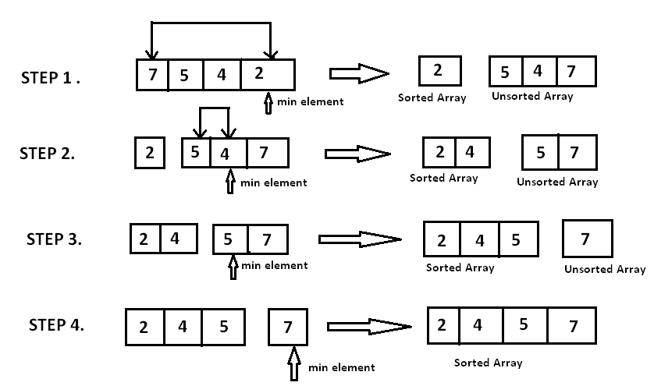
Steps:
Steps:

Slide 4
Bubble Sort
Bubble Sort
Bubble sort, sometimes referred to as sinking sort, is a simple sorting algorithm that repeatedly steps through the list, compares adjacent elements and swaps them if they are in the wrong order. The pass through the list is repeated until the list is sorted.
Worst complexity: n^2
Average complexity: n^2
Best complexity: n
Space complexity: 1
Method: Exchanging
Stable: Yes
Class: Comparison sort

Slide 5
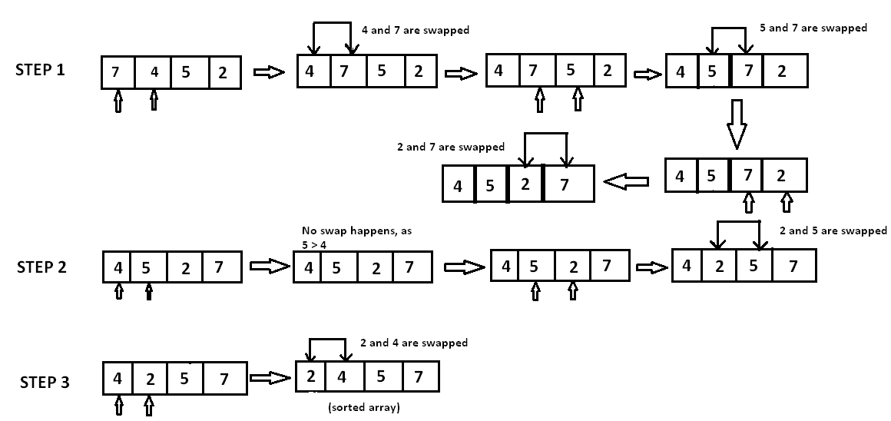
Steps:
Steps:

Slide 6
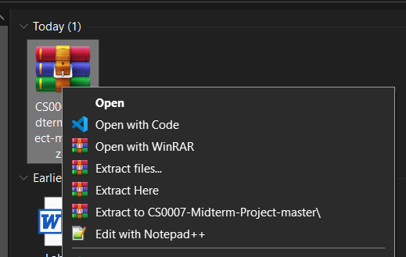

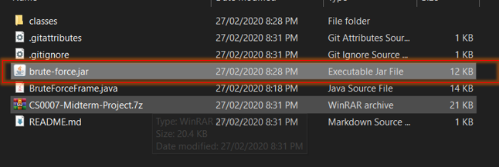
Steps in extracting resources
Steps in extracting resources
1
2
STEP 1 – Download “CS0007-Midterm-Project-master.zip” and extract the files.
STEP 2 – Open the folder.
STEP 3 – Open the folder and extract the contents of “CS0007-Midterm-Project.7z”.
STEP 4 – Open the “brute-force.jar”, the executable jar file.
3
4

Slide 7
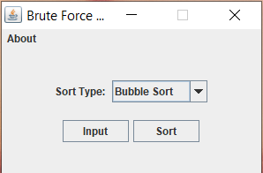
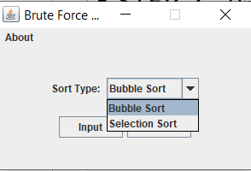
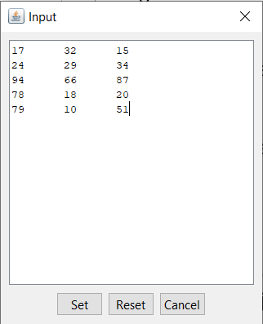
Steps in extracting resources
Steps in extracting resources
STEP 1 – choose preferred sorting algorithm from the drop-down menu bar.
NOTICE: You can re-use the same input, just select the sort type and sort again.
: Bubble Sort: Sorts the input using Bubble sort Algorithm. : Selection Sort: Sorts the input using Selection sort Algorithm.
STEP 2 – Press the input button.
STEP 3 – Type integers in any format(row or column) separated by a white space then press SET.
NOTICE: Only insert integers or it will issue an error.
: Reset Button clears the input in the field. : Cancel Button returns you to the main screen.
STEP 4 – Click the sort button.
2
1
3
4

Slide 8
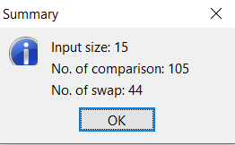
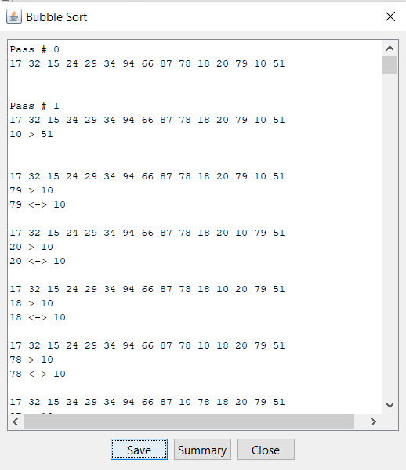
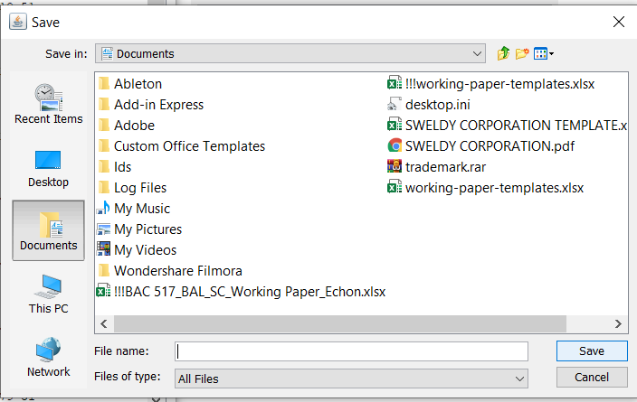
Steps in extracting resources
Steps in extracting resources
STEP 5 – View the passes and steps to sorting by scrolling through the window
NOTICE:
Pressing the summary button would show you the input size, number of comparisons and number of swaps
Pressing the Save button would prompt you to save the result as a text file for further use.
Pressing the Close Button would return you back to the main screen

Slide 9
Bubble Sort
Sample Simulations
Bubble Sort
Sample Simulations

Slide 10
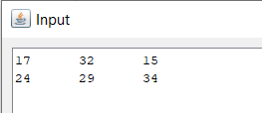
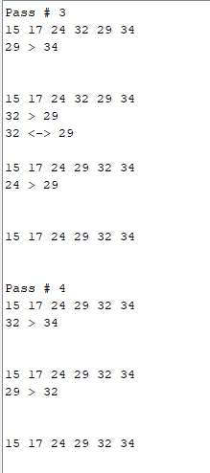
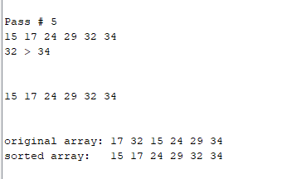
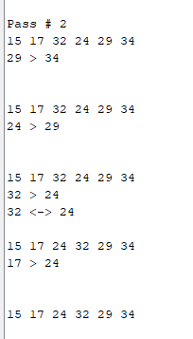
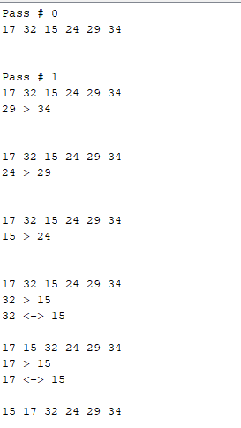
1st Sorting Simulation Right to Left
1st Sorting Simulation Right to Left

Slide 11
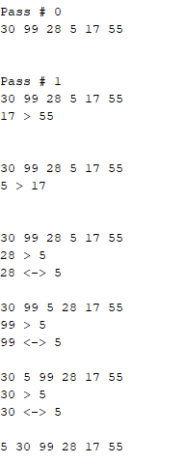
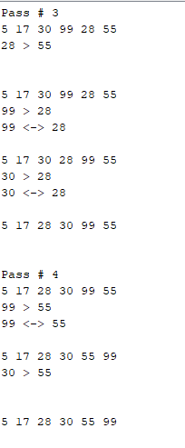
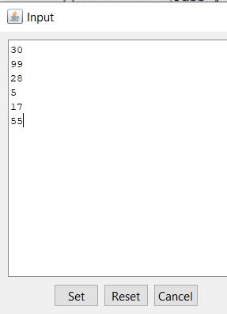
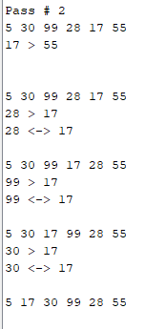
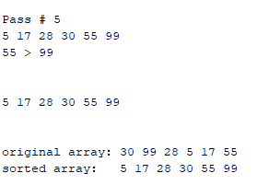
2nd Sorting Simulation Right to Left
2nd Sorting Simulation Right to Left

Slide 12
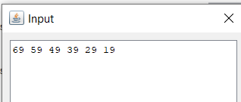
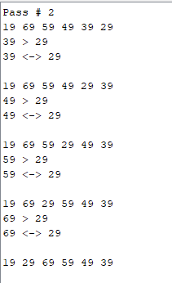
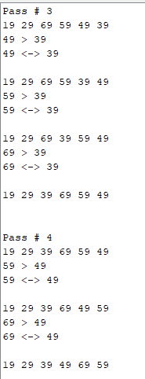
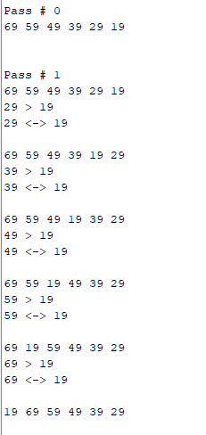
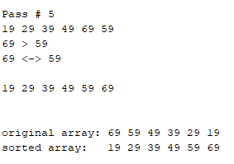
3rdSorting Simulation Right to Left
3rd Sorting Simulation Right to Left

Slide 13
Selection Sort
Sample Simulations
Selection Sort
Sample Simulations

Slide 14
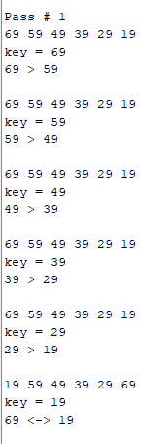
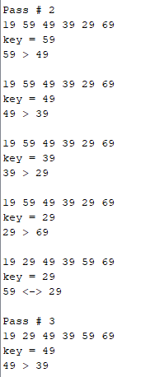
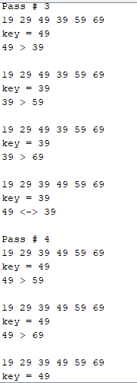
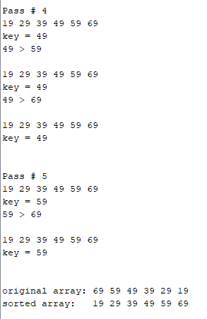
1st Sorting Simulation
1st Sorting Simulation

Slide 15
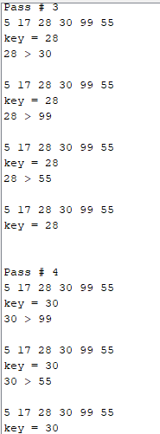

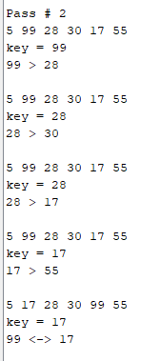
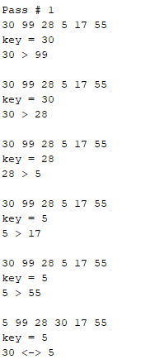
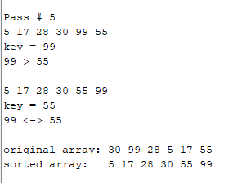
2nd Sorting Simulation
2nd Sorting Simulation

Slide 16

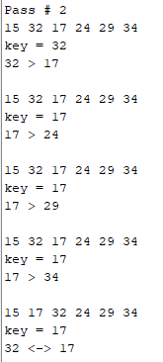
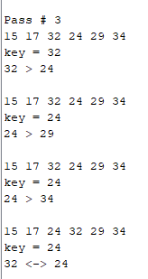
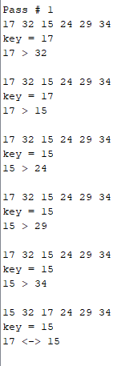
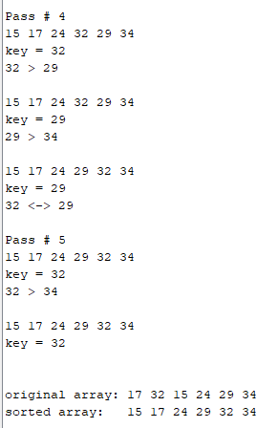
3rdSorting Simulation
3rd Sorting Simulation

Slide 17
Thank you!
Thank you!

