Slide 1
Stage Top bio-containment with consideration for a BSL-3 Lab

Slide 2
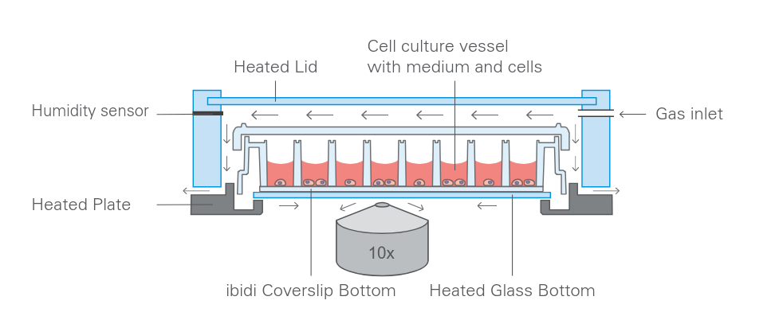
The Goal:
Live-Cell Imaging of Microbes in BSL-3 Labs
Low Cost Equipment
Stage-Top Incubator Format
The Problem:
Commercial Incubators not BSL-3 Containment viable
Commercial Incubators not Suitable for Autoclave Sterilisation
Commercial Incubators are Costly
Notes:
It would be beneficial to perform long-term live cell imaging of microbes such as Mtb to observe the long term behaviour. A simple and low cost solution would be to live monitor these cultures using a low cost microscope such as the Iolight microscope, however typically this would require having a small sealed plate which can be placed on the microscope, and then the entire microscope is placed inside a conventional incubator to allow the cells to grow.
This is not ideal for several reasons:
Complicates the sterility/containment procedure
Takes up significant space in the incubator, thus limiting the functionality of both the incubator and number of observations that can be done at one time
Introduces significant variance in the culture environment and optical results since the incubator introduces lots of vibrations, and temperature stability is dependant on the usage of the incubator.
Limits the ability to log incubator data continuously during the observation
Current stage top incubator systems such as the Zeis/Pecon stage top incubator, Ibidi stage top incubation system and the Tokai Hit system provide very good control of their stage top incubators that are designed to fit with industry standard microscope stages, such as the k-type. However they lack the critical feature of being fully sealed to prevent contamination.
These three solutions all encorperate a design where the Gas flow (CO2/O2/humidity controlling gas flow) is meant to flow through the chamber and then pasivly get exhausted around the bottom of the container through gaps and holes in the incubator. This is not ideal in a BSL-3 environment as it leads to workspace contamination.
Therefore this project is aiming to try and determine if it is viable to produce a product that could function as a fully contained incubator whilst still fitting ontop of a microscope stage, which allows for research of long term cell performance, whilst being placed on worktop outside of a standard incubator and being fully contained to meet BSL-3 standards.

Slide 3
The project goal
Immediate Goals
Determine feasibility of designing a stage-top bio-containment system suitable for BSL-3
Identify basic specifications required for the design of a BSL-3 Incubator
Future Goals
Design and prototype a temperature controlled incubator that can operate in a BSL-3 lab.
Determine feasibility of including CO2/O2 concentration control
Notes:
The current scope of this project is limited to just determining the feasibility of designing an incubator with basic temperature control that can be used in a BSL-3 lab. For feasibility:
Commercial solutions are assessed to determine the functionality that is offered by them, aspects that prevent them form working in a BSL-3 Lab. ETC
Determine the containment requirements that allow a containment system to function within a BSL-3
Determining the environmental control specifications required to obtain sufficient incubation.
Determine the sterilization techniques that are required for a BSL-3 lab
A part of determining the feasibility of this system, is to determine if it is possible to hermetically seal a culture vessel within a container whilst still allowing for optical viewing.
This includes:
Prototyping an enclosure which holds a 96 well plate.
Prototyping an enclosure which offers complete hermetic seal comparable to an IP68 enclosure
Prototyping an enclosure which provides suitable optical clarity for low magnification microscopy
If it is feasible to begin prototyping and performing a conceptual design, the eventual goal is the following:
Prototype a stage top incubator that is completely hermetically sealed.
Prototype a stage top incubator that can maintain a stable temperature required for cell growth.
Prototype a stage top incubator that is capable of being sterilized using existing BSL-3 protocols.
Prototype a stage top incubator that can fit ontop of a low magnification microscope for long term live cell imaging
Allow for the possibility of CO2/O2/Humidity regulation
Allow for the possibility of compatibility with several different culture dishes.

Slide 4
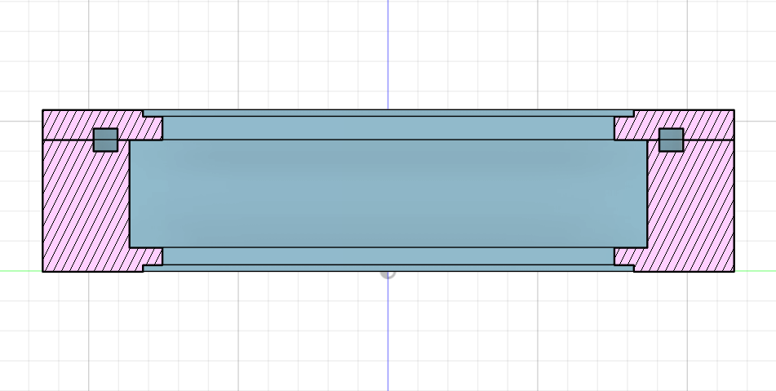
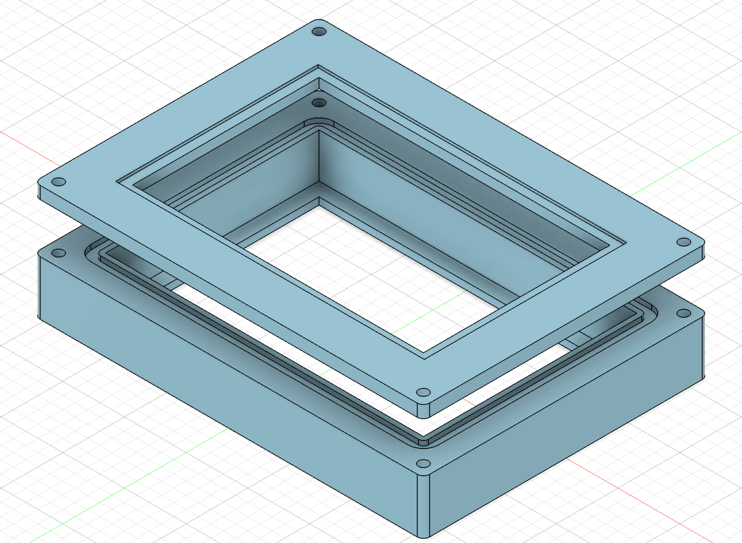
Prototyping V1
O-Ring Groove
Top and Bottom Plate Insert
Plate Cavity
Secured Using Bolts
Notes:
First Round used a simple box design with a cavity that seats the multi-well plate.
The box will use plates on the top and bottom that are set in place using epoxy or glue sealant. These will be either both glass, or glass and aluminum plate.
This design uses a rudimentary grove based into both the lid and base with sharp corners for an o-ring.
The entire plate will be completely sealed within the chamber using the two plates on the outer surfaces, as well as the o-ring that sits in the groove.

Slide 5
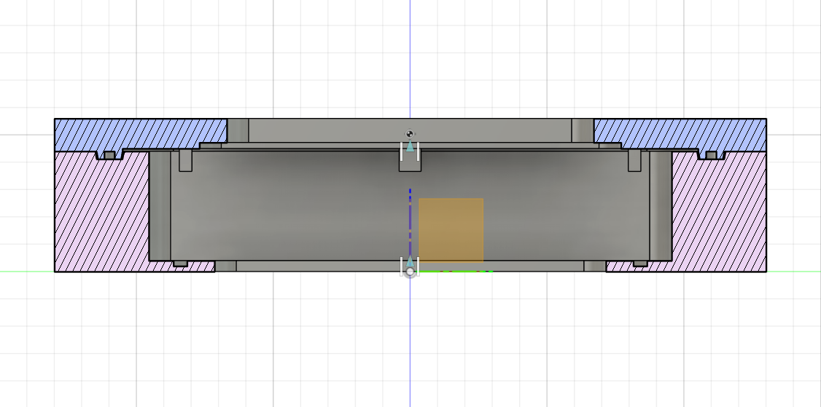
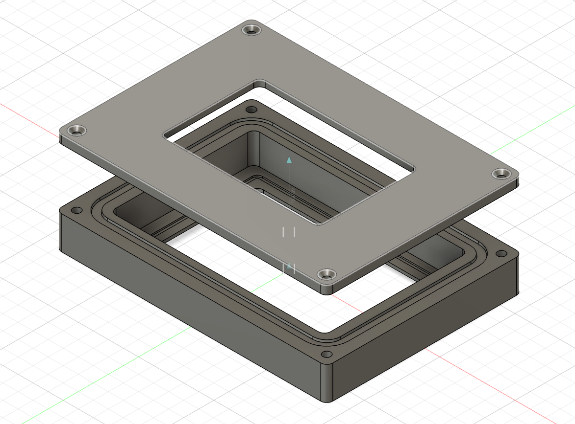
Prototyping V3.3
Recessed O-Ring Groove
Plate Lid Standoffs
Plate Cavity
Sealing Plate Recess
Top Plate Insert
Un-Obscured
Viewing port
Secured Using
Counter Sunk Screws
Notes:
After 2 rounds of revision the latest edition updates and improves several parts
O-Ring groove has been revised to use a recessed design that allows for aligned mating of lid and base
Bottom viewing plate removed and top viewing plate insert moved to inside of lid for better pressure seals.
Base uses a groove that seals against the base of the multi-well plate to allow for more direct optical viewing
Lid includes standoffs to press the plate into the base for sealing.
The lid is mounted to the base using a counter sunk screw and a threaded insert in the base.

Slide 6
Summary & Future Improvements
Silicone O-Ring Used to Seal Lid
Silicone Gasket Used to Seal Base
Compatible with Greiner Multi-well plates
Secured using countersunk screws
Unobstructed viewing from Top and Bottom
Screw Mounting Tedious, and Supply Insufficient Mounting Pressure
New Mechanism to Apply pressure to Multi-Well Plate
Two Sealant Mechanisms Sub-Optimal
Provisions for Gas and Temperature Control

Slide 7
Product overview
Combining functionality and user-friendliness, we empower users to streamline operations and boost efficiency

Slide 8

Product benefits
Increased productivity
Seamless integration
Enhanced user experience
Scalability for future growth
User-friendly learning

Slide 9

Market overview

Slide 10

market comparison
Stands out in market
Innovative features
Provides unique solution
Edge over competitors
User-focused design
Prioritizes user experience

Slide 11
Growth strategy
Expand market reach through strategic partnerships
Enhance product features based on user feedback
Explore international market opportunities
Expand
Foster collaborative growth
Enhance
Ensure a tailored and user-focused experience
Explore
Capitalize on emerging global markets

Slide 12
Traction
Product launch
Successful introduction of our product to market
10,000 user milestone
Substantial user base, indicating growing demand
Strategic partnership
Expanding market presence and capabilities
Milestone | Quarter
Product launch | Q1
10,000 user milestone | Q2
Strategic partnership | Q3
Campaign launch | Q4

Slide 13
Financials
Quarter | Revenue ($) | Expenses ($) | Net profit ($)
Q1 | $200,000 | $150,000 | $50,000
Q2 | $300,000 | $200,000 | $100,000
Q3 | $400,000 | $250,000 | $150,000
Q4 | $300,000 | $200,000 | $100,000

Slide 14
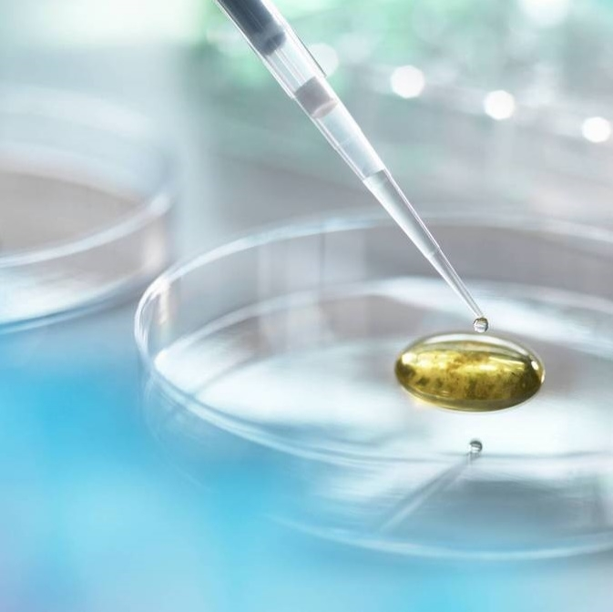
Thank you
Aidyn zhanbolat | Aidyn@adatum.com | www.adatum.com

