Slide 1
MS2 TECHNICAL DEMO
VSS
Vectorized Signal Star
A SIMD-lite extension of the StarCore-1 RISC core
EEE4120F HPES Project · 2026
Group 7
Joab Gray Kloppers KLPJOA002
Alex Hillman HLLALE010
Justin Heathcote-Marks HTHJUS001

Slide 2
Twice the byte throughput.
One instruction.
VSS adds a single SIMD-lite extension to the Practical 4 StarCore-1: a new VECTOR opcode that splits the 16-bit ALU into two independent 8-bit lanes. Built for the byte-packed workloads embedded telemetry lives on — sensor fusion, status masks, threshold compares — where the scalar core wastes most of its cycles unpacking and repacking.
2 / 13

Slide 3
The problem with scalar on packed data
Why specialise the StarCore-1 at all?
StarCore-1 (baseline)
VSS (this work)
Two bytes packed in one register? You pay 5–8 instructions per pair.
One instruction, both bytes, one cycle.
; add packed pairs A, B
AND R1, A, 0xFF00 #Mask upper 8 Bits For A
AND R2, A, 0x00FF #Mask Lower 8 Bits For A
AND R3, B, 0xFF00 #Mask upper 8 Bits For B
AND R4, B, 0x00FF #Obtain upper 8 Bits For B
ADD R5, R1, R3 #Add upper 8 Bits
ADD R6, R2, R4 #Add lower 8 Bits
OR R7, R5, R6 #Mask The Two Together
7 cycles per byte-pair
; add packed pairs A, B
VADD R7, A, B
1 cycle per byte-pair
Telemetry payloads pack two ADC channels or status bytes per 16-bit word. The scalar core spends most of its life moving bits around — VSS does the actual work instead.
VSS · Group 7 · EEE4120F HPES 2026
3 / 13

Slide 4
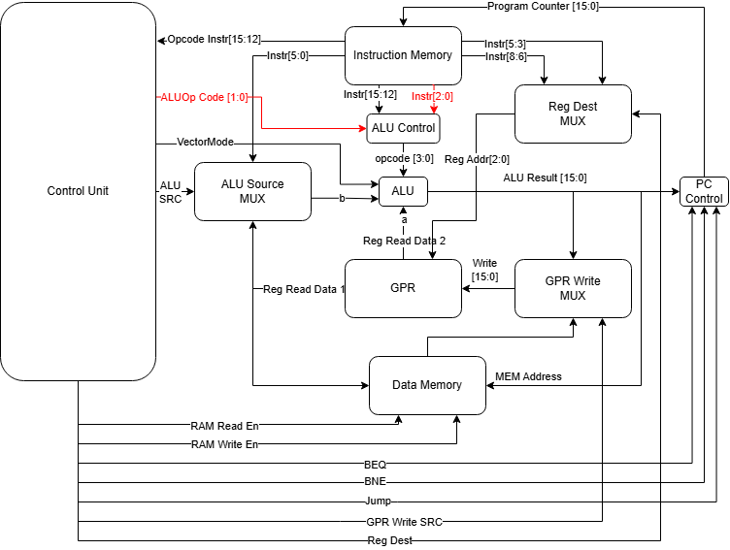
The StarCore-1 datapath with VSS modifications
Red signals are new for VSS; everything else is unchanged from Practical 4.
What's new
vector_mode
New 1-bit signal from Control Unit. Switches ALU between scalar and 2 × 8-bit lane mode.
ALUOp = 2'b11
New encoding (ALUOP_VECTOR). Tells ALU_Control to bypass the opcode decode table.
funct[2:0]
instr[2:0] of the VECTOR instruction; passes straight through to alu_control.
opcode 4'b1110
VECTOR instruction. R-type-like register addressing, writes ALU result back to register file.
VSS · Group 7 · EEE4120F HPES 2026
4 / 13

Slide 5
Three modules
The smallest possible edit that delivers a real SIMD extension.
ALU.v
ALU_Control.v
ControlUnit.v
Lane-split arithmetic
Funct passthrough
New opcode + mode bit
Dual case-statement: vector_mode = 0 keeps the original 16-bit ops; vector_mode = 1 splits a, b and result into independent {hi, lo} 8-bit lanes. The carry chain between bits 7 and 8 is broken by construction — each lane evaluates as its own 8-bit expression.
Added one casex pattern: 6'b11xxxx → ALU_Cnt = funct. When ALUOp = 2'b11 the funct field bypasses the opcode decode table entirely. Every baseline pattern from Practical 4 is unchanged.
Added case for opcode 4'b1110 (VECTOR): R-type-like register addressing, ALUOp = 2'b11, and assertion of the new vector_mode output. All other opcodes safely default vector_mode to 0.
+ vector_mode input
+ 8 SIMD-lite ops
+ funct[2:0] input
+ ALUOP_VECTOR case
+ vector_mode output
+ OP_VECTOR case
VSS · Group 7 · EEE4120F HPES 2026
5 / 13

Slide 6
The VECTOR instruction
One opcode, eight operations, zero impact on existing instructions.
Instruction encoding (16 bits)
1110
RS1
RS2
WS
funct
opcode [15:12]
[11:9]
[8:6]
[5:3]
[2:0] → ALU op
funct[2:0] selects the vector operation
funct | Mnemonic | Behaviour (when vector_mode = 1)
000 | VADD | lane-wise add
001 | VSUB | lane-wise sub
010 | VINV | bitwise NOT of operand A
011 | VSHL | per-lane shift left (b[11:8] | b[3:0])
100 | VSHR | per-lane shift right (b[11:8] | b[3:0])
101 | VAND | bitwise AND
110 | VOR | bitwise OR
111 | VSLT | per-lane set-less-than (unsigned)
Reusing the ALU's existing 3-bit operation encoding for funct means ALU_Control needs no new decode logic — it just forwards the bits. Opcode 4'b1010 (the brief's reserved coprocessor slot) is deliberately left untouched.
VSS · Group 7 · EEE4120F HPES 2026
6 / 13

Slide 7
Gold standard: software reference vs hardware DUT
Two independent implementations. If they agree, the hardware matches the spec.
Verification flow
vss_golden.py · alu_vector(a, b, op)
1
Python golden model
def alu_vector(a, b, op):
a_hi, a_lo = (a >> 8) & 0xFF, a & 0xFF
b_hi, b_lo = (b >> 8) & 0xFF, b & 0xFF
if op == ADD:
hi = (a_hi + b_hi) & 0xFF # carry trapped
lo = (a_lo + b_lo) & 0xFF # wraps in-lane
elif op == SUB:
hi = (a_hi - b_hi) & 0xFF
lo = (a_lo - b_lo) & 0xFF
...
return ((hi << 8) | lo) & 0xFFFF
vss_golden.py — independent reference implementation of the VSS ALU spec.
2
Test vector list
14 ALU + 16 ALU_Control + 9 ControlUnit cases, covering scalar regression and every vector op.
3
Verilog testbench
Drives the same vectors into the DUT, compares to expected values, prints PASS/FAIL.
4
VCD waveform
$dumpvars captures every signal — GTKWave shows the lane split visually.
VSS · Group 7 · EEE4120F HPES 2026
7 / 13

Slide 8
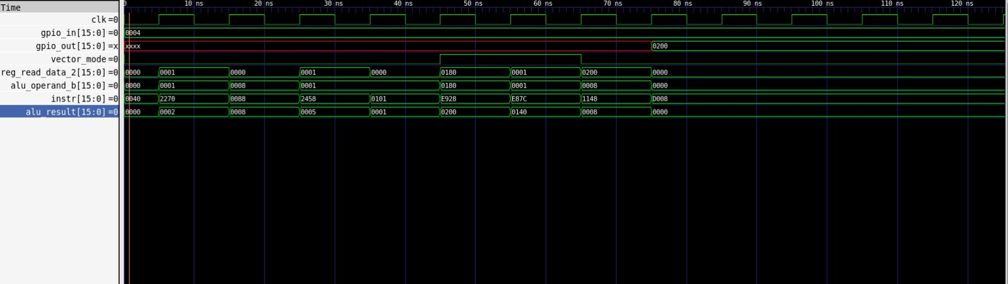
Waveform proof:
Same operands, two cycles. The signal trace makes the lane split self-evident.
VSS · Group 7 · EEE4120F HPES 2026
9 / 13

Slide 9
Live demo — what we'll run now
.
1
YODA_tb.v
Star-Core 1 with SIMD
1Adapting Star-Core 1 Normal Test bench
2
gtkwave
Waveform inspection
VSS · Group 7 · EEE4120F HPES 2026
11 / 13

Slide 10
VSS, in one slide
What we built
What we proved
What's next
A SIMD-lite extension of StarCore-1: one new opcode, one new mode signal, 8 vector operations sharing the existing 3-bit ALU encoding.
39 of 39 module-level golden tests pass. Scalar regression is zero. The lane split is visible on the waveform between bits 7 and 8.
Top-level integration with the unchanged Practical 4 datapath, then memory-mapped I/O for telemetry ingest. Per-lane masks and saturation as stretch goals.
12 / 13

Slide 11
Thank you.
Questions?
Group 7 · EEE4120F HPES Project · 2026
Joab Gray Kloppers (KLPJOA002) · Alex Hillman (HLLALE010)

