Slide 1

Geospatial Analysis Using the Google Maps API
November 15th, 2022
Employment and Training Administration (ETA)
Office of Policy Development and Research (OPDR)
Notes:
Hi everyone! Thanks for taking time out of your day to join this presentation. Today I’ll be demonstrating how to use the Google Maps API to conduct geospatial analysis.

Slide 2

Agenda
Geocoding and Geospatial Analysis
Google Maps API Overview
Analysis Overview
Visualizing Results
Take Aways
Q + A / Code Demonstration
Notes:
Before I get to that however, I will start with a brief recap on geocoding and geospatial analysis. Then I will talk a little bit about the google maps API and what functionality is available through it. Then I’ll walk through the analyses I conducted at a conceptual level and discuss some of the results. Finally, I’ll summarize some of the key takeaways and close with Q&A. If folks are interested, we can also use some time at the end to walk through the actual code I used.

Slide 3
Review: Benefits of Geocoding APIs
Validation provides an assurance the location is recognized, valid
You likely encountered real time location validation in e-commerce
Standardization in format and content for widest set of use cases
Supports search by address components, record linkage, broad public use
Geocoding turns addresses into points that are useful analytically
Supports mapping, GIS apps, wide range of computations
Quality Assessment: identifies scope/severity of problematic data
Objective, practical data quality appraisal (Can I find that address on a map?)
Distinguish valid data from data that can’t identify a specific location
Ensures “good” data are fit for the widest array of purposes
Notes:
I’d like to begin by recapping some of the information that Scott shared a few meetings ago about the benefits of address geocoding and standardization webservices. In that presentation he walked through a couple of related concepts such as validation (assuring that a location is valid and recognized), standardization (converting address information into a format and content for the widest set of use cases), and quality assessment (identifying scope / severity of problematic data). Today, however, we will be focusing primarily on geocoding – which refers turning addresses into points that are useful analytically (usually latitude longitude coordinates). This conversion supports a number of use cases including mapping, GIS apps, and a wide range of analytical tasks.

Slide 4
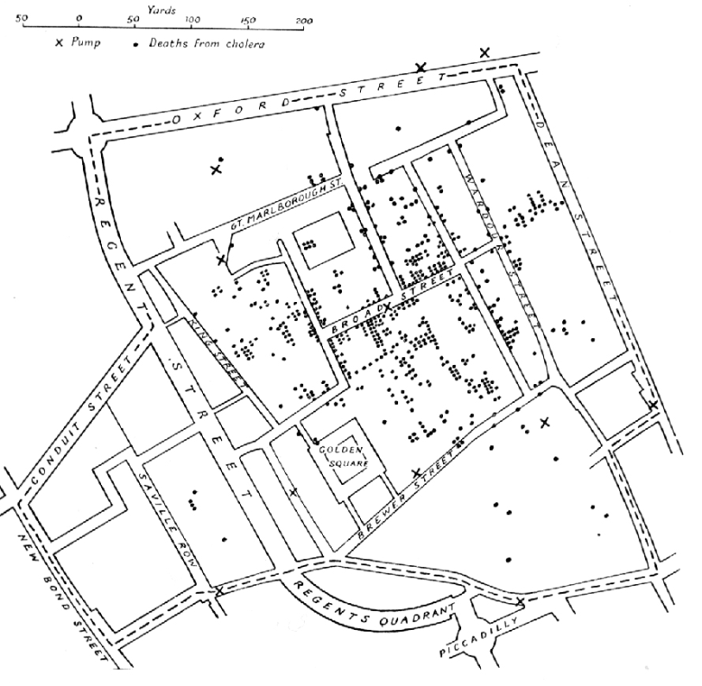
Geospatial Analysis
Collecting, combining, and visualizing datasets which contains geographic or geospatial elements
Can be used to model and represent how people, objects, or phenomena interact within physical space
Can be used to make predictions or observe trends
Notes:
At it’s most basic, geospatial analysis refers to Collecting, combining, and visualizing datasets which contains geographic or geospatial elements. It can be used to model and represent how people, objects, or phenomena interact within physical space. It can also be used to make predictions or observe trends
To demonstrate how powerful this can be I want to go back to one of the earliest examples of geospatial analysis. In 1854 London was in the midst of a cholera epidemic. At that time people did not know what the causes of the disease was or how it spread. Skeptical of unscientific explanations, Dr. John Snow (no relation to game of thrones) decided to map the deaths from cholera – his map is shown on the right. He marked deaths from cholera with dots and water pumps with X’s. From observing the patterns on this map he could quickly see that most of the cases tended to cluster around broad street, and particularly the broad street pump. This lead him to hypothesize that drinking water was related to the outbreak and prompted authorities to disable the well pump. Soon afterwards the epidemic began to subside in that area.
Geospatial analysis enabled John Snow to correctly hypothesize the causes of the epidemic from seemingly random data, and in the process founded the study of epidimeology.

Slide 5
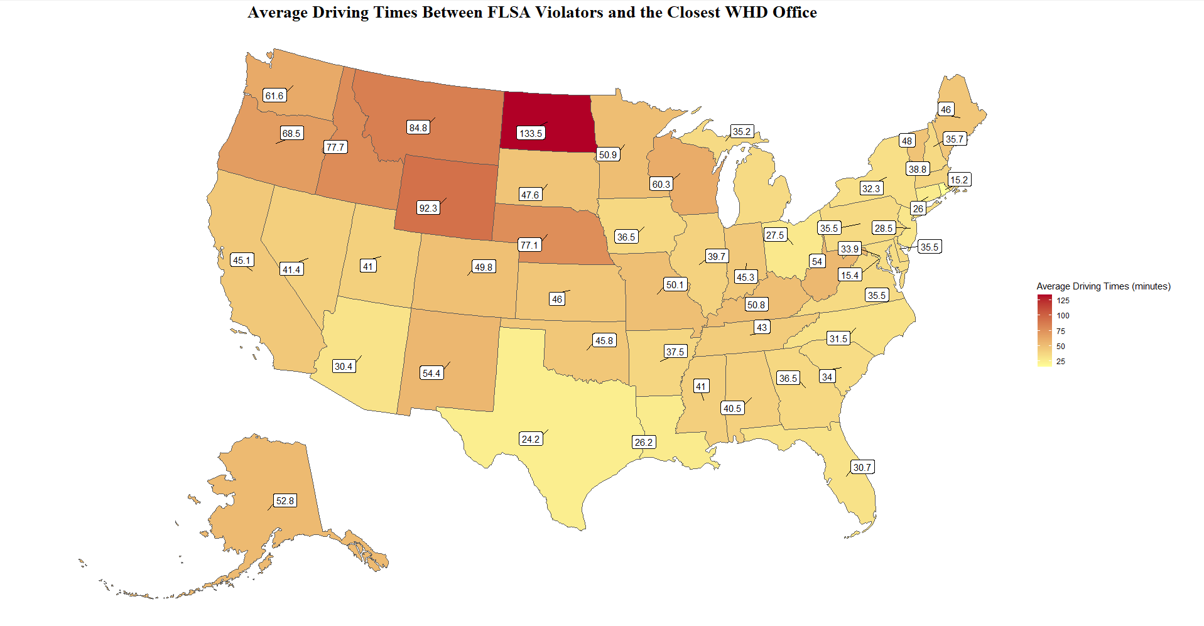
Demo: Distances Between WHD Offices and FLSA Violators
Goals
Demonstrate how to enrich WHD enforcement data with geospatial information in order to analyze driving distances and times between WHD field offices and FLSA violators.
Topics Include:
Accessing DOL data via the API using the tidyDOL R package
Basic geospatial analysis techniques including finding “closest neighbors”
Leveraging the Googleway R package to access the google maps API for geocoding and deriving driving times / distances
Basic geospatial visualization techniques (choropleths)
Notes:
Today I am going to demonstrate how to enrich WHD enforcement data with geospatial information in order to analyze driving distances and times between WHD field offices and FLSA violators. Through this presentation and the accompanying code you should learn how to:
Access DOL data via the API using the tidyDOL R package
Conduct basic geospatial analysis techniques including finding “closest neighbors”
Leverage the Googleway R package to access the google maps API for geocoding and deriving driving times / distances
Basic geospatial visualization techniques (choropleths)
I want to thank WHD for supplying the office location data but acknowledge that the analysis and interpretation are mine (as are any errors), and may reflect my ignorance about WHD data or enforcement. The results of this analysis are merely intended to be illustrative of the concepts ant techniques we are attempting to demonstrate.

Slide 6
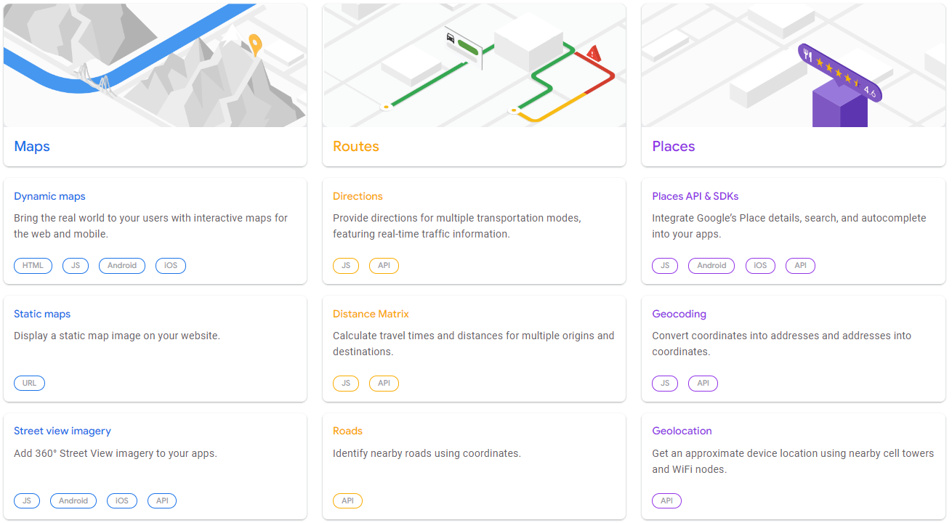
Google Maps API
Notes:
Most people are probably familiar with Google Maps but may be less familiar with the google maps API. The google maps API exposes some of the functionality that powers google maps and makes it accessible to developers who would like to leverage google’s data. This is not a free service, however, Google does provide trial credits that are more than enough to cover the costs of most non-production use cases.
The Google Maps API is organized into three main families, Maps, Routes, and Places. As might be expected, the Maps API family allows developers to build dynamic maps, display static maps, or incorporate street view imagery into their apps and websites. The routes API family exposes some of the directional capabilities of the platforms and allows developers to get directions between points, calculate travel times and distances, or identify nearby roads to any coordinate. We will be using the distance matrix api to calculate driving distances between WHD field offices and FLSA violators.
Finally the places API family provides location specific services such as returning place details (for example reviews of restaurants), geocoding addresses, or geolocation (approximating a devices location). We will be using the geocoding API to convert FLSA violator addresses to geospatial coordinates.

Slide 7
Analytical Steps
Access WHD Enforcement Data for 2019 through the DOL API (using the tidydol package)
Use the google maps places API to geocode enforcement data (leveraging the googleway r package)
Visually inspect the geospatial data
Notes:
I’m going to walk through the analysis at a conceptual level but if folks are interested and would like to stick around, I can walk through some of the code after the Q&A.
For this analysis we used two primary datasets. The first was WHD’s enforcement data for 2019 which I accessed by using the DOL API. More specifically I accessed it with the tidyDOL R package which makes accessing the API a whole lot easier. If you are interested in this package you can see presentation I gave last year to the COP or email me for access. The second dataset is a list of all WHD field offices and their latitude and longitudes which was provided by Matt Helms in WHD.
Although the WHD field office data has geospatial coordinates, the enforcement data does not. Without geospatial coordinates for enforcement data I can not conduct the geospatial analysis of driving times. So my first step is to pass the address information contained in the enforcement data to the google maps geocoding API using the googleway R package. This is a package that makes it very easy to work with the google maps API. At this point we now have geospatial coordinates for both datasets and can do some basic geospatial analysis.
Similar to the analysis Dr. Snow conducted in 1854, we might curious to see how the location of FLSA violations compares to WHD field offices. (unlike that analysis WHD enforcement is the solution not the cause of the problem).

Slide 8
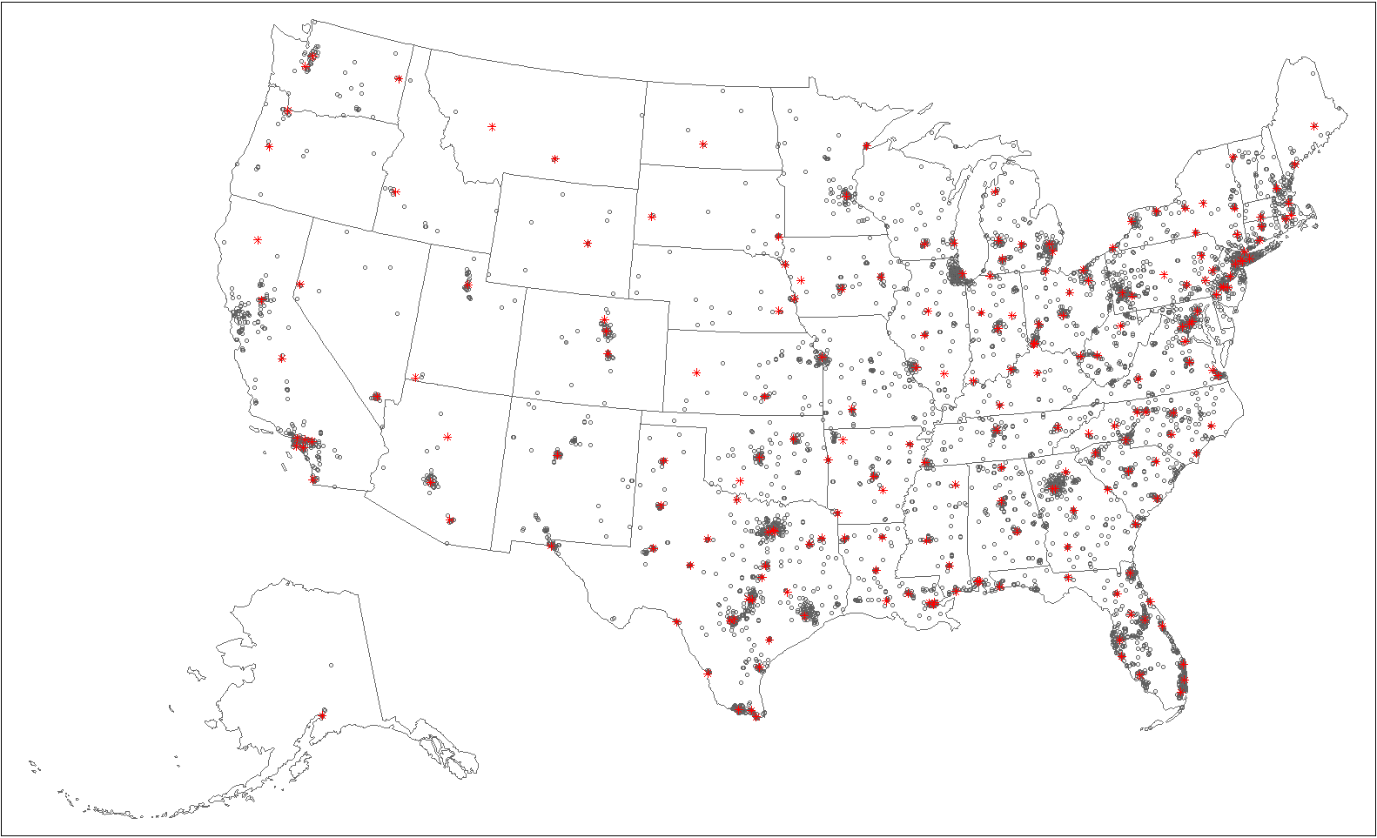
WHD Offices vs. FLSA Violations
Notes:
Here you can see the location of WHD field offices (the red stars) compared to flsa violations (grey circles). Although it’s a little difficult to see at this scale you can see that WHD field offices tend to be located fairly closely to FLSA violations. However, of course this depends on the state. For example, violations in the great plains states tend to be more spread out, likely reflecting the lower population density.
Still from this map it is hard to conclude much. Luckily for us we have many more tools available than Dr. Snow had, including the google distances API.

Slide 9
Analytical Steps
Find the closest WHD field office to each WHD FLSA violator
Notes:
Our next step is to find the closest WHD office to each FLSA violation. To do this we can use the spatialrisk R package which contains a function to do exactly this.
Once we have the closest WHD office for each violation we can also calculate the distance between “as the crow flies” between these points.

Slide 10
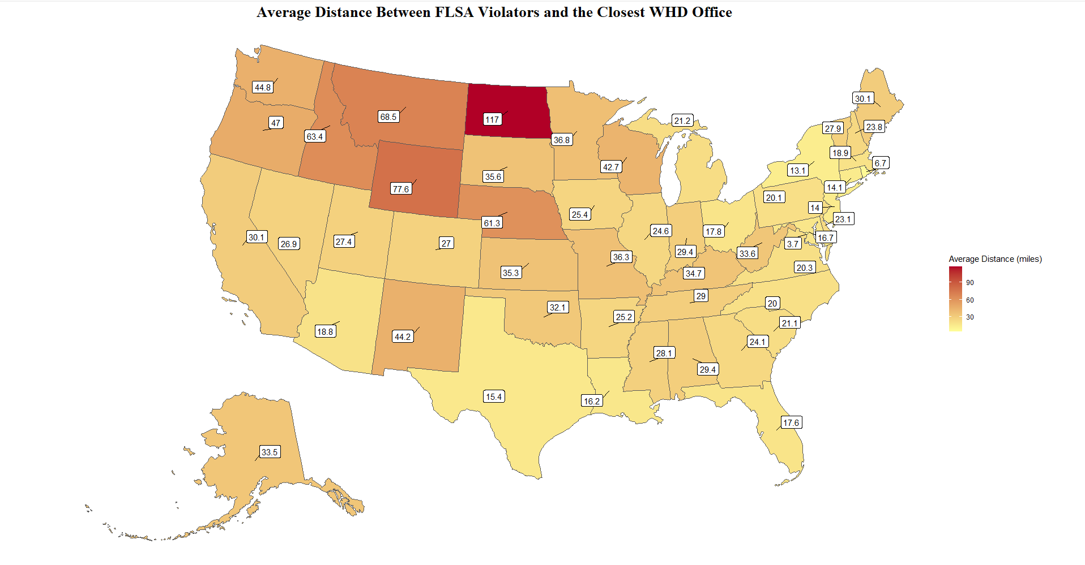
Average Distances (As The Crow Flies)
Notes:
This is a choropleth map, which is a type of geospatial visualization that uses colors to represent an aggregate measure. In this case we are using color to represent the average distance in miles between FLSA violators and the closest WHD office by violation state. This initial analysis confirms our earlier hypothesis that driving times in the less dense great plains states would be greater and the more densely populated north east would be lower. North Dakota stands out as the clear outlier with an average distance of 117 miles between violators and field offices. However, there are some interesting insights that pop out. Texas for example has relatively low driving distances, comparable to north east states. Conversely, California has relatively high driving distances despite being a very populous state.

Slide 11
Analytical Steps
Calculate driving distances and times between FLSA violators and WHD field offices using the google maps Routes API
Notes:
However, we are actually interested in how long it takes inspectors on average, to drive from the field office to FLSA violators. To do this we will need to calculate driving distances and times, and to do that we will need to use the google maps distances API. We now have the lat and longitudes of our starting locations (field offices) and our destination locations (FLSA violations). We can pass these parameters into the googlemaps API, again using the googleway R Package. With some data wrangling we can extract the driving times and driving distances for each set of FLSA violator and WHD office.
Although we did not use it here, the google API allows you to specify your driving starting times and model good, bad, or average traffic conditions for that time. By default it will select average traffic conditions for the time that you submit the API request.

Slide 12
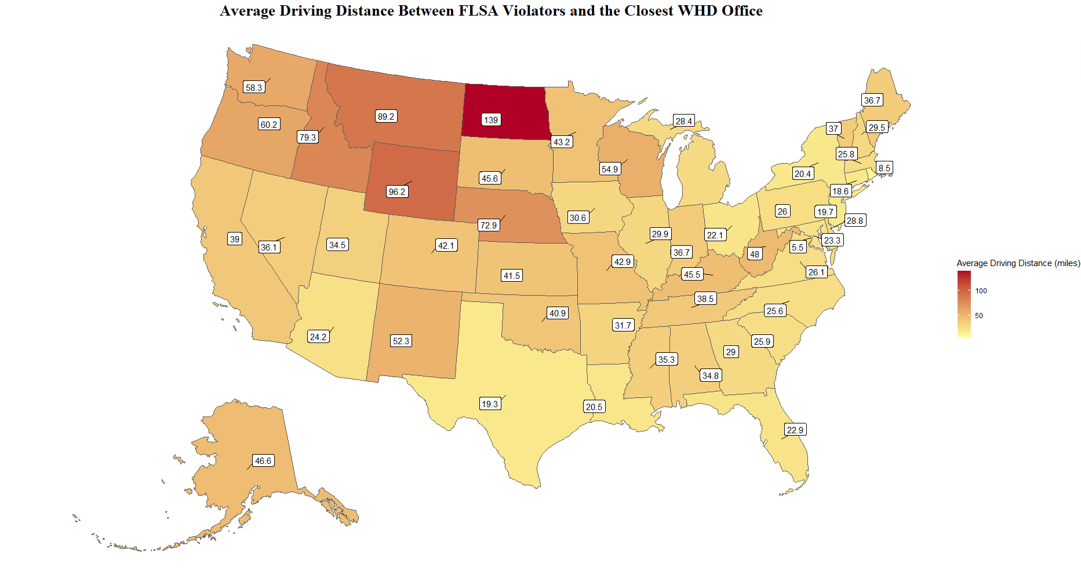
Average Driving Distances
Notes:
With this information we can now calculate average driving distances and times. While this map looks largely similar to the “as the crow flies” map we looked at earlier, some states have very different driving distances. For example, the average distance between an FLSA violator and WHD field office is only 27 miles in Colorado, the average driving distance is 42.1 miles – more than 50% longer!

Slide 13
Average Driving Times
Notes:
But again we are really interested in driving times. When we plot driving times a similar story emerges – particularly in the upper great plains and north west. However, I want to focus on California which seems to be an outlier with regards to highly populated states. The average distance of 30 miles translates to an average drive of 45 minutes. Much higher than any of the next 9 most populous US states (TX, FL, NY, PA, IL, OH, GA, NC, MI). If we go back to our first plot we may find some clues as to why.

Slide 14
WHD Offices vs. FLSA Violations
Notes:
It looks like the majority of FLSA violation cases occur in Los Angeles and the inner Bay Area. Despite that fact there is only one field office that is close to the bay area, the Sacramento office. The primary route between sacramento and the bay area (I-80) is often congested with traffic which may exacerbate this. Using this analytical framework you could easily model the effect that placing a field office in Oakland would have on driving distances (although this is beyond the scope of this analysis)

Slide 15
Additional Geospatial Analysis Questions
Do lower driving distances / times reflect good coverage or field staff choosing to inspect businesses that are closer?
What are the demographics of census tracts where field offices are located?
Are there high population areas that do not have field offices?
What questions do you have?
Notes:
Although this is the end of the presentation this would likely just be a starting point for additional analysis. This data exploration doesn’t answer many questions, such as “are long driving distances good or bad”? They could be good because they reflect that inspectors are investigating more remote or difficult to access locations. On the other hand these driving times put additional burdens on investigators and may be bad for these reasons. We may also be curious as to the demographics of census tracts where the field offices are located. Are they located in diverse areas or areas of persistent poverty?
We might also wonder if there are high population areas that do not currently have a field office. Our initial analysis suggested that the inner bay area may be one such case, are there others?
I’d like to pause before concluding and opening it up to Q&A to here what analytical questions this raises for you? How could we deepen or broaden this geospatial analysis?

Slide 16
Key Takeaways
Linking DOL data to other sources allows us to conduct more powerful analyses than we may be able to do otherwise
Geocoding data with geographical elements opens up a world of new analytical possibilities
There are a number of free / freemium services like the Google Maps API which can expand your capabilities
Notes:
I hope that this presentation sparked some ideas of what you can do with geospatial data and the tools that are available. We saw how linking datasets (in this case WHD field office locations and google maps data) allows us to conduct more powerful analyses than we may be able to do otherwise. We also covered how geocoding your data with geographical elements can open up a world of new analytical possibilities. Finally, I hope you will remember that there are a number of free / freemium services like the Google Maps API which can expand your capabilities and make working with geospatial data easier.

Slide 17
Q & A / Code Demonstration
Notes:
With that I’ll open it up to questions!

