Slide 1

Using Python with Power BI
By Kevin Russell

Slide 2

What is Python & Power BI?
Python is a simplified object-oriented programming language
Power BI is a powerful reporting tool to create dashboards and stunning visuals

Slide 3
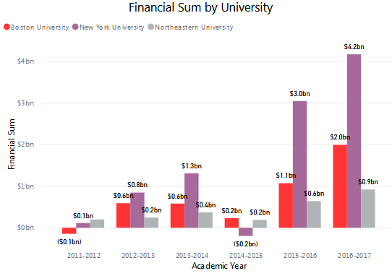
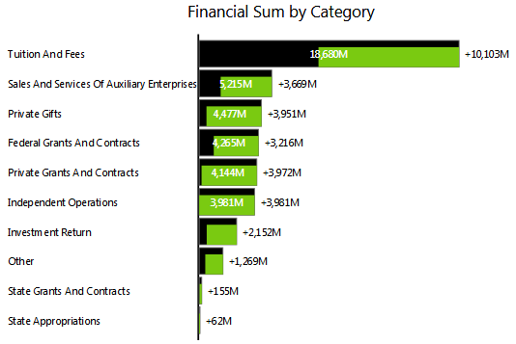
What can Python & Power BI do?
Python can scrape data by file, website, or data connection, and can manipulate data better than alternatives
Power BI can utilize Python as a data source and be used to create custom visuals

Slide 4
Why use Python & Power BI?
Simplify reporting
Prevent unnecessary ODS tables
Reduce server resources
Improve visualization and information reporting

Slide 5

How to use Python as a data source?
Write python script in your favorite python IDE and debug
Ensure data is stored in a pandas DataFrame
Copy python code
Install MatPlotLib package using PIP
Open Power BI

Slide 6

How to use Python as a data source? (Continued)
Go to Options and Settings -> Options
Under Global -> Preview features, put a tick on Python Support and save
Go to Get Data -> More -> Other -> Python script
Paste code and press OK

Slide 7

Resources
Getting Started with Python
Working with Pandas
Creating visuals with Python
PowerShell to Python Menu Launcher
Getting started with Power BI

Slide 8

Any Questions?

