Slide 1
MagmaDnn Intro

Slide 2
MagmaDNN
MagmaDNN currently must be built from source
MagmaDNN can work on the GPU (DEVICE), CPU (HOST), or both (MANAGED, CUDA_MANAGED)
All MagmaDNN operations must be enclosed within magmadnn_init() and magmadnn_finalize()
Sample Makefile can be found here https://drive.google.com/file/d/1FoU0aroZu6sa8td84xmNmJzxo2IVLAT4/view?usp=sharing
https://github.com/MagmaDNN/magmadnn/tree/master/docs/tutorials has tutorials that should be read first to help understand the code

Slide 3
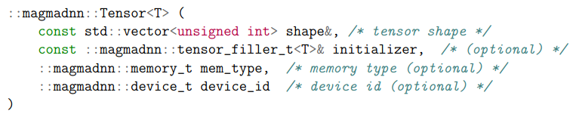
Tensors
To store data, MagmaDNN has a tensor class to allow it to store the values and do the calculations.
The tensor class has its own memory manager, which stores the data about the memory, allowing for efficient memory management, increasing the speed of the code and calculations
Tensor takes three input arguments, a vector of the size parameters of the input, a vector of the fill type and what to fill the tensor with, and where the memory is stored.

Slide 4
Compute graphs
Compute graphs are how MagmaDNN does operations (wx+b example)
add
/ \
matmul B
/ \
W X
You can use op::var(“variable name”, tensor_ptr) or op::var(“variable name”, {tensor, shape}, {tensor, {filler}}, memory_type) to wrap tensors and represent them as nodes as tensors cannot be directly used in gradient calculations
Compute graphs can then be created using op::add(), op::matmul(), etc. but are not evaluated until you call the operations eval function
This allows the gradient calculations in the backpropagation process to be done faster

Slide 5
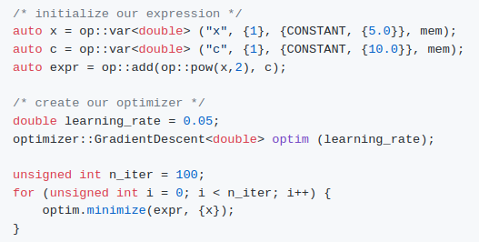
Optimizers
Optimizers minimize an objective function (op::Operation) with respect to several variables (op::Operation). All optimizers inherit from optimizer::Optimizer<T> class and define a minimize function which takes a vector of variables to minimize w.r.t.
This minimizes the expression x^2 + c w.r.t. x using Stochastic Gradient Descent

Slide 6
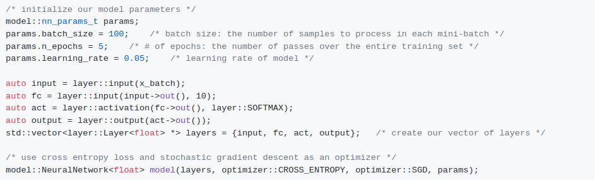

Neural Networks
MagmaDNN provides the Model class, which only requires the coder to define the network and it will take care of training. The model we'll be using is magmadnn::model::NeuralNetwork<T>.
The Model class uses the compute graphs and optimizers to do the calculations.
The model is now made and ready to be trained. All models have a .fit() function, which will train the data set

Slide 7
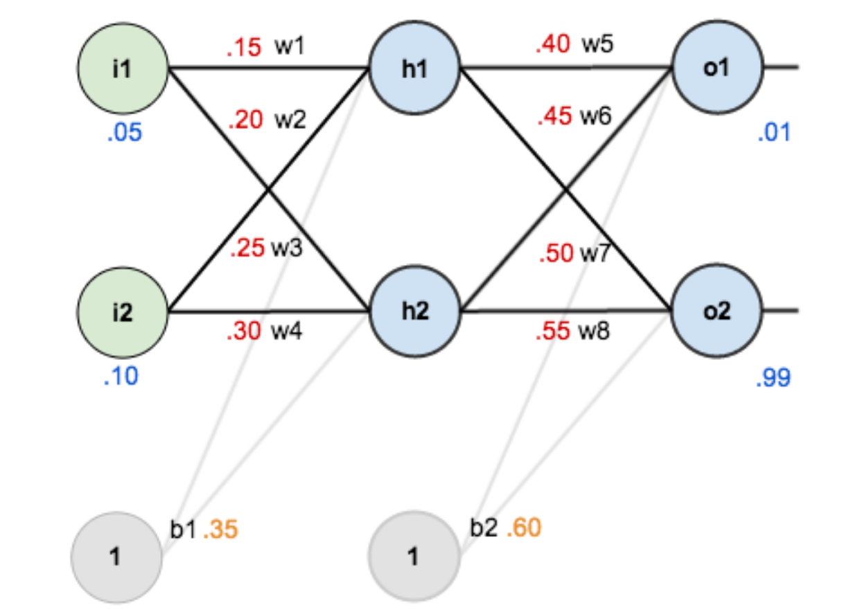
MLP
From Example THA2 in lecture slides
Sample code at https://drive.google.com/file/d/1AuUcaBqOzCbEexGAK4YN7BCHyJzpdRT9/view?usp=sharing

Slide 8
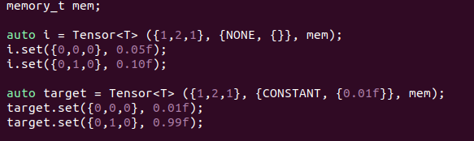
MLP: Inputting Data
In MagmaDNN, all the data is stored within tensors.
T defines the type of data that the data will be stored as(int, float, double)
For simple examples such as ours, we can load in the data manually.
.set() is a function of Tensors and will set the values within the tensors
More in depth info about tensors such as fill type and formats at https://github.com/MagmaDNN/magmadnn/blob/master/docs/tutorials/02_tensors.md

Slide 9
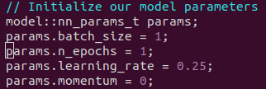
MLP: Initializing the Parameters
To set up the NN, we have to set up the parameters based on the type of optimizer we are going to use:
unsigned int n_epochs
unsigned int batch_size
double learning_rate
double momentum = 0.9
double decaying_factor = 0.9 (for RMS prop)
double beta1 = 0.9 (for adam)
double beta2 = 0.999 (for adam)

Slide 10
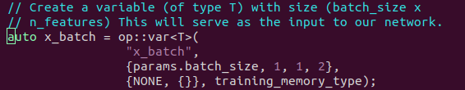
MLP: Network Building (i)
First, we have to create a variable to be the input to the network. A variable intakes a string for the variables name, and then a tensor, and returns a tensor pointer. Calculations in MagmaDNN are done with variables instead of tensors.
We initialize the tensor to none, as the data will be loaded in later.

Slide 11
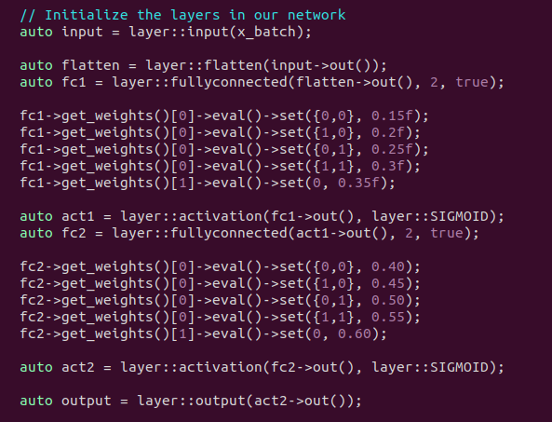
MLP: Network Building (ii)
Then, we list out the different layers of the neural network we want to have.
In this case, we have the input layer, which takes the input var we created before. Is it then fed into a flatten layer, then a fully connected, with 2 neurons, and a bias, then fed to an activation layer, which applies an activation function SIGMOID, RELU, TANH or SOFTMAX.
After all the desired layers are added, call the output layer for the final step.

Slide 12
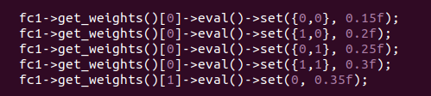
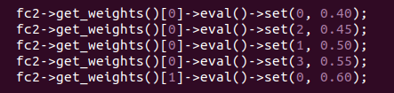
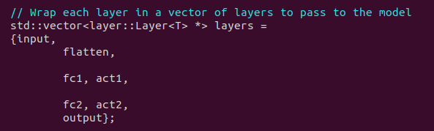
MLP: Network Building (iii)
We can access the weights and biases for each layer manually though the layer.get_weights() function, where it returns a vector of operation pointers {weights, bias}. We have to call eval(), which returns it as a tensor pointer, and then we set it with the set() function. The weights are set in row major and can be set just using indexes or a position vector within the matrix
After that, we have to put all the layers within a vector.

Slide 13
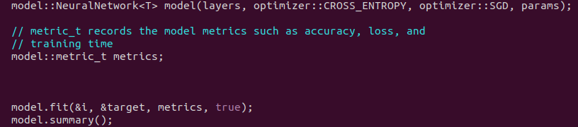
MLP: Running the Model
To train the network, we first have to create the model, telling it the vector of layers, the error function(MSE or CROSS_ENTROPY) , the optimizer function (SGD, ADAM, RMSPROP, or ADAGRAD) and the parameters we set up before.
The we create a metric_t data type which stores data such as the time, the loss, and the accuracy
After that, we call model.fit() to train the model, with arguments of input data, ground truth, metric_t and a bool, which tells the code whether to print out the metrics for each epoch

Slide 14
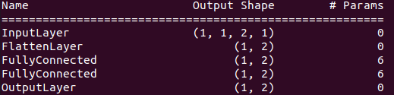
MLP: Output and Finalization
Model.print summary returns a summary of the whole neural network, showing the layer names, the output shapes of each layer, and the number of trainable parameters.
To print specific values, we do the same steps as we did to set the weights, but instead, we just call get() to retrieve the value
Remember to clean up memory. We can just delete the head node, in our case, just output.

Slide 15
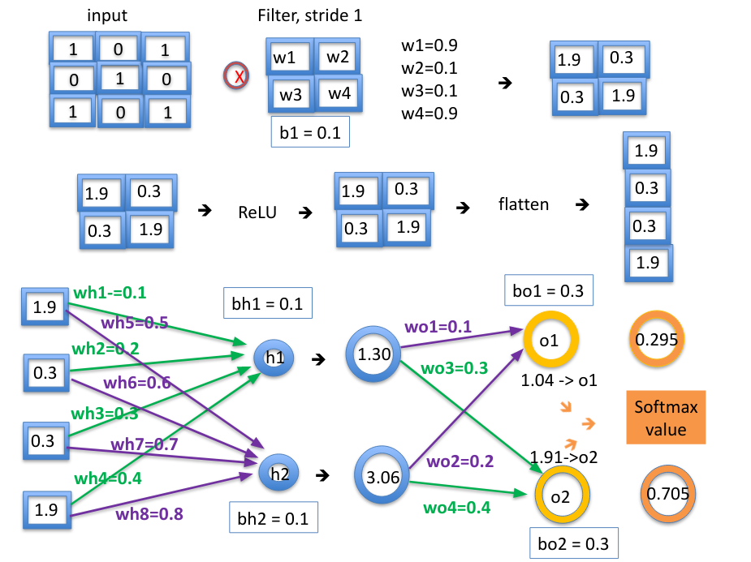
CNN
From Example 3 in the lecture slides
Sample code at https://drive.google.com/file/d/1GD3GKwRQ_7iucOoSnPYCH6-xaNyrvICy/view?usp=sharing

Slide 16
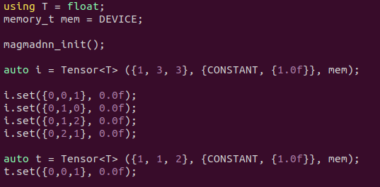

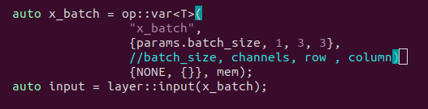
CNN: Inputting the Data
The structure for a CNN is very similar to the MLP, except for the extra conv2d layer that is added, and the fact that you have to use a GPU for the CNN2d calculations, which uses cudnn for its calculations so the memory_t has to be DEVICE.

Slide 17
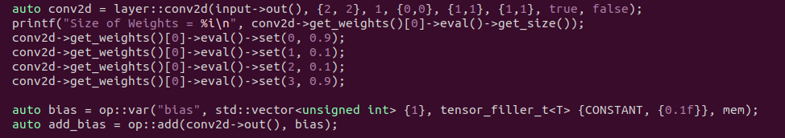
CNN: Creating the Conv2d Layer
The Conv2d layer is similar to the other layers, with the input arguments below:
conv2d<T>(op::Operation<T>* input, vector<unsigned int>& filter_shape, int out_channels, vector<unsigned int>& padding, vector<unsigned int>& strides, vector<unsigned int>& dilation_rates, bool use_cross_correlation, bool use_bias, tensor_filler_t<T> filter_initializer, tensor_filler_t<T> bias_initializer)
And we will set the weights the same way.

Slide 18
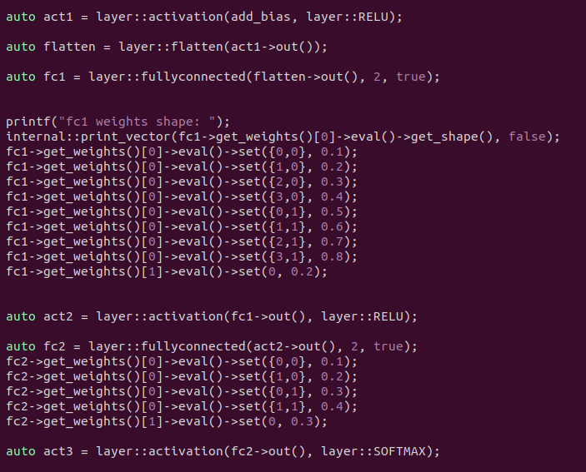
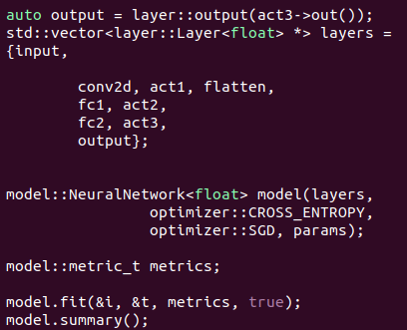
CNN: Network Creation
The rest of the steps are the same as the MLP example.

Slide 19
Gradients
Gradients are contained within the grad table in a map of paired operation * and tensor *
The table is filled using get_grad_table() which calls build_grad() in compute/gradients.cpp
Each base operation has its own _grad function which build_grad() calls to calculate the gradients.

Slide 20
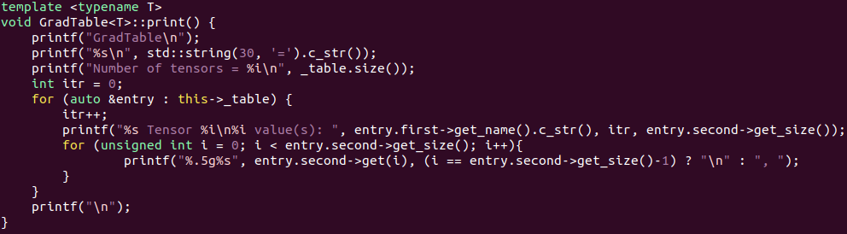
Steps for printing grad values with labels
To print the values of the grad table, you pass in true for the 6th argument for the model.fit() call and the grad table will print.
We iterate through each entry in the map and print the operation name with entry.first->get_name().c_str() and all the entries in each tensor with entry.second->get(i)

Slide 21
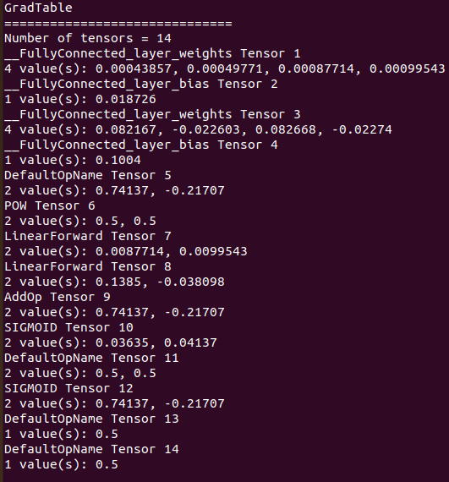
Grad Table Example
MLP example

Slide 22
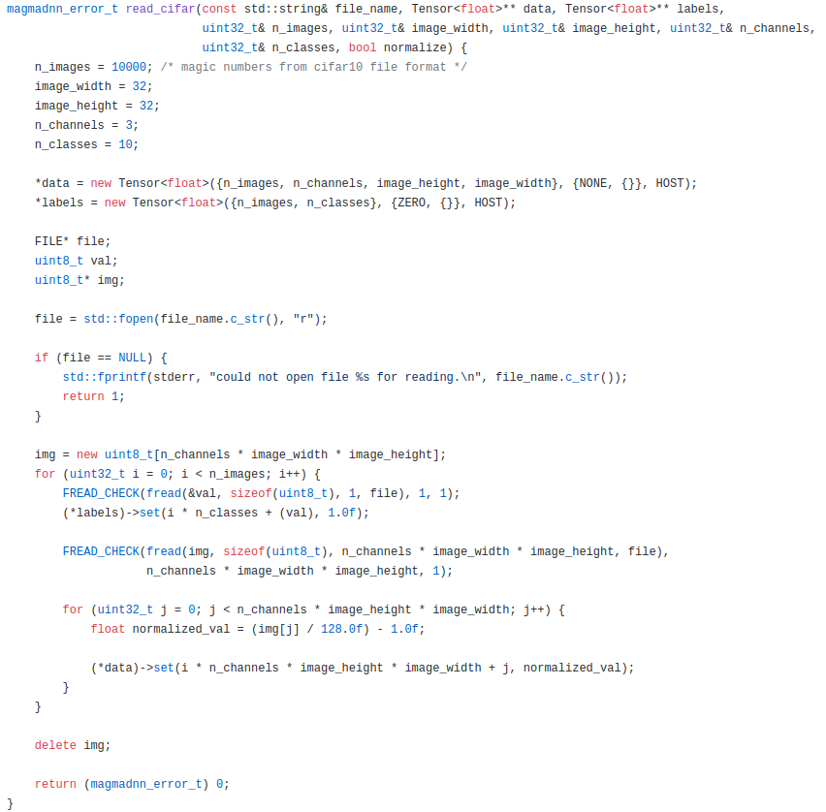
Inputting large data sets
A tensor for the data and the labels are created, with the data being read into the tensors based on how the data file is structured
There are functions present for reading MNIST images/labels and CIFAR 10/100, as well as .csv data types
If inputting any other type of data, you will need to read it and store it into the tensors yourself
Code from cifar10_interactive.cpp

Slide 23
Deep Dive Into mDNN Code

Slide 24
Bitbucket
Where all the development is done.
bitbucket.org/icl/magmadnn

Slide 25
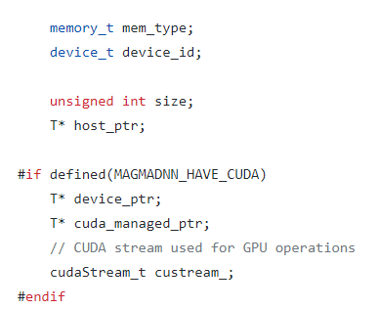
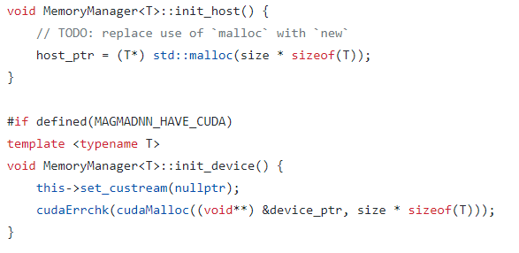
Memory Manager
Everytime a tensor is created, a memory manager is also automatically created, which allocates the memory for the tensor and stores the pointers to the data.
Memory manager allows for simpler interactions when dealing with memory allocation
The location of the data is all stored in the pointers
Code from momory_manager.cpp

Slide 26
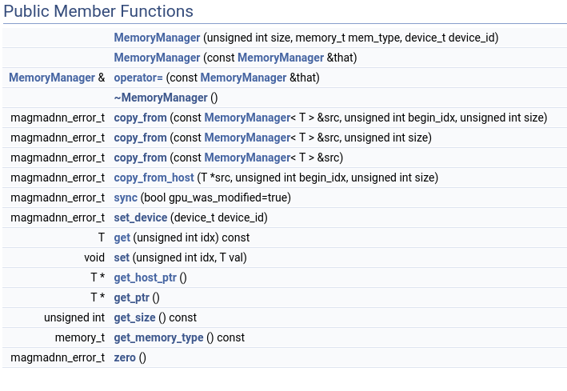
Memory Manager
Memory Manager also has many functions such as copy_from(), sync(), get_host_ptr() which can help allocate data and memory.

Slide 27
Memory following mem_test.cpp, found at https://drive.google.com/file/d/1aG8gWRQ40RmVC32UVD6s7XdU_JWuEMy5/view?usp=sharing
memory_t mem = DEVICE;
auto i = Tensor<float> ({1, 2,1}, {NONE, {}}, mem),
since memory_t mem = DEVICE, the tensor is created in both the CPU and then copied to the GPU
When you create a tensor it calls Tensor<T>::init() which finds the total number of elements and creates a new memory manager
The code above allocates memory for a {1,2,1} tensor through Memory Manager, the data about the memory is stored within Memory Manager
Here we fill the tensor with {NONE, {}}, but if you decide to fill it with something (UNIFORM, GLOROT, MASK, etc.) fill_internal_host.cpp will fill it by using MemoryManager<T>::get_host_ptr() when on HOST and initialize the tensor

Slide 28
Memory following mem_test.cpp
auto target = Tensor<T> ({1,1,1}, {CONSTANT, {0.01f}}, mem);
We then create a target tensor, in our case, a {1,1,1}, and it is allocated by the memory manager also.
auto x_batch = op::var<T>( "x_batch", {params.batch_size, 1, 2, 1}, {NONE, {}}, mem);
The last tensor we create is a variable, or basically a pointer to a tensor. It is the same as a tensor, but just returns the address of the tensor instead of the actual tensor. The memory allocation is the same.
It is better if all things created were pointers since they are the main type of arguments passed through the functions in the code

Slide 29
Memory following mem_test.cpp
Now to the memory allocation in the layers.
For every layer, there is a input/output shape and tensor, as well as a name of the layer.
For the input and output layers, since no values are changed, the input tensor is just set to the output tensor
For our flatten layer, nothing is changed either, but the size of the output tensor is changed
For the layers with weights and biases, in our case the fully connected layer, a separate weight and bias tensor pointer is created which is then filled with the values desired. Math is all done with tensor pointers

Slide 30
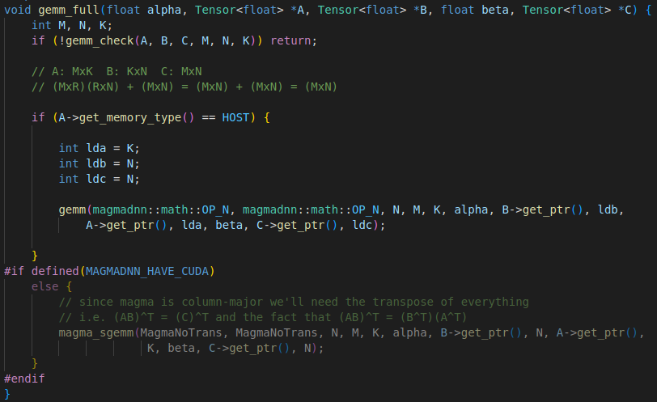
Matrix Multiplication
Matrix multiplication is done through gemm (general matrix multiplication) calls.
If using the cpu, it is done through openblas if using the gpu, it is done through magma
Code from compute/matmul/gemm_internal.cpp

Slide 31
Gemm calls
Where C = αAB + βC and β = 0 for most cases
Transposing depending if data is stored in row/column major
-
Same thing , but instead calls the magma version of sgemm

Slide 32
Operations
In the include/compute folder for file headers and src/compute for .cpp files.
Simple mathematical operations such as add, subtract, matmul…
Basis of the compute graphs, each includes
_eval(): computes the forward path, returns a tensor
_grad(): calculates the gradient, returns a tensor
_to_string(): outputs the operation as a string, formatting purposes
constructor/destructor - more information in /include/compute/readme

Slide 33
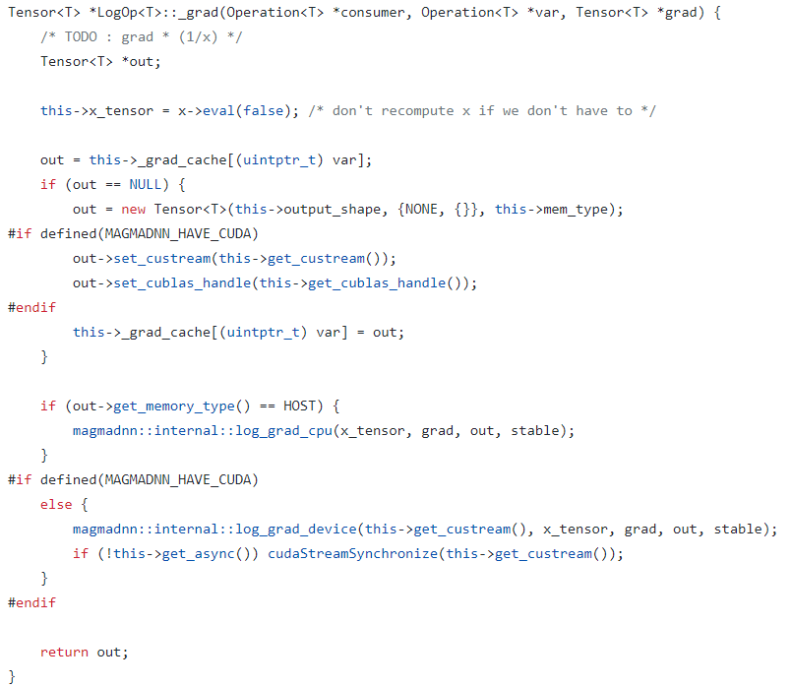
Operation Gradients
Each operation had a _grad_cache to store the gradients wrt other operations to save time when doing the backpropagation
If the cache is empty, the you go through the process of calculating the grad and then store it .
Checks if the grad has been calculated before
Calculated the grad with helper functions
Code from compute/log/logop.cpp
Helper functions are in compute/log/log_internal.cpp

Slide 34
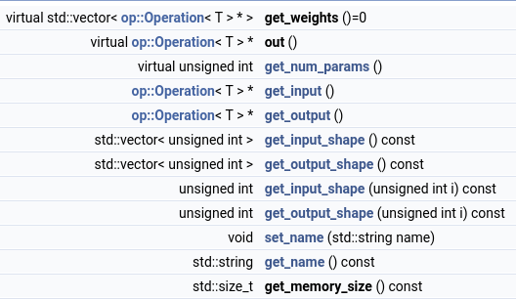
Layers
Used to create the neural network model,
Includes layers such as fully connected, conv2d, activation layers…
Each layer includes a weights tensor and defines some sort of transformation function
Other helper functions are shown to the right and if necessary more can be written

Slide 35
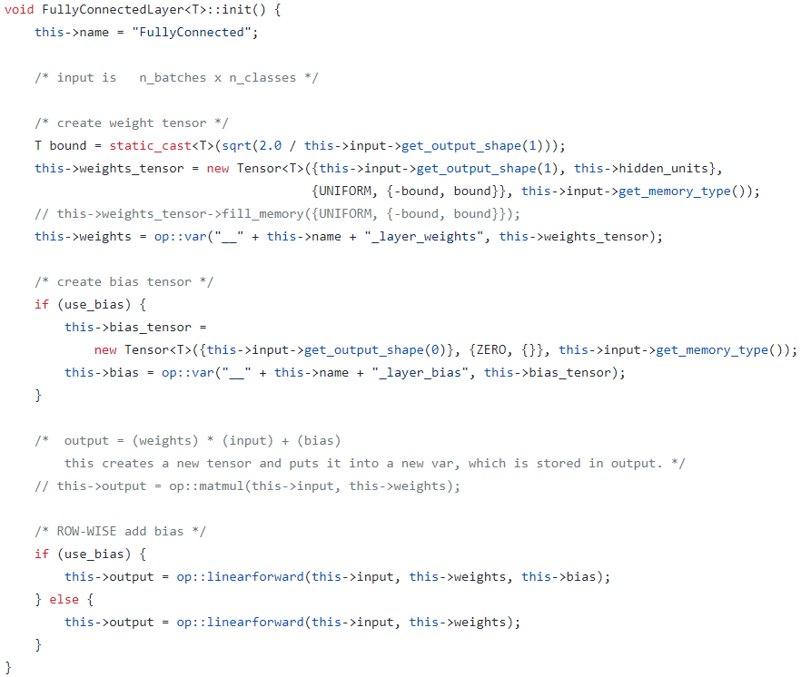
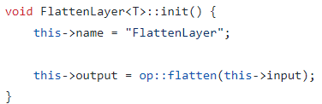
Layers (cont)
In each layer, operations are used to create the desired output of the layer i.e.
Code from layer/fullyconnected/fullyconnectedlayer.cpp

Slide 36
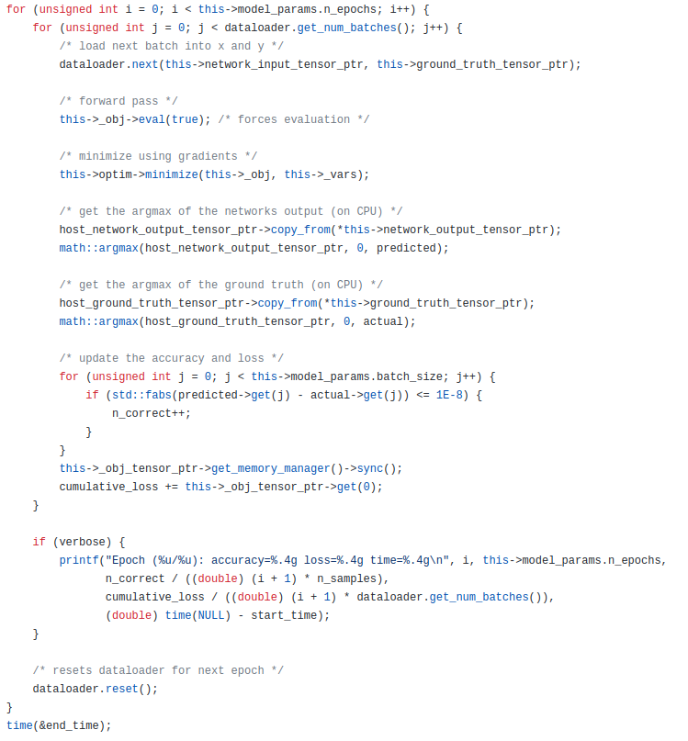
Model
The model class is where all the training happens
The minimize function goes through the compute tree and calculates all the gradients and adjusts the weights according to the optimizer function
Code from src/model/neuralnetwork/neuralnetwork.cpp

Slide 37
Documentation
Documentation for the magmadnn can be found in magmadnn/docs

