Slide 1
Review of Linear Algebra
Introduction to Matlab
10-701/15-781 Machine Learning
Fall 2010
Recitation by Leman Akoglu
9/16/10

Slide 2
Outline
Linear Algebra Basics
Matrix Calculus
Singular Value Decomposition (SVD)
Eigenvalue Decomposition
Low-rank Matrix Inversion
Matlab essentials

Slide 3


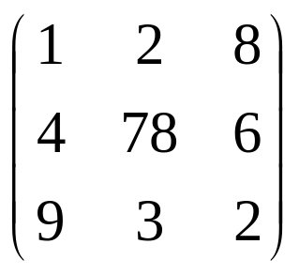
Basic concepts
Vector in R^{n} is an ordered set of n real numbers.
  e.g. v = (1,6,3,4) is in R⁴
  A column vector:
  A row vector:
m-by-n matrix is an object in R^{mxn} with m rows and n columns, each entry filled with a (typically) real number:

Slide 4
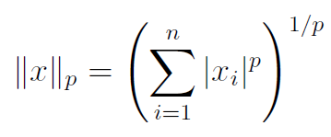
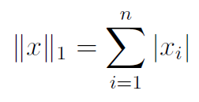
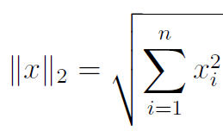

Basic concepts
Vector norms: A norm of a vector ||x|| is informally a measure of the “length” of the vector.
  Common norms: L₁, L₂ (Euclidean)
  L_{infinity}

Slide 5
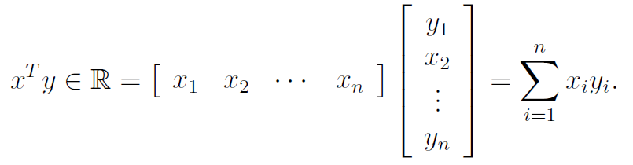
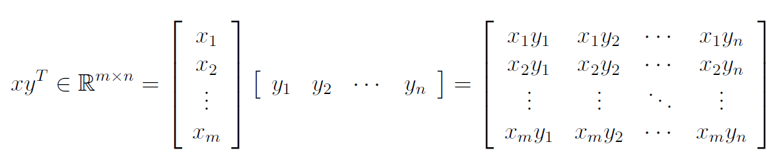
Basic concepts
We will use lower case letters for vectors The elements are referred by x_{i}.
Vector dot (inner) product:
Vector outer product:
If u•v=0, ||u||₂ != 0, ||v||₂ != 0 → u and v are orthogonal
If u•v=0, ||u||₂ = 1, ||v||₂ = 1 → u and v are orthonormal

Slide 6



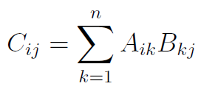
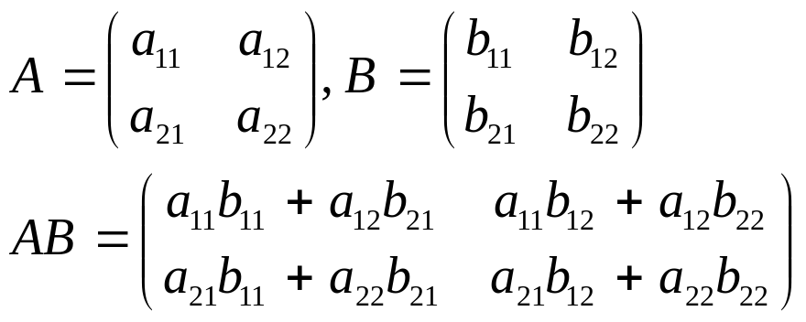
Basic concepts
We will use upper case letters for matrices. The elements are referred by Ai,j.
Matrix product:
e.g.

Slide 7
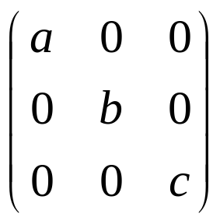
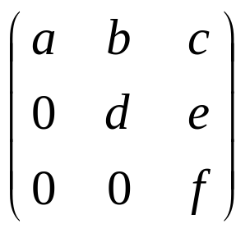
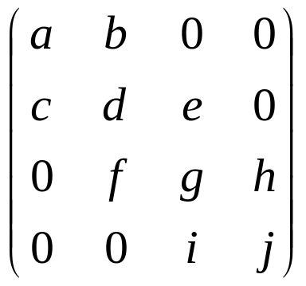
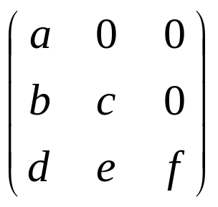
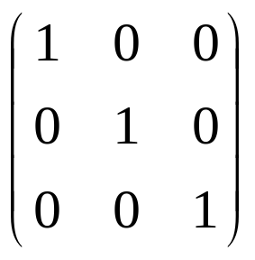
Special matrices
diagonal
upper-triangular
tri-diagonal
lower-triangular
I (identity matrix)

Slide 8
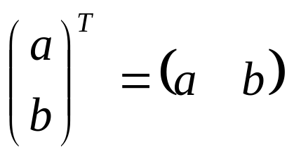
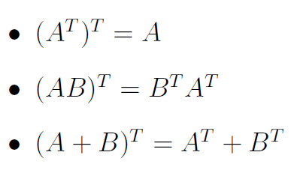
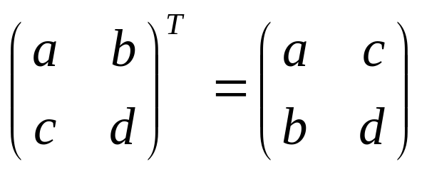
Basic concepts
Transpose: You can think of it as
  “flipping” the rows and columns
OR
  “reflecting” vector/matrix on line
e.g.

Slide 9
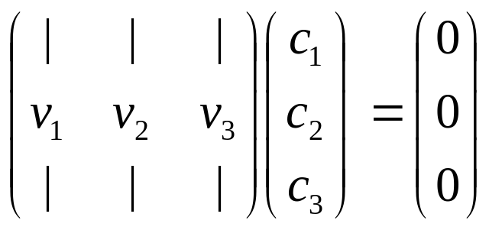
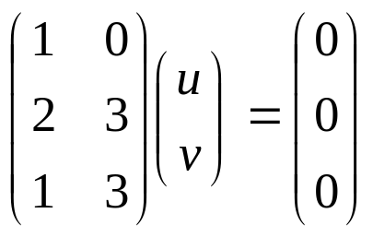
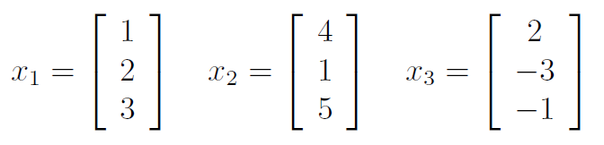
Linear independence
A set of vectors is linearly independent if none of them can be written as a linear combination of the others.
Vectors v₁,…,v_{k} are linearly independent if c₁v₁+…+c_{k}v_{k} = 0 implies c₁=…=c_{k}=0
e.g.
(u,v)=(0,0), i.e. the columns are linearly independent.
x3 = −2x1 + x2

Slide 10
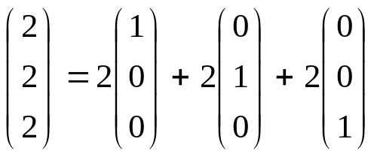
Span of a vector space
If all vectors in a vector space may be expressed as linear combinations of a set of vectors v₁,…,v_{k}, then v₁,…,v_{k} spans the space.
The cardinality of this set is the dimension of the vector space.
  A basis is a maximal set of linearly independent vectors and a minimal set of spanning vectors of a vector space
e.g.
(0,0,1)
(0,1,0)
(1,0,0)

Slide 11
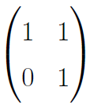
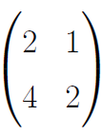
Rank of a Matrix
rank(A) (the rank of a m-by-n matrix A) is
  The maximal number of linearly independent columns
  =The maximal number of linearly independent rows
  =The dimension of col(A)
  =The dimension of row(A)
If A is n by m, then
  rank(A)<= min(m,n)
  If n=rank(A), then A has full row rank
  If m=rank(A), then A has full column rank

Slide 12


Inverse of a matrix
Inverse of a square matrix A, denoted by A⁻¹ is the unique matrix s.t.
  AA⁻¹ =A⁻¹A=I (identity matrix)
If A⁻¹ and B⁻¹ exist, then
  (AB)⁻¹ = B⁻¹A⁻¹,
  (A^{T})⁻¹ = (A⁻¹)^{T}
For orthonormal matrices
For diagonal matrices

Slide 13
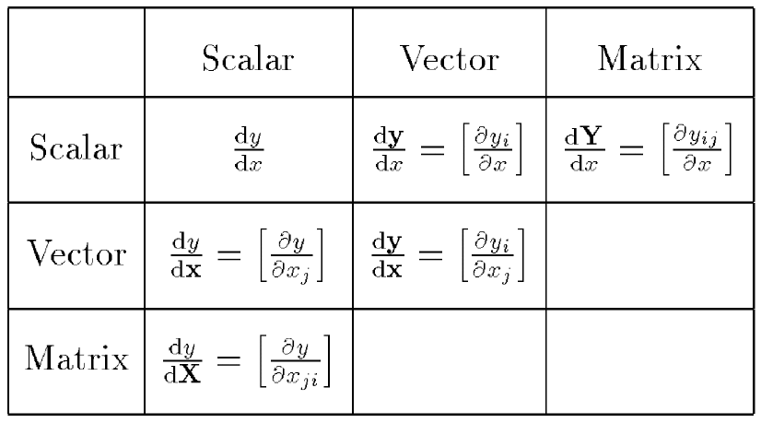
Dimensions
By Thomas Minka. Old and New Matrix Algebra Useful for Statistics

Slide 14
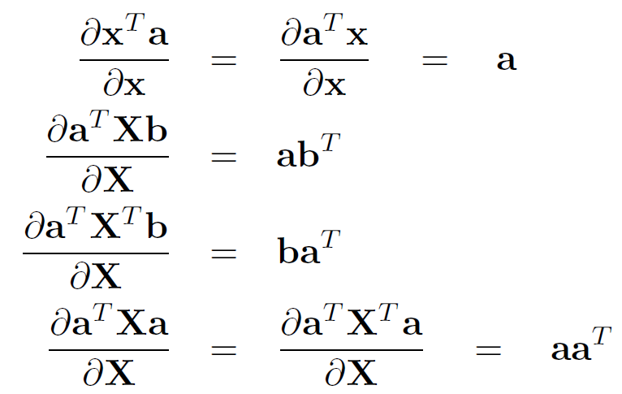
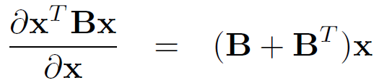
Examples
http://matrixcookbook.com/

Slide 15
Singular Value Decomposition
(SVD)
Any matrix A can be decomposed as A=UDV^{T}, where
  D is a diagonal matrix, with d=rank(A) non-zero elements
  The fist d rows of U are orthogonal basis for col(A)
  The fist d rows of V are orthogonal basis for row(A)
Applications of the SVD
  Matrix Pseudoinverse
  Low-rank matrix approximation

Slide 16
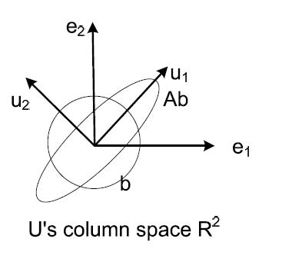
Eigen Value Decomposition
Any symmetric matrix A can be decomposed as A=UDU^{T}, where
  D is diagonal, with d=rank(A) non-zero elements
  The fist d rows of U are orthogonal basis for col(A)=row(A)
Re-interpreting Ab
  First stretch b along the direction of u₁ by d₁ times
  Then further stretch it along the direction of u₂ by d₂ times

Slide 17
Low-rank Matrix Inversion
In many applications (e.g. linear regression, Gaussian model) we need to calculate the inverse of covariance matrix X^{T}X (each row of n-by-m matrix X is a data sample)
If the number of features is huge (e.g. each sample is an image, #sample n<<#feature m) inverting the m-by-m X^{T}X matrix becomes an problem
Complexity of matrix inversion is generally O(n³)
Matlab can comfortably solve matrix inversion with m=thousands, but not much more than that

Slide 18
Low-rank Matrix Inversion
With the help of SVD, we actually do NOT need to explicitly invert X^{T}X
  Decompose X=UDV^{T}
  Then X^{T}X = VDU^{T}UDV^{T} = VD²V^{T}
  Since V(D²)V^{T}V(D²)⁻¹V^{T}=I
  We know that (X^{T}X )⁻¹= V(D²)⁻¹V^{T}
  Inverting a diagonal matrix D² is trivial

Slide 19
http://matrixcookbook.com/
Basics
Derivatives
Decompositions
Distributions
…

Slide 20
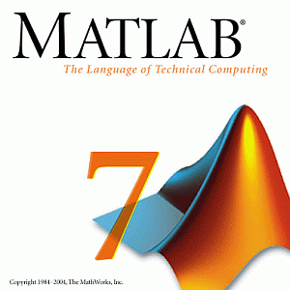
Review of Linear Algebra
Introduction to Matlab

Slide 21
MATrix LABoratory
Mostly used for mathematical libraries
Very easy to do matrix manipulation in Matlab
If this is your first time using Matlab
  Strongly suggest you go through the “Getting Started” part of Matlab help
  Many useful basic syntax

Slide 22
Installing Matlab
Matlab licenses are expensive;
  but “free” for you!
  Available for installation by contacting help+@cs.cmu.edu → SCS students only
  Available by download at my.cmu.edu
    Windows XP SP3+
    MacOS X 10.5.5+
    ~4GB!

Slide 23
Making Arrays
>> v’
ans: 1 2 3 4 5
>> 1:5
ans: 1 2 3 4 5
>> 1:2:5
ans: 1 3 5
>> 5:-2:1
ans: 5 3 1
>> rand(3,1)
ans: 0.0318
0.2769
0.0462
% A simple array
  >> [1 2 3 4 5]
  ans: 1 2 3 4 5
  >> [1,2,3,4,5]
  ans: 1 2 3 4 5
  >> v = [1;2;3;4;5]
  v = 1
        2
        3
        4
        5

Slide 24
Making Matrices
% All the following are equivalent
>> [1 2 3; 4 5 6; 7 8 9]
>> [1,2,3; 4,5,6; 7,8,9]
>> [[1 2; 4 5; 7 8] [3; 6; 9]]
>> [[1 2 3; 4 5 6]; [7 8 9]]
ans: 1 2 3
4 5 6
7 8 9

Slide 25
Making Matrices
% Creating all ones, zeros, identity, diagonal matrices
>> zeros( rows, cols )
>> ones( rows, cols )
>> eye( rows )
>> diag([1 2 3])
% Creating Random matrices
>> rand( rows, cols ) % Unif[0,1]
>> randn( rows, cols) % N(0, 1)
% Make 3x5 with N(1, 4) entries
>> 2 * randn(3,5) + 1
% Get the size
>> [rows, cols] = size( matrix );

Slide 26
Accessing Elements
Unlike C-like languages, indices start from 1 (NOT 0)
>> A = [1 2 3; 4 5 6; 7 8 9]
ans: 1 2 3
4 5 6
7 8 9
% Access Individual Elements
>> A(2,3) ans: 6
% Access 2nd column ( : means all elements)
>> A(:,2)
ans: 2
5
8

Slide 27
Accessing Elements
A= 1 2 3
4 5 6
7 8 9
Matlab has column-order
>> A([1, 3, 5])
ans: 1 7 5
>> A( [1,3], 2:end )
ans: 2 3
8 9
>> A( A > 5) = -1
ans: 1 2 3
4 5 -1
-1 -1 -1
>> A( A > 5) = -1
ans: 7 8 6 9
>> [i j] = find(A>5)
i = 3 j = 1
3 2
2 3
3 3

Slide 28
Matrix Operations
A= 1 2 3
4 5 6
7 8 9
>> A + 2 * (A / 4)
ans: 1.5000 3.0000 4.5000
6.0000 7.5000 9.0000
10.5000 12.0000 13.5000
>> A ./ A
ans: 1 1 1
1 1 1
1 1 1
>> A’
>> A*A is same as A^2
>> A.*B
>> inv(A)
>> A/B, A./B, A+B, …
% Solving Systems
(A+eye(3)) \ [1;2;3]
% inv(A+eye(3)) * [1; 2; 3]
ans: -1.0000
-0.0000
1.0000

Slide 29
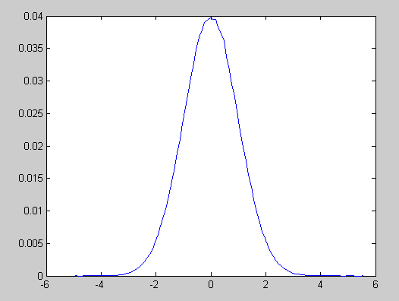
Plotting in Matlab
% Lets plot a Gaussian N(0,1)
% Generate 1 million random data points
d = randn(1000000,1);
% Find the histogram
x = min(d):0.1:max(d);
c = histc(d, x);
p = c / 1000000;
% Plot the pdf
plot(x, p);

Slide 30
Other things to know
if, for statements
scripts and functions
Useful operators
>, <, >=, <=, ==, &, |, &&, ||, +, -, /, *, ^, …, ./,
‘, .*, .^, \
Useful Functions
sum, mean, var, not, min, max, find, exists,
pause, exp, sqrt, sin, cos, reshape, sort,
sortrows, length, size, length, setdiff, ismember,
isempty, intersect, plot, hist, title, xlabel, ylabel,
legend, rand, randn, zeros, ones, eye, inv, diag,
ind2sub, sub2ind, find, logical, repmat, num2str,
disp, svd, eig, sparse, clear, clc, help …

