Slide 1
برنامه نویسی پیشرفته
برنامه نویسی ساخت‌یافته با Java
Notes:
رویه‌ای

Slide 2
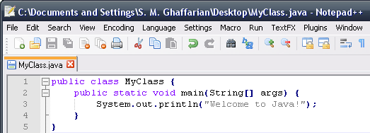
Java Basics
Each Java file includes a public class with the same name as the file-name:
Just like the `C` language, the main method is the program's starting point.

Slide 3
Java Basics (continued ...)
Java is a C based language
very similar to the syntax of C / C++
The Java primitive data types:
byte, int, short, long, float, double, boolean, char
Control statements are also mostly the same:
if, else, switch-case, while, for, do-while, continue, break
Syntax of Java methods is also similar to `C` functions

Slide 4
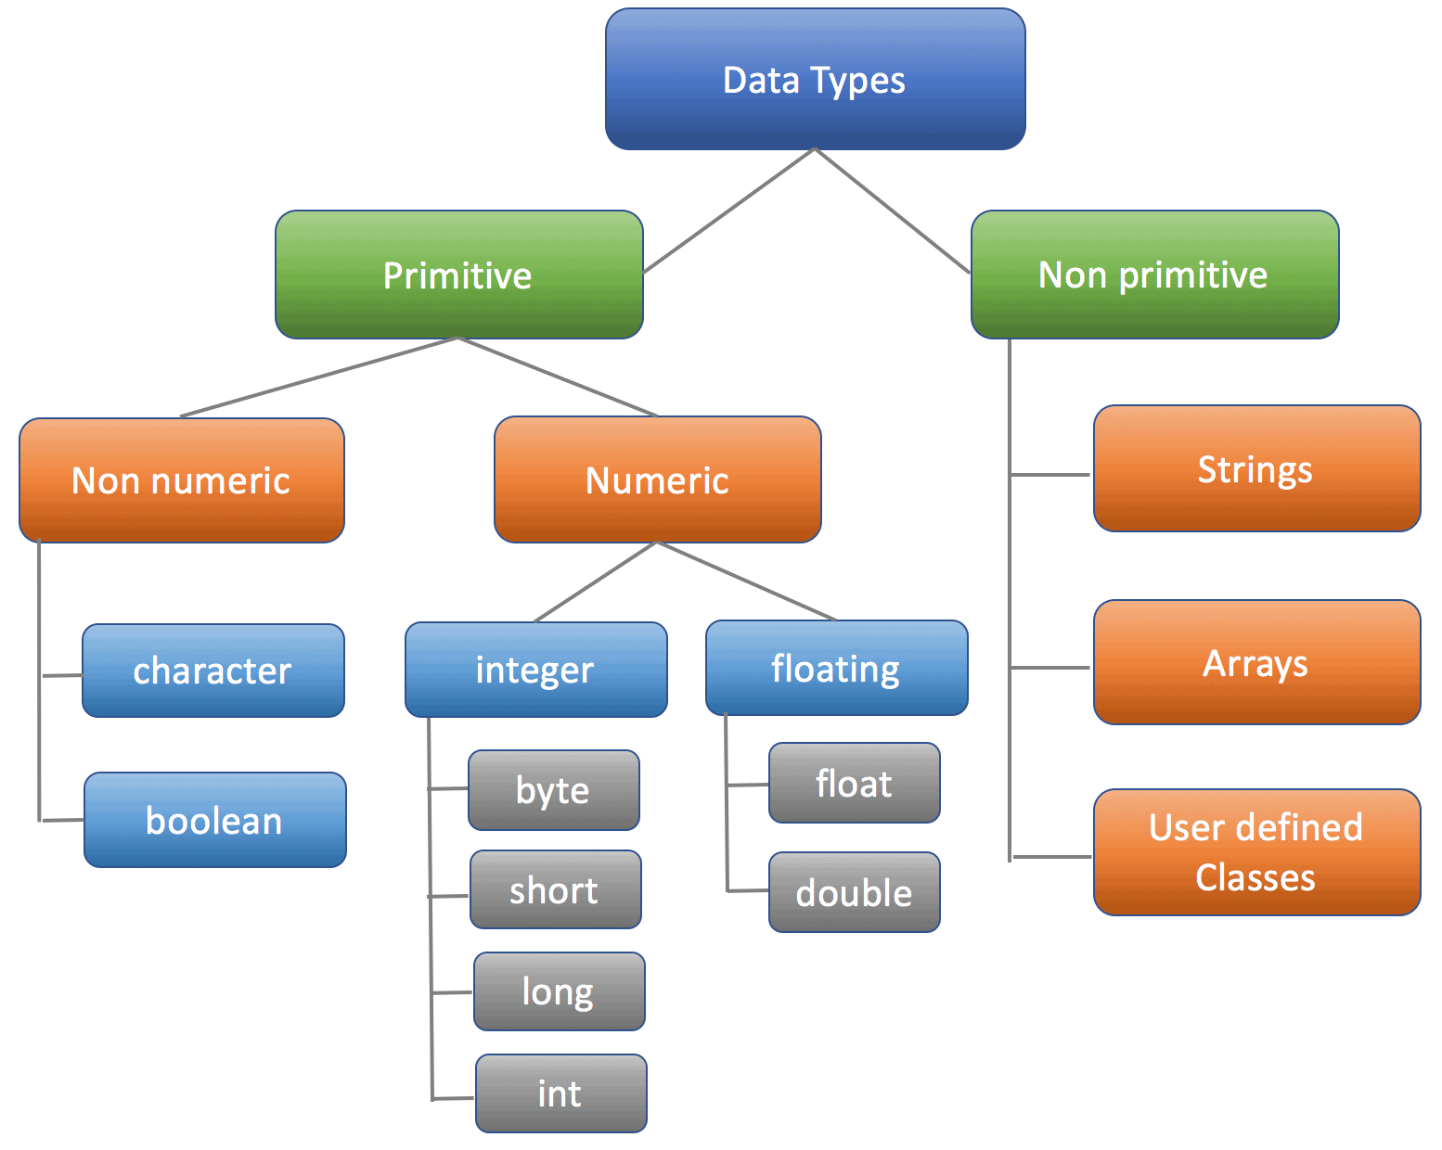
Data Types in Java

Slide 5
Primitive Data Types
Data Type | Size | Description
byte | 1 byte | Stores whole numbers from -128 to 127
short | 2 bytes | Stores whole numbers from -32,768 to 32,767
int | 4 bytes | Stores whole numbers from -2,147,483,648 to 2,147,483,647
long | 8 bytes | Stores whole numbers from -9,223,372,036,854,775,808 to 9,223,372,036,854,775,807
float | 4 bytes | Stores fractional numbers. Sufficient for storing 6 to 7 decimal digits
double | 8 bytes | Stores fractional numbers. Sufficient for storing 15 decimal digits
boolean | 1 bit | Stores true or false values
char | 2 bytes | Stores a single character/letter or ASCII values

Slide 6
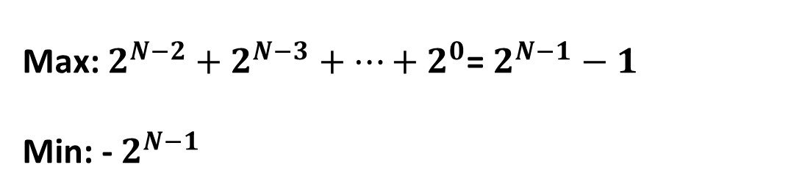
Range Computing
N bit
Sign
0, Non-negative
1, Negative
Max: $2^{N−2}+2^{N−3}+…+2^{0}$= $2^{N−1}−1$
Min: - $2^{N−1}$

Slide 7
Float and Double
float myNum = 5.75f;
System.out.println(myNum);
double myNum = 19.99d;
System.out.println(myNum);
Float is used when:
We need to save memory in large arrays of floating-point numbers,
When the higher precision and range of double are not required.

Slide 8
Boolean
Very often in programming, we will need a data type that can only have one of two values, like:
YES / NO
ON / OFF
TRUE / FALSE
Boolean values are mostly used for conditional testing.

Slide 9
Char
The char data type is used to store a single character.
The character must be surrounded by single quotes, like 'A' or ‘c’.
Example:
char myGrade = 'B';
System.out.println(myGrade)
ASCII , abbreviated from American Standard Code for Information Interchange, is a character encoding standard for electronic communication.

Slide 10
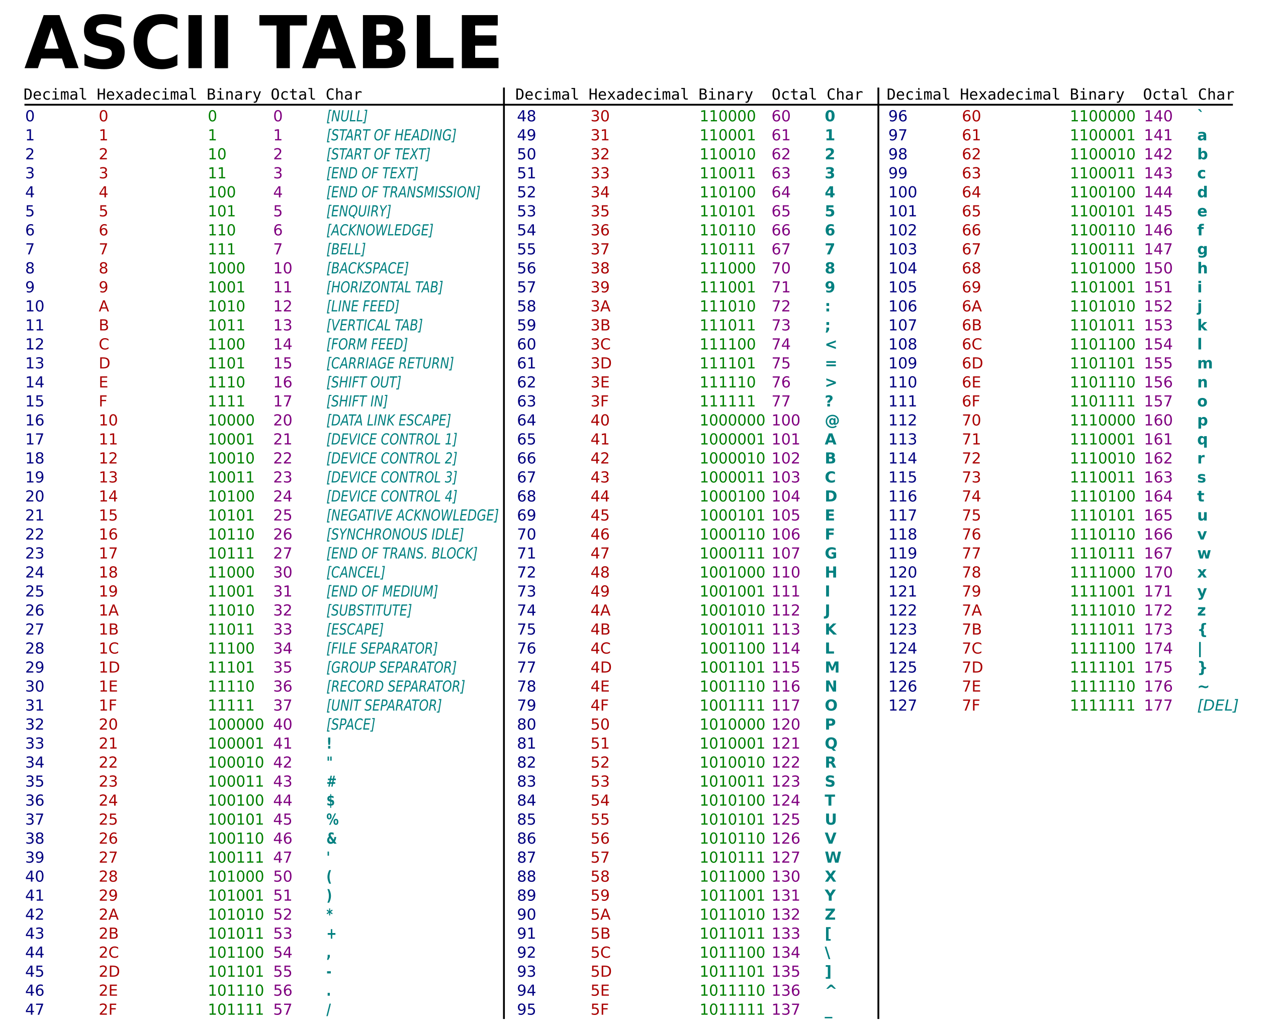

Slide 11
Printing in Java
Java print () method: Data displays in the same line using print statement in java.
Java println ()Method: Output print in the current line, and cursor position moves to the next line.
Java printf ()Method: data displays with the particular format as per requirement.
%s: String
%d: Decimal integer (base 10)
%f: Floating-point number
%n: Newline character (platform-independent)
%t: Date/Time (prefix for date and time conversion characters)
%b: Boolean
%x: Hexadecimal integer (base 16)
%o: Octal integer (base 8)
%%: Literal percent sign %

Slide 12
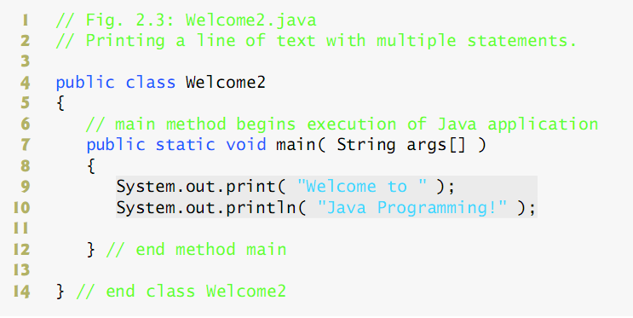
print and println Methods
Notes:
The System class contains several useful class fields and methods. It cannot be instantiated.
Among the facilities provided by the System class are standard input, standard output, and error output streams; access to externally defined properties and environment variables; a means of loading files and libraries; and a utility method for quickly copying a portion of an array.

Slide 13
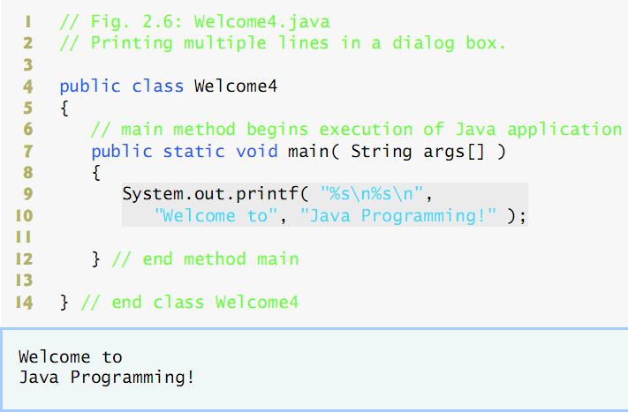
Good Old printf !!

Slide 14
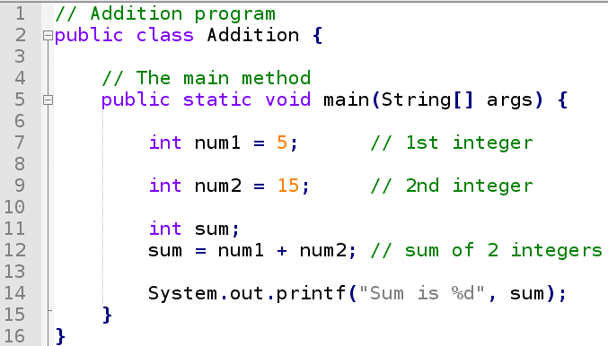
Simple Arithmetic Example

Slide 15
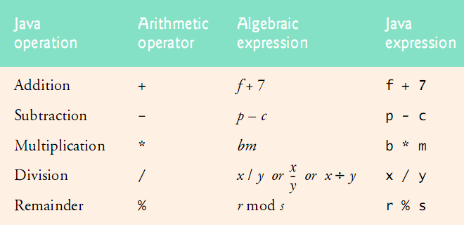
Arithmetic Operators

Slide 16
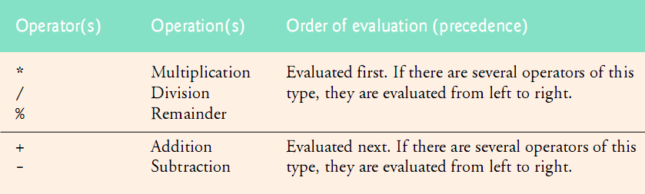
Arithmetic Operators: Precedence

Slide 17
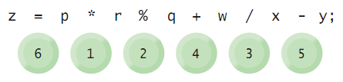
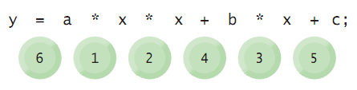
Arithmetic Operators (continued ...)
Examples of operator precedence:
Notes:
Z = 3 * 5 % 4 + 6 / 2 – 1
Z = 5
Y = 2 * 3 * 3 + -2 * 3 + 1 = 13

Slide 18
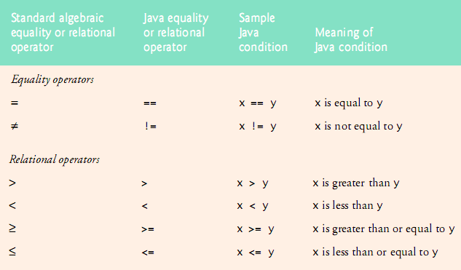
Relational Operators

Slide 19
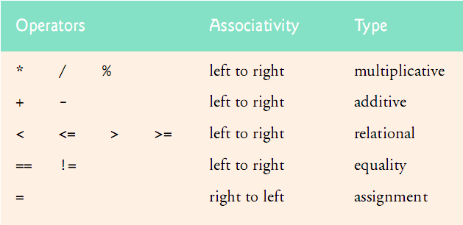
Precedence & Associativity of Operators
Notes:
x = y = 2;

Slide 20
Simple Example Program
public class IfElse0 {
public static void main(String[] args) {
int num1 = 18; // 1st integer
int num2 = 15; // 2nd integer
if (num1 == num2)
System.out.printf("%d == %d\n", num1, num2);
if (num1 != num2)
System.out.printf("%d != %d\n", num1, num2);
if (num1 > num2)
System.out.printf("%d > %d\n", num1, num2);
if (num1 < num2)
System.out.printf("%d < %d\n", num1, num2);
if (num1 >= num2)
System.out.printf("%d >= %d\n", num1, num2);
if (num1 <= num2)
System.out.printf("%d <= %d\n", num1, num2);
}
}

Slide 21
if-else Control Statements
char gradeRank;
float studentGrade = 18.0f;
if (studentGrade >= 17) {
gradeRank = 'A';
System.out.println("Student Grade is A!");
} else if (studentGrade >= 15) {
gradeRank = 'B';
System.out.println("Student Grade is B!");
} else if (studentGrade >= 12) {
gradeRank = 'C';
System.out.println("Student Grade is C!");
} else if (studentGrade >= 10) {
gradeRank = 'D';
System.out.println("Student Grade is D!");
} else {
System.out.println("Student Failed!");
}
Notes:
Any problems?

Slide 22
if-else Control Statements
char gradeRank;
float studentGrade = 18.0f;
if (studentGrade >= 17) {
gradeRank = 'A';
} else if (studentGrade >= 15) {
gradeRank = 'B';
} else if (studentGrade >= 12) {
gradeRank = 'C';
} else if (studentGrade >= 10) {
gradeRank = 'D';
} else {
gradeRank = 'F';
}
System.out.println("Student's grade is " + gradeRank + "!");

Slide 23
More on print
Output?
System.out.println(1 + 2);
System.out.println(1 + 2 + " = 1 + 2");
System.out.println("1 + 2 = " + 1 + 2);
System.out.println("" + 1 + 2);
System.out.println("1 + 2 = " + (1 + 2));

Slide 24
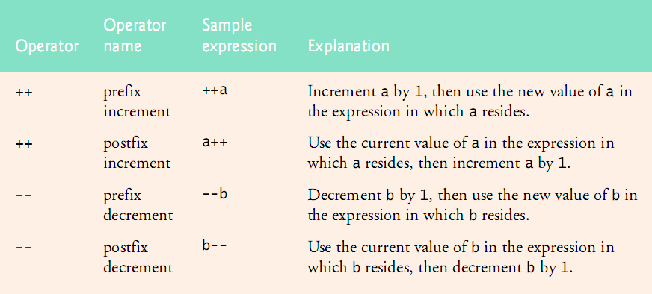
Increment & Decrement Operators
Notes:
int x = 5;
int y = 10;
int z = ++x * y--;

Slide 25
The Difference …
public class PostVsPrefix {
public static void main(String[] args) {
int number1 = 5;
System.out.println("number1 is: " + number1);
System.out.println("number1 is: " + number1++);
System.out.println("number1 is: " + number1);
int number2 = 5;
System.out.println("number2 is: " + number2);
System.out.println("number2 is: " + ++number2);
System.out.println("number2 is: " + number2);
}
}

Slide 26
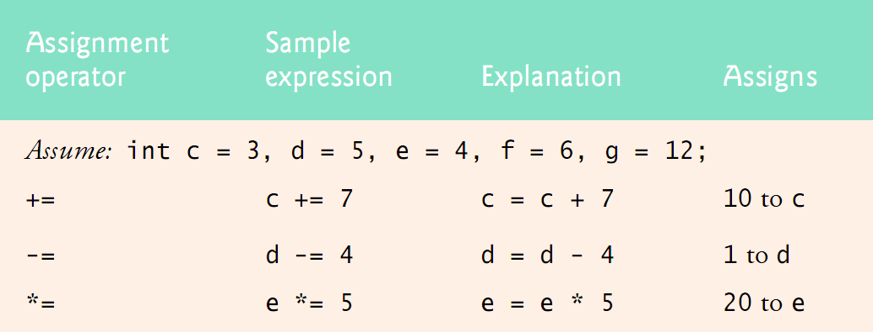
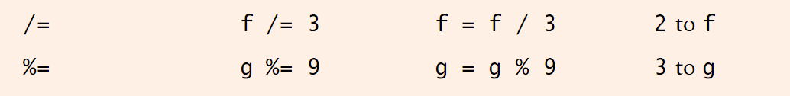
Arithmetic Compound Assignment Operators

Slide 27
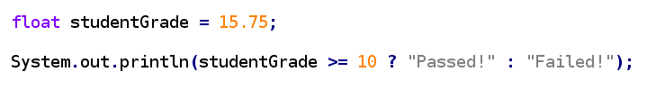
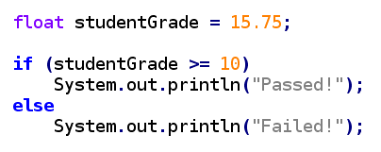
The Conditinal Operator
The Conditinal Operator ( ?: )
is equal to …
double
double
Notes:
The only trioprand operator

Slide 28
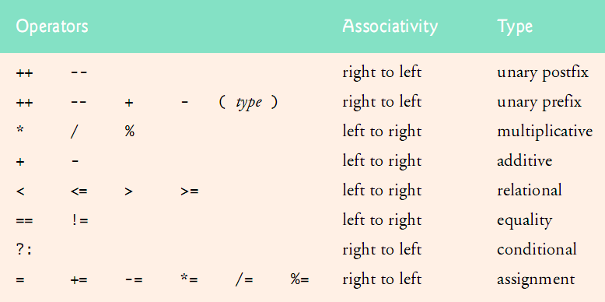
Precedence & Associativity of Operators

Slide 29
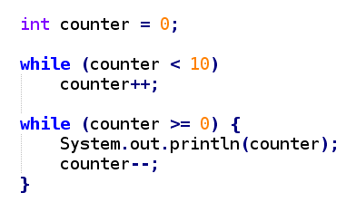
Repetition Control Statements
while Repetition Statement

Slide 30
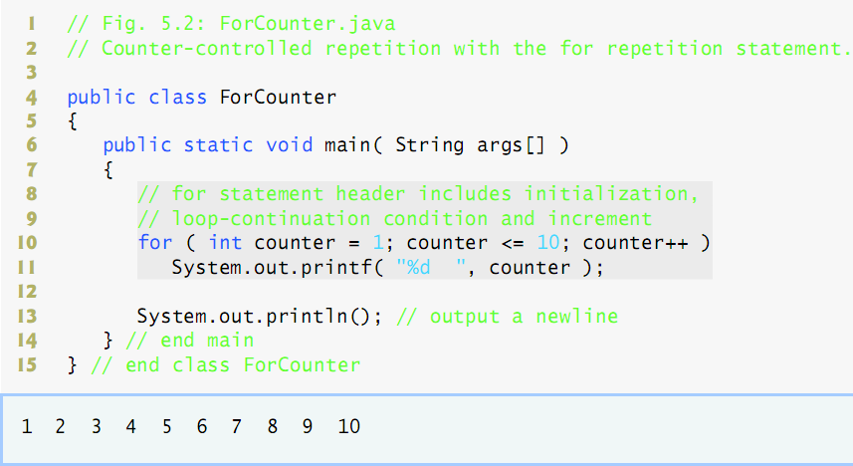
Repetition Control Statements (continued ...)
for Repetition Statement

Slide 31
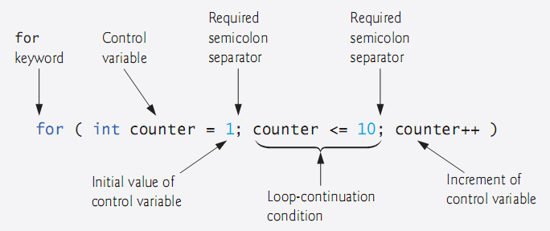
Repetition Control Statements (continued ...)

Slide 32

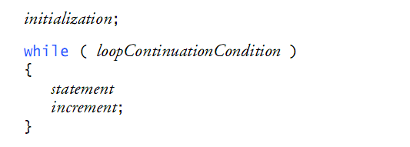
Repetition Control Statements (continued ...)
is equal to …
{
}
Notes:
This is more accurate!

Slide 33
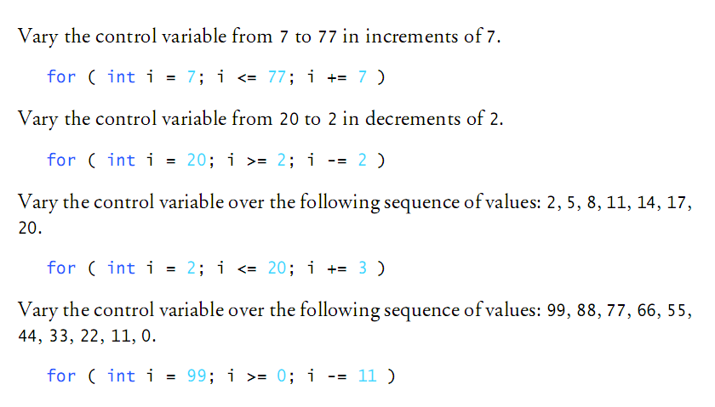
Repetition Control Statements (continued ...)

Slide 34
Repetition Control Statements (continued ...)
Summation of even numbers in the range of 2 to 20:

Slide 35
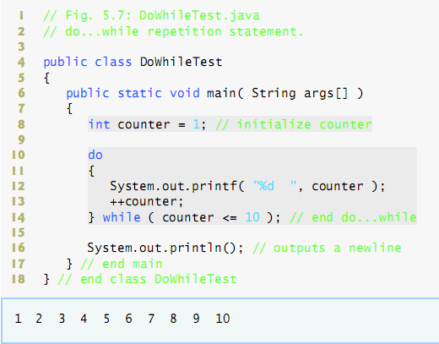
Repetition Control Statements (continued ...)
do...while Repetition Statement

Slide 36
Write A Simple Program!
Assume: getNum() is a method that reads a number (integer) from the user and returns it. You don’t need to know how it works for now.
Using getNum() write a program that reads integer values and adds the values as long as the entered number is not -1. After the user enters -1, the program shows the sum of the numbers (not including the last -1).

Slide 37
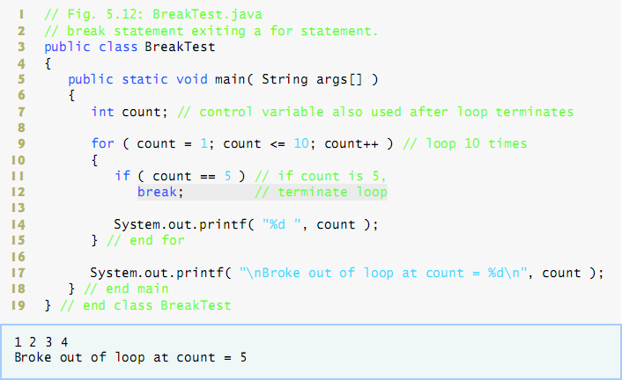
break Statement

Slide 38
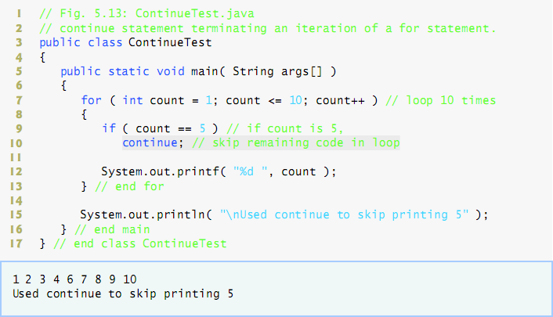
continue Statement

Slide 39
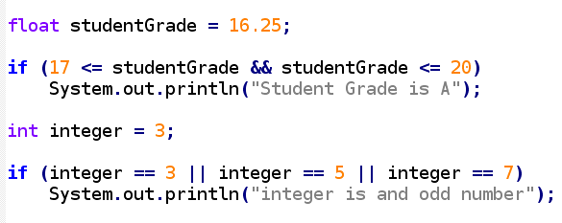
Logical Operators
Conditional AND and OR operators
double

Slide 40
Write Another Program!
Write a program that given a year shows if the year is a leap year or not.
چنانچه باقی‌مانده حاصل تقسیم سال مورد نظر (سال‌های ۱۳۴۳ تا ۱۴۷۲) بر عدد ۳۳، یکی از اعداد (۱، ۵، ۹، ۱۳، ۱۷، ۲۲، ۲۶ و ۳۰) باشد، آن سال کبیسه است
از صفحه سال کبیسه ویکی‌پدیا

Slide 41
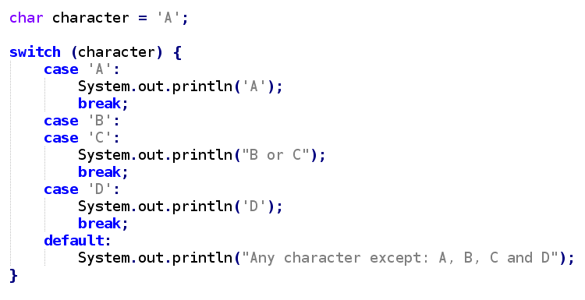
switch Multiple-Selection Statement
Notes:
A switch works with the byte, short, char, and int primitive data types. It also works with enumerated types (discussed in Enum Types), the String class, and a few special classes that wrap certain primitive types: Character, Byte, Short, and Integer (discussed in Numbers and Strings).

Slide 42
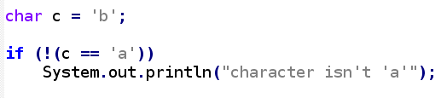
Logical Operators (continued ...)
Logical Negation Operator
Notes:
نفی

Slide 43
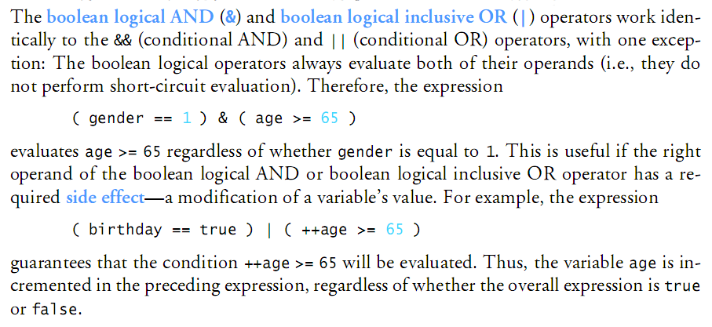
Logical Operators (continued ...)
Logical AND and OR operators
Also called bitwise
Notes:
https://www.programiz.com/java-programming/bitwise-operators

Slide 44
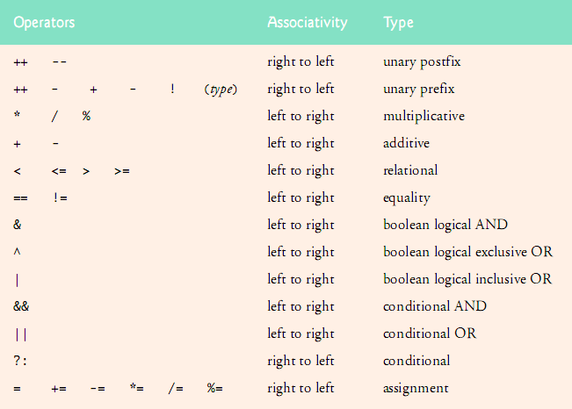
Precedence & Associativity of Operators
-
Notes:
The unary bitwise complement operator "~" inverts a bit pattern; it can be applied to any of the integral types, making every "0" a "1" and every "1" a "0". For example, a byte contains 8 bits; applying this operator to a value whose bit pattern is "00000000" would change its pattern to "11111111".
Java Bitwise XOR Operator

Slide 45
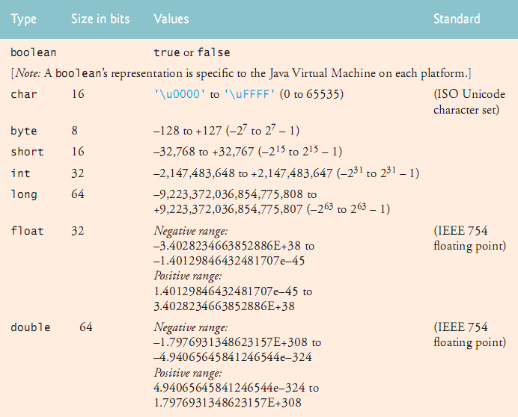
Primitive Data-Types

Slide 46
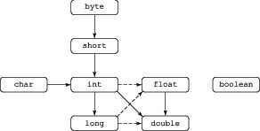
Automatic Conversions in Java

Slide 47
Code Aesthetics
Indent the code inside a block ( 4x spaces or 1x tab )
Put a space on both sides of every operator
Start the name of every variable with lower-case letters
Start the name of every class with upper-case letters
Use Camel-case letters for all names

Slide 48
Java Coding Conventions
Sun MicroSystems original Java coding conventions:
www.oracle.com/technetwork/java/codeconventions-150003.pdf
Google's Java coding conventions:
https://google.github.io/styleguide/javaguide.html
Twitter's Java coding conventions:
github.com/twitter/commons/blob/master/src/java/com/twitter/common/styleguide.md

Slide 49
References
Deitel's Java How to Program (7th Edition)
Chapter 2
Chapter 4
Chapter 5

