Slide 1
Object interaction
Creating cooperating objects
6.0

Slide 2
Contribution: to give something that is or becomes part of a larger whole.
Cooperation: To work with someone in the sense of enabling: making them more able to do something.
e.g. The editors agreed to cooperate.
Collaboration: to work together with others to achieve a common goal1.
When people collaborate on a project, they work together in order to produce something.
e.g. two writers can collaborate to produce a single piece of writing.
Collaboration allows for a shared vision and co-ownership of a project.
Cooperation allows individuals to contribute to a project without having to take on a larger role.

Slide 3
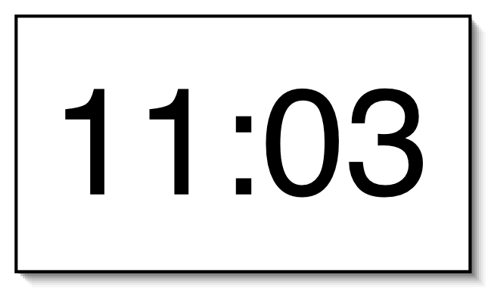
A digital clock

Slide 4
Abstraction
Abstraction is the ability to ignore details of parts to focus attention on a higher level of a problem.
In Java, abstraction is achieved by interfaces and abstract classes.

Slide 5
Abstraction (cont.)
Can also be defined as the process of: identifying only the required characteristics of an object ignoring the irrelevant details.
Required characteristic
Irrelevant details
Object

Slide 6
Abstract Terms
Abstract class: is a restricted class that cannot be used to create objects.
to access it, it must be inherited from another class.
How to access??

Slide 7


Usual way to access a room: Opening its door!
Usual way to access a Class: Making an Object and calling the class content using it.
Usual way to access an Abstract Class: Creating an inherited class and define an object of it.

Slide 8
Abstract Terms
Abstract method: can only be used in an abstract class.
It does not have a body.
The body is provided by the subclass (inherited from).

Slide 9
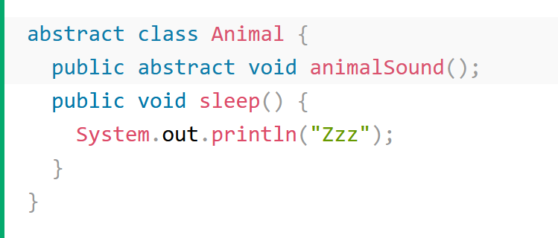
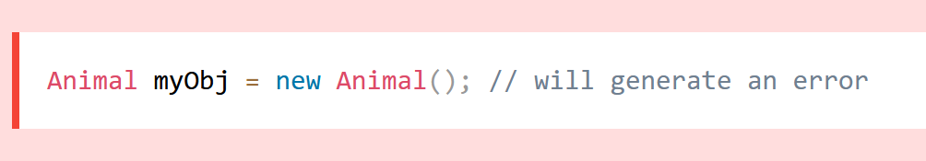
An abstract method
A non-abstract method
To access the abstract class, it must be inherited from another class.

Slide 10
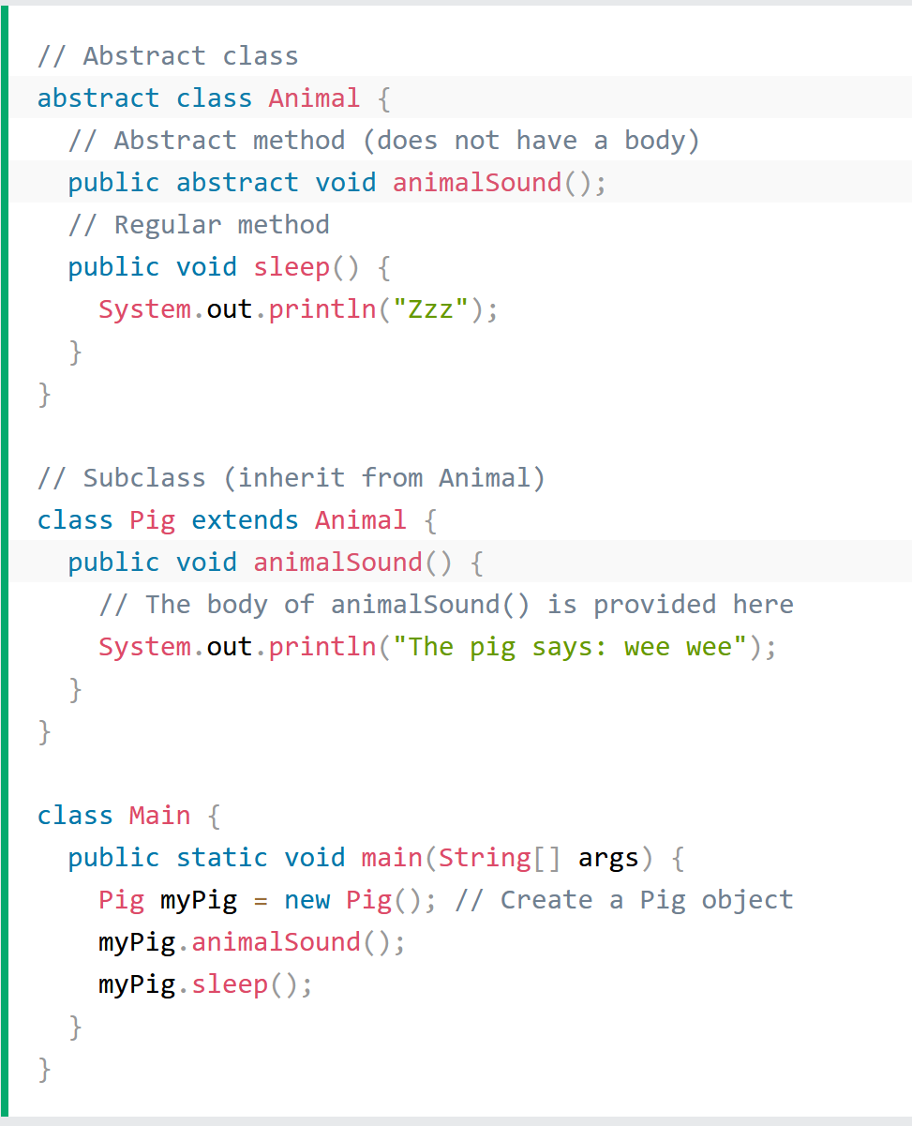
Why and When to use abstract classes and methods?
To achieve security hide certain details and only show the important details of an object.

Slide 11

Modularization
Modularization is the process of dividing a whole into well-defined parts:
which can be built and examined separately,
and which interact in well-defined ways.

Slide 12



Modularizing the clock display
One four-digit display?
Or two two-digit displays?
Implementation:
NumberDisplay
ClockDisplay

Slide 13
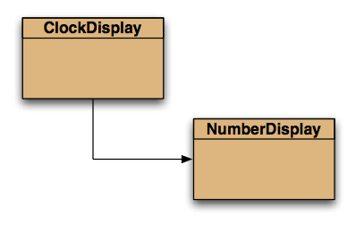
Class diagram (static view)

Slide 14
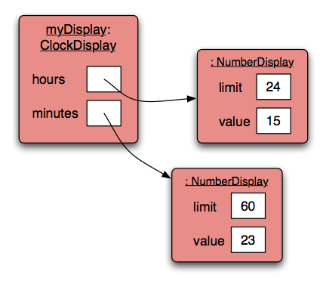
Object diagram (dynamic view)

Slide 15

NumberDisplay class
The NumberDisplay class represents a digital number display that can hold values from zero to a given limit.
The limit can be specified when creating the display.
The values range from zero to limit-1.
e.g. for the seconds on a digital clock, the limit would be 60,
resulting in display values from 0 to 59.
When incremented, the display automatically rolls over to zero when reaching the limit.

Slide 16
Implementation - NumberDisplay
public class NumberDisplay
{
private int limit;
private int value;
Constructor and
methods omitted.
}
We need to Decide about:
How to perform incrementation?
How to get the time as the output?
How to set the time as the input?

Slide 17
Source code: NumberDisplay
public NumberDisplay(int rollOverLimit)
{
limit = rollOverLimit;
value = 0;
}
public void increment()
{
value = (value + 1) % limit;
}
* value is between 0 --> (limit - 1)

Slide 18
Source code: NumberDisplay
public String getDisplayValue()
{
if(value < 10) {
return "0" + value;
}
else {
return "" + value;
}
}

Slide 19
Source code: setValue()
public void setValue(int replacementValue)
{
if((replacementValue >= 0) &&
(replacementValue < limit))
{
value = replacementValue;
}
}

Slide 20
Implementation - ClockDisplay
public class ClockDisplay
{
private NumberDisplay hours;
private NumberDisplay minutes;
Constructor and
methods omitted.
}

Slide 21
Objects creating objects
public class ClockDisplay
{
private NumberDisplay hours;
private NumberDisplay minutes;
private String displayString;
public ClockDisplay()
{
hours = new NumberDisplay(24);
minutes = new NumberDisplay(60);
…
}
}

Slide 22
Objects creating objects
in class ClockDisplay:
hours = new NumberDisplay(24);
actual parameter
in class NumberDisplay:
public NumberDisplay(int rollOverLimit)
formal parameter

Slide 23
Quiz: What is the output?
int a; int b; a = 32; b = a; a = a + 1; System.out.println(b);
Person a; Person b; a = new Person("Everett"); b = a; a.changeName("Delmar"); System.out.println(b.getName());

Slide 24
Primitive types vs. object types
ObjectType a;
ObjectType b;
b = a;
int a;
int b;
32
32

Slide 25
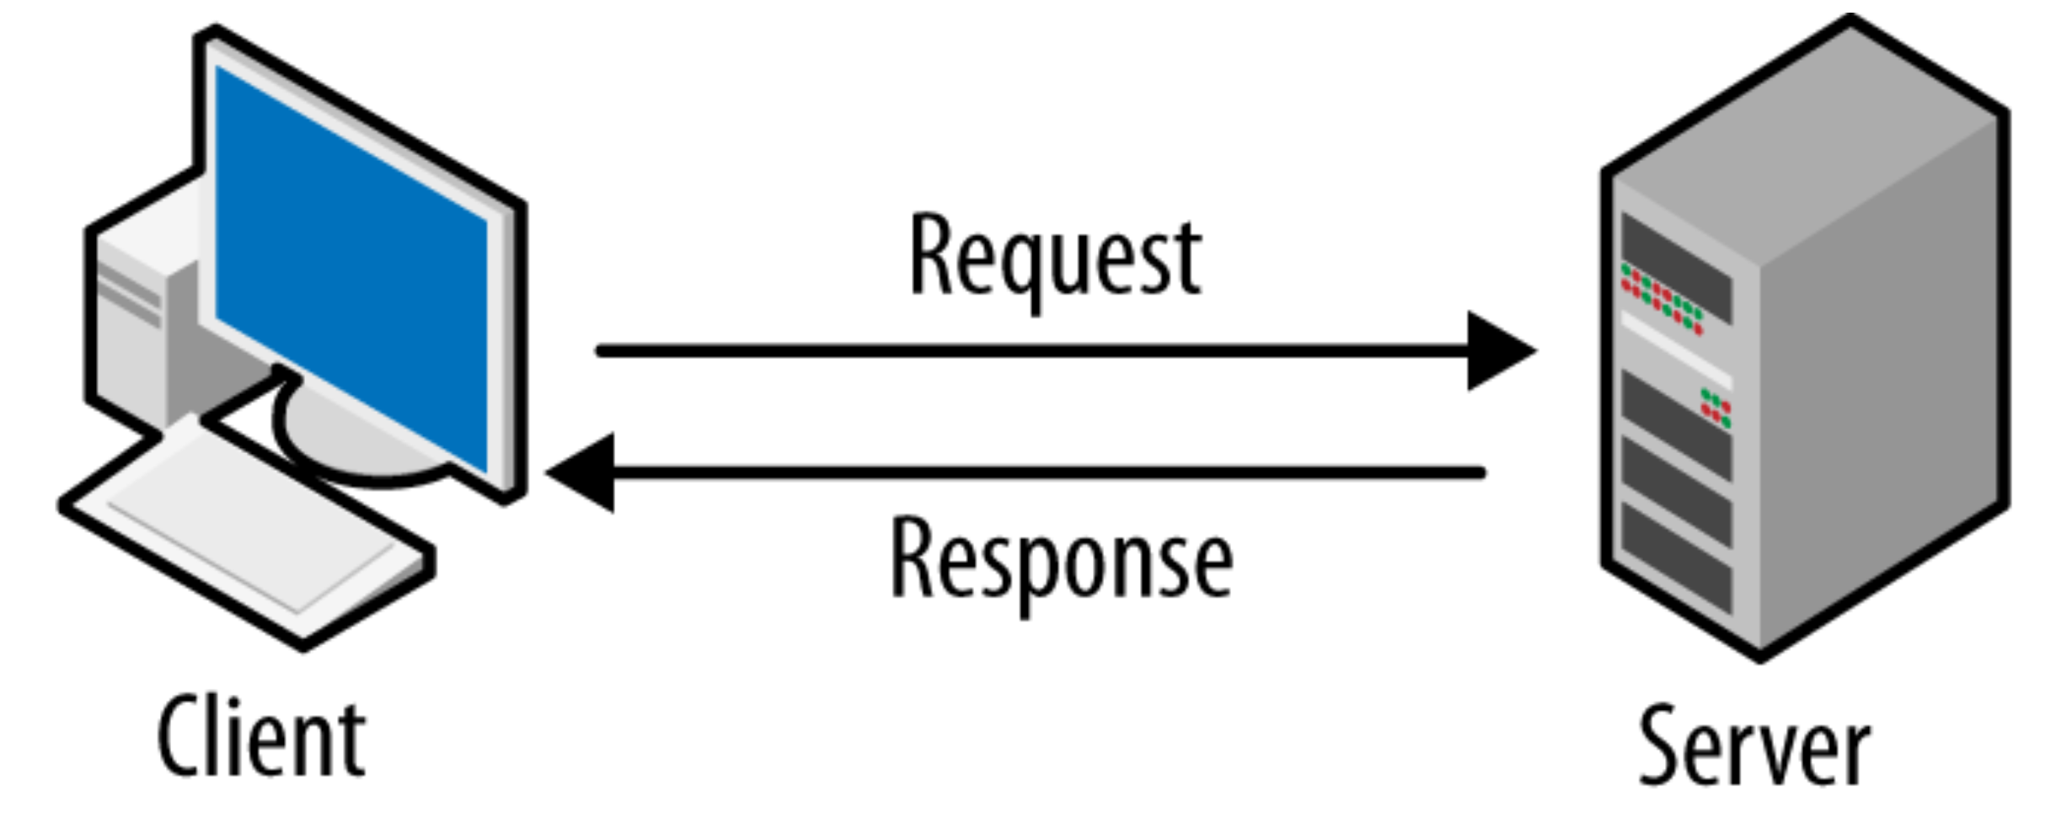
Client and Server
A client is an entity that makes requests to a server.
A server is an entity that fulfills those requests.

Slide 26
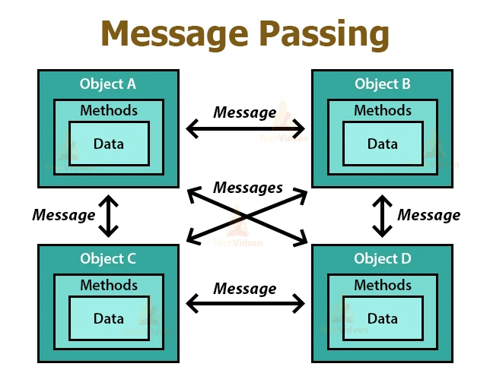
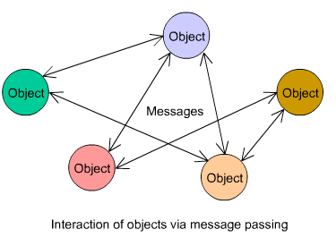
Object Interaction
We create many objects from prototypes known as classes.
These objects interact with one another by sending each other messages.
The result of a message is a method invocation which:
performs some action
modifies the state of the receiving object.

Slide 27
Object interaction
Two objects interact when one object calls a method on another.
The interaction is usually all in one direction (client, server).
The client object can ask the server object to do something.
The client object can ask for data from the server object.

Slide 28
Object interaction
Two NumberDisplay objects store data on behalf of a ClockDisplay object
The ClockDisplay is the client object
The NumberDisplay objects are the server objects
The client calls methods in the server objects

Slide 29
Method calling
‘client’ method
‘server’ external methods
public void timeTick()
{
minutes.increment();
if(minutes.getValue() == 0) {
// it just rolled over!
hours.increment();
}
updateDisplay();
}
internal/self method call

Slide 30
External method calls
General form of external method call: object . methodName ( params )
Examples: hours.increment() minutes.getValue()
NumberDisplay Class
ClockDisplay Class

Slide 31
Internal method calls
No variable name is required for internal method calls: updateDisplay();
Internal methods often have private visibility to prevent them from being called from outside their defining class.
Method is found in this same invoking class/object where the call is made.

Slide 32
Internal method
/**
* Update the internal string that
* represents the display.
*/
private void updateDisplay()
{
displayString =
hours.getDisplayValue() + ":" +
minutes.getDisplayValue();
}

Slide 33
Method calls
Internal means this object.
External means any other object, regardless of its type.

Slide 34
Consider a class, Rectangle, that defines a rectangle, with the following features:
int fields for length and width,
a constructor to initialize length and width,
a method to calculate the area.
public class Rectangle {
private int length;
private int width;
// Constructor to initialize length and width
public Rectangle(int length, int width) {
this.length = length;
this.width = width;
}
// Method to calculate the area
public int calculateArea () {
return length * width;
}
public static void main(String[] args) {
Rectangle rect = new Rectangle (10, 5);
System.out.println("Area of the rectangle: " + rect.calculateArea());
}
}
internal method call

Slide 35
public class Shapes {
// Fields
private Rectangle box1;
private Rectangle box2;
// Constructor
public Shapes() {
box1 = new Rectangle(5, 10);
box2 = new Rectangle(2, 2);
}
public static void main(String[] args) {
Shapes shapes = new Shapes();
// Invoking the method calculateArea() using dot notation
System.out.println("Area of box1: " + shapes.box1.calculateArea()); // outputs 50
System.out.println("Area of box2: " + shapes.box2.calculateArea()); // outputs 4
}
}

Slide 36
Method / Constructor Overloading
Overloading: with a different set of parameters:
public ClockDisplay() {
hours = new NumberDisplay(24);
minutes = new NumberDisplay(60);
updateDisplay();
}
public ClockDisplay(int hour, int minute) {
hours = new NumberDisplay(24);
minutes = new NumberDisplay(60);
setTime(hour, minute);
}

Slide 37
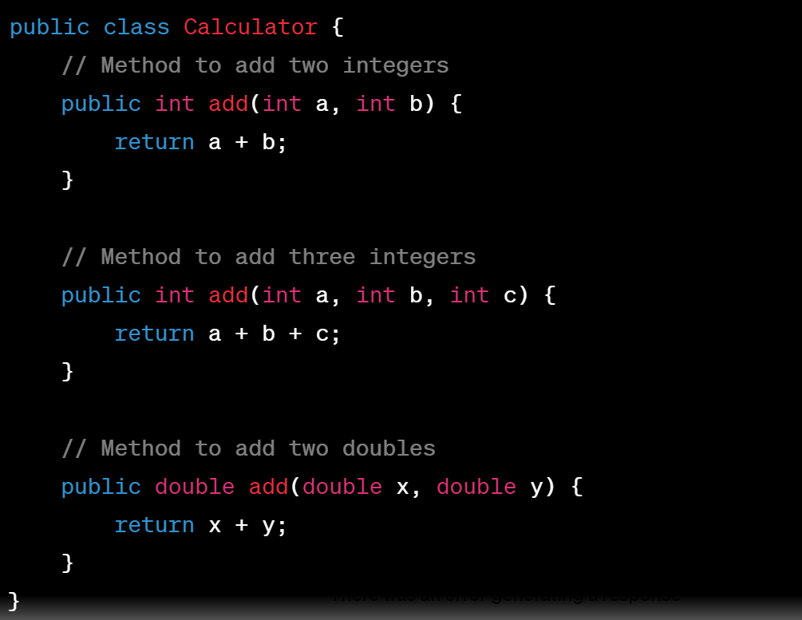
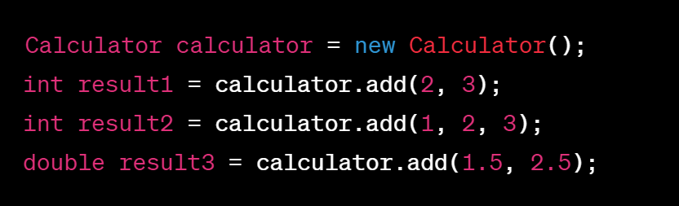
In both constructor and method overloading:
The Java compiler determines which constructor or method to call
based on the number and types of arguments provided when creating objects or invoking methods.
Overloading makes the code more readable and allows you to provide different functionalities while using the same name.

Slide 38
Quiz: is this correct ?!
private int value;
public void setValue(int value) {
value = value;
}

Slide 39
Static Vs. Instance
Static members:
Such as static variables and static methods, belong to the class itself rather than to any specific object (instance) of the class.
They are associated with the class and can be accessed using the class name without the need to create an object of the class.
There is only one copy of each static member shared among all instances of the class.
Instance Members:
Such as instance variables and instance methods, belong to individual objects (instances) of the class.
Each object has its own separate copy of instance members, and changes made to instance members of one object do not affect other objects of the same class.

Slide 40
Accessing Members
Static members:
Static members can be accessed using the class name or through an object of the class. However, it is recommended to access them using the class name for clarity.
They can be accessed without creating an instance of the class.
Instance Members:
Instance members can only be accessed through an object (instance) of the class.
Each instance of the class has its own set of instance members.

Slide 41
Accessing Members
Static members:
Are typically used for properties that are shared among all instances of the class.
They are used when a property or method does not depend on the specific state of individual objects.
Instance Members:
Instance members are used when properties need to maintain state specific to each object.
For example, instance variables can store unique data for each object.
They are used when a property or method's behavior depends on the specific state of individual objects.

Slide 42
Quiz
Memory allocation?
Initialization?

Slide 43
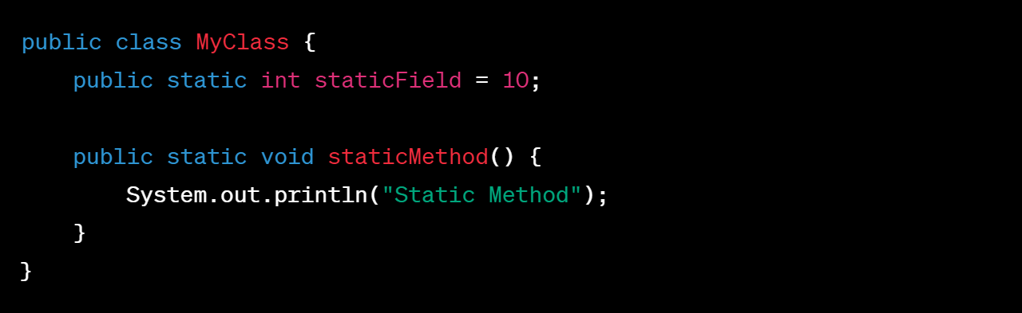

Static Member
You can access the staticField and staticMethod like this:

Slide 44
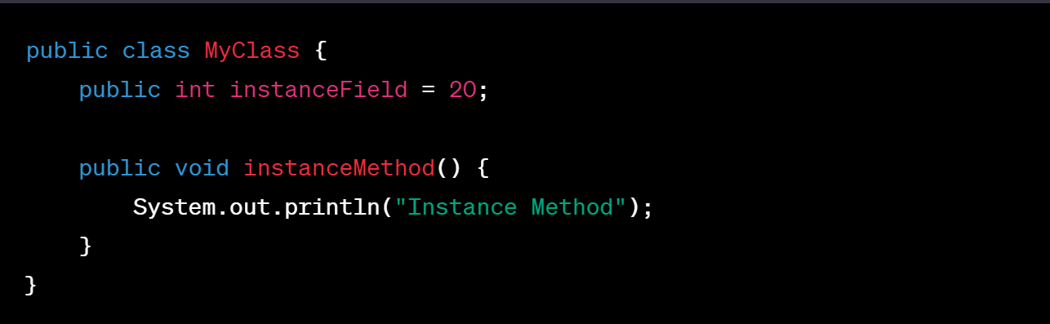

Instance Member
You can access the instanceField and instanceMethod like this within an instance method:

Slide 45
The this keyword
Used to distinguish parameters and fields of the same name.
public ClockDisplay(int limit) { this.limit = limit; value = 0; }

Slide 46
null
null is a special value in Java
Object fields are initialized to null by default
You can test for and assign null
private NumberDisplay hours; if(hours != null) { ... } hours = null;

Slide 47
null vs. void
null
Means undefined or no memory address is being pointed to
Used in code to represent no object reference exists
void
Means empty or no data type
Used in place of the return type for a method when no value is being returned

Slide 48
Main Method
Do all Java classes include the main method?
In a Java program, you can have multiple classes, but only one of them should contain the public static void main(String[] args) method.
This is the class that the Java Virtual Machine (JVM) will look for when you execute your program.
Other classes can be used to define objects and methods that are used by the main method or by other parts of your program.

Slide 49
The debugger
A Java debugger is a tool that allows developers to inspect, monitor, and debug their Java applications during development.
Java developers typically use integrated development environments (IDEs) like Eclipse, IntelliJ IDEA, or NetBeans to take advantage of their built-in debugging features.
Useful for gaining insights into program behavior

Slide 50
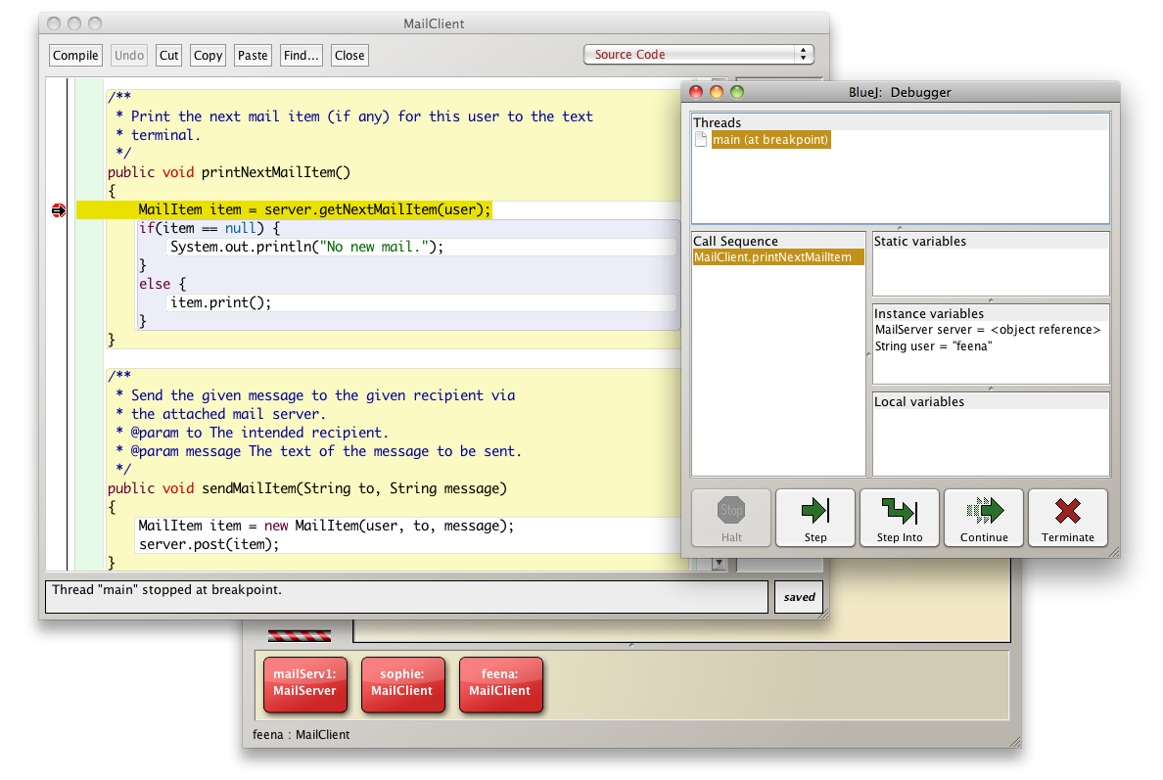
The debugger

Slide 51
Compiling
Definition: Compiling is the process of translating the human-readable source code (written by a programmer) into machine-readable code (usually in the form of bytecode or machine code) that can be executed by the computer.
When It Occurs: Compilation is done before the program is executed.
It is a one-time process that converts the entire source code into an intermediate or binary form.
In Java, the output of compilation is often a bytecode file (with a .class extension), which can be run on the Java Virtual Machine (JVM).

Slide 52
Running
Definition: Running refers to the process of executing a compiled program or script. It involves the actual execution of the program's instructions by the computer's CPU.
When It Occurs: Running occurs after the compilation phase. Once the program is successfully compiled, it can be run multiple times without recompilation.
The output of running a program can vary widely, depending on the program's functionality. It may produce text output, display graphics, interact with users, or perform various computations.

Slide 53
Executing
Definition: Executing is a broader term that encompasses both compilation and running.
It refers to the entire process of
taking a program from its source code form,
checking it for errors,
translating it into machine-readable code
and finally, running it.

Slide 54
Errors
Syntax
* Errors in the code text itself
* Found when compiling with unrecognizable text
* Fix by editing code
Logic
* Errors in the behavior of the program
* Found when running with unexpected results
* Fix by debugging and observing states
Runtime
* Errors which prohibit program from completing
* Found when executing the program
* Fix by tracing, debugging, observing and editing

Slide 55
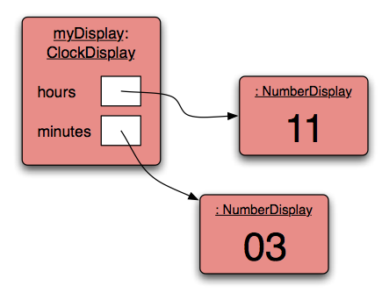
Object diagram (dynamic view)

Slide 56
The modulo operator
The division operator (/), when applied to int operands, returns the result of an integer division
The modulo operator (%) returns the remainder of an integer division
For example, generally: 17 / 5 gives result 3, remainder 2
In Java: 17 / 5 == 3 17 % 5 == 2

Slide 57

The modulo operation as an expression
Dividend / Divisor = Quotient RRemainder
21 / 5 = 4 R1
Thus, the modulo operation(%) is expressed as:
a % b == a – ((a / b) * b)
21 % 5 == 21 – ((21 / 5) * 5)
== 21 – ((4) * 5)
== 21 – 20
== 1

Slide 58
Quiz
What is the result of the expression 8 % 3
For integer n >= 0, what are all possible results of: n % 5
Can n be negative? ………… YES!! What are all the possible results of: -n % 5
Is this possible? n % 0

Slide 59
Quiz
What is the result of the expression 8 % 3 == 2
For integer n >= 0, what are all possible results of: n % 5 0, 1, 2, 3, 4
Can n be negative? ………… YES!! What are all the possible results of: -n % 5 -4, -3, -2, -1, -0
Is this possible? ………… NO!! n % 0 since n/0 is undefined

Slide 60
increment method
public void increment()
{
value = value + 1;
if(value == limit) { // Keep the value within the limit. value = 0; }
}

Slide 61
Alternative increment method
public void increment()
{
value = (value + 1) % limit;
}
Check that you understand how the rollover works in this version.

