Slide 1
Grouping objects
Introduction to collections
6.0

Slide 2
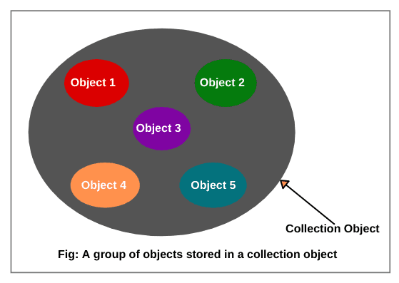
Object Collection
Any group of individual objects which are represented as a single unit is known as a collection of objects.
Collection framework is used to store, retrieve and manipulate collections.

Slide 3
The requirement to group objects
Many applications involve collections of objects:
Personal organizers
Library catalogs
Student record systems
Music organizer
Number of items to be stored is dynamic
Items added
Items deleted
Items retrieved

Slide 4
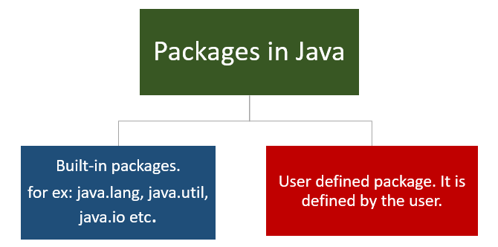
Class Libraries
In Java, a class library refers to:
A collection of pre-compiled classes, interfaces, and methods that provide a wide range of reusable functionality to Java developers.
These libraries can be used to perform various tasks without having to implement them from scratch.
Class libraries are organized into packages, and each package contains related classes and interfaces.

Slide 5
Class Libraries
Provides many useful classless.
Java calls its libraries packages.
Use library classes the same way as classes that you write (i.e constructor/methods)

Slide 6
An organizer for music files
COLLECTION
Contains a group of songs
ITEMS
Songs are stored as its filename only
No pre-defined limit on the number of songs
OPERATIONS
Song files may be added
Song files may be deleted
How many song files are stored (i.e. size)
Get a song filename from the group

Slide 7
Music collection example MusicOrganizer
CLASS
* MusicOrganizer containing various song files.
FIELDS
* Dynamic ArrayList storage for a varying number of song String filenames.
METHODS
* addFile
* removeFile
* getNumberOfFiles
* listFile

Slide 8
import java.util.ArrayList; // import statement
The import keyword is used to bring classes, interfaces, or other constructs from a specific package into your current Java source file.
In Java, packages are used to organize classes and other code constructs into namespaces.
The java.util package is a standard Java package that contains utility classes, including the ArrayList class.
When you include the statement import java.util.ArrayList; in your Java code,
You are telling the Java compiler that you want to use the ArrayList class from the java.util package in your current class.
After importing it, you can simply refer to ArrayList in your code without specifying the full package name every time,
making your code more concise and readable.

Slide 9
Collections
We specify ...
collection type: ArrayList
containing objects of type: <String>
We say ... “ArrayList of String”
private ArrayList<String> files;
myMusic:
MusicOrganizer
•
null
files
* Only 1 field named files is defined for the entire class

Slide 10
ArrayList
ArrayList class represents a dynamic array-like data structure that can
Grow or shrink in size as elements are added or removed.
It is one of the most commonly used classes for working with lists or collections of objects.
Difference between Array and ArrayList???

Slide 11
Key methods of class ArrayList
The ArrayList class implements list functionality with methods for the following operations:
add(item)
add(index, item)
remove(item)
remove(index)
get(index)
size()
isEmpty()

Slide 12
key characteristics of the ArrayList class
Dynamic Sizing: Unlike regular arrays in Java, which have a fixed size, an ArrayList can dynamically resize itself to accommodate more elements as needed.
Generics: You can create an ArrayList of a specific type of object, such as ArrayList<String> for a list of strings or ArrayList<Integer> for a list of integers. This type safety helps prevent runtime type errors.
Methods for Adding and Removing Elements:
add(element): Adds an element to the end of the list.
add(index, element): Inserts an element at a specified index.
remove(index): Removes the element at a specified index.
remove(element): Removes the first occurrence of the specified element.
clear(): Removes all elements from the list.
Methods for Accessing Elements:
get(index): Retrieves the element at a specified index.
set(index, element): Replaces the element at a specified index with a new element.
size(): Returns the number of elements in the list.
isEmpty(): Checks if the list is empty.

Slide 13
Creating an ArrayList object in the constructor
In Java versions prior to version 7
files = new ArrayList<String>( );
Java 7 introduced ‘diamond notation’
files = new ArrayList< >( );
where the type parameter can be inferred from the variable it is being assigned to
myMusic:
MusicOrganizer
:ArrayList<String>
new
files
•

Slide 14
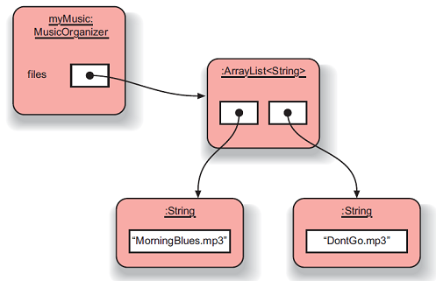
Object structures with ArrayList collections
Only a single field that stores an object of type ArrayList<String>
All work to access and manage the data is done in ArrayList object
Benefits of abstraction by not knowing details of how work is done
Helps us avoid duplication of information and behavior

Slide 15
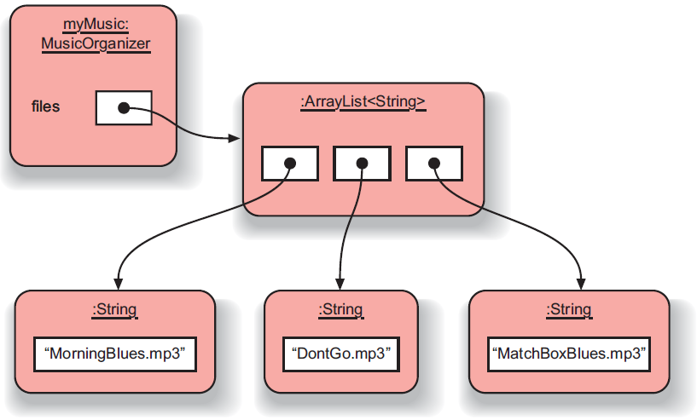
Adding a third file
Dynamic capacity with ability to increase and/or decrease as needed with its add( ) and remove( ) methods
Keeps an internal count of the number of items with size( ) method returning that count
Maintains the items in the order inserted with each new item added to the end of the list
As an item is removed, all items following after the removed item are shifted up and forward in order to fill the removed item’s space

Slide 16
Features of the collection
It increases its capacity as necessary
It keeps a private count of the number of items in the list
size() accessor
It keeps the objects in order of adding, but is otherwise unsorted
Details of how this is done are hidden
Does that matter?
Does not knowing prevent us from using it?

Slide 17
Generic classes
We can use ArrayList with any class type: ArrayList<TicketMachine> ArrayList<ClockDisplay> ArrayList<Track> ArrayList<Person>
Each will store multiple objects of the specific type

Slide 18
Using the collection
public class MusicOrganizer
{
private ArrayList<String> files;
...
public void addFile(String filename)
{
files.add(filename);
}
public int getNumberOfFiles()
{
return files.size();
}
...
}
Adding a new file
Returning the number of files
(delegation)

Slide 19
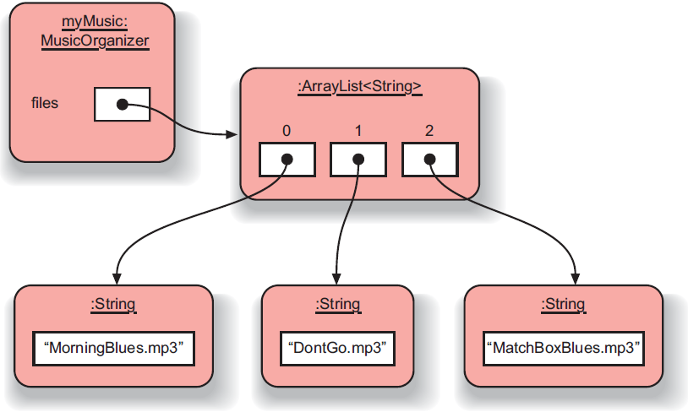
ArrayList Index numbering
Implicit numbering which starts with index 0 (same as String class)
Last item in the collection has the index size-1
Thus, valid index values would be between [0 . . . size( )-1]

Slide 20
Retrieving an object from the collection
Index validity checks
between [0 … size-1]
public void listFile(int index)
{
if(index >= 0 && index < files.size()) { String filename = files.get(index);
System.out.println(filename);
}
else {
// This is not a valid index.
}
}
Retrieve and print the file name
Needed? (Error message?)

Slide 21
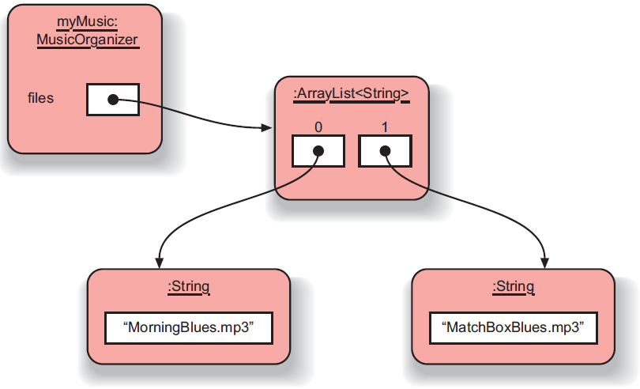
Removal may affect numbering
Removal process may change index values of other objects in the list
Collection moves all subsequent items up by 1 position to fill the gap
Indices of items in front of (preceding) the removed item are UNCHANGED
Indices of items after (following) the removed item are decreased by 1
Same “shifting” of items may also occur if adding new items into positions other than the end
files.remove(1);

Slide 22
The general utility of indices
Index values:
start at 0
are numbered sequentially
have no gaps in consecutive objects
Using integers to index collections has a general utility:
next: index + 1
previous: index – 1
last: list.size( ) – 1
the first three: items at indices 0, 1, 2
We could use loops and iteration to access items in sequence: 0, 1, 2, …

Slide 23
Review
Collections allow an arbitrary number of objects to be stored
Class libraries usually contain tried-and-tested collection classes
Java’s class libraries are called packages
We have used the ArrayList class from the java.util package

Slide 24
Review
Items may be added and removed
Each item has an index
Index values may change if items are removed (or further items added)
The main ArrayList methods are add, get, remove and size
ArrayList is a parameterized or generic type

Slide 25
Interlude: Some popular errors...

Slide 26
/** * Print out info (number of entries). */ public void showStatus() { if(files.size() == 0); { System.out.println("Organizer is empty"); } else { System.out.print("Organizer holds "); System.out.println(files.size() + " files"); } }
What’s wrong here?

Slide 27
/** * Print out info (number of entries). */ public void showStatus() { if(files.size() == 0); { System.out.println("Organizer is empty"); } else { System.out.print("Organizer holds "); System.out.println(files.size() + "files"); } }
This is the same as before!

Slide 28
/** * Print out info (number of entries). */ public void showStatus() { if(files.size() == 0) ; { System.out.println("Organizer is empty"); } else { System.out.print("Organizer holds "); System.out.println(files.size() + "files"); } }
This is the same again

Slide 29
/** * Print out info (number of entries). */ public void showStatus() { if(files.size() == 0) { ; } { System.out.println("Organizer is empty"); } else { System.out.print("Organizer holds "); System.out.println(files.size() + "files"); } }
and the same again…

Slide 30
/** * Print out info (number of entries). */ public void showStatus() { if(isEmpty = true) { System.out.println("Organizer is empty"); } else { System.out.print("Organizer holds "); System.out.println(files.size() + "files"); } }
This time I have a boolean field called ‘isEmpty’...
What’s wrong here?

Slide 31
/** * Print out info (number of entries). */ public void showStatus() { if(isEmpty == true) { System.out.println("Organizer is empty"); } else { System.out.print("Organizer holds "); System.out.println(files.size() + "files"); } }
This time I have a boolean field called ‘isEmpty’...
The correct version

Slide 32
/** * Store a new file in the organizer. If the * organizer is full, save it and start a new one. */ public void addFile(String filename) { if(files.size() == 100) files.save(); // starting new list files = new ArrayList<String>(); files.add(filename); }
What’s wrong here?

Slide 33
/** * Store a new file in the organizer. If the * organizer is full, save it and start a new one. */ public void addFile(String filename) { if(files.size() == 100) files.save(); // starting new list files = new ArrayList<String>(); files.add(filename); }
This is the same.

Slide 34
/** * Store a new file in the organizer. If the * organizer is full, save it and start a new one. */ public void addFile(String filename) { if(files.size() == 100) { files.save(); // starting new list files = new ArrayList<String>(); } files.add(filename); }
The correct version

Slide 35
Grouping objects
Collections and the for-each loop

Slide 36
Main concepts to be covered
Collections
Iteration
Loops: the for-each loop

Slide 37
Iteration
We often want to perform some actions an arbitrary number of times
e.g. print ALL the file names in the organizer
How many are there?
Most programming languages include loop statements or iterative control structures to make this possible
Java has several sorts of loop statement
We will start with its for-each loop

Slide 38
Iteration fundamentals
The process of repeating some actions over and over
Loops provide us with a way to control how many times we repeat those actions
With a collection, we often want to repeat the actions: exactly once for every object in the collection

Slide 39
For-each loop pseudo code
General form of the for-each loop
for keyword
loop header
for(ElementType element : collection) {
loop body
}
Statement(s) to be repeated
Pseudo-code expression of the actions of a for-each loop
For each element in collection, do the things in the loop body.
** where element is indeed a variable declaration of type ElementType and the variable is known as the loop variable

Slide 40
A Java example
/**
* List all file names in the organizer.
*/
public void listAllFiles()
{
for(String filename : files) {
System.out.println(filename);
}
}
for each filename in files, print out filename
for keyword introduces loop with details between ( )
loop variable filename is declared of type String
loop body repeated for each element in files ArrayList
each time, variable filename holds one of the elements
allows access to the object for that particular element

Slide 41
Review
Loop statements allow a block of statements to be repeated
The for-each loop allows iteration over a whole collection
With a for-each loop every object in the collection is made available exactly once to the loop’s body
But the for-each loop does NOT provide the index position of the current element

Slide 42
Selective processing
Statements may be nested, giving greater selectivity to the actions:
public void findFiles(String searchString)
{
for(String filename : files) {
if(filename.contains(searchString)) { System.out.println(filename); }
}
}
contains gives a partial match of the filename; use equals for an exact match
** using if statement to only print filenames matching the searchString

Slide 43
Critique of for-each
Only use for any type of collection
Accesses each element in sequence
Same action for each element but may use selective filter using if statements
Easy to write
Termination happens naturally
But, the collection cannot be changed
There is no index provided during access
Not all collections are index-based
Can NOT stop part way through loop
e.g. Find-the-first-that-matches
Provides definite iteration of ENTIRE list
a.k.a. bounded iteration

Slide 44
for-each
PROS
easy to use
access to ALL items one-by-one
ability to change the state of the item
terminates automatically
selective filter using if-else statements
actions in body may be complicated with multiple lines
use on ANY type of collection
abstraction from details of how handling occurs
CONS
no index provided
can NOT stop during looping
definite iteration of ALL items
can NOT remove or add elements during loop
use for collections only
access must be to ALL items in sequence [0 to size-1]

Slide 45
Grouping objects
Indefinite iteration - the while loop

Slide 46
Main concepts to be covered
The difference between iterations:
definite … size
indefinite (unbounded) … 0 - infinite
The while loop

Slide 47
Search tasks are indefinite
Consider: searching for your keys
You cannot predict, in advance, how many places you will have to look
There may be an absolute limit
i.e. check EVERY possible location
Or, it may not be any at all
i.e. check 0 locations (you had them!)
You will stop when you find them
Infinite loops are also possible
Through error or the nature of the task.

Slide 48
The while loop
A for-each loop repeats the loop body for every object in a collection
Sometimes we require more flexibility
The while loop supports flexibility
We use a boolean condition to decide whether or not to keep iterating
Maybe NO need to search to the end
This is a very flexible approach
Not tied to collections

Slide 49
While loop pseudo code
General form of a while loop
while keyword
boolean test (true or false)
while(loop condition) {
loop body
}
Statements to be repeated
Pseudo-code expression
of the actions of a while loop
while we wish to continue,
do the things in the loop body

Slide 50
Looking for your keys
while(true)
while(the keys are missing)
{
look in the next place;
}
while(!(false))
while(not (the keys have been found))
{
look in the next place;
}

Slide 51
Looking for your keys
boolean searching = true;
while(searching)
{
if(they are in the next place)
{
searching = false;
}
}
Suppose we don’t find them?
Infinite loop

Slide 52
for-each == while
public void listAllFiles()
{
for(String filename : files) {
System.out.println(filename);
}
}
public void listAllFiles()
{
int index = 0;
while(index < files.size()) { String filename = files.get(index);
System.out.println(filename);
index++;
}
}
Increment index by 1
while the value of index is less than the size of the collection, get and print the next file name, and then increment index

Slide 53
Elements of the loop
We have declared an index variable
The condition must be expressed correctly
We have to fetch each element
The index variable must be incremented explicitly

Slide 54
while loop search
PROS
can stop at any time during looping
indefinite iteration of SOME items using loop condition
may change collection during loop
use explicit index variable inside and outside of loop
index variable records location of item at all times
CONS
more effort to code
requires index looping variable declaration
maintain looping variable and manually increment
correctly determine loop condition for termination
must .get item using index to access the item
NOT guaranteed to stop with possible infinite loop

Slide 55
for-each versus while
for-each
easier to write
safer because it is guaranteed to stop
access is handled for you
Access ALL items without changing collection
while
don’t have to process entire collection
doesn’t have to be used with a collection
take care to watch for an infinite loop
Access only SOME items, includes a record of the index location, and also could be used for non-collections

Slide 56
Searching a collection
A re-occurring fundamental activity
Applicable beyond collections
Indefinite iteration because we don’t know exactly where to look
We must code for both success (stops midway) and failure (after all searched) using an exhausted search
Either MUST make the loop condition false to terminate the loop
Even works if collection is empty

Slide 57
Finishing a search
So when do we finish a search?
No more items to check: index >= files.size()
OR
Item has been found: found == true found ! searching

Slide 58
Continuing a search
We need to state the condition for continuing:
So the loop’s condition will be the opposite of that for finishing: index < files.size() && !found index < files.size() && searching
NB: ‘or’ becomes ‘and’ when inverting everything.

Slide 59
Search condition >= becomes <
FINISH search when:
No more items OR Item is found index >= files.size() || found
CONTINUE search while:
Still more items AND Item is not found index < files.size() && !found

Slide 60
Search condition >= becomes <
FINISH search when:
No more items OR Item is found index >= files.size() || found
CONTINUE search while:
Still more items AND Item is not found index < files.size() && !found

Slide 61
Search condition OR becomes AND
FINISH search when:
No more items OR Item is found index >= files.size() || found
CONTINUE search while:
Still more items AND Item is not found index < files.size() && !found

Slide 62
Search condition OR becomes AND
FINISH search when:
No more items OR Item is found index >= files.size() || found
CONTINUE search while:
Still more items AND Item is not found index < files.size() && !found

Slide 63
Search condition true becomes !true
FINISH search when:
No more items OR Item is found index >= files.size() || found
CONTINUE search while:
Still more items AND Item is not found index < files.size() && !found

Slide 64
Search condition true becomes !true
FINISH search when:
No more items OR Item is found index >= files.size() || found
CONTINUE search while:
Still more items AND Item is not found index < files.size() && !found

Slide 65
Searching a collection (using searching)
int index = 0;
boolean searching = true;
while(index < files.size() && searching) {
String file = files.get(index);
if(file.equals(searchString)) {
// We don't need to keep looking.
searching = false;
}
else {
index++;
}
}
// Either we found it at index,
// or we searched the whole collection.

Slide 66
Searching a collection (using found)
int index = 0;
boolean found = false;
while(index < files.size() && !found) {
String file = files.get(index);
if(file.equals(searchString)) {
// We don't need to keep looking.
found = true;
}
else {
index++;
}
}
// Either we found it at index,
// or we searched the whole collection.

Slide 67
Method findFirst
public int findFirst(String searchString)
{
int index = 0;
boolean searching = true;
while(searching && index < files.size())
{
String filename = files.get(index);
if(filename.contains(searchString))
{ // Match found
searching = false; // Stop searching
}
else // Not found here
{ // Keep searching
index++; // Move to next item
}
}
if(searching) // NO match found
{
return -1; // Return out-of-bounds
} // index for failures
else
{ // Return item index of
return index; // where it is found
}
}
Notes:
Objects First with Java
© David J. Barnes and Michael Kölling
67

Slide 68
Indefinite iteration
Does the search still work if the collection is empty (but not null)?
Yes! The loop’s body would NOT be entered in that case.
Important feature of while:
The body of the while could be executed zero or more times.

Slide 69
While with non-collections
// Print all even numbers from 2 to 30
int index = 2;
while(index <= 30)
{
System.out.println(index);
index = index + 2;
}
local variable
START: index start
STOP: index end
increment
NOTE: This while loop uses definite iteration, since it is clear from the start exactly how many times the loop will be repeated. But, we could NOT have used a for-each loop, because there is no collection of items.
Notes:
Objects First with Java
© David J. Barnes and Michael Kölling
69

Slide 70
The String class
The String class is defined in the java.lang package
It has some special features that need a little care
In particular, comparison of String objects can be tricky

Slide 71
String equality
if(input == "bye") {
...
}
if(input.equals("bye")) {
...
}
Important:
Always use .equals to test String equality!
tests identity
Do not use!!
tests equality

Slide 72
Identity vs equality 1
Other (non-String) objects:
:Person
:Person
“Fred”
“Jill”
person1
person2
person1 == person2 ?
false
Notes:
== is not true here (of course)

Slide 73
Identity vs equality 2
Other (non-String) objects:
:Person
:Person
same
value
“Fred”
“Fred”
person1
person2
person1 == person2 ?
false
Notes:
== is still not true here (different objects, == tests identity)

Slide 74
Identity vs equality 3
Other (non-String) objects:
:Person
:Person
“Fred”
“Fred”
person1
person2
person1 == person2 ?
true
Notes:
== is true now (same object)

Slide 75
Identity vs equality (Strings)
String input = reader.getInput();
if(input == "bye") {
...
}
== tests identity
:String
:String
==
?
"bye"
"bye"
input
false!
Notes:
== is still not true here (different objects, == tests identity)

Slide 76
Identity vs equality (Strings)
String input = reader.getInput();
if(input.equals("bye")) {
...
}
equals tests equality
:String
:String
.equals
?
"bye"
"bye"
input
true!
Notes:
== is still not true here (different objects, == tests identity)

Slide 77
The problem with Strings
The compiler merges identical String literals in the program code
The result is reference equality for apparently distinct String objects
But this cannot be done for identical strings that arise outside the program’s code
e.g. from user input

Slide 78
Moving away from String
Our collection of String objects for music tracks is limited
private ArrayList<String> tracks;
No separate id for artist, title, etc…
Make Track class with separate fields
private String artist;
private String title;
private String filename;
Changes collection of music tracks
private ArrayList<Track> tracks;

Slide 79
ArrayList of non-String objects
public class MusicOrganizer
{
// ArrayList of Track objects
private ArrayList<Track> tracks;
:
:
}
// non-String Track class definition
public class Track
{
private String artist;
private String title;
private String filename;
:
:
}

Slide 80
Class diagram
public class MusicOrganizer
{
private ArrayList<Track> tracks;
:
:
}
public class Track
{
private String artist;
private String title;
private String filename;
:
:
}
MusicOrganizer
uses or references
Track

Slide 81
Object diagram
Suppose the project consists of the following:
1 object instance of the MusicOrganizer class named myMusic
2 instances of Track items in the tracks ArrayList field of myMusic
new Track(“Maroon 5”, “Payphone”, “payphone.mp3”)
new Track(“MTKO”, “Classic”, “classic.mp3”)
myMusic:
MusicOrganizer
:ArrayList<Track>
0 1
tracks
:String
:String
:Track
“MTKO”
:Track
“Maroon 5”
artist
title
filename
:String
artist
title
filename
:String
“Classic”
“Payphone”
:String
:String
“classic.mp3”
“payphone.mp3”

Slide 82
Grouping objects
Iterator objects
Notes:
also explain: how to pass an ArrayList for testing

Slide 83
Iterator type
Third variation to iterate over a collection
Uses a while loop and Iterator object
But NO integer index variable
Takes advantage of abstraction with use of library class (like for-each)
import java.util.Iterator;
Iterator class vs. iterator( ) method

Slide 84
Iterator and iterator()
Collections (e.g. ArrayList) have an iterator() method
This returns an Iterator object
Iterator<E> has three methods:
boolean hasNext()
E next()
void remove()

Slide 85
Using an Iterator object
java.util.Iterator
returns an Iterator object
Iterator<ElementType> it = myCollection.iterator();
while(it.hasNext()) {
call it.next() to get the next object
do something with that object
}
Declare variable it as type Iterator of ElementType
Use iterator() method of collection (e.g. ArrayList) and assign the returned Iterator object to variable it
it object *indexes* to the first element in the collection
it.hasNext() checks to see if there is an object at the index
it.next() will get the actual object and advance the index
Objects First with Java - A Practical Introduction using BlueJ, © David J. Barnes, Michael Kölling
Notes:
Objects First with Java
© David J. Barnes and Michael Kölling
85
java.util.Iterator use = (1) create it object using .iterator method, (2) it.hasNext in loop condition, (3) it.next to get the next object, (4) it.remove (if necessary)

Slide 86
Iterator object example
java.util.Iterator
returns an Iterator object
public void listAllFiles()
{
Iterator<Track> it = tracks.iterator();
while(it.hasNext()) { Track tk = it.next();
System.out.println(tk.getDetails());
}
}
Prints ALL tracks in the collection (like while & for-each)
Still use while … BUT do not need an index variable
Iterator keeps track of current location, if there are any more items (hasNext) and which one to return (next)
Iterator.next returns next item AND moves past that item (can NOT go back)
Notes:
Objects First with Java
© David J. Barnes and Michael Kölling
86
Use ArrayList<Track> tracks (i.e. first row of students) to demo it.next -> (1) retrieve current object, (2) increment it to next, (3) return the retrieved object from #1

Slide 87
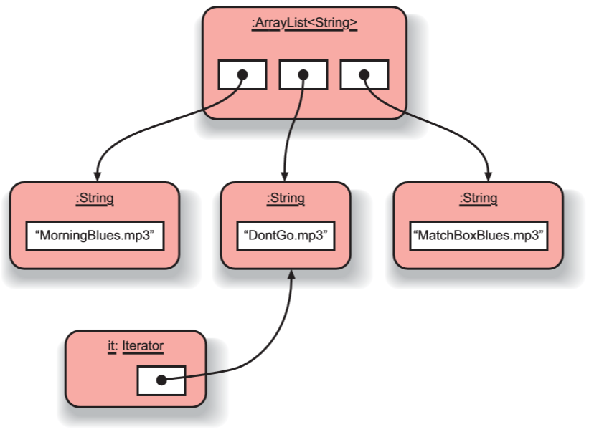
Iterator object
An iterator, after one iteration, pointing to the next item to be processed.
Objects First with Java - A Practical Introduction using BlueJ, © David J. Barnes, Michael Kölling

Slide 88
Iterator mechanics

Slide 89
myList:List
myList.iterator()
:Element
:Element
:Element
:Element
:Iterator

Slide 90
myList:List
:Element
:Element
:Element
:Element
:Iterator
:Iterator
hasNext()?
✔
next()
Element e = iterator.next();

Slide 91
myList:List
:Element
:Element
:Element
:Element
:Iterator
:Iterator
hasNext()?
✔
next()

Slide 92
myList:List
:Element
:Element
:Element
:Element
:Iterator
:Iterator
hasNext()?
✔
next()

Slide 93
myList:List
:Element
:Element
:Element
:Element
:Iterator
:Iterator
hasNext()?
✔
next()

Slide 94
myList:List
:Element
:Element
:Element
:Element
:Iterator
✗
hasNext()?

Slide 95
Track example
private ArrayList<Track> tracks;
tracks:
ArrayList<Track>
:Track
:Track
:Track
:Track
tracks:
ArrayList<Track>
Each Track has:
String artist
String title
String filename
0 1 2 3
:Track
:Track
:Track
:Track
Objects First with Java - A Practical Introduction using BlueJ, © David J. Barnes, Michael Kölling

Slide 96
Track example
tracks:
ArrayList<Track>
0 1 2 3
:Track
:Track
:Track
:Track
public void listAllFiles()
{
Iterator<Track> it = tracks.iterator();
while(it.hasNext())
{ Track t = it.next();
System.out.println(t.getDetails());
}
}
Objects First with Java - A Practical Introduction using BlueJ, © David J. Barnes, Michael Kölling

Slide 97
Track example
Iterator<Track> it = tracks.iterator();
tracks:
ArrayList<Track>
0 1 2 3
:Track
:Track
:Track
:Track
Use the iterator method of the ArrayList class to get an Iterator object for tracks
Assigns the Iterator object to the local variable named it
it
:Iterator
Objects First with Java - A Practical Introduction using BlueJ, © David J. Barnes, Michael Kölling

Slide 98
Track example
while(it.hasNext())
tracks:
ArrayList<Track>
0 1 2 3
:Track
:Track
:Track
:Track
it
:Iterator
it.hasNext()?
true
Objects First with Java - A Practical Introduction using BlueJ, © David J. Barnes, Michael Kölling

Slide 99
Track example
Track t = it.next();
tracks:
ArrayList<Track>
0 1 2 3
:Track
:Track
:Track
:Track
it.next( ) will:
Return element(object) at it
Move to the next element
=
it
:Iterator
it
:Iterator
t

Slide 100
Track example
System.out.println(t.getDetails());
tracks:
ArrayList<Track>
0 1 2 3
:Track
:Track
:Track
:Track
it
:Iterator
t.getDetails( ) makes an external method call to the Track class with the t object to print out the String artist, title and filename fields.
t

Slide 101
Track example
Exit 1st iteration of while body
and repeat loop
tracks:
ArrayList<Track>
0 1 2 3
:Track
:Track
:Track
:Track
while(it.hasNext())
{
Track t = it.next();
System.out.println
(t.getDetails());
}
it
:Iterator
X
t

Slide 102
Track example
2nd iteration
tracks:
ArrayList<Track>
0 1 2 3
:Track
:Track
:Track
:Track
next
hasNext
true
=
it
:Iterator
while(it.hasNext())
{
Track t = it.next();
System.out.println
(t.getDetails());
}
t

Slide 103
Track example
Exit 2nd iteration
tracks:
ArrayList<Track>
0 1 2 3
:Track
:Track
:Track
:Track
it
:Iterator
while(it.hasNext())
{
Track t = it.next();
System.out.println
(t.getDetails());
}
X
t

Slide 104
Track example
3rd iteration
tracks:
ArrayList<Track>
0 1 2 3
:Track
:Track
:Track
:Track
=
while(it.hasNext())
{
Track t = it.next();
System.out.println
(t.getDetails());
}
it
:Iterator
t

Slide 105
Track example
Exit 3rd iteration
tracks:
ArrayList<Track>
0 1 2 3
:Track
:Track
:Track
:Track
it
:Iterator
while(it.hasNext())
{
Track t = it.next();
System.out.println
(t.getDetails());
}
X
t

Slide 106
Track example
4th iteration
tracks:
ArrayList<Track>
0 1 2 3
:Track
:Track
:Track
:Track
while(it.hasNext())
{
Track t = it.next();
System.out.println
(t.getDetails());
}
=
it
:Iterator
t

Slide 107
Track example
Exit 4th iteration
tracks:
ArrayList<Track>
0 1 2 3
:Track
:Track
:Track
:Track
while(it.hasNext())
{
Track t = it.next();
System.out.println
(t.getDetails());
}
it
:Iterator
X
t

Slide 108
Track example
5th iteration
tracks:
ArrayList<Track>
0 1 2 3
:Track
:Track
:Track
:Track
false
hasNext
while(it.hasNext())
{
Track t = it.next();
System.out.println
(t.getDetails());
}
it
:Iterator
NO more elements,
so the while loop STOPS!!

Slide 109
Index versus Iterator
Ways to iterate over a collection:
for-each loop (definite iteration)
Process every element w/o removing an element
while loop (indefinite iteration)
Use if we might want to stop part way through
Use for repetition that doesn't involve a collection
Iterator object (indefinite iteration)
Use if we might want to stop part way through
Often used with collections where indexed access is not very efficient, or impossible
Available for all collections in the Java class library
Use to remove from a collection
Iteration is important programming pattern

Slide 110
Removing elements
for each track in the collection
{
if track.getArtist( ) is the out-of-favor artist:
collection.remove(track)
}
Impossible with a for-each loop
Trying to remove( ) during an iteration causes ConcurrentModificationException
while loop possible, but NOT recommended
Easy to get indices wrong when removing
Proper solution is use of Iterator with while

Slide 111
Removing from a collection
Iterator<Track> it = tracks.iterator();
while(it.hasNext()) {
Track t = it.next();
String artist = t.getArtist();
if(artist.equals(artistToRemove)) {
it.remove();
}
}
Use the Iterator’s remove method.
Does NOT use tracks collection variable in the loop body
Must use Iterator’s remove( ) and NOT the ArrayList’s
Iterator’s can only remove the last retrieved using next
But it ALLOWS the element to be removed during loop
Iterator abstracts removal and keeps iteration in sync
Notes:
Use ArrayList<Track> tracks to demo it.remove -> (1) removes pointer of LAST object from tracks, (2) shifts ALL objects from current-to-last up one, (3) it still points to the correct element

Slide 112
Removing from a collection
tracks:
ArrayList<Track>
0 1 2 3
:Track
:Track
:Track
:Track
=
it
:Iterator
while(it.hasNext())
{
Track t = it.next();
String artist = t.getArtist();
if(artist.equals(artistToRemove))
{
it.remove();
}
}
t

Slide 113
Removing from a collection
tracks:
ArrayList<Track>
0 1 2 3
X
:Track
:Track
:Track
:Track
remove
Iterator remove method will:
remove the LAST element that returned by Iterator
handle indices of remaining elements (abstraction)
keeps iteration properly in sync
BUT limited to removing only last element
=
it
:Iterator
t

Slide 114
Removing from a collection without using an Iterator?
int index = 0;
while(index < tracks.size()) {
Track t = tracks.get(index);
String artist = t.getArtist();
if(artist.equals(artistToRemove)) {
tracks.remove(index);
}
index++;
}
Can you spot what is wrong?
Notes:
HINT: What if the 2nd to last element is removed? Will the last element get searched?

Slide 115
Review
Use an ArrayList to store an arbitrary number of object in a collection
Loop statements allow a block of statements to be repeated
for-each iterates over a whole collection
while loop allows the repetition to be controlled by a boolean expression
All collection classes provide Iterator objects that provide sequential access and modification to a whole collection

Slide 116
New COPY of an existing ArrayList
ArrayList<Track> copiedList = new ArrayList<Track>(tracks);
Declare a variable with the same ArrayList of <Element> type as the original ArrayList
Create a new ArrayList object (with the same element type as original) to store the copy in
Pass the original ArrayList as the parameter
Point the variable to the new COPY of the original list with exact same contents
NOTE:
Only ONE instance of each object element – but TWO ArrayList objects which point to the same objects in exactly the same order!!
Objects First with Java - A Practical Introduction using BlueJ, © David J. Barnes, Michael Kölling
Notes:
Objects First with Java
© David J. Barnes and Michael Kölling
116
java.util.ArrayList constructors – (1) no params, (2) one int param, (3) one list param

Slide 117
Random library class
import java.util.Random;
Random rand = new Random();
int index = rand.nextInt(size);
Generates a pseudo-random number by:
Using the Random library class imported from the java.util package
Creating an instance of class Random and assigning it to a local variable
With that instance, call the method nextInt to get a number
Optional parameter – upper limit size passed
Notes:
Objects First with Java
© David J. Barnes and Michael Kölling
117
java.util.Random constructors – (1) no params, (2) one long param for seed
Random.nextInt methods – (1) no params, (2) one int param … other Random methods?

Slide 118
Collections library class
import java.util.Collections;
ArrayList<String> files = new ArrayList< >();
Collections.shuffle(files);
Shuffles the items in a collection by:
Using the Collections library class imported from the java.util package
Calls the method shuffle to randomly change the order of existing items in the collection without removing/adding items
Parameter – pass the entire collection
Objects First with Java - A Practical Introduction using BlueJ, © David J. Barnes, Michael Kölling
Notes:
Objects First with Java
© David J. Barnes and Michael Kölling
118
** Ways to return a copied list of only Track elements containing “an” – (1) COPY & REMOVE, (2) NEW & ADD
** Ways to play a random Track order every time starting – (1) Collections.shuffle (if orig changed), (2) Random w/ seed index, (3) COPY & shuffle

Slide 119
auction project example
Online Auction system with:
Set of items (called lots) offered for sale
Each Lot assigned a unique lot number
A Person can try to buy the lot by bidding
At close of auction, highest Bid wins lot
Any lots with no bids remain sold at close
Unsold lots may be offered in later auction
Classes: Auction, Bid, Lot, Person
Objects First with Java - A Practical Introduction using BlueJ, © David J. Barnes, Michael Kölling

Slide 120
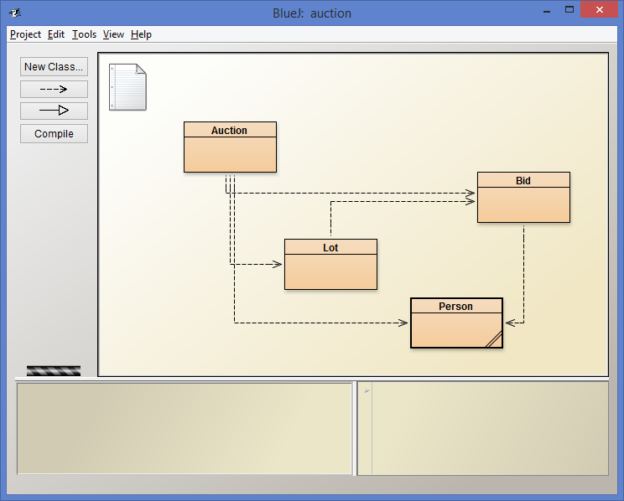
auction project

Slide 121
The auction project
The auction project provides further illustration of collections and iteration
Examples of using null
Anonymous objects
Chaining method calls

Slide 122
auction project
Online Auction system:
Sell items via enterLot with String description
Auction object creates Lot object for entered lot
lot number and description is assigned with no bidders
Bidder Person can register with only their name
Place bid with bidFor method of Auction object with lot number and how much to bid
Lot number passed so Lot objects internal to Auction
Auction object transforms bid amount to object
Lot records the highest bid object
Objects First with Java - A Practical Introduction using BlueJ, © David J. Barnes, Michael Kölling

Slide 123
null
Used with object types
Used to indicate … 'no object'
Used to indicate ‘no bid yet’ at the intialization of highestBid in the auction
highestBid = null;
We can test if an object variable holds the null value: if(highestBid == null) …
Attempt to de-reference null pointer:
NullPointerException

Slide 124
Anonymous objects
Objects are often created and handed on elsewhere immediately: Lot furtherLot = new Lot(…); lots.add(furtherLot);
We don’t really need furtherLot: lots.add(new Lot(…));

Slide 125
Chaining method calls
Methods often return objects
We often immediately call a method on the returned object:
Bid bid = lot.getHighestBid(); Person bidder = bid.getBidder();
We can use the anonymous object concept and chain method calls:
Person bidder = lot.getHighestBid().getBidder();

Slide 126
Chaining method calls
Each method in the chain is called on the object returned from the previous method call in the chain.
String name = lot.getHighestBid().getBidder().getName();
Returns a Bid object from the Lot
Returns a Person object from the Bid
Returns a String object from the Person

Slide 127
while versus do-while
Iterator<ElementType> it = myCollection.iterator();
while(it.hasNext()) {
call it.next() to get the next object
do something with that object
possibly it.remove()
}
How is a do-while loop different?
if collection has at least 1 element
{
Iterator<ElementType> it = myCollection.iterator();
do {
call it.next() to get the next object
do something with that object
possibly it.remove()
} while(it.hasNext());
}
Notes:
ArrayList.isEmpty()

Slide 128
Review
Collections are used widely in many different applications
The Java library provides many different ready made collection classes
Collections are often manipulated using iterative control structures
The while loop is the most important control structure to master

Slide 129
Review
Some collections lend themselves to index-based access
e.g. ArrayList
Iterator provides a versatile means to iterate over different types of collection
Removal using an Iterator is less error-prone in most circumstance

