Slide 1


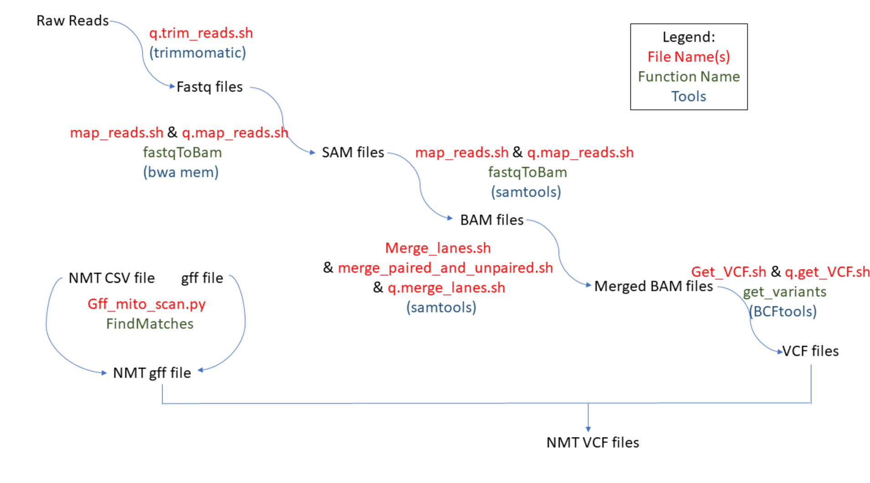

MiCFiG: MitoCarta database to Filter GFF files
Erin Bunch, Reagan McKee, Alex Everett, Randy Klabacka
Biological Sciences Department
Utah Tech University
INTRODUCTION
RESULTS/DISCUSSION
SUMMARY/CONCLUSIONS
Hybrid Parthenogenic (asexual) Whiptail species have reduced aerobic performance in comparison to their parent sexual species.
Mitochondrial DNA is inherited exclusively from the maternal line. Therefore, reduced fitness in hybrid species may be due to genetic incompatibilities between nuclear DNA from one parent and mitochondrial DNA from the other.
If an incompatibility exists, we expect to see variation in nuclear-encoded mitochondrial-targeting genes (NMT genes) among sexual parental species.
Fig 1:
Fig 2:
FUTURE DIRECTIONS
HYPOTHESIS
Caption
Lower endurance and mitochondrial respiration is due to incompatibility in NMT genes resulting from either: (A) inter-genomic (mother-mother) interactions or (B) intragenomic (mother-father) interactions
METHODS
Caption
Whole-genome sequencing of four sexual whiptails was conducted
Reads were processed in
Fig 3:
REFERENCES
Fig 4:
ACKNOWLEDGEMENTS
Caption
Caption
GITHUB

