Slide 1
GATM (AGAT) allele frequency thresholds
ClinGen CCDS VCEP
Oct 10, 2019

Slide 2
AGAT deficiency (GATM)
Prevalence
  Based on the seven pathogenic GATM missense variants in 6,503 individuals (one in 929) in the EVS database, the carrier frequency of GATM deficiency was 0.11% (CI 0.03%–0.19%) and estimated incidence of GATM deficiency was one in 3,450,000 in the general population (Des Roches et al).
  Would be higher if included other variant types?
Penetrance – 100%?
Maximum allelic contribution
  6/26 or 0.23 (calculated per case), 2/16 or 0.125 (calculated per family; some families have multiple affected children) (Des Roches et al)

Slide 3
Calculations for GATM
Max allelic contribution = 100%
Max genetic contribution = 100%
Max allelic contribution = 25%
Max genetic contribution = 100%
Max allelic contribution = 6%
Max genetic contribution = 100%
Prevalence | AF
1 in 3,450,000 | 0.0005
Prevalence | AF
1 in 3,450,000 | 0.0001
Prevalence | AF
1 in 3,450,000 | 0.00003
BA1
BS1
PM2
Highest population minor allele frequency in gnomAD ~ 0.000055
(based on frequency of LOF variants, under the assumption that all LOF are pathogenic)
https://www.cardiodb.org/allelefrequencyapp/

Slide 4
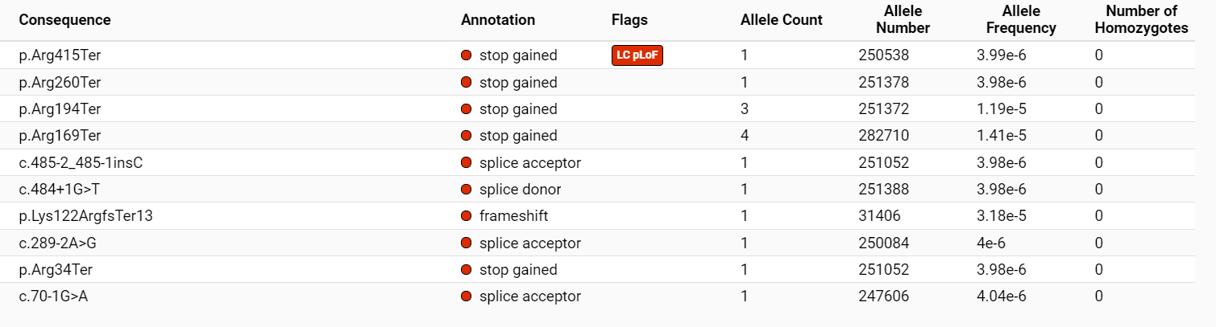
Highest population gnomAD frequency of suspected pathogenic variants in GATM
GATM variant | gnomAD highest MAF
p.Trp149Ter | Not listed
c.1111_1112insA | Not listed
p.Trp203Ser | Not listed
p.Arg413Gln | Not listed
p.Arg413Trp | Not listed
p.Trp210Ter | Not listed
p.Ala185Pro | Not listed
p.Pro105Leu | Not listed
GATM variant | gnomAD highest MAF
c.484+1G>T | 0.00005437 (E. Asian)
p.Arg169Ter | 0.00005013 (E. Asian)
p.Glu181Lys | 0.000008794 (Euro NF)
p.Arg189Cys | 0.00006155 (African)
p.Ala208Thr | 0.00005437 (E. Asian)
p.Arg282His | 0.00002892 (Latino)
p.Leu329Val | 0.00001759 (Euro NF)
p.Pro346Leu | 0.000008795 (Euro NF)
VUS in ClinVar
LOF variants in gnomAD
0.00006156
0.00005013
0.00006164
0.00005437
0.0006410*
0.000008858
0.000008814
0.000008967
*1 in 1560 alleles, E. Asian (does not meet 2000 allele requirement)

