Slide 1
GAMT allele frequency thresholds
ClinGen CCDS VCEP
Oct 10, 2019

Slide 2
Prevalence of GAMT deficiency
Publication | Method | Carrier frequency (2pq) | q | Prevalence (q²)
Des Roches et al, 2015 (PMID 26003046) | Reviewed EVS for variants; measured GAMT activity of missense variants | 1 in 812 (0.123%) | 1 in 1624 (0.000613) | 1 in 2,640,000
Des Roches et al, 2015 (PMID 26003046) | Searched ExAC for missense variants predicted to be damaging, and LOF variants | 1 in 372 (0.268%) | 1/744 (0.00134) | 1 in 550,000
Merimek-Mahmutoglu et al, 2012 (PMID 23031365) | 2950 DNA samples from NBS, British Columbia; targeted screening for p.Trp20Ser and c.327G>A; 2 other pathogenic variants identified | 1/1475 (95% CI, 1/409–1/4762) | 1/2950 (0.00034) | 1 in 9, 090, 090
Almeida et al, 2007 (PMID 17336114) | Screened Portuguese individuals for p.Trp20Ser | 1/125 (0.8%) (CI, 0.2-1.3%) | 1/250 (0.004) | 1 in 62,500
Merimek-Mahmutoglu et al, 2016 | Sequenced GAMT for 500 newborns from the Netherlands; 2 pathogenic variants identified. | 1/250 (0.004) | 1/500 (0.002) | 1 in 250 000
Viau et al, 2013 | Utah newborn population | 1/170 (0.006) | 1/340 (0.003) | 1 in 114,072
Due to founder variant

Slide 3
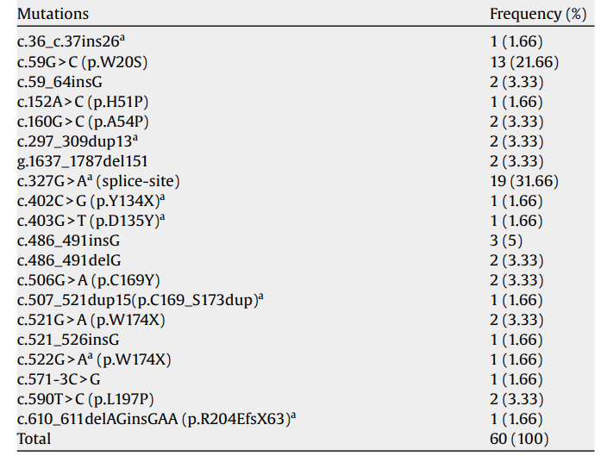
Maximum allelic contribution
The maximum proportion of cases potentially attributable to a single allele i.e. the allele frequency of the most common variant
~40% of alleles are c.327G>A
Rarer alleles ~4-5%
Dhar et al, 2009; PMID 19027335
Stockler-Ipsiroglu et al, 2016, PMID 24268530
Of the 82 known/reported alleles, 30 were c.327G>A (p.K109K, splice site exon 2), occurring in 26 families (~40%).
15 alleles were c.59G>C (p.W20S) and they occurred exclusively in Portuguese (n = 7) families.
The remaining mutations occurred in < 3 alleles ( 4% ).

Slide 4
Specifying allele frequency rules
Maximum genetic contribution
  The proportion of all cases that are attributable to the gene under evaluation
  100% for GAMT-D.
Penetrance
  Assume 100%

Slide 5
Calculations for GAMT
Max allelic contribution = 100%
Max genetic contribution = 100%
Max allelic contribution = 40%
Max genetic contribution = 100%
Max allelic contribution = 4%
Max genetic contribution = 100%
Prevalence | AF
1 in 114,000 | 0.003
1 in 250,000 | 0.002
1 in 550,000 | 0.0014
1 in 1,000,000 | 0.001
1 in 2,640,000 | 0.000615
BA1
Prevalence | AF
1 in 114,000 | 0.001
1 in 250 000 | 0.0008
1 in 550,000 | 0.00054
1 in 1,000,000 | 0.0004
1 in 2,640,000 | 0.000246
BS1
Prevalence | AF
1 in 114,000 | 0.0001
1 in 250 000 | 0.00008
1 in 550,000 | 0.00005
1 in 1,000,000 | 0.00004
1 in 2,640,000 | 0.0000246
Highest population minor allele frequency in gnomAD for c.327G>A = 0.0004
PM2
https://www.cardiodb.org/allelefrequencyapp/

