Slide 1
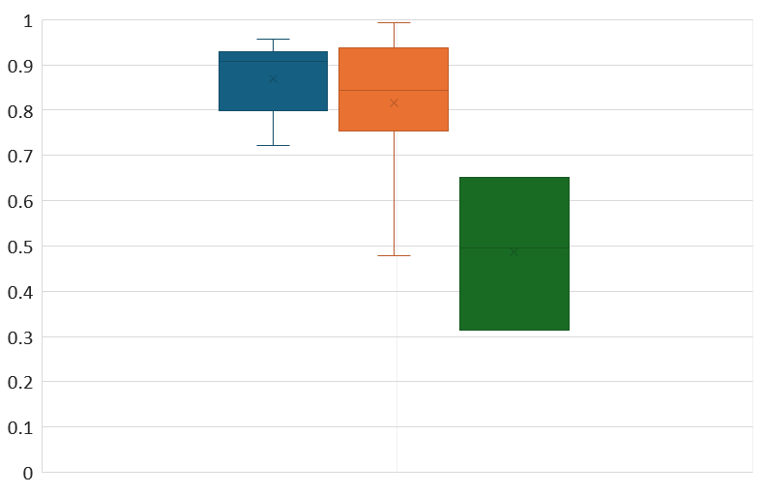
REVEL scores for GAMT variants classified WITHOUT in silico evidence
P/LP
VUS
n=20
n=24
n=3
B/LB

