Slide 1
RPGR

Slide 2
Template

Slide 3
Instructions
VCEPs should modify the PVS1 flowchart for their specifications
Create a copy of the next slide to modify and attach to your specifications in the CSpec Editor
Review the boxes highlighted in yellow and modify the text if relevant:
  Nonsense/Frameshift
    Predicted to undergo NMD - Please provide most terminal codon/nucleotide that is expected to result in NMD (if NMD boundary not in penultimate exon please specify).
      Exon is present in biologically-relevant transcript(s) - Please designate relevant transcript
    Not predicted to undergo NMD
      Truncated/altered region is critical to protein function - If relevant please specify regions
  GT--AG 1,2 splice sites (if AT–AC (U2) splice sites exist please specify)
    Exon skipping or use of a cryptic splice site disrupts reading frame and is NOT predicted to undergo NMD - Please note any exons that are not expected to undergo NMD
      Truncated/altered region is critical to protein function - If relevant please specify regions
    Exon skipping or use of a cryptic splice site preserves reading frame - Please note exons that are in-frame
      Truncated/altered region is critical to protein function - If relevant please specify regions
  Deletion (Single exon to full gene)
    Single to multi exon deletion – Preserves reading frame
      Truncated/altered region is critical to protein function - If relevant please specify regions
  Initiation Codon - Please note alt starts if known

Slide 4
Nonsense or Frameshift
Predicted to undergo NMD ^{b}
(Please provide most terminal codon/nucleotide that is expected to result in NMD)
Exon is present in biologically-relevant transcript(s) (Please designate relevant transcript)
PVS1
Exon is absent from biologically-relevant transcript(s)
N/A
Truncated/altered region is critical to protein function ^{c} (If relevant please specify regions)
PVS1_Strong
Not predicted to undergo NMD ^{b}
Role of region in protein function is unknown
LoF variants in this exon are frequent in the general population and/or exon is absent from biologically-relevant transcript(s)
N/A
LoF variants in this exon are not frequent in the general population and exon is present in biologically-relevant transcript(s)
Variant removes >10% of protein
PVS1_Strong
Variant removes <10% of protein
PVS1_Moderate
GT--AG
1,2 splice
sites ª
Exon skipping or use of a cryptic splice site disrupts reading frame and is predicted to undergo NMD ^{b}
Exon is present in biologically-relevant transcript(s)
PVS1
Exon is absent from biologically-relevant transcript(s)
N/A
Exon skipping or use of a cryptic splice site disrupts reading frame and is NOT predicted to undergo NMD ^{b}
(Please note any exons that are not expected to undergo NMD)
Truncated/altered region is critical to protein function ^{c} (If relevant please specify regions)
PVS1_Strong
Role of region in protein function is unknown
LoF variants in this exon are frequent in the general population and/or exon is absent from biologically-relevant transcript(s)
N/A
LoF variants in this exon are not frequent in the general population and exon is present in biologically-relevant transcript(s)
Variant removes >10% of protein
PVS1_Strong
Variant removes <10% of protein
PVS1_Moderate
Exon skipping or use of a cryptic splice site preserves reading frame
(Please note exons that are in-frame)
Role of region in protein function is unknown
LoF variants in this exon are frequent in the general population and/or exon is absent from biologically-relevant transcript(s)
N/A
LoF variants in this exon are not frequent in the general population and exon is present in biologically-relevant transcript(s)
Variant removes >10% of protein
PVS1_Strong
Variant removes <10% of protein
PVS1_Moderate
Truncated/altered region is critical to protein function ^{c} (If relevant please specify regions)
PVS1_Strong
Deletion
(Single exon to full gene)
Full gene deletion
PVS1 ^{d}
Single to multi exon deletion –
Disrupts reading frame and is predicted to undergo NMD ^{b}
Exon is present in biologically-relevant transcript(s)
PVS1
Exon is absent from biologically-relevant transcript(s)
N/A
Single to multi exon deletion –
Disrupts reading frame and is NOT predicted to undergo NMD ^{b}
Truncated/altered region is critical to protein function ^{c}
PVS1_Strong
Role of region in protein function is unknown
LoF variants in this exon are frequent in the general population and/or exon is absent from biologically-relevant transcript(s)
N/A
LoF variants in this exon are not frequent in the general population and exon is present in biologically-relevant transcript(s)
Variant removes >10% of protein
PVS1_Strong
Single to multi exon deletion –
Preserves reading frame
Variant removes <10% of protein
PVS1_Moderate
Truncated/altered region is critical to protein function ^{c} (If relevant please specify regions)
PVS1_Strong
Duplication
(≥1 exon in size and must be completely contained within gene)
Proven in tandem
Reading frame disrupted and NMD predicted to occur
PVS1
Presumed in tandem
No or unknown impact on reading frame and NMD
N/A
Proven not in tandem
Reading frame presumed disrupted and NMD predicted to occur
PVS1_Strong
N/A
Initiation Codon
No known alternative start codon in other transcripts
≥1 pathogenic variant(s) upstream of closest potential in-frame start codon
PVS1_Moderate
Different functional transcript uses alternative start codon
No pathogenic variant(s) upstream of closest potential in-frame start codon
PVS1_Supp
N/A
Notes:
PLEASE NOTE – highlighted areas are where the VCEP should provide guidance for each gene under specification.
Weights may be adjusted if appropriate (e.g start codon)

Slide 5
Nonsense or Frameshift
Predicted to undergo NMD ^{b}
Exon is present in biologically-relevant transcript(s)
PVS1
Exon is absent from biologically-relevant transcript(s)
N/A
Truncated/altered region is critical to protein function ^{c}
PVS1_Strong
Not predicted to undergo NMD ^{b}
Role of region in protein function is unknown
LoF variants in this exon are frequent in the general population and/or exon is absent from biologically-relevant transcript(s)
N/A
LoF variants in this exon are not frequent in the general population and exon is present in biologically-relevant transcript(s)
Variant removes >10% of protein
PVS1_Strong
Variant removes <10% of protein
PVS1_Moderate
GT--AG
1,2 splice
sites ª
Exon skipping or use of a cryptic splice site disrupts reading frame and is predicted to undergo NMD ^{b}
Exon is present in biologically-relevant transcript(s)
PVS1
Exon is absent from biologically-relevant transcript(s)
N/A
Exon skipping or use of a cryptic splice site disrupts reading frame and is NOT predicted to undergo NMD ^{b}
Truncated/altered region is critical to protein function ^{c}
PVS1_Strong
Role of region in protein function is unknown
LoF variants in this exon are frequent in the general population and/or exon is absent from biologically-relevant transcript(s)
N/A
LoF variants in this exon are not frequent in the general population and exon is present in biologically-relevant transcript(s)
Variant removes >10% of protein
PVS1_Strong
Variant removes <10% of protein
PVS1_Moderate
Exon skipping or use of a cryptic splice site preserves reading frame
Role of region in protein function is unknown
LoF variants in this exon are frequent in the general population and/or exon is absent from biologically-relevant transcript(s)
N/A
LoF variants in this exon are not frequent in the general population and exon is present in biologically-relevant transcript(s)
Variant removes >10% of protein
PVS1_Strong
Variant removes <10% of protein
PVS1_Moderate
Truncated/altered region is critical to protein function ^{c}
PVS1_Strong
Deletion
(Single exon to full gene)
Full gene deletion
PVS1 ^{d}
Single to multi exon deletion –
Disrupts reading frame and is predicted to undergo NMD ^{b}
Exon is present in biologically-relevant transcript(s)
PVS1
Exon is absent from biologically-relevant transcript(s)
N/A
Single to multi exon deletion –
Disrupts reading frame and is NOT predicted to undergo NMD ^{b}
Truncated/altered region is critical to protein function ^{c}
PVS1_Strong
Role of region in protein function is unknown
LoF variants in this exon are frequent in the general population and/or exon is absent from biologically-relevant transcript(s)
N/A
LoF variants in this exon are not frequent in the general population and exon is present in biologically-relevant transcript(s)
Variant removes >10% of protein
PVS1_Strong
Single to multi exon deletion –
Preserves reading frame
Variant removes <10% of protein
PVS1_Moderate
Truncated/altered region is critical to protein function ^{c}
PVS1_Strong
Duplication
(≥1 exon in size and must be completely contained within gene)
Proven in tandem
Reading frame disrupted and NMD predicted to occur
PVS1
Presumed in tandem
No or unknown impact on reading frame and NMD
N/A
Proven not in tandem
Reading frame presumed disrupted and NMD predicted to occur
PVS1_Strong
N/A
Initiation Codon
No known alternative start codon in other transcripts
≥1 pathogenic variant(s) upstream of closest potential in-frame start codon
PVS1_Moderate
Different functional transcript uses alternative start codon
No pathogenic variant(s) upstream of closest potential in-frame start codon
PVS1_Supp
N/A
Notes:
PLEASE NOTE - Download as a Powerpoint or make a copy of this slide and save elsewhere - this is a template for general use.

Slide 6
Splicing prediction data only
Outside donor/acceptor +/- 1,2 dinucleotide positions (exonic or intronic)
Splicing tool prediction
(for missense/in-frame indel variants, also consider relevant predictions of protein impact
PP3 applied
No appropriate comparison P/LP variant in this splice region
PP3
P variant at this nt position with same predicted impact
PP3 + PS1
LP variant at this nt position with same predicted impact
PP3 + PS1_M
P variant within the same splice region with same predicted impact
PP3 + PS1_M
LP variant within the same splice region with same predicted impact
PP3 + PS1_P
Not applied (prediction inconclusive)
N/A (consider protein impact if relevant)
BP4 applied
Silent / Intronic
BP4 + BP7
Other variant types / positions
BP4 (only if protein impact ruled out)
Donor/acceptor +/- 1,2 dinucleotide positions
Use PVS1 rule table for PREDICTED impact
PVS1 applied
No appropriate comparison P/LP variant in this splice region
PVS1
P variant at this nt position or in same donor/acceptor +/-1,2 dinucleotide with same predicted impact
PVS1 + PS1_P
P / LP variant within the same splice region, but outside donor/acceptor +/-1,2 dinucleotide, with same predicted impact
PVS1 + PS1_P
PVS1_S, PVS1_M, or PVS1_P (PVS1_Strength) applied
No appropriate comparison P/LP variant within this splice region
PVS1_Strength
P variant at this nt position or in same donor/acceptor +/-1,2 dinucleotide with same predicted impact
PVS1_Strength
+ PS1
P variant within the same splice region, but outside donor/acceptor +/-1,2 dinucleotide, with same predicted impact
PVS1_Strength
+ PS1_M
LP variant within the same splice region, but outside donor/acceptor +/-1,2 dinucleotide, with same predicted impact
PVS1_Strength
+ PS1_P
PVS1 not applicable
Not applied
RNA/Splicing Data
Categorization of splicing data need to consider multiple factors including assay / technique, RNA source, and gene-specific knowledge.
See (c): RPGR Rule Table for PVS1
No variant-specific observed impact
Silent / Intronic
BP7_S (RNA) applied
Consider splicing predictive data
BP7_S (RNA) + prediction (PP3/BP4)
Assess pathogenicity using protein pathway
Can the protein impact be ruled out (based on functional and / or clinical data)?
Yes
BP7_S (RNA) + prediction (PP3/BP4)
Other variant types / positions
No
Document as “BP7_S (RNA)” Not Met to indicate that data was present and reviewed
Variant-specific impact (compared to controls)
Use PVS1 rule table OBSERVED RNA impact
PVS1_Strength assigned to at least 1 transcript
Proportion of alternative transcript/s (inferred to be) predicted
by variant allele (e)
If background rate is considered to be low-moderate levels suggestive of being tolerated, consider reducing PVS1 (RNA) codes by an additional level
Determine PVS1 (RNA) weight from combined analysis (PP3/BP4 not applicable)
Complete
Keep strength level
Near Complete
Reduce strength by 1 level
PVS1 (RNA) or BP7_S (RNA) not applicable (reconsider PVS1 decision tree as appropriate)
Incomplete
Do not apply codes
PVS1 decision tree for splicing
Notes:
Use this template for splicing

Slide 7
RPGR

Slide 8
Nonsense or Frameshift
Predicted to undergo NMD ^{b}
Variants that terminate in codons 2-619 (NM_001034853.2:c.4-1704 or NM_00328.3:c.4-1704e)
PVS1
Variants that terminate in codons 620-783 in transcript NM_00328.3:c.1705-2106^{f})
N/A
NM_001034853.2:c.1705-3398 variants in codons 620-1132, disrupt ORF15 glutamylation, a critical function ^{c, g}
PVS1
Not predicted to undergo NMD ^{b}
LoF variants in this exon are frequent in the general population and/or exon is absent from biologically-relevant transcript(s)
N/A
Role of region in protein function is unknown.
Applies to NM_001034853.2:c.3399-3458 (codons 1132-1152), or 3’ UTR,
NM_00328.3:c.2352-2909 (codons 784-969), or 3’ UTR^{h}
LoF variants in this exon are not frequent in the general population and exon is present in biologically-relevant transcript(s)
Variant removes >10% of protein
PVS1_Strong
NM_00328.3 variants after codon 872 remove <10% of protein
PVS1_Moderate
GT--AG
1,2 splice
sitesª that cause exon skipping or use of a cryptic splice site
Disrupts reading frame and NMD ^{b} predicted
Skipped exons 1, 11, 12, or 14 in NM_ 001034853.2 or cryptic splice sites which disrupt reading frame
PVS1
For skipped exons 15, 17, 18, 19 in NM_00328.3 or cryptic splice sites which disrupt reading frame
PVS1
Exon is absent from biologically-relevant transcript(s)
N/A
Disrupts reading frame and NMD is NOT predicted
NM_001034853.2 variants in codons 619-1132, disrupt ORF15 glutamylation, a critical function ^{c , g}
PVS1
Role of region in protein function is unknown.
Applies to NM_001034853.2 codons 1132-1152, or 3’ UTR,
NM_00328.3 codons 584-969, or 3’ UTR^{h}.
LoF variants in this exon are frequent in the general population and/or exon is absent from biologically-relevant transcript(s)
N/A
LoF variants in this exon are not frequent in the general population and exon is present in biologically-relevant transcript(s)
Variant removes >10% of protein
PVS1_Strong
Variant preserves reading frame
NM_00328.3 variants after codon 872 remove <10% of protein
PVS1_Moderate
Variants that skip exons 2, 3, 4, 5, 6, 7, 8, or 10 affect regions critical to protein function ^{c, i}
PVS1
Deletion
(Single exon to full gene)
Full gene deletion
PVS1 ^{d}
Disrupts reading frame and NMD is predicted
Deletions of single exons 1, 9, 11, 12, or 14 in NM_ 001034853.2
PVS1
Deletions of single exons 15, 17, 18 in NM_00328.3
PVS1
Exon is absent from biologically-relevant transcript(s)
N/A
Disrupts reading frame and NMD is NOT predicted
NM_001034853.2 :c.1705-3398 variants in codons 619-1132, disrupt ORF15 glutamylation, a critical function ^{c , g}
PVS1
LoF variants in this exon are frequent in the general population and/or exon is absent from biologically-relevant transcript(s)
N/A
Role of region in protein function is unknown.
Applies to NM_001034853.2:c.3399-3458 (codons 1132-1152), or 3’ UTR,
NM_00328.3:c.2352-2909 (codons 784-969), or 3’ UTR^{h}
LoF variants in this exon are not frequent in the general population and exon is present in biologically-relevant transcript(s)
Variant removes >10% of protein
PVS1_Strong
Deletion
Preserves reading frame
NM_00328.3 variants after codon 872 remove <10% of protein
PVS1_Moderate
Deletions that truncate/alter exons 2, 3, 4, 5, 6, 7, 8, or 10 affect regions critical to protein function ^{c , i}
PVS1
Duplication
(≥1 exon in size and must be completely contained within gene)
Proven in tandem
Reading frame disrupted in either transcript or presumed disrupted in NM_ 001034853.2 and NMD predicted to occur
PVS1
Presumed in tandem
No or unknown impact on reading frame and NMD
N/A
Reading frame presumed disrupted and NMD predicted to occur
PVS1
Proven not in tandem
N/A
Initiation Codon
No known alternative start codon in other transcripts
≥1 pathogenic variant(s) upstream of closest potential in-frame start codon
PVS1_Moderate
Different functional transcript uses alternative start codon
No pathogenic variant(s) upstream of closest potential in-frame start codon
PVS1_Supp
N/A
Notes:
Figure 1 Taken from SVI recommendations for PVS1 interpretation (Tayoun et al., 2018). Legend for this figure includes this text: PVS1 decision tree. Refer to text for detailed description. (a) This criterion should not be applied in combination with in silico splicing predictions (PP3). Additionally, splice site variants must have no detectable nearby (+/- 20nts) strong consensus splice sequence that may constitute in-frame splicing. (b) NMD prediction based on the premature termination codon not occurring in the 3’ most exon or in the 3’ most 50bp of the penultimate exon. (c) Relevant domain indicated by experimental evidence proving a critical role of the domain and/or presence of non-truncating pathogenic variants in the region. (d) For a full gene deletion of a known haploinsufficient gene, a pathogenic classification is warranted (in the absence of conflicting data) even though application of PVS1 alone would not reach a pathogenic classification using the combining rules in Richards et al., (2017). NMD, nonsense-mediated decay; LoF, loss of function.
Additional footnotes which contain genomic coordinates:
e. Variants that terminate in codons 2-619 in transcripts NM_001034853.2 and NM_00328.3 (before transcript base 1859) (genomic regions 38,287,910 to 38,327,367) are expected to produce transcripts that will undergo NMD
f. Variants that terminate in codons 619-783 in transcript NM_00328.3 (before transcript base 2351) (hg38 genomic regions 38,273,435 to 38,287,910) are expected to produce transcripts that will undergo NMD
g. Variants in transcript NM_001034853.2 between bases 1859-3396 (codons 619-1132, hg38 genomic regions 38,287,910 to 38,285,759) are predicted to disrupt the glutamylation in ORF 15 a region that is critical to protein function ^{c}
h. Role of region in protein function is unknown. Transcript NM_001034853.2 variants in bases 3397-4749 (codons 1132-1152 and 3’ UTR, correspond to hg38 between 38,285,759 to 38,284,807). Transcript NM_00328.3 variants in bases 2351-3073 (codons 584-969, and 3’ UTR), correspond to hg38 between 38,273,435 to 38,269,162).
i. Variants that skip exon 2 which has a defined pathogenic missense variant (PMID37352859) or skip or alter the RCC1 domain in exons 3, 4, 5, 6, 7, 8, or 10 affect regions critical to protein function ^{c}

Slide 9
Splicing prediction data only
Outside donor/acceptor +/- 1,2 dinucleotide positions (exonic or intronic)
Splicing tool prediction
(for missense/in-frame indel variants, also consider relevant predictions of protein impact See (a): Flowchart for PP3 and BP4
PP3 applied
No appropriate comparison P/LP variant in this splice region
PP3
P variant at this nt position with same predicted impact
PP3 + PS1
LP variant at this nt position with same predicted impact
PP3 + PS1_M
P variant within the same splice region with same predicted impact
PP3 + PS1_M
LP variant within the same splice region with same predicted impact
PP3 + PS1_P
Not applied (prediction inconclusive)
N/A (consider protein impact if relevant)
BP4 applied
Silent / Intronic
BP4 + BP7
Other variant types / positions
BP4 (only if protein impact ruled out)
Donor/acceptor +/- 1,2 dinucleotide positions
See (c): RPGR Rule Table for PVS1
Use PVS1 rule table for PREDICTED impact
PVS1 applied
No appropriate comparison P/LP variant in this splice region
PVS1
P variant at this nt position or in same donor/acceptor +/-1,2 dinucleotide with same predicted impact
PVS1 + PS1_P
P / LP variant within the same splice region, but outside donor/acceptor +/-1,2 dinucleotide, with same predicted impact
PVS1 + PS1_P
PVS1_S, PVS1_M, or PVS1_P (PVS1_Strength) applied
No appropriate comparison P/LP variant within this splice region
PVS1_Strength
P variant at this nt position or in same donor/acceptor +/-1,2 dinucleotide with same predicted impact
PVS1_Strength
+ PS1
P variant within the same splice region, but outside donor/acceptor +/-1,2 dinucleotide, with same predicted impact
PVS1_Strength
+ PS1_M
LP variant within the same splice region, but outside donor/acceptor +/-1,2 dinucleotide, with same predicted impact
PVS1_Strength
+ PS1_P
PVS1 not applicable
Not applied
RNA/Splicing Data
Categorization of splicing data need to consider multiple factors including assay / technique, RNA source, and gene-specific knowledge.
See (c): RPGR Rule Table for PVS1
No variant-specific observed impact
Silent / Intronic
BP7_S (RNA) applied
Consider splicing predictive data
BP7_S (RNA) + prediction (PP3/BP4)
Assess pathogenicity using protein pathway
Can the protein impact be ruled out (based on functional and / or clinical data)?
Yes
BP7_S (RNA) + prediction (PP3/BP4)
Other variant types / positions
No
Document as “BP7_S (RNA)” Not Met to indicate that data was present and reviewed
Variant-specific impact (compared to controls)
Use PVS1 rule table OBSERVED RNA impact
PVS1_Strength assigned to at least 1 transcript
Proportion of alternative transcript/s (inferred to be) predicted
by variant allele (e)
If background rate is considered to be low-moderate levels suggestive of being tolerated, consider reducing PVS1 (RNA) codes by an additional level
Determine PVS1 (RNA) weight from combined analysis (PP3/BP4 not applicable)
Complete
Keep strength level
Near Complete
Reduce strength by 1 level
PVS1 (RNA) or BP7_S (RNA) not applicable (reconsider PVS1 decision tree as appropriate)
Incomplete
Do not apply codes
RPGR-specific PVS1 decision tree for splicing
Notes:
Use this template for splicing

Slide 10
RPGR
PVS1 Documents 7/30/2024 Version

Slide 11
RPGR PVS1 Decision Tree
Nonsense or Frameshift
Predicted to undergo NMD ^{b}
Variants that terminate in codons 2-619 (NM_001034853.2:c.4-1704 or NM_00328.3:c.4-1704e)
PVS1
Variants that terminate in codons 620-783 in transcript NM_00328.3:c.1705-2106^{f})
N/A
NM_001034853.2:c.1705-3398 variants in codons 620-1132, disrupt ORF15 glutamylation, a critical function ^{c, g}
PVS1
Not predicted to undergo NMD ^{b}
LoF variants in this exon are frequent in the general population and/or exon is absent from biologically-relevant transcript(s)
N/A
Role of region in protein function is unknown.
Applies to NM_001034853.2:c.3399-3458 (codons 1132-1152), or 3’ UTR,
NM_00328.3:c.2352-2909 (codons 784-969), or 3’ UTR^{h}
LoF variants in this exon are not frequent in the general population and exon is present in biologically-relevant transcript(s)
Variant removes >10% of protein
PVS1_Strong
NM_00328.3 variants after codon 872 remove <10% of protein
PVS1_Moderate
Deletion
(Single exon to full gene)
Full gene deletion
PVS1 ^{d}
Disrupts reading frame and NMD is predicted
Deletions of single exons 1, 9, 11, 12, or 14 in NM_ 001034853.2
PVS1
Deletions of single exons 15, 17, 18 in NM_00328.3
PVS1
Exon is absent from biologically-relevant transcript(s)
N/A
Disrupts reading frame and NMD is NOT predicted
NM_001034853.2 :c.1705-3398 variants in codons 619-1132, disrupt ORF15 glutamylation, a critical function ^{c , g}
PVS1
LoF variants in this exon are frequent in the general population and/or exon is absent from biologically-relevant transcript(s)
N/A
Role of region in protein function is unknown.
Applies to NM_001034853.2:c.3399-3458 (codons 1132-1152), or 3’ UTR,
NM_00328.3:c.2352-2909 (codons 784-969), or 3’ UTR^{h}
LoF variants in this exon are not frequent in the general population and exon is present in biologically-relevant transcript(s)
Variant removes >10% of protein
PVS1_Strong
Deletion
Preserves reading frame
NM_00328.3 variants after codon 872 remove <10% of protein
PVS1_Moderate
Deletions that truncate/alter exons 2, 3, 4, 5, 6, 7, 8, or 10 affect regions critical to protein function ^{c , i}
PVS1
Duplication
(≥1 exon in size and must be completely contained within gene)
Proven in tandem
Reading frame disrupted in either transcript or presumed disrupted in NM_ 001034853.2 and NMD predicted to occur
PVS1
Presumed in tandem
No or unknown impact on reading frame and NMD
N/A
Reading frame presumed disrupted and NMD predicted to occur
PVS1
Proven not in tandem
N/A
Initiation Codon
No known alternative start codon in other transcripts
≥1 pathogenic variant(s) upstream of closest potential in-frame start codon
PVS1_Moderate
Different functional transcript uses alternative start codon
No pathogenic variant(s) upstream of closest potential in-frame start codon
PVS1_Supp
N/A
RPGR PVS1 Decision Tree. This is taken from Figure 1 in SVI recommendations for PVS1 interpretation (Tayoun et al., 2018). See also RPGR PVS1 (RNA) Decision Tree. (a) This criterion should not be applied in combination with in silico splicing predictions (PP3). Additionally, splice site variants must have no detectable nearby (+/- 20nts) strong consensus splice sequence that may constitute in-frame splicing. (b) NMD prediction based on the premature termination codon not occurring in the 3’ most exon or in the 3’ most 50bp of the penultimate exon. (c) Relevant domain indicated by experimental evidence proving a critical role of the domain and/or presence of non-truncating pathogenic variants in the region. (d) For a full gene deletion of a known haploinsufficient gene, a pathogenic classification is warranted (in the absence of conflicting data) even though application of PVS1 alone would not reach a pathogenic classification using the combining rules in Richards et al., (2017). For a full gene deletion of RPGR in a male, a pathogenic classification is warranted. NMD, nonsense-mediated decay; LoF, loss of function. Additional notes providing genomic coordinates include (e) Variants that terminate in codons 2-619 in transcripts NM_001034853.2:c.4-1704 and NM_00328.3:c.4-1704 (genomic regions 38,287,910 to 38,327,367) are expected to produce transcripts that will undergo NMD. (f) Variants that terminate in codons 619-783 in transcript NM_00328.3:c.1705-2106 (hg38 genomic regions 38,273,435 to 38,287,910) are expected to produce transcripts that will undergo NMD. (g) Variants in transcript NM_001034853.2:c.1705-3398 (codons 619-1132, hg38 genomic regions 38,287,910 to 38,285,759) are predicted to disrupt the glutamylation in ORF 15 a region that is critical to protein function ^{c}. (h) Role of region in protein function is unknown. Transcript NM_001034853.2:c.3399-3458 (codons 1132-1152) and 3’ UTR. Transcript NM_00328.3:c.2352-2909 (codons 584-969), and 3’ UTR. (i) Variants that skip exon 2 which has a defined pathogenic missense variant (PMID37352859) or skip or alter the RCC1 domain in exons 3, 4, 5, 6, 7, 8, 9 or 10 affect regions critical to protein function ^{c}.
Notes:
Figure 1 Taken from SVI recommendations for PVS1 interpretation (Tayoun et al., 2018). Legend for this figure includes this text: PVS1 decision tree. Refer to text for detailed description. (a) This criterion should not be applied in combination with in silico splicing predictions (PP3). Additionally, splice site variants must have no detectable nearby (+/- 20nts) strong consensus splice sequence that may constitute in-frame splicing. (b) NMD prediction based on the premature termination codon not occurring in the 3’ most exon or in the 3’ most 50bp of the penultimate exon. (c) Relevant domain indicated by experimental evidence proving a critical role of the domain and/or presence of non-truncating pathogenic variants in the region. (d) For a full gene deletion of a known haploinsufficient gene, a pathogenic classification is warranted (in the absence of conflicting data) even though application of PVS1 alone would not reach a pathogenic classification using the combining rules in Richards et al., (2017). NMD, nonsense-mediated decay; LoF, loss of function.
Additional footnotes which contain genomic coordinates:
e. Variants that terminate in codons 2-619 in transcripts NM_001034853.2 and NM_00328.3 (before transcript base 1859) (genomic regions 38,287,910 to 38,327,367) are expected to produce transcripts that will undergo NMD
f. Variants that terminate in codons 619-783 in transcript NM_00328.3 (before transcript base 2351) (hg38 genomic regions 38,273,435 to 38,287,910) are expected to produce transcripts that will undergo NMD
g. Variants in transcript NM_001034853.2 between bases 1859-3396 (codons 619-1132, hg38 genomic regions 38,287,910 to 38,285,759) are predicted to disrupt the glutamylation in ORF 15 a region that is critical to protein function ^{c}
h. Role of region in protein function is unknown. Transcript NM_001034853.2 variants in bases 3397-4749 (codons 1132-1152 and 3’ UTR, correspond to hg38 between 38,285,759 to 38,284,807). Transcript NM_00328.3 variants in bases 2351-3073 (codons 584-969, and 3’ UTR), correspond to hg38 between 38,273,435 to 38,269,162).
i. Variants that skip exon 2 which has a defined pathogenic missense variant (PMID37352859) or skip or alter the RCC1 domain in exons 3, 4, 5, 6, 7, 8, or 10 affect regions critical to protein function ^{c}

Slide 12
RPGR-specific PVS1 (RNA) Decision Tree for Splicing
Splicing prediction data only
Outside donor/acceptor +/- 1,2 dinucleotide positions (exonic or intronic)
Splicing tool prediction
(for missense/in-frame indel variants, also consider relevant predictions of protein impact See (a): Flowchart for PP3 and BP4
PP3 applied
See (a) Flowchart for PP3 and BP4 and (b) Table 2 from Walker et. al., 2023
No appropriate comparison P/LP variant in this splice region
PP3
P variant at this nt position with same predicted impact
PP3 + PS1
LP variant at this nt position with same predicted impact
PP3 + PS1_M
P variant within the same splice region with same predicted impact
PP3 + PS1_M
LP variant within the same splice region with same predicted impact
PP3 + PS1_Supp.
Not applied (prediction inconclusive)
N/A (consider protein impact if relevant)
BP4 applied
Silent / Intronic
BP4 + BP7
Other variant types / positions
BP4 (only if protein impact ruled out)
Donor/acceptor +/- 1,2 dinucleotide positions
See (c): RPGR Rule Table for PVS1 (RNA)
Use PVS1 rule table for PREDICTED impact
PVS1 applied
No appropriate comparison P/LP variant in this splice region
PVS1
P variant at this nt position or in same donor/acceptor +/-1,2 dinucleotide with same predicted impact
PVS1 + PS1_Supp.
P / LP variant within the same splice region, but outside donor/acceptor +/-1,2 dinucleotide, with same predicted impact
PVS1 + PS1_Supp.
PVS1_S, PVS1_M, or PVS1_P (PVS1_Strength) applied
No appropriate comparison P/LP variant within this splice region
PVS1_Strength
P variant at this nt position or in same donor/acceptor +/-1,2 dinucleotide with same predicted impact
PVS1_Strength
+ PS1
P variant within the same splice region, but outside donor/acceptor +/-1,2 dinucleotide, with same predicted impact
PVS1_Strength
+ PS1_M
LP variant within the same splice region, but outside donor/acceptor +/-1,2 dinucleotide, with same predicted impact
PVS1_Strength
+ PS1_Supp.
PVS1 not applicable
Not applied
RNA/Splicing Data
To categorize splicing data consider multiple factors including assay / technique, RNA source, and gene-specific knowledge.
See (c): RPGR Rule Table for PVS1 (RNA)
No variant-specific observed impact
Silent / Intronic
BP7_S (RNA) applied
Consider splicing predictive data
BP7_S (RNA) + prediction (PP3/BP4)
Assess pathogenicity using protein pathway
Can the protein impact be ruled out (based on functional and / or clinical data)?
Yes
BP7_S (RNA) + prediction (PP3/BP4)
Other variant types / positions
No
Document as “BP7_S (RNA)” Not Met to indicate that data was present and reviewed
Variant-specific impact (compared to controls)
Use PVS1 rule table OBSERVED RNA impact
PVS1_Strength assigned to at least 1 transcript
Proportion of alternative transcript/s (inferred to be) predicted
by variant allele (e)
If background rate is considered to be low-moderate levels suggestive of being tolerated, consider reducing PVS1 (RNA) codes by an additional level
Determine PVS1 (RNA) weight from combined analysis (PP3/BP4 not applicable)
Complete
Keep strength level
Near Complete
Reduce strength by 1 level
PVS1 (RNA) or BP7_S (RNA) not applicable (reconsider PVS1 decision tree as appropriate)
Incomplete
Do not apply codes
Notes:
PLEASE NOTE – highlighted areas are where the VCEP should provide guidance for each gene under specification.
Weights may be adjusted if appropriate (e.g start codon)

Slide 13
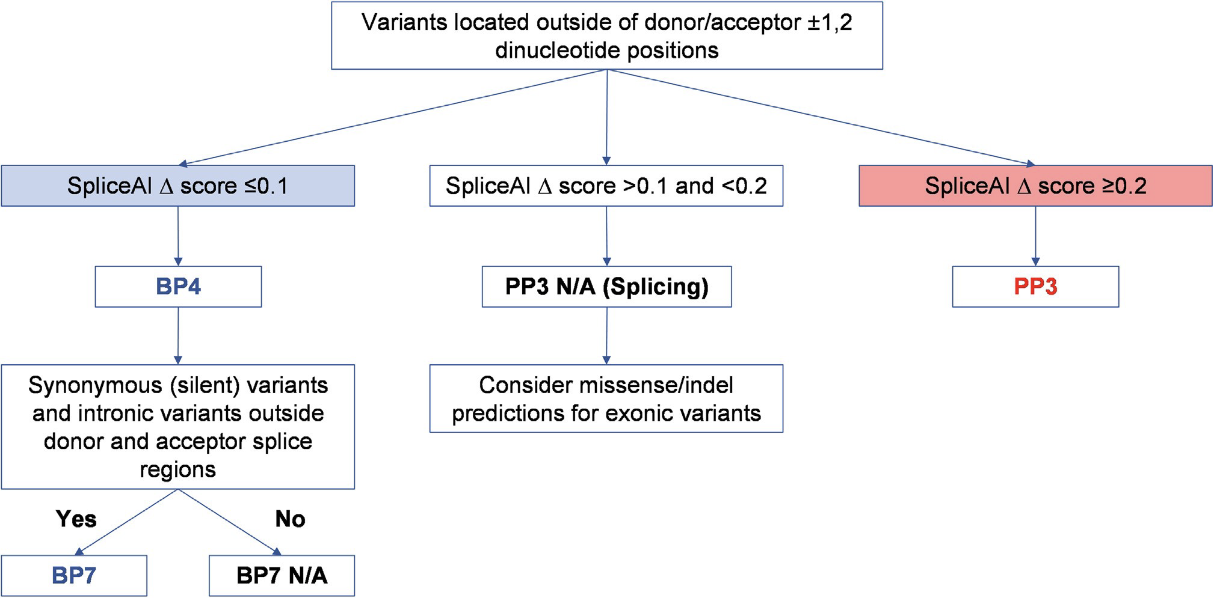
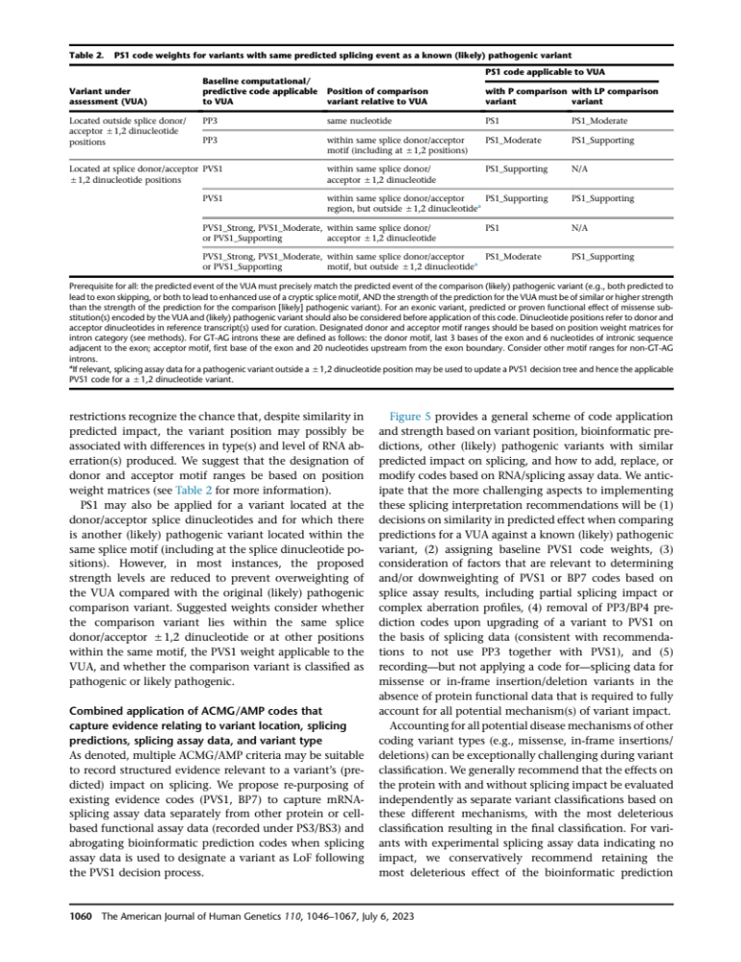
(a) SpliceAI Flowchart (based on Walker et al., 2023, Figure 4
Donor and acceptor splice region positions are below and are excluded from BP7:
Synonymous substitutions in the first base of an exon
Synonymous substitutions in the last three base of an exon
+1 through +7 of the donor sequence after an exon
-1 through -21 of the acceptor sequence before an exons
(b) Table 2 from Walker et al., 2023

Slide 14
(c) RPGR PVS1 (RNA) rule table (for +- 1,2 changes and RNA splicing assays) for in the retinal-specific transcript NM_001034853.2 and broadly expressed transcript NM_00328.3 coordinates are shown, black exons are common to both red is the retinal-specific ORF15 exon and preceding exon 14, blue are splice sites in NM_00328.3 only.
Based on generic gene schematic (shown below) proposed by Walker et al., 2023 with the following modifications:
Pathogenic missense variants have been identified in exons 3, 4, 5, 6, 7, 8, 9, 10, 11, 12, 13 and ORF15 which are considered to be ”critical to protein function”, requirement for being more that 10% of total protein length does not apply.
ATG initiation site is located in exon 1 so 5’ UTR recommendation (A) does not apply.
No potential ”rescue isoforms” are known.
Use this table to assign appropriate PVS1 code and rationale:
 |  |  |  |  |  |  |  | Exon skipping leads to preserved reading frame or frameshift (FS) with nonsense mediated decay (NMD)? |  |  | PFs1 code for +/- 1,2 dinucleotide change and rationale from Walker et al. below | Exon known to be critical to protein function
 |  |  |  |  |  | HG38 coordinates (reverse strand)
 | NM_000328.3 | Transcript Start |  | Transcript End
 | NM_001034853.2 | 3' acceptor position |  | 5' donor position |  | Genome Start | Genome End | FS | NMD | NMD
 | Exon 1 | 1 | c.-142 | 170 | c.28 | 38,327,509 | 38,327,340 | FS | NMD | NMD | PVS1 (B) | Yes
 | Exon 2 | 171 | c.29 | 296 | c.154 | 38,323,524 | 38,323,399 | in frame | No NMD | No NMD | PVS1 (G) | No
 | Exon 3 | 297 | c.155 | 389 | c.247 | 38,322,945 | 38,322,853 | in frame | No NMD | No NMD | PVS1 (F) | Yes
 | Exon 4 | 390 | c.248 | 452 | c.310 | 38,321,089 | 38,321,027 | in frame | No NMD | No NMD | PVS1 (F) | Yes
 | Exon 5 | 453 | c.311 | 611 | c.469 | 38,318,987 | 38,318,829 | in frame | No NMD | No NMD | PVS1 (F) | Yes
 | Exon 6 | 612 | c.470 | 761 | c.619 | 38,317,465 | 38,317,316 | in frame | No NMD | No NMD | PVS1 (F) | Yes
 | Exon 7 | 762 | c.620 | 920 | c.778 | 38,310,773 | 38,310,615 | in frame | No NMD | No NMD | PVS1 (F) | Yes
 | Exon 8 | 921 | c.779 | 1076 | c.934 | 38,304,790 | 38,304,635 | in frame | No NMD | No NMD | PVS1 (F) | Yes
 | Exon 9 | 1077 | c.935 | 1201 | c.1059 | 38,301,371 | 38,301,247 | FS | NMD | NMD | PVS1 (C) | Yes
 | Exon 10 | 1202 | c.1060 | 1387 | c.1245 | 38,299,141 | 38,298,956 | in frame | No NMD | No NMD | PVS1 (F) | Yes
 | Exon 11 | 1388 | c.1246 | 1556 | c.1414 | 38,297,452 | 38,297,284 | FS | NMD | NMD | PVS1 (C) | Yes
 | Exon 12 | 1557 | c.1415 | 1648 | c.1506 | 38,291,484 | 38,291,393 | FS | NMD | NMD | PVS1 (C) | Yes
 | Exon 13 | 1649 | c.1507 | 1714 | c.1572 | 38,291,024 | 38,290,959 | in frame | No NMD | No NMD | PVS1 (G) | Yes
NM_001034853.2 | Exon 14 | 1715 | c.1573 | 1895 | c.1753 | 38,288,041 | 38,287,861 | FS | No NMD | No NMD | PVS1 (J) | No
NM_000328.3 | Exon 14 | 1715 |  | 1895 |  | 38,288,041 | 38,287,861 | FS | NMD | NMD | PVS1 (C) | No
NM_001034853.2 | Exon ORF15 | 1896 | c.1754 | 4733 | c,*3459 | 38,287,245 | 38,284,408 | in frame | No NMD | No NMD | PVS1 (F) | Yes
NM_000328.3 | Exon 15 | 1896 | c.1754 | 2047 | c.1905 | 38,287,245 | 38,287,094 | FS | NMD | NMD | PVS1 (C) | Yes
NM_000328.3 | Exon 16 | 2048 | c.1906 | 2233 | c.2091 | 38,276,772 | 38,276,587 | in frame | No NMD | No NMD | PVS1 (G) | No
NM_000328.3 | Exon 17 | 2234 | c.2092 | 2291 | c.2149 | 38,275,146 | 38,275,089 | FS | NMD | NMD | PVS1 (D) | No
NM_000328.3 | Exon 18 | 2292 | c.2150 | 2389 | c.2241 | 38,273,477 | 38,273,386 | FS | No NMD | No NMD | PVS1 (H) | No
NM_000328.3 | Exon 19 | 2384 | c.2242 | 3053 | c.*463 | 38,269,832 | 38,269,163 | FS | No NMD | No NMD | PVS1 (I) | No
Start codon |  | 143 | c.1 | 145 | c.3 | 38,327,368
Nearest in-frame start codon |  | 164 | c.21 | 166 | c.23 | 38,327,346 | This alternate start codon precludes use of PVS1(B)
Next nearest in-frame start codon |  | 172 | c.30 | 174 | c.32 | 38,327,338 | This alternate start codon is in exon 3.
Stop codon ORF15 |  | 3599 | c.*3457 | 3601 | c.*3459 | 38,285,542
Stop codon exon 19 |  | 2446 | c.*2304 | 2448 | c.*2306 | 38,269,627
NDM predicted cutoff NM001034853.2 |  | 1845 | c.1702 | 1847 | c.1704 | 38,287,897
NMD predicted cutoff NM_000328.3 |  | 2349 | c.2106 | 2351 | c.2108 | 38,273,420
Stop codon after stop-loss in ORF15 |  | 3710 | c.3567 | 3712 | c.3569 | 38,285,431 | +37 codons
Stop codon after stop-loss in exon 19 |  | 2639 | c.2496 | 2641 | c.2498 | 38,269,577 | +17 codons

Slide 15
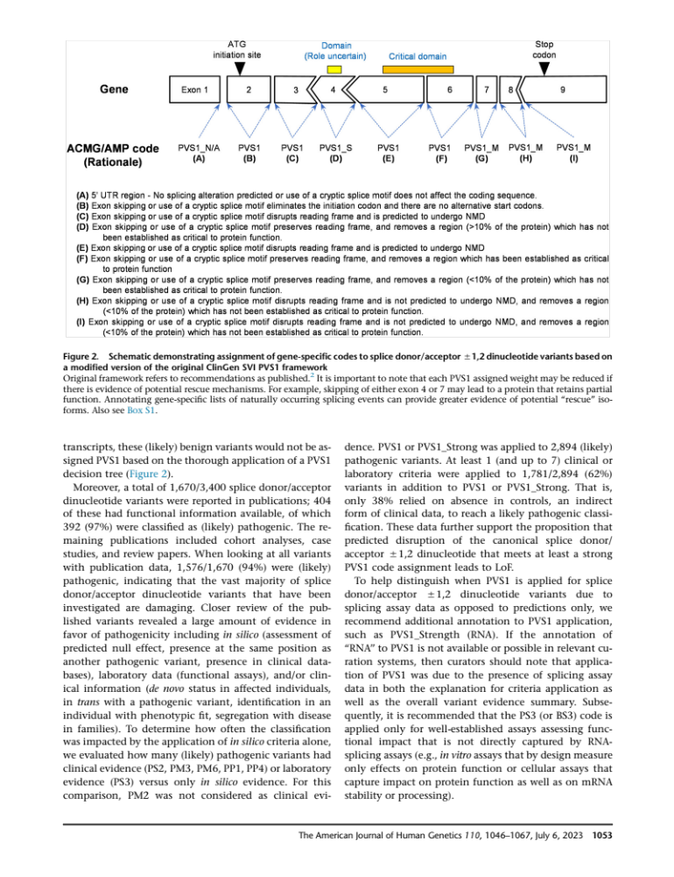
(d) RPGR exon map: The retinal-specific transcript NM_001034853.2 is on the top and NM_00328.3 is on the bottom. Splice sites for exons 1-14 and the start of exon 15 or ORF15 are the same in both transcripts. The overhang shown at the top is a two-nt overhang, overhang on bottom is a one-nt overhang. Parallel lines represent in-frame junctions (e.g. deletion of exons 2+3 is in frame, deletion of 8+9 is out of frame.
1
2
3
4
5
6
7
8
9
10
11
12
13
14
ORF15
1
2
3
4
5
6
7
8
9
10
11
12
13
14
15
16
17
18
19
(e) Generic PVS1 schematic – Figure 2 from Walker et al., 2023
XLIRD VCEP proposes to add:
(J, edit of H) Exon skipping or use of a cryptic splice motif disrupts reading frame and is not predicted to undergo NMD, and removes a region (<10% of the protein) which has not been established as critical to protein function, but it disrupts a region in the next exon which has been established as critical to protein function. PVS1

