Slide 1
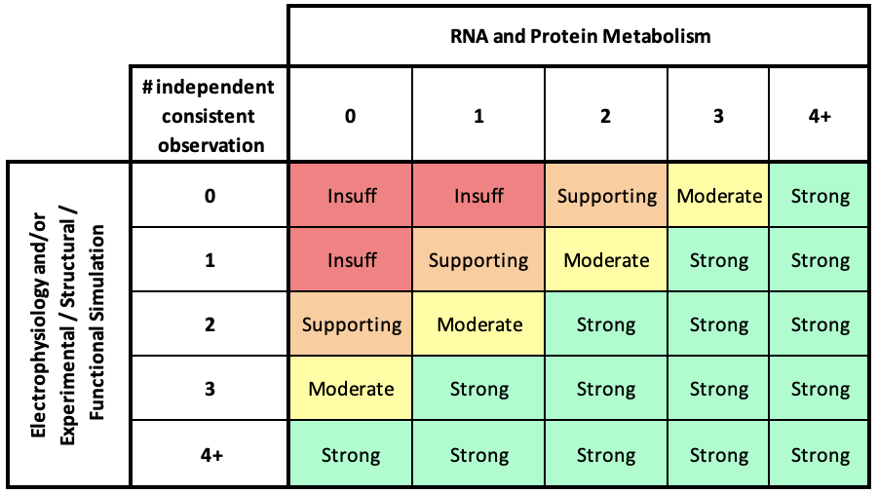
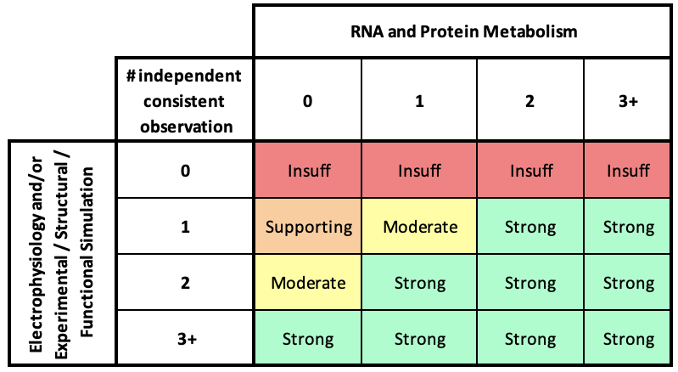
VCEP PS3 Recommendation
VCEP BS3 Recommendation
Caveats:
Conflicting evidence from different papers - no points
Same types of evidence (e.g RNA and Protein Metabolism) coming from the same paper - count 1
No more than 2 pieces of evidence can be counted from the same paper
Same finding in 2 papers from the same group – count 1
Electrophysiology result can only meet PS3 if the variant is co-expressed with KCNE1 and the current magnitude is outside the normal range defined by the paper and is statistically significantly different from the normal control.
Please count Experimental / Structural / Functional Simulation (PMID: 29021305) only when the results align with a electrophysiology experiment.
Caveats:
Conflicting evidence from different papers - no points
Same types of evidence (e.g RNA and Protein Metabolism) coming from the same paper - count 1
No more than 2 pieces of evidence can be counted from the same paper
Same finding in 2 papers from the same group – count 1
Electrophysiology result can only meet BS3 if the variant is co-expressed with KCNE1 and if the variant current magnitude is within the normal range defined by the paper and is NOT statistically significantly different from the normal control.
Please count Experimental / Structural / Functional Simulation (PMID: 29021305) only when the results align with a electrophysiology experiment.

