Slide 1
Innovations in distance learning
By: Kyle Lasante

Slide 2
OverView
Distance learning is helpful for Students

Slide 3
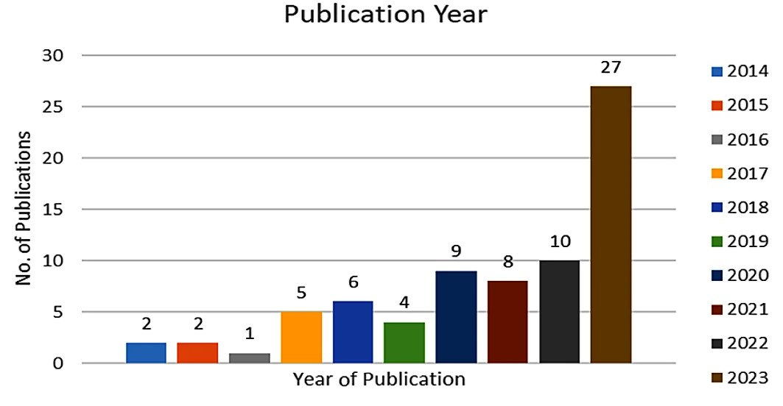
Graphs & Tables

Slide 4

Info & picture
Distance learning has innovated well enough to the point of offering a diverse set of features to accommodate a broad range of learners.

Slide 5
References
References
Luckin, R., Holmes, W., Griffiths, M., & Forcier, L. B. (2016). "Intelligence Unleashed: An Argument for AI in Education."
Johnson, L., Adams Becker, S., Estrada, V., & Freeman, A. (2014). "NMC Horizon Report: 2014 Higher Education Edition."
Garrison, D. R., & Anderson, T. (2003). "E-Learning in the 21st Century: A Community of Inquiry Framework for Text and Multimedia." Routledge.
Siemens, G. (2013). "Learning Analytics: The Emergence of a Discipline." American Behavioral Scientist, 57(10), 1409-1420. doi:10.1177/0002764213498851

Slide 6
Links
How the Remote Learning Pivot Sparked Innovation in Education | EdTech Magazine
Online education in the post-COVID era | Nature Electronics

