Slide 1
Software Development Life Cycle
Presenter: Kyle Latimer
Project: Module 8-Final Project
Course: CS 250 Software Development Life Cycle

Slide 2
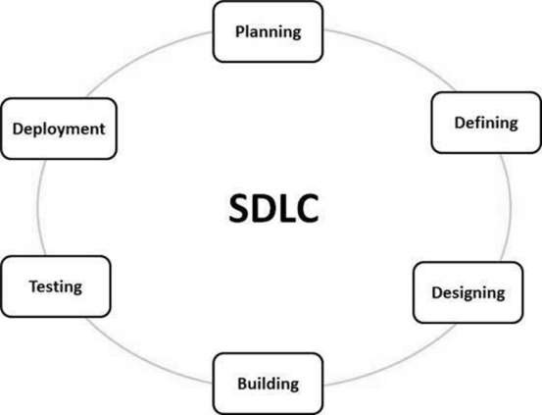
What is a Software Development Life Cycle?
“SDLC is a process followed for a software project, within a software organization. It consists of a detailed plan describing how to develop, maintain, replace and alter or enhance specific software. The life cycle defines a methodology for improving the quality of software and the overall development process.” (SDLC Tutorial 2022)
There are 6 Stages to SDLC, they are:
Stage 1: Planning and Requirement Analysis.
Stage 2: Defining Requirements.
Stage 3: Designing the Product Architecture.
Stage 4: Building and Developing the Product.
Stage 5: Testing the Product.
Stage 6: Deployment in the Market and Maintenance.

Slide 3

What is the Best SDLC Approach?
There is no “Best” SDLC Approach. A one size fits all SDLC approach does not exist. There are various factors, however, that may determine which is the best SDLC approach for a particular company and project. These factors include:
Project Size
Team Size
Complexity of Project
Stakeholder Specifications
Stakeholder input

Slide 4

What SDLC Approach Do We Currently Use?
At CHADA Tech, we are currently utilizing the Waterfall Model. The Waterfall approach uses a process where software development and projects are divided into separate phases, and generally the outcome of one phase acts as input or a starting point to the next phase. The manner in which these phases are completed is sequentially.
The Waterfall model has the following phases:
Requirements and analysis
System Design
Implementation
Testing
System Deployment
Maintenance
Each phase cascades into the next phase downwards, similar to a waterfall in nature.

Slide 5
Advantages and Disadvantages of the Waterfall Model:
Advantages:
Disadvantages:
Easy to manage.
Does not work well for large, complex projects.
High level of risk and uncertainty.
Simple and easy to understand and implement.
Clearly defined stages.
Easy to delegate tasks.
Works well with small, well-defined projects.
Difficult to gauge progress.
Product is not able to be demoed until towards the end.
Extremely Difficult to accommodate change.

Slide 6
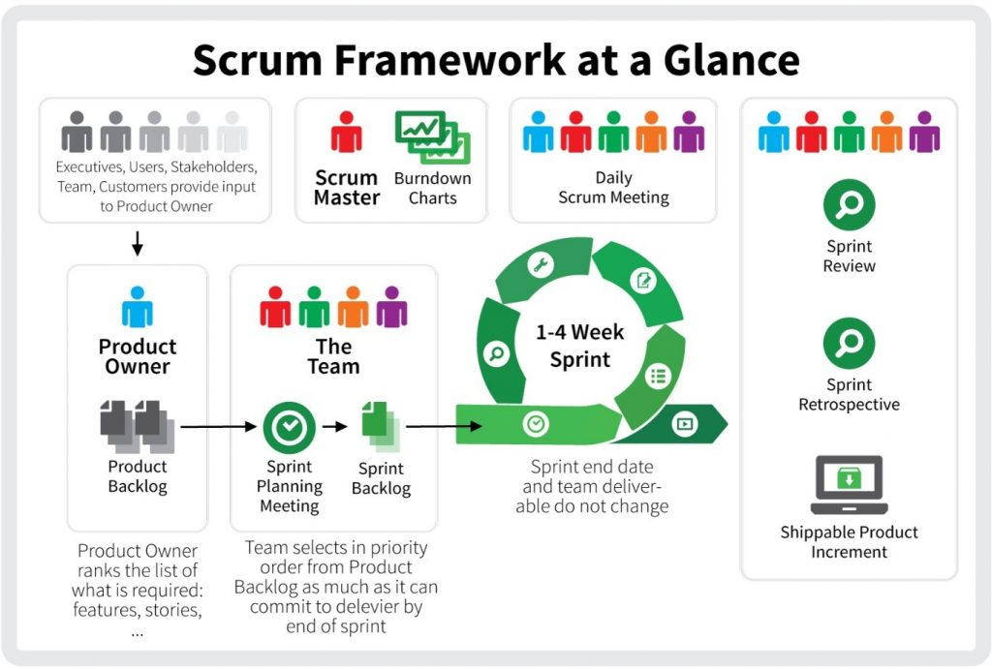
What is an alternative SDLC Approach?
Here at CHADA Tech, we want to be responsive to our customers. We also work on large, complex projects. We want to continue obtaining our stakeholder’s input. Scrum –Agile Based SDLC Approach would better suit out company.
What is a Scrum-Agile SDLC Approach?
The Scrum Model is the most widely used Agile Methodology in the industry and utilizes an empirical process. An empirical process is the process that allows some frequent changes and adaptation as well as frequent demonstrations and inspections that utilizes a trial and error approach. In Scrum, there are various roles in the team, which include Product Owner, Scrum Master, the Scrum Team.
(Source: State of CA-2022)

Slide 7
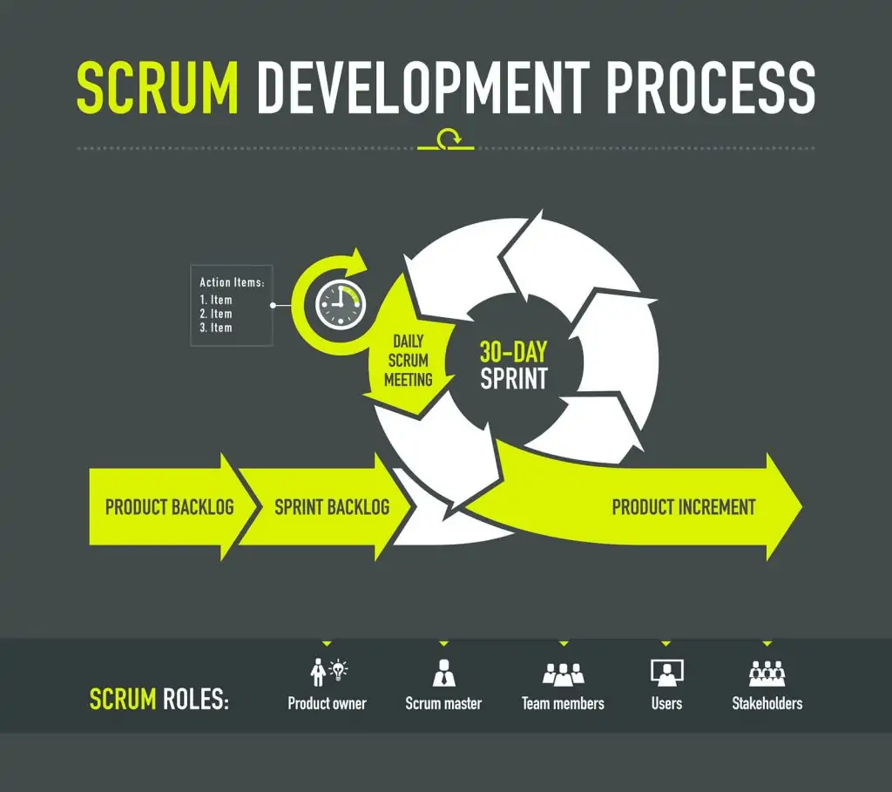
Advantages and Disadvantages of the Scrum-Agile Approach:
Advantages:
Disadvantages:
Promotes teamwork and cross-training.
Relies heavily on customer interaction.
Not suitable for complex dependencies.
Able to demo working portions of the project to stake holders.
Suitable for changing requirements.
Can facilitate stakeholder requests and input.
Works well with complex projects.
Not suitable for small projects.
(Source: Digite.com 2022)

Slide 8
Composition of Scrum-Agile SDLC Team:
Product Owner:
Responsibilities include:
Manage Product Backlog items.
Communicate with stakeholders.
Ensure the product backlog is visible, transparent, and clear for the Scrum Team and that they understand the items needed in the product backlog.
Obtain the necessary information from the stakeholder.
Scrum Master:
Responsibilities and characteristics include:
Act as a servant-leader for the Scrum Team and help facilitate the Scrum Team.
Work with the Product Owner to find effective techniques for product backlog management.
Ensuring the Product Owner knows how to organize the product backlog in order to maximize value and allocation of resources.
Facilitate Scrum events, such as daily stand up meetings.
Remove obstacles and impediments that hinder the team’s progress.
Development Team:
Responsibilities and Characteristics include:
Delivering a potentially releasable increment of work from the product backlog.
The team is self organizing.
No one, not even the Scrum Master, instructs the team how to turn items in the product backlog into releasable increments.
Cross functional, and they do not recognize titles other than “developer” in order to prevent the creation of sub teams and specialist.
Sources: Cobb 2015

Slide 9

In Conclusion:
Our company strives to provide the best possible product to its customers. Our company also wants to remain responsive to the customer’s needs. We strive to provide the best product in the industry. In order to do this, we must change our approach from the Waterfall Model to the Scrum-Agile approach SDLC model.

Slide 10
Sources Cited:
SDLC Tutorial 2022 Tutorialspoint Simple Easy Learning: SDLC - Waterfall Model (tutorialspoint.com)
State of California 2022: Agile tools and techniques 3.8.1 Agile Tools and Techniques | Project Resources (ca.gov)
Digite.com 2022 What Is Scrum Methodology? & Scrum Project Management What Is Scrum Methodology? & Scrum Project Management (digite.com)
Charles Cobb 2015: The Project Manager's Guide to Mastering Agile : Principles and Practices for an Adaptive Approach Hoboken : Wiley. 2015

