Slide 1
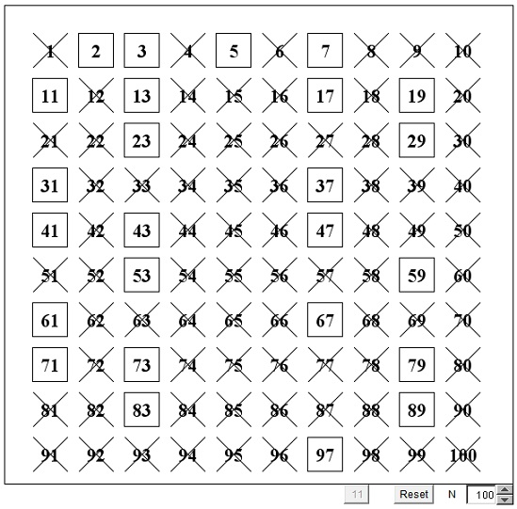
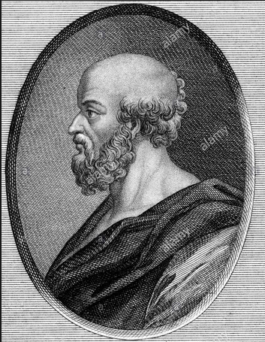
The Sieve of Eratosthenes using OpenMP Multi-Threading
By: Keith Livingston & Leomar Olivares

Slide 2
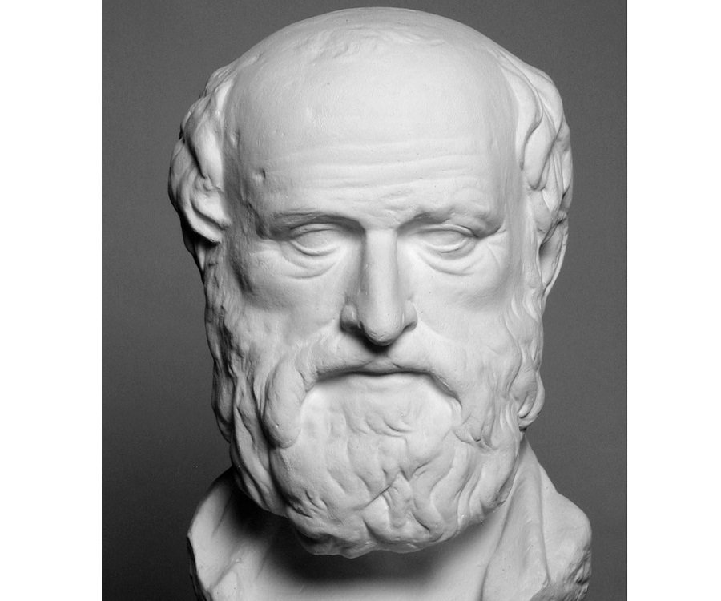
Brief History on Eratosthenes
Eratosthenes, born in Cyrene in the year 276 B.C.E, was a Greek mathematician, geographer and astronomer.
His contemporaries nicknamed him "beta", which is Greek for number 2, because he supposedly proved himself to be the second in the ancient Mediterranean world in many fields.
During the Hellenistic Age we saw the expansion of Greek science and philosophy across the western world. Eratosthenes was a brilliant Greek thinker who was well known for many important discoveries and inventions, but he is truly known for his work in mathematics.

Slide 3
The Sieve of Eratosthenes Begins
The Sieve of Eratosthenes is a mathematical algorithm that is used to discover all possible prime numbers from 1 to N. Eratosthenes best known contribution to mathematics is his sieve used to easily find prime numbers in massive lists.
A mathematical sieve is any pattern or algorithm that functions by “crossing off” any potential numbers that doesn’t fit a certain criteria.
The Sieve of Eratosthenes works by using multiples of certain numbers to eliminate numbers from being primes. Leaving only prime numbers in the list at the end.

Slide 4
Why The Sieve of Eratosthenes?
You can view a prime sieve as an application of dynamic programming to small complete prime number enumerations. It is essential to test an algorithm by comparing varieties of time complexities in programs to show its efficiency. Back then, mathematicians were fascinated with prime numbers. In order to develop theories about them, it was useful to make lists of which numbers were prime, and which were composite. That's how the technique Eratosthenes developed was born.

Slide 5
Why it’s useful in Parallel Computing
To improve the speed of generating prime numbers, the parallel processing principle can be used in parallel computing systems. When we need to exhibit speedups in a high performance computer, parallel computing can enhance the time to find all the prime numbers up to N.
Many computer scientist using parallel computing find that the Sieve of Eratosthenes algorithm can be meticulously handled to prove accurate results. The beauty of executing multiple threads doing different jobs at once makes the Sieve a lot more efficient.

Slide 6
What is OpenMP?
OpenMP (Open Multi-Processing) is an application programming interface (API) that supports multi-platform shared memory multi-processing and multi-threading programming in C, C++, and Fortran.
OpenMP is an implementation of multi-threading, a method of paralleling whereby a master thread (a series of instructions executed consecutively) forks a specified number of slave threads and the system divides a task among them. The threads then run concurrently, with the run-time environment allocating threads to different processors.

Slide 7
Why OpenMP Multi-Threading?
An easy to implement algorithm with the ability to run our algorithm through multiple threads to make the process’s not only run more efficient, but give us accurate results.
The most important concept to this algorithm is that it will overpower the serial algorithm (sequential algorithm).

Slide 8
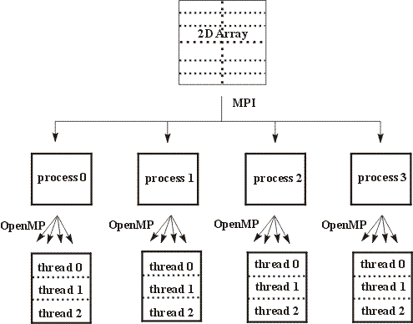
OpenMP Mechanism
“Message Passing Interface”

Slide 9
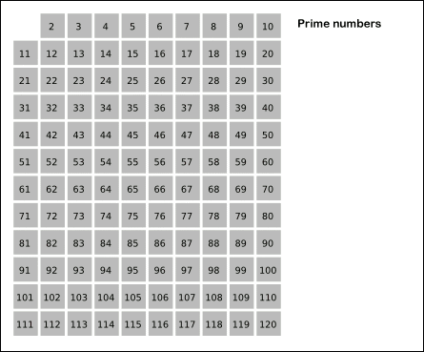
Code/Example
int Multipier(int n)
{
int prime;
int total = 0;
int i;
int j;
# pragma omp parallel \
shared (n) \
private(i,j,prime)
# pragma omp for reduction(+total)
for (i = 2; i <= n; i++)
{
prime = 1;
for (j = 2; j < i; j++)
{
if (i % j == 0)
{
prime = 0;
break;
}
}
total = total + prime;
}
return total;
}

Slide 10
Time Complexity?
The Sieve of Eratosthenes time complexity is O(n log(log n)) to find all prime numbers less than n.

Slide 11
Run 1: 1 Thread
Processors Used = 4
Threads Used = 1
N Primes Time
5 3 5.5e-07
10 4 5.6e-07
20 8 7.86e-07
40 12 3.743e-06
80 22 1.0669e-05
160 37 3.2303e-05
320 66 9.8998e-05
640 115 0.000316522
1280 207 0.00114824
2560 375 0.00283656
5120 685 0.00806831
10240 1254 0.0337508
20480 2312 0.0907966
40960 4288 0.340142
81920 8009 1.19935
163840 14999 4.78474
327680 28223 18.3321

Slide 12
Run 2: 4 Threads
Processors Used = 4
Threads Used = 4
N Primes Time
5 3 4.82993e-06
10 4 4.65006e-06
20 8 9.46995e-05
40 12 2.225e-05
80 22 7.517e-04
160 37 2.2648e-04
320 66 6.0747e-04
640 115 0.000177202
1280 207 0.000605125
2560 375 0.00227954
5120 685 0.00868653
10240 1254 0.0294642
20480 2312 0.0974112
40960 4288 0.348446
81920 8009 1.01271
163840 14999 3.32197
327680 28223 12.3092

Slide 13
Run 3: 8 Threads
Processors Used = 4
Threads Used = 8
N Primes Time
5 3 1.054e-05
10 4 5.04995e-03
20 8 1.34601e-02
40 12 2.951e-02
80 22 1.0065e-01
160 37 2.2545e-01
320 66 7.1811e-01
640 115 0.000232766
1280 207 0.000876865
2560 375 0.00296006
5120 685 0.00730872
10240 1254 0.0266819
20480 2312 0.0946679
40960 4288 0.33995
81920 8009 0.45351
163840 14999 2.92144
327680 28223 7.8111

Slide 14
Video Link
https://www.youtube.com/watch?v=V08g_lkKj6Q

Slide 15
Real World Examples
Generating Psuedo-Random Numbers with computers.
Generating hash codes.
Creating machine tools. Avoid setting up harmonics.
Many designs and patterns.

Slide 16
Fun Facts
Eratosthenes is credited with being the first person to have calculated the Earth's circumference. He observed that at Syene (present-day Aswan) in Egypt, the Sun's rays fell vertically at noon on the summer solstice.
Eratosthenes went further and computed the tilt of the Earth's axis to within a degree. This is the tilt which is the main cause of the annual climate cycle of spring, summer, autumn, winter.

