Slide 1
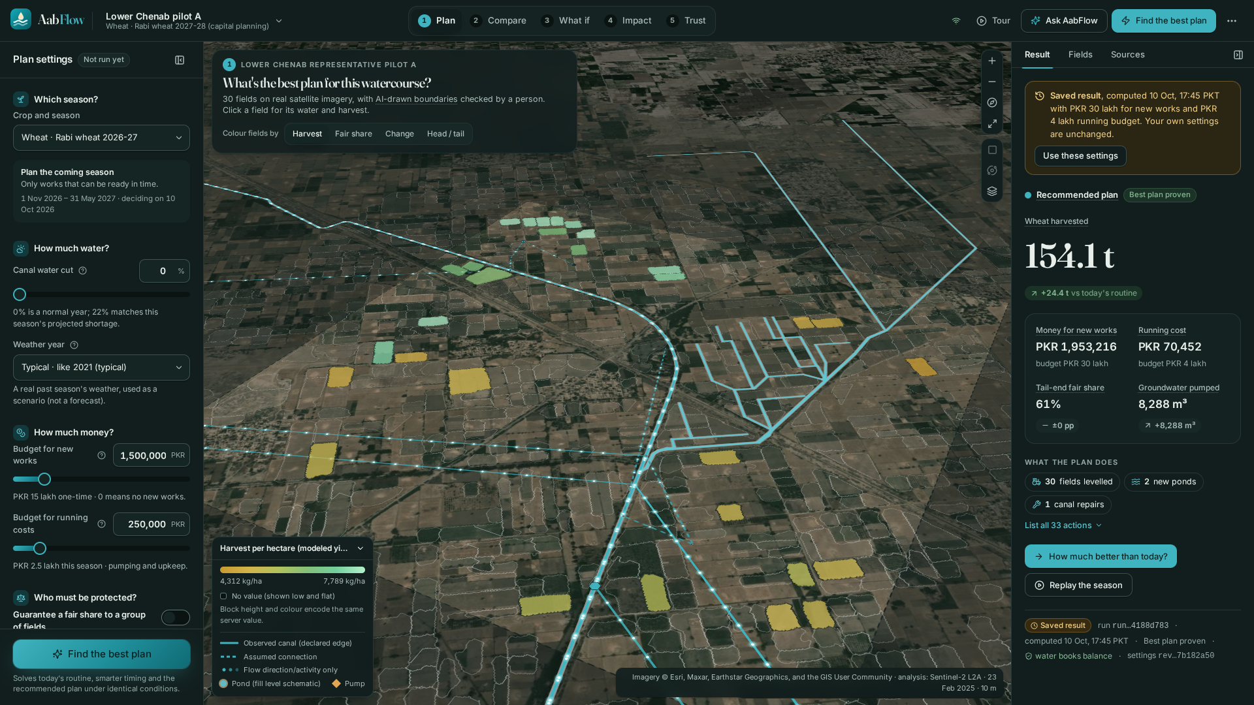
AICON 2026 · IRRIGATION AND CANAL WATER PLANNING
AabFlow
Test the season before you spend.
An AI planning agent that helps a village water committee decide which improvements to fund, before a single rupee is spent.
Real Sentinel-2 imagery · 30 AI-drawn fields · yield shown as height
Notes:
Open: AabFlow is an AI planning agent for village water committees. One line: test the season before you spend. Everything you will see is computed from real runs; nothing is staged.

Slide 2
THE DECISION
The tail farmer gets water last
A few dozen farmers share one earthen watercourse and take fixed turns. The far end goes short first.
1
One shared channel
Fields near the canal (the head) water first; the tail waits.
22%
2
A small budget
Levelling, a pond, a canal repair, extra pumping: they can fund only some.
projected system-level water shortage for Rabi 2026–27 in Punjab and Sindh
3
Less water coming
Every rupee and every turn matters more in a short year.
Source: Associated Press of Pakistan (APP), 2026
Notes:
Warabandi: fixed weekly turns. The tail is served last. The committee can afford only some improvements, and a 22% shortage is projected (APP).

Slide 3
WHAT OUR MODEL FOUND
Optimising what exists quietly hurts the tail
Same season, same water, same weather: three plans solved under identical conditions (pilot A, Rabi wheat 2027-28).
Notes:
Optimising only what exists grew 8.3% more wheat but cut the worst-off tail field from 61% to 44% of its water. AabFlow catches that. Runs: B0 run_8b6f, B1 run_6980, P run_5f2a.

Slide 4
AABFLOW'S INTEGRATED PLAN
More wheat, fairer water, under budget
Proven best within its candidate options, then checked against the water rules.
+18.8%
61%
65%
more wheat than today's routine
129.7 t → 154.1 t
of its water for the worst-off tail field, back from 44% under 'optimise existing'
of the Rs 30 lakh budget used
Rs 19.5 lakh on 33 works
Honest trade-off: the plan pumps 8,288 m³ of groundwater where today's routine pumps none, within each well's cap. We say it before anyone asks.
Notes:
+18.8% wheat, tail back to 61%, 65% of the budget. Say the groundwater cost out loud: it builds trust.

Slide 5
IS AI THE CORE? YES: FOUR ENGINES
It sees, predicts, plans and explains
Perceive → simulate → decide → explain and act. Every fact below is read from stored evidence.
S
Sees
P
Predicts
O
Plans
E
Explains
931 → 30
6.8 ms
7,745
27 tools
possible fields found on Sentinel-2 by Delineate Anything; review rules and a person kept the 30 clearest
per yield estimate from a model we trained on GPU on 45,619 crop simulations (held-out error ≈ 7%)
field options searched by an exact optimiser; best plan proven in 0.37 s
GPT-6 Luna runs the app's real tools, in English or Urdu; it never types a number
Notes:
Frame: AabFlow is an AI planning agent with four senses. Sees: 931 raw outlines to 30 reviewed. Predicts: LightGBM trained on 45,619 AquaCrop runs, 6.8 ms. Plans: CP-SAT searched 7,745 policies and proved the best. Explains: 27 real tools, Urdu.

Slide 6
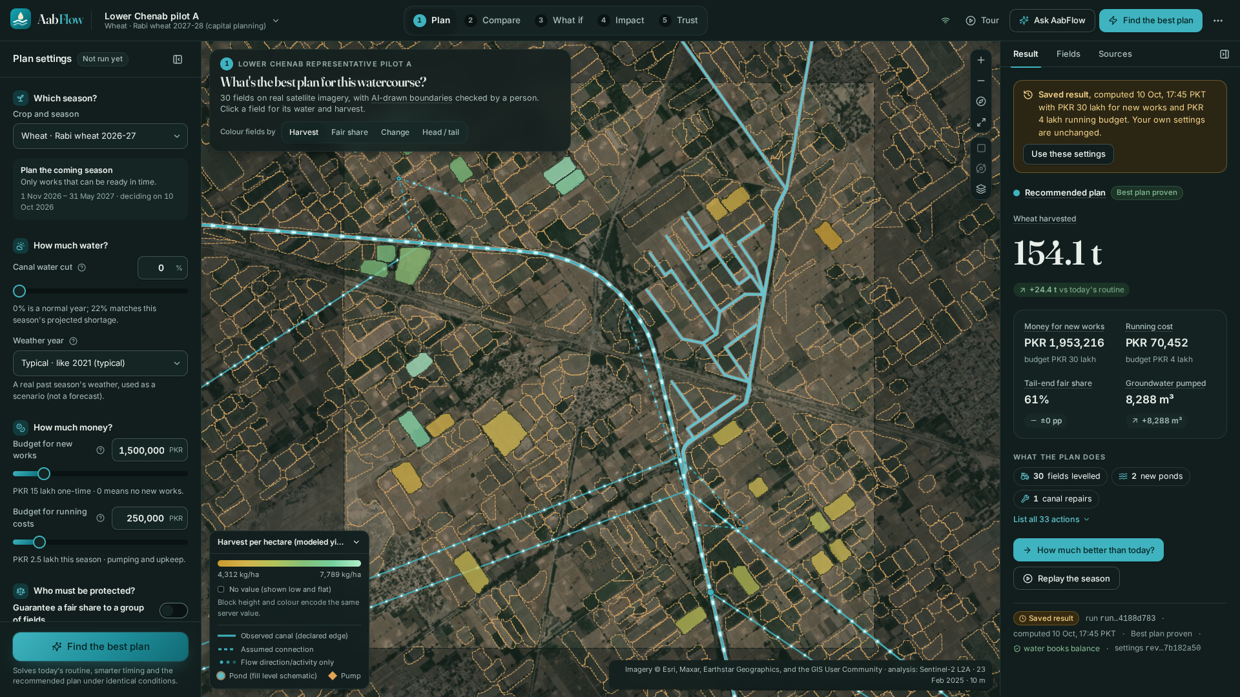
ENGINE 1 · SEES
The AI found every field from space
931
possible field outlines the AI drew on one Sentinel-2 image (pilot A)
30
kept by our review rules, then checked by a person
Draw a new area and the same pipeline onboards it: pilot B v2 was published this way.
Notes:
Dashed outlines are raw AI detections. Accuracy is not estimated (no reference boundaries); we report the review rate instead.

Slide 7
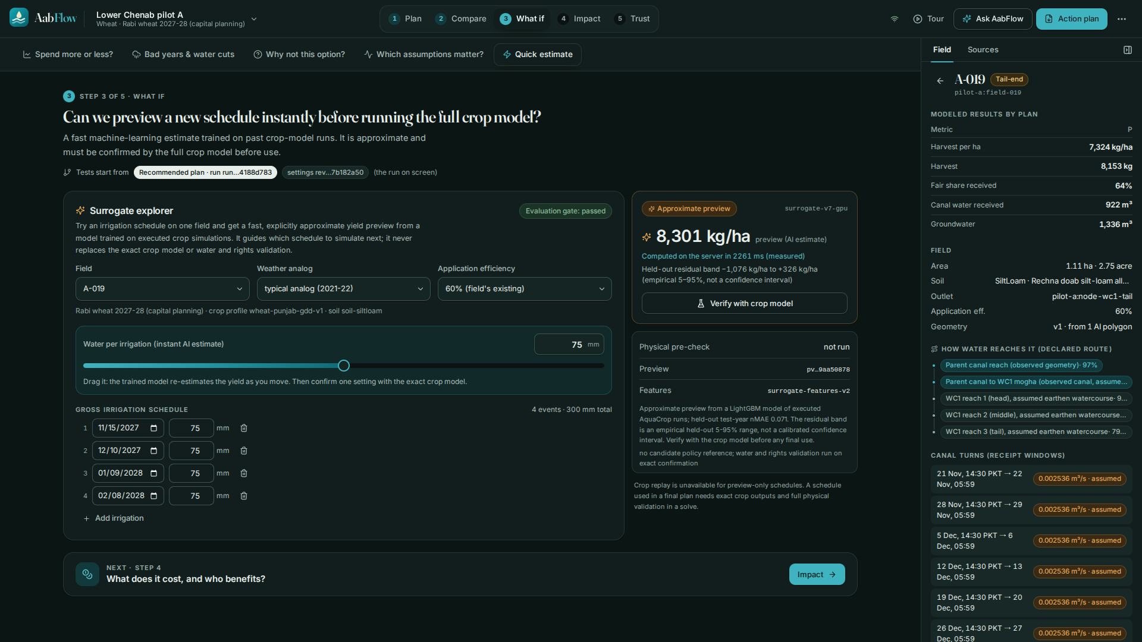
ENGINE 2 · PREDICTS
Drag a slider, get a crop yield in milliseconds
45,619
exact AquaCrop simulations we ran and stored, then trained a model on (GPU)
≈ 7%
held-out error (wheat nMAE 0.071), gated on years the model never saw
Labelled “approximate preview”; one click runs the exact crop model side by side.
Notes:
Live, the server measured 6–15 ms per estimate while dragging. The preview is never shown as exact.

Slide 8
ENGINE 3 · PLANS
It tells a committee when not to spend
Six budget settings, each solved to a proven optimum (frontier analysis).
+12.4 t
from the first Rs 5 lakh
+1.7 t
from the next Rs 75 lakh
A 95% tail floor at Rs 30 lakh is proven infeasible: an honest “no”, not a fake “yes”.
Notes:
Frontier analysis ana_5bfa: 0 to 80 lakh. Returns flatten after 5 lakh. Each point is its own immutable run.

Slide 9
STRESS TEST
The robust plan holds in all 9 tested seasons
3 weather years × 3 canal supplies. A plan that breaks a water rule gets no yield, never a made-up one.
Normal turns
22% water cut
14-day closure
Insurance with a price tag
The robust plan (R) is chosen to survive the bad states. In a typical year it grows 126.8 t, below the typical-year plan's 154.1 t. The committee sees that price before choosing.
Dry year
✓ deliverable
55.3 t
✓ deliverable
55.3 t
✓ deliverable
55.3 t
Typical year
✓ deliverable
126.8 t
✓ deliverable
126.8 t
✓ deliverable
126.8 t
Wet year
✓ deliverable
175.7 t
✓ deliverable
175.7 t
✓ deliverable
175.7 t
Notes:
Stress analysis ana_4e96 on the robust plan: deliverable in all 9 states. Production per weather year is the same across supply rows for this fixed plan.

Slide 10
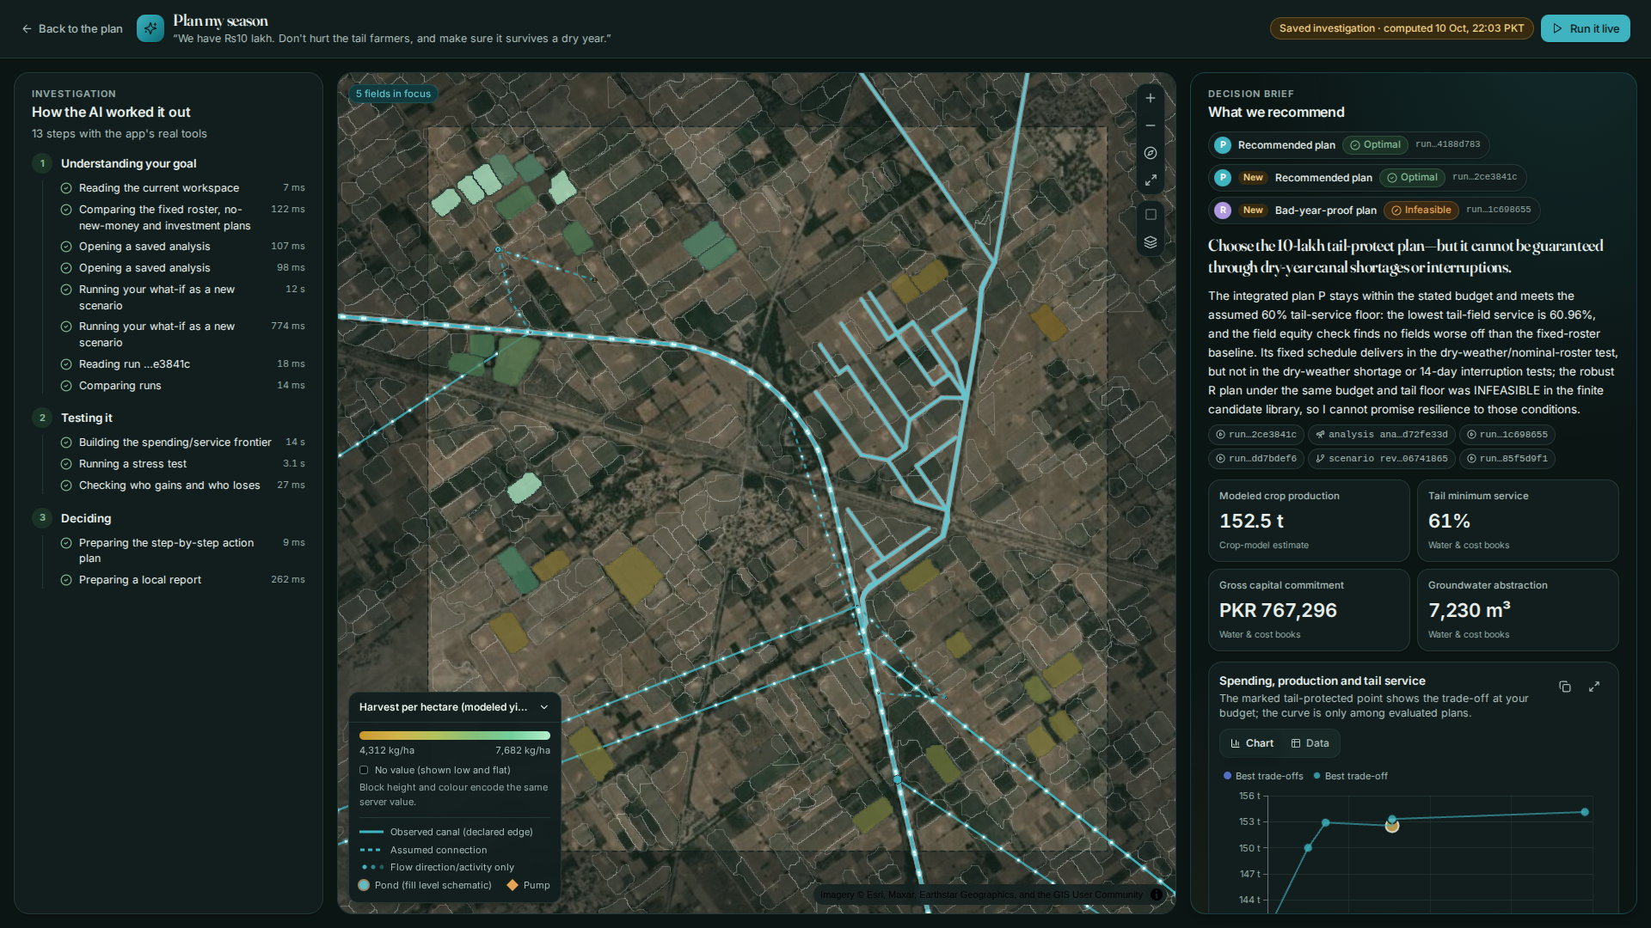
ENGINE 4 · EXPLAINS AND ACTS
One sentence in, a season plan out
“We have Rs 10 lakh. Don't hurt the tail farmers, and make sure it survives a dry year.”
1
Understands the goal
reads the watercourse, solves the plan ladder and a what-if
2
Tests it
budget frontier, stress test, who gains and who loses
3
Decides
dated action plan and a one-page brief, every number traced
93.7 s
live, 13 real tool calls, all numbers validated
Notes:
Plan mode on the same copilot engine: 4 model rounds, tools in parallel. Its honest headline: choose the 10-lakh tail-protect plan, but it cannot be guaranteed through dry-year shortages; the robust variant was infeasible at that budget. Saved investigation replays offline; Run it live is the encore.

Slide 11
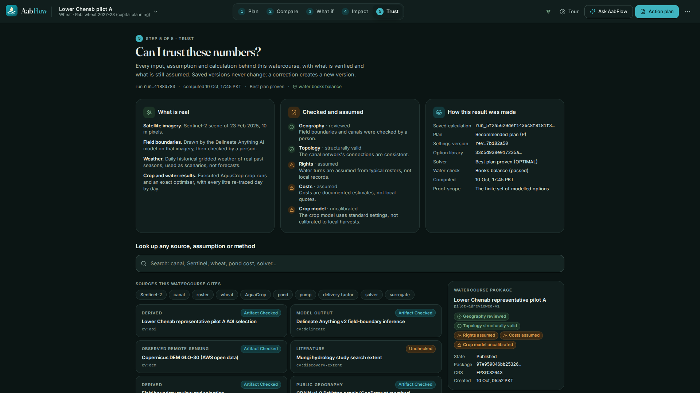
WHY A COMMITTEE CAN TRUST IT
Honest by construction
#
Every number is traced
to a stored run, analysis or source, with its licence and hash. The copilot withholds any figure it cannot trace.
!
Assumptions are labelled
Water rights and costs are assumed and editable; the crop model is uncalibrated. Badges say so on screen.
⌁
Works offline
Planning, the crop model and the optimiser run locally in Docker. Cold start: 3.1 s to ready, 3.9 s to the tour.
✓
Reproducible
Published pilots re-derive byte for byte; make evidence-pack bundles the proof.
Notes:
Limits, said first: uncalibrated crop model; assumed rights and costs; optimal only within generated candidates; copilot 30x3 evaluation (AT17) not yet run.

Slide 12
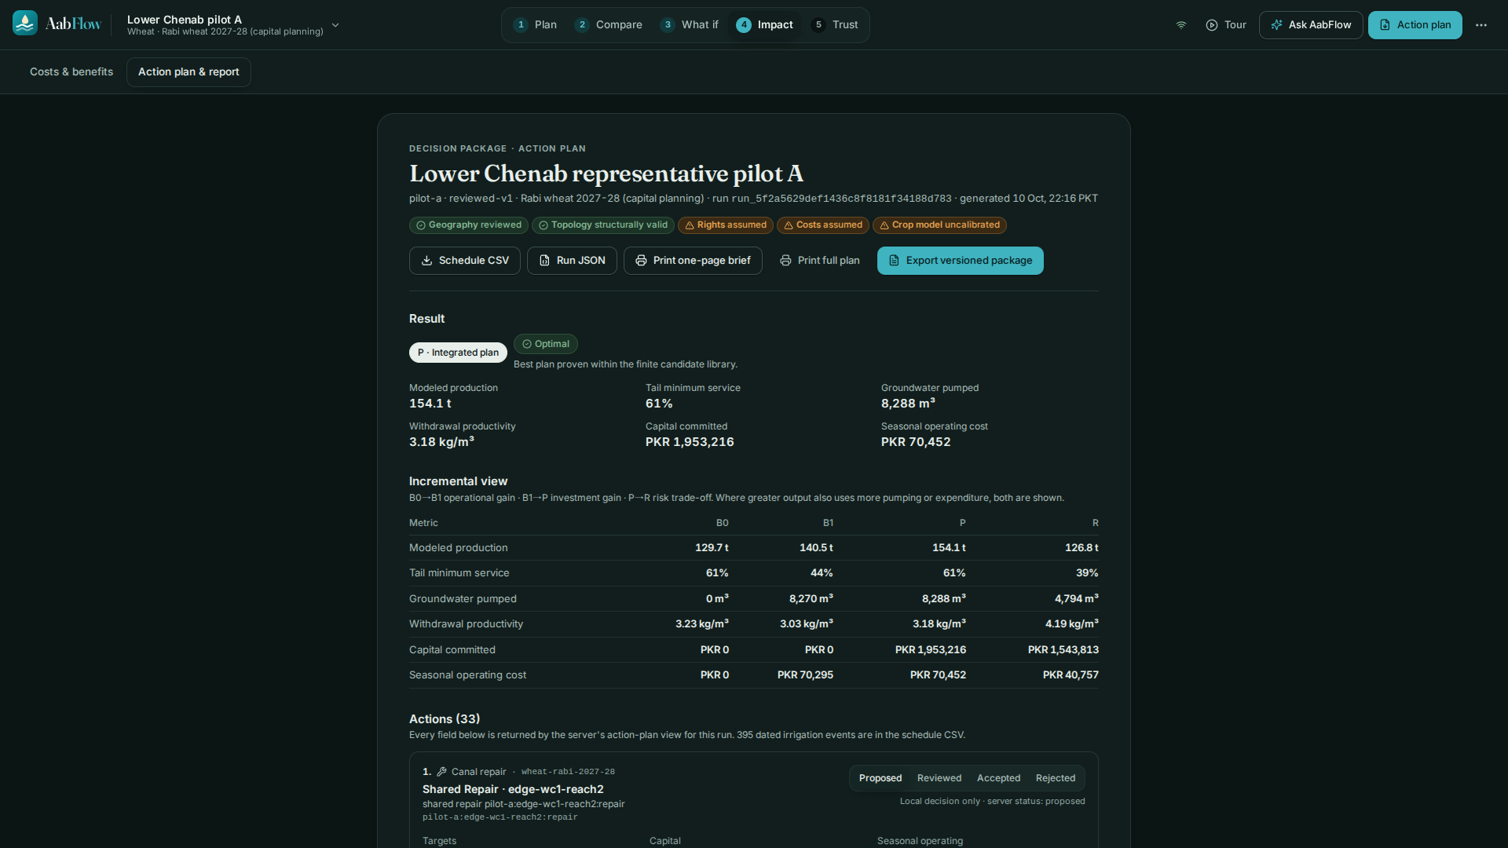
WHAT THE COMMITTEE TAKES HOME
A one-page, dated action plan
Who does what, when, at what cost, and who still goes short. Printed from the real run.
Operator
a WUA coordinator or extension officer
First buyer
a programme funding irrigation or resilience work
Scales by
onboarding: draw an area, AI finds fields, review, publish
Notes:
Hold up the printed brief (make print-brief). IWMI's PRIAT works with 72 WUAs in Punjab: that is the channel.

Slide 13
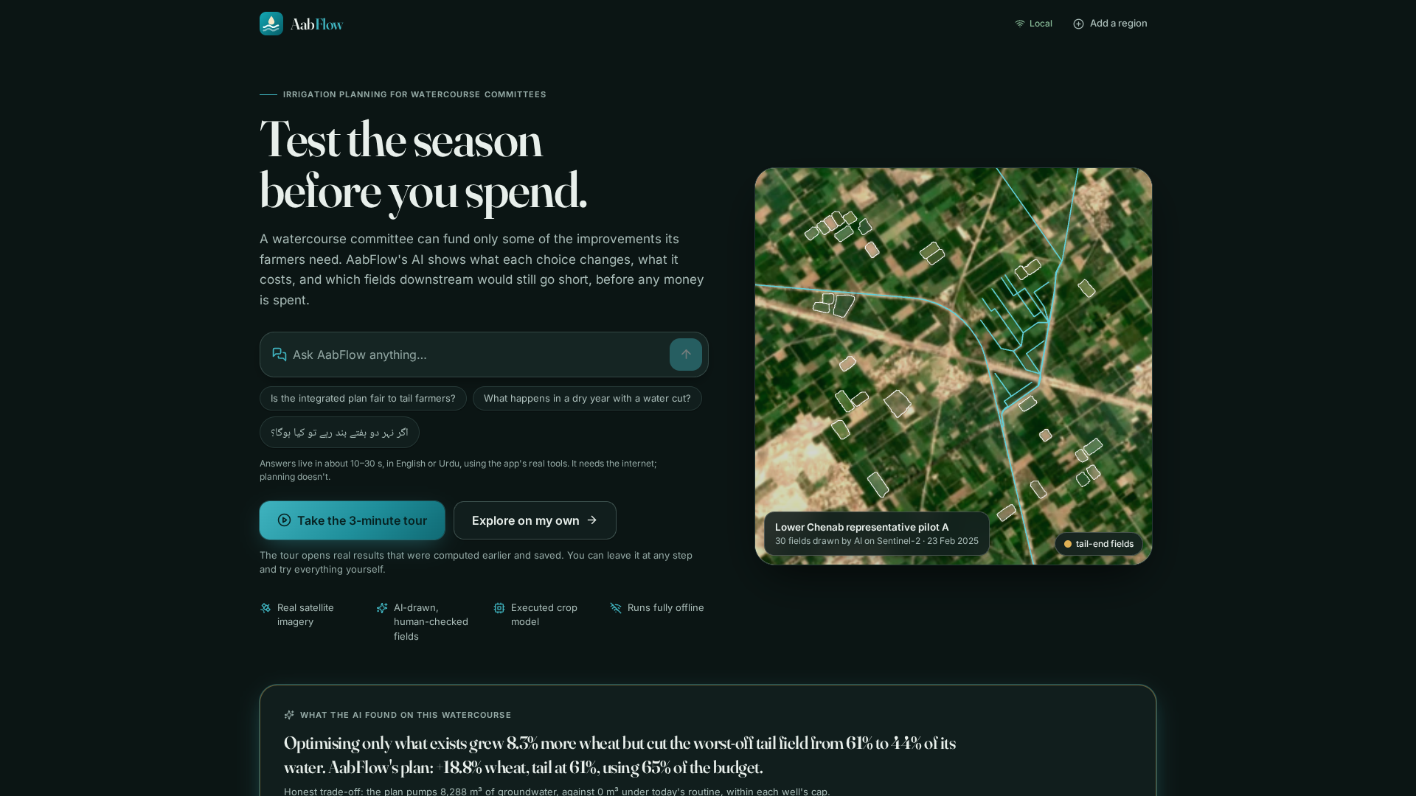
NEXT STEP
Test the season before you spend.
A supervised pilot with one Water User Association: calibrate the crop model, verify rights and costs, and put the plan in the committee's hands.
Who wants to be first?
Notes:
Close on the ask. Do not claim AT17, calibrated yields or measured rights or costs.

