Slide 1
Wordnet - A lexical database for the English Language.
Project at Cognitive Science Laboratory, Princeton University - began in late 80s.
Team consisted of linguists and psychologists.
Design - inspired by psycho-linguistic theories of human lexical memory.
Wordnet continues to grow – Novel applications to research.

Slide 2
Wordnet - A lexical database for the English Language – Goal.
Alphabetical organization –
clusters words that are spelt alike.
scatters words with similar or related meanings.
Wordnet resembles a thesaurus more than a dictionary.
Goal - search dictionaries conceptually.

Slide 3
Wordnet - A lexical database for the English Language – Forms and Meanings.
Some Definitions
Word form - Physical utterance or inscription.
Word meaning - a possible lexical concept that a form can be used to express.
Word is commonly used to refer both.
Lexical Matrix – captures the mapping between forms and meanings.

Slide 4
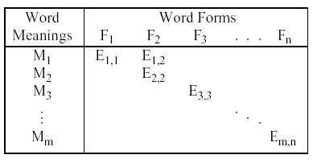
Wordnet - A lexical database for the English Language – Lexical Matrix.
A Lexical Matrix

Slide 5
Wordnet - A lexical database for the English Language – Polysemy and Synonymy.
Two entries in the same column - word form is polysemous. For example, the word form “case”.
Two entries in the same row - word forms are
synonymous. For example, the word forms “cruel”
and “unjust”.
Mappings between forms and meanings are many -many.

Slide 6
Wordnet - A lexical database for the English Language – Synonymy and Synsets.
Synonymy – Two words are synonymous if
substitution of one for the other does not alter the truth value. (inverse is Antonymy.)
Possible Representations:
List the word forms (synsets) that can be used to express a meaning - Thesaurus.
Draw semantic relations between meanings i.e. synsets or list of synonyms – Wordnet.

Slide 7
Wordnet - A lexical database for the English Language – Human Lexical Memory.
In lexical memory
Nouns are organized as topical hierarchies.
Verbs are organized by a variety of entailment.
Adjectives and adverbs are organized as hyperspaces.

Slide 8
Wordnet - A lexical database for the English Language – Lexical Inherence of Nouns.
Dictionary – words used to describe words, causes circularity.
Lexicographers impose tree structure on the semantic memory of nouns.
Consider the following: oak->tree->plant->organism.
Asymmetric, transitive semantic relation – Hypernymic relation. (inverse is hyponymic relation).

Slide 9
Wordnet - A lexical database for the English Language – Lexical Inherence of Nouns.
Design creates a sequence of levels – hierarchies.
Specific terms at lower levels to a few generic terms at the top.
Hierarchies provide conceptual skeletons for nouns.

Slide 10
Wordnet - A lexical database for the English Language – Lexical Inherence of Nouns.
Issue - How to choose top level generic classes.
One way - Assume all nouns are in a single hierarchy.
Alternative - Few generic top-level concepts.
Multiple hierarchies - relatively distinct semantic fields.

Slide 11
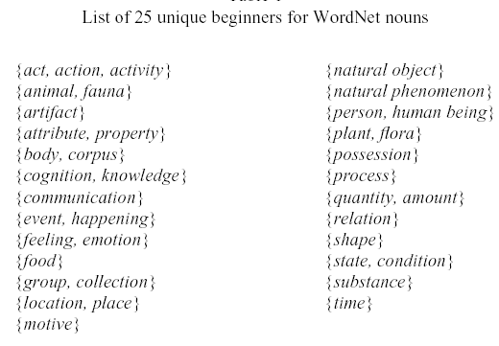
Wordnet - A lexical database for the English Language – Multiple Hierarchies.

Slide 12
Wordnet - A lexical database for the English Language – Capturing Meronymy.
Canary -> Bird. (-> is Hypernymic relationship)
Canary has a small size, beak and wings. (Is this relation captured?)
Associate nouns with 3 characteristic features:
Attributes : small, yellow. (adjectives)
Parts : beak, wings. (nouns)
Functions : sing, fly. (verbs)

Slide 13
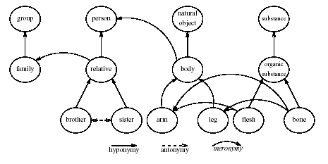
Wordnet - A lexical database for the English Language – Network Representation.

Slide 14
Wordnet - A lexical database for the English Language – Adjectives.
Linguists divide adjectives into two distinct classes.
Descriptive - which describe a head noun.
Relational - stylistic variants of nouns.
Descriptive - good, bad, big, small, interesting.
Relational - presidential, nuclear - derived from a noun.

Slide 15
Wordnet - A lexical database for the English Language – Descriptive Adjectives.
Descriptive Adjectives ascribe attribute to nouns.
Pointers between adjectives and noun synsets .
There is no hierarchy – semantic organization thought as abstract hyperspace.
Basic Semantic Relation here is antonymy.

Slide 16
Wordnet - A lexical database for the English Language – Bipolar Adjective Structure.
Adjective synsets organized as adjective clusters.
Association – Semantic similarity to a focal adjective.
Focal adjective relates the cluster to contrasting cluster at opposite pole.

Slide 17
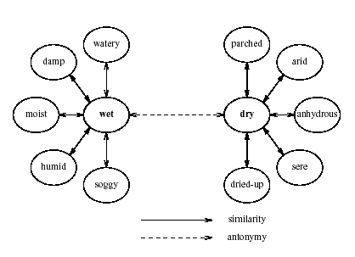
Wordnet - A lexical database for the English Language – Bipolar Adjective Structure.

Slide 18
Wordnet - A lexical database for the English Language – Relational Adjectives.
Often derived from Greek and Latin nouns.
Some examples:
“Fraternal” relates to brother.
“Atomic bomb” and “Atom bomb” both admissible.
Relation with nouns most important.
Cross Referenced to parent nouns.

Slide 19
Wordnet - A lexical database for the English Language – Verbs as Semantic Net.
Verbs – Central Organizers of English sentences.
Verbs highly polysemous.
Polysemy count: nouns - 1.74 , verbs – 2.11.
Mutability of verbs – meanings depend on kind of noun arguments.
“run in the street” versus “run a company”.

Slide 20
Wordnet - A lexical database for the English Language – Lexical Entailment of Verbs.
Entailment means Strict Implication. (P -> Q).
Not possible for that “P is true” and “Q is false”.
“He is snoring” entails “He is sleeping”.
Entailment - Primary Relation among verbs.
Troponymy - To V1 is to V2 in some particular fashion – “amble” is troponomous to “walk”.

Slide 21
Wordnet - A lexical database for the English Language – Familiarity Index.
Familiarity influences performance variables like reading, speed of comprehension.
Indicators of Familiarity:
Frequency of Use – from literature.
Polysemy count – more meanings implies more usage – Psycholinguistic evidence.
Wordnet uses Polysemy count as written literature is a small sample compared to spoken language.

Slide 22
Wordnet - A lexical database for the English Language – Wordnet Team.
http://www.cogsci.princeton.edu/~wn/
Website
Main Team –
Prof. George Miller.
Dr. Christiane Fellbaum.
Randee Tengi.
"WordNet: An Electronic Lexical Database" is available from MIT Press.

