Slide 1
Intro to NLP
Dmitry Ilvovsky
September 5, 2022

Slide 2
Natural language processing ...
along with computer vision a crucial part of modern artificial intelligence
deals with all human (and machine) interactions in language
requires understanding of linear algebra, statistics, mathematics in general, linguistics and coding skills

Slide 3
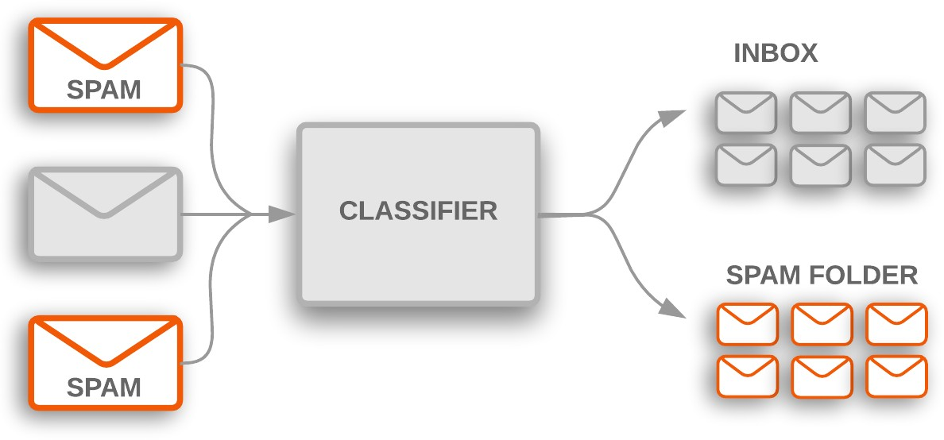
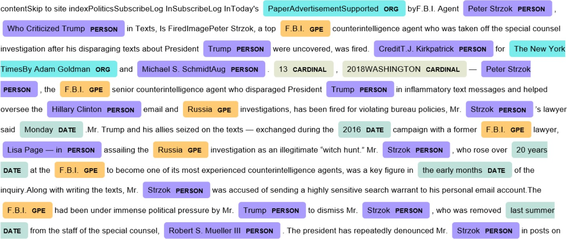
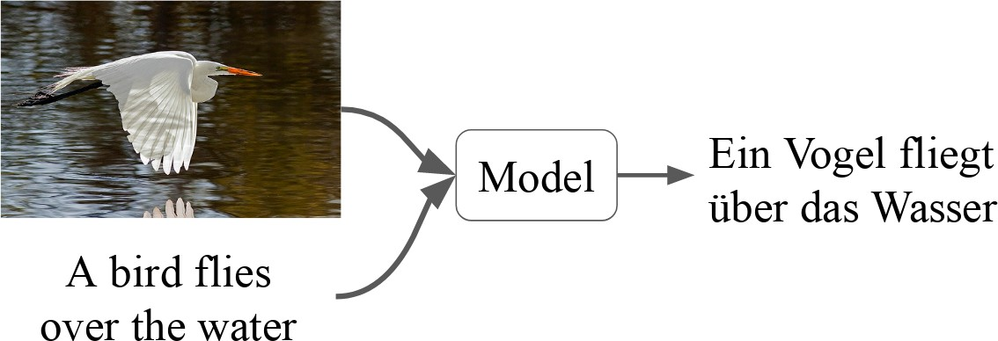
Example tasks
Text classification
Sentiment analysis
Intent detection
Spam filtering
Topic classification
Sequence labelling
Named entity recognition
Coreference resolution
Sequence transformation (seq2seq)
Machine translation
Question answering
Image sources: developers.google.com, towardsdatascience.com, statmt.org

Slide 4
Phenomena to handle
Tokenization and sentence boundary detection
Morphology
Syntax
Semantics
Discourse
Pragmatics
Multilinguality

Slide 5
Ambiguity
Polysemy and word-sense disambiguation: орган, bank
Homonymy: the ship or to ship, стекло
Syntactic ambiguity: John saw the man on the mountain with a telescope.

Slide 6

Syntactic ambiguity
John saw the man on the mountain with a telescope

Slide 7
Today
Intro
About this course Recent trends in NLP
Example task: text classification Practice: tools for processing Russian

Slide 8
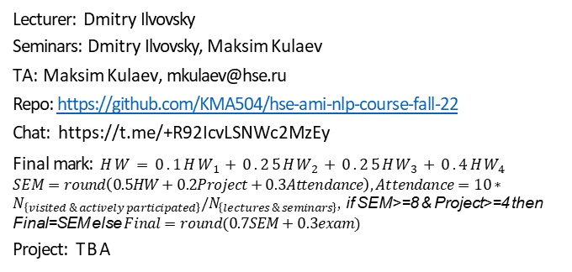
About this course
This course is based on the NLP course developed by Ekaterina Chernyak from HSE: github.com/PragmaticsLab/NLP-course-AMI
Lecturer: Dmitry Ilvovsky
Seminars: Dmitry Ilvovsky, Maksim Kulaev
TA: Maksim Kulaev, mkulaev@hse.ru
Repo: https://github.com/KMA504/hse-ami-nlp-course-fall-22
Chat: https://t.me/+R92IcvLSNWc2MzEy
Final mark: $HW=0.1HW_{1}+0.25HW_{2}+0.25HW_{3}+0.4HW_{4}$
$SEM=round\left(0.5HW+0.2Project+0.3Attendance\right), Attendance=10∗N_{\left\{visited \& actively participated\right\}}/N_{\left\{lectures \& seminars\right\}}$, if SEM>=8 & Project>=4 then Final=SEM else $Final=round(0.7SEM+0.3exam)$
Project: TBA
1
2
3
4
5
6
7

Slide 9
Our plan
Word embeddings Text classification Sequence modelling Seq2Seq modelling Syntax
Machine translation Generative models Sentiment Analysis Question Answering
Summarization and Simplification Fact Checking
Discourse
1
2
3
4
5
6
7
8
9
10
11
12

Slide 10
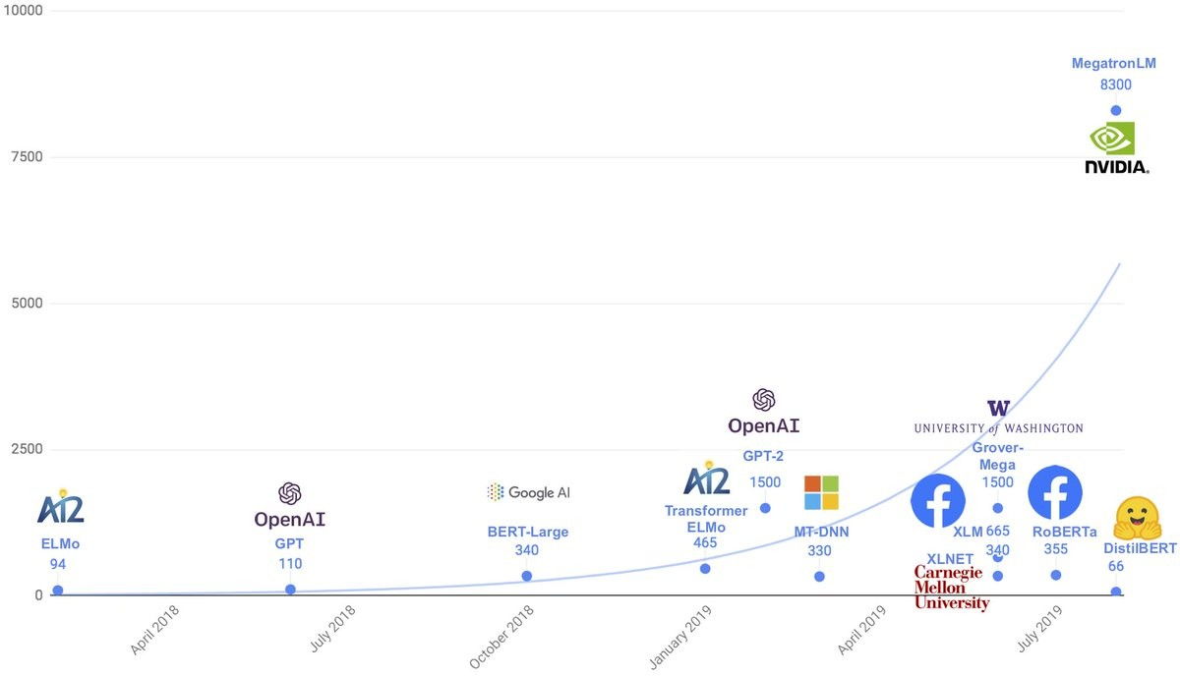
NLP’s ImageNet moment has arrived
... but is rather questionable

Slide 11
Recent trends in NLP
The ethics of AI
⁾ Fairness
⁾ Societal applications
Transfer learning
⁾ Cross-lingual methods
⁾ Cross-domain methods
Question answering
Multimodal NLP
Clinical NLP

Slide 12
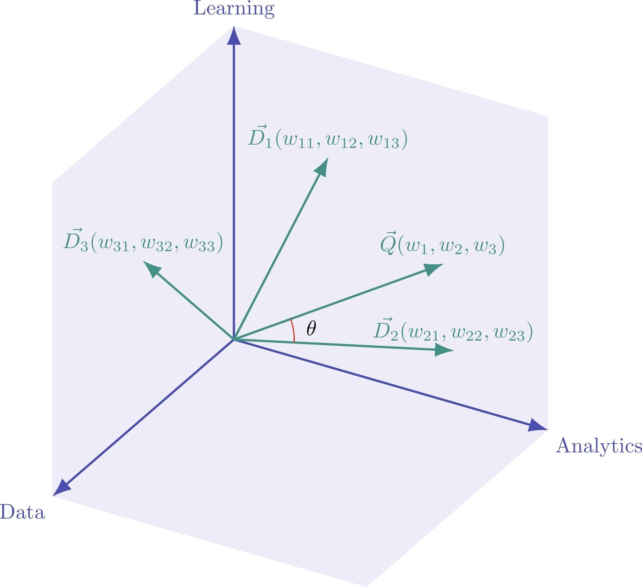
Vector space model [1]
Image source: Handbook of statistics

Slide 13
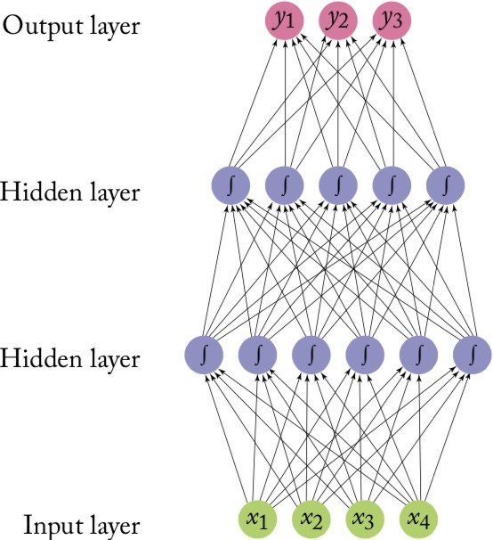
Feed forward network
Image source: NN Methods for NLP

Slide 14
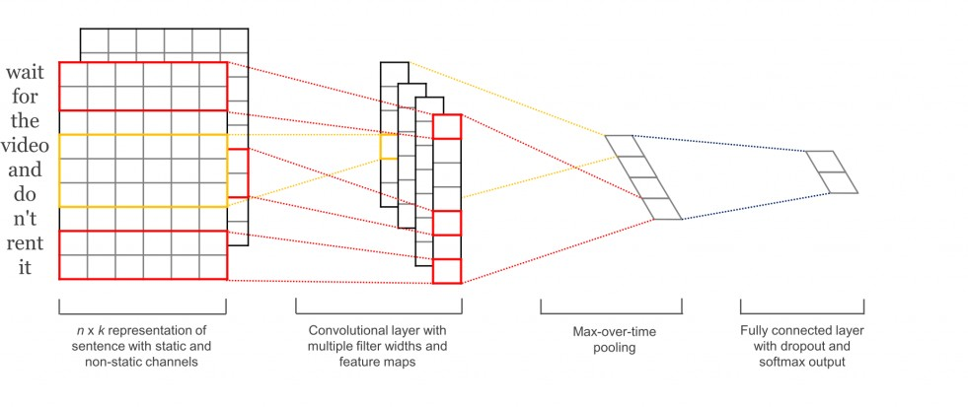
Convolutional network [2]

Slide 15
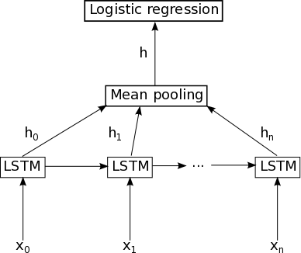
LSTM
Image source: deeplearning.net

Slide 16
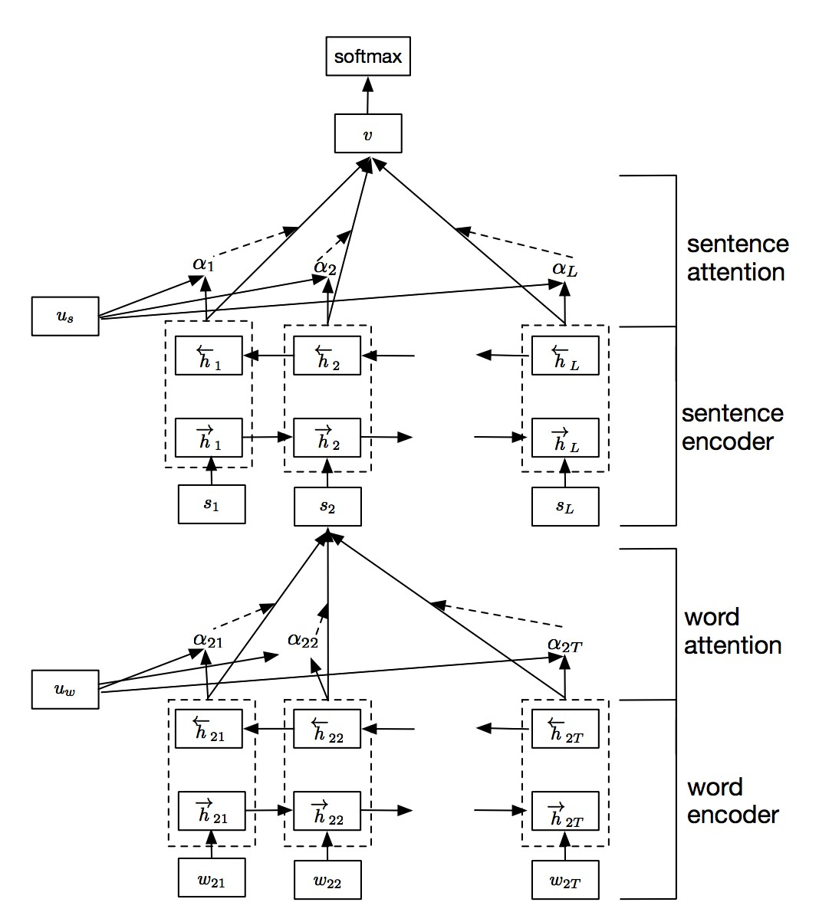
Hierarchical attention network [3]

Slide 17
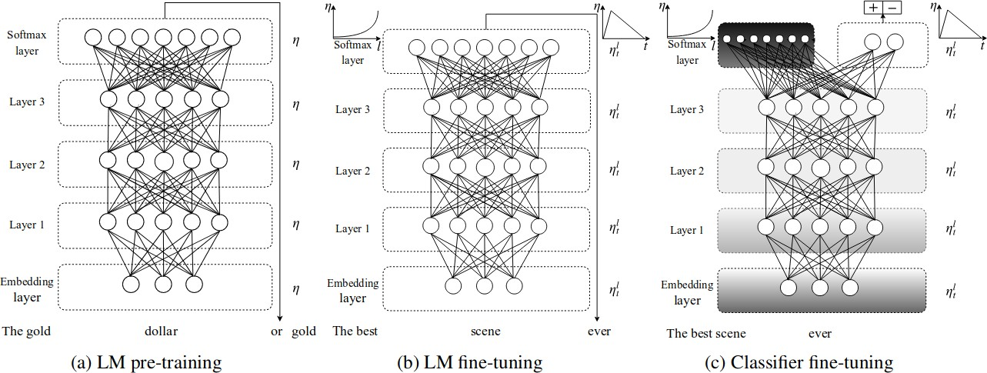
ULMFiT [4]

Slide 18
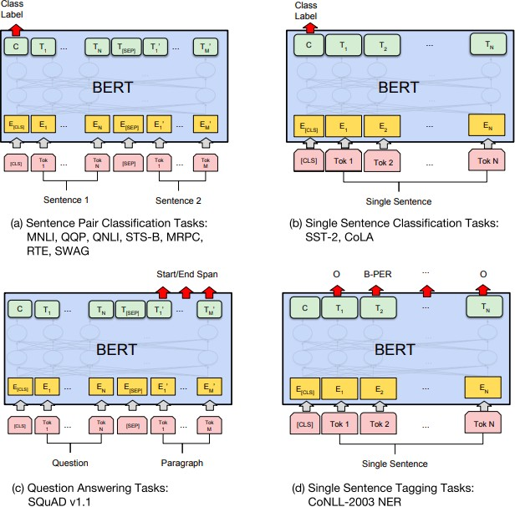
BERT [5]

Slide 19
Reading
Text classification algorithms: a survey [arXiv]
Speech and Language Processing. Daniel Jurafsky, James H. Martin, Ch. 2 [url]
Natural Language Processing. Jacob Eisenstein, Ch. 2-4, [GitHub]

Slide 20
Reference
G. Salton, A. Wong и C.-S. Yang, “A vector space model for automatic indexing”, Communications of the ACM, т. 18,
№ 11, с. 613—620, 1975.
Y. Kim, “Convolutional neural networks for sentence classification”, arXiv preprint arXiv:1408.5882, 2014.
Z. Yang, D. Yang, C. Dyer, X. He, A. Smola и E. Hovy, “Hierarchical attention networks for document classification”, в Proceedings of the 2016 conference of the North American chapter of the association for computational linguistics: human language technologies, 2016, с. 1480—1489.
J. Howard и S. Ruder, “Universal language model fine-tuning for text classification”, arXiv preprint arXiv:1801.06146, 2018.
J. Devlin, M.-W. Chang, K. Lee и K. Toutanova, “Bert: Pre-training of deep bidirectional transformers for language understanding”, arXiv preprint arXiv:1810.04805, 2018.

