Slide 1
AR
HOW TO CHANGE OUR LIFE
BY Chen J.M
Yan H.R

Slide 2
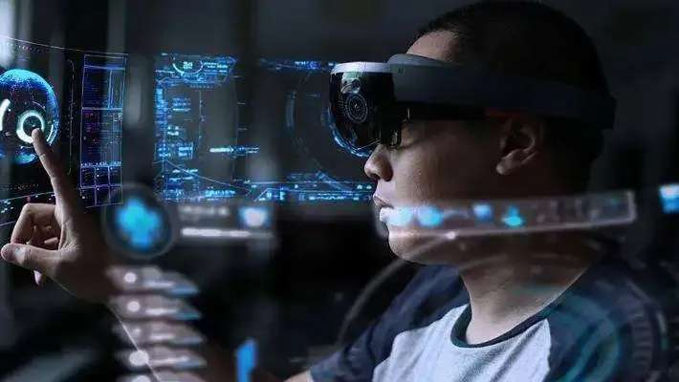
WHAT IS AR?
Augmented Reality (AR) is a technology that superimposes virtual content (e.g., images, text, 3D models) onto the real world, allowing users to view blended environments where digital and physical elements coexist through devices like smartphones or glasses.

Slide 3
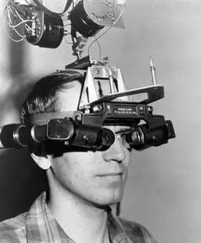
The Origin of AR
AR technology originated in military and academic laboratories. Over decades of iterative advancements in hardware and algorithms, it has evolved from clunky experimental prototypes to mainstream consumer applications.
Its development has consistently revolved around the core framework of "sensing, positioning, rendering, and interaction". In the future, AR is poised to become the next-generation general-purpose computing platform, driven by lightweight glasses and deeper integration with AI.

Slide 4
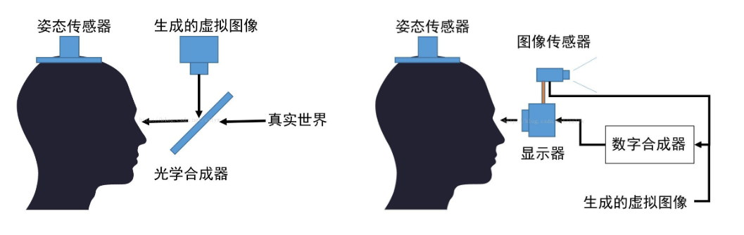
The Working Principle of AR
AR dynamically integrates virtual content with the real world by real-time environmental perception (via computer vision and sensors), precise positioning and tracking (using SLAM technology), virtual-real fusion rendering (ensuring geometric and lighting consistency), and natural interaction (gesture/voice recognition), creating a seamless "digital layer" that interacts with physical reality.

Slide 5
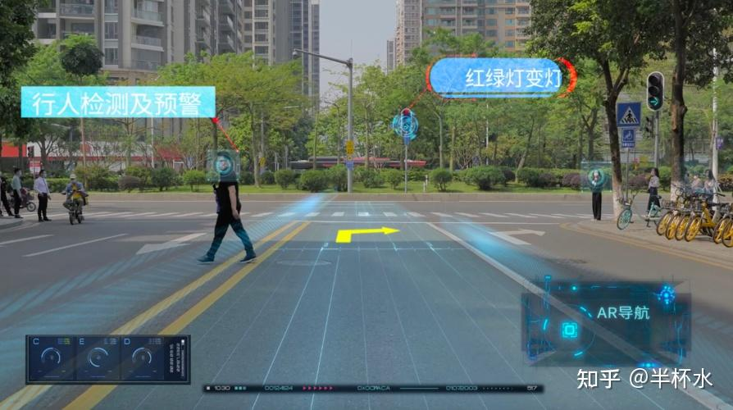
AR Navigation: ground guidance shortens navigation time in complex environments
AR导航
.

Slide 6
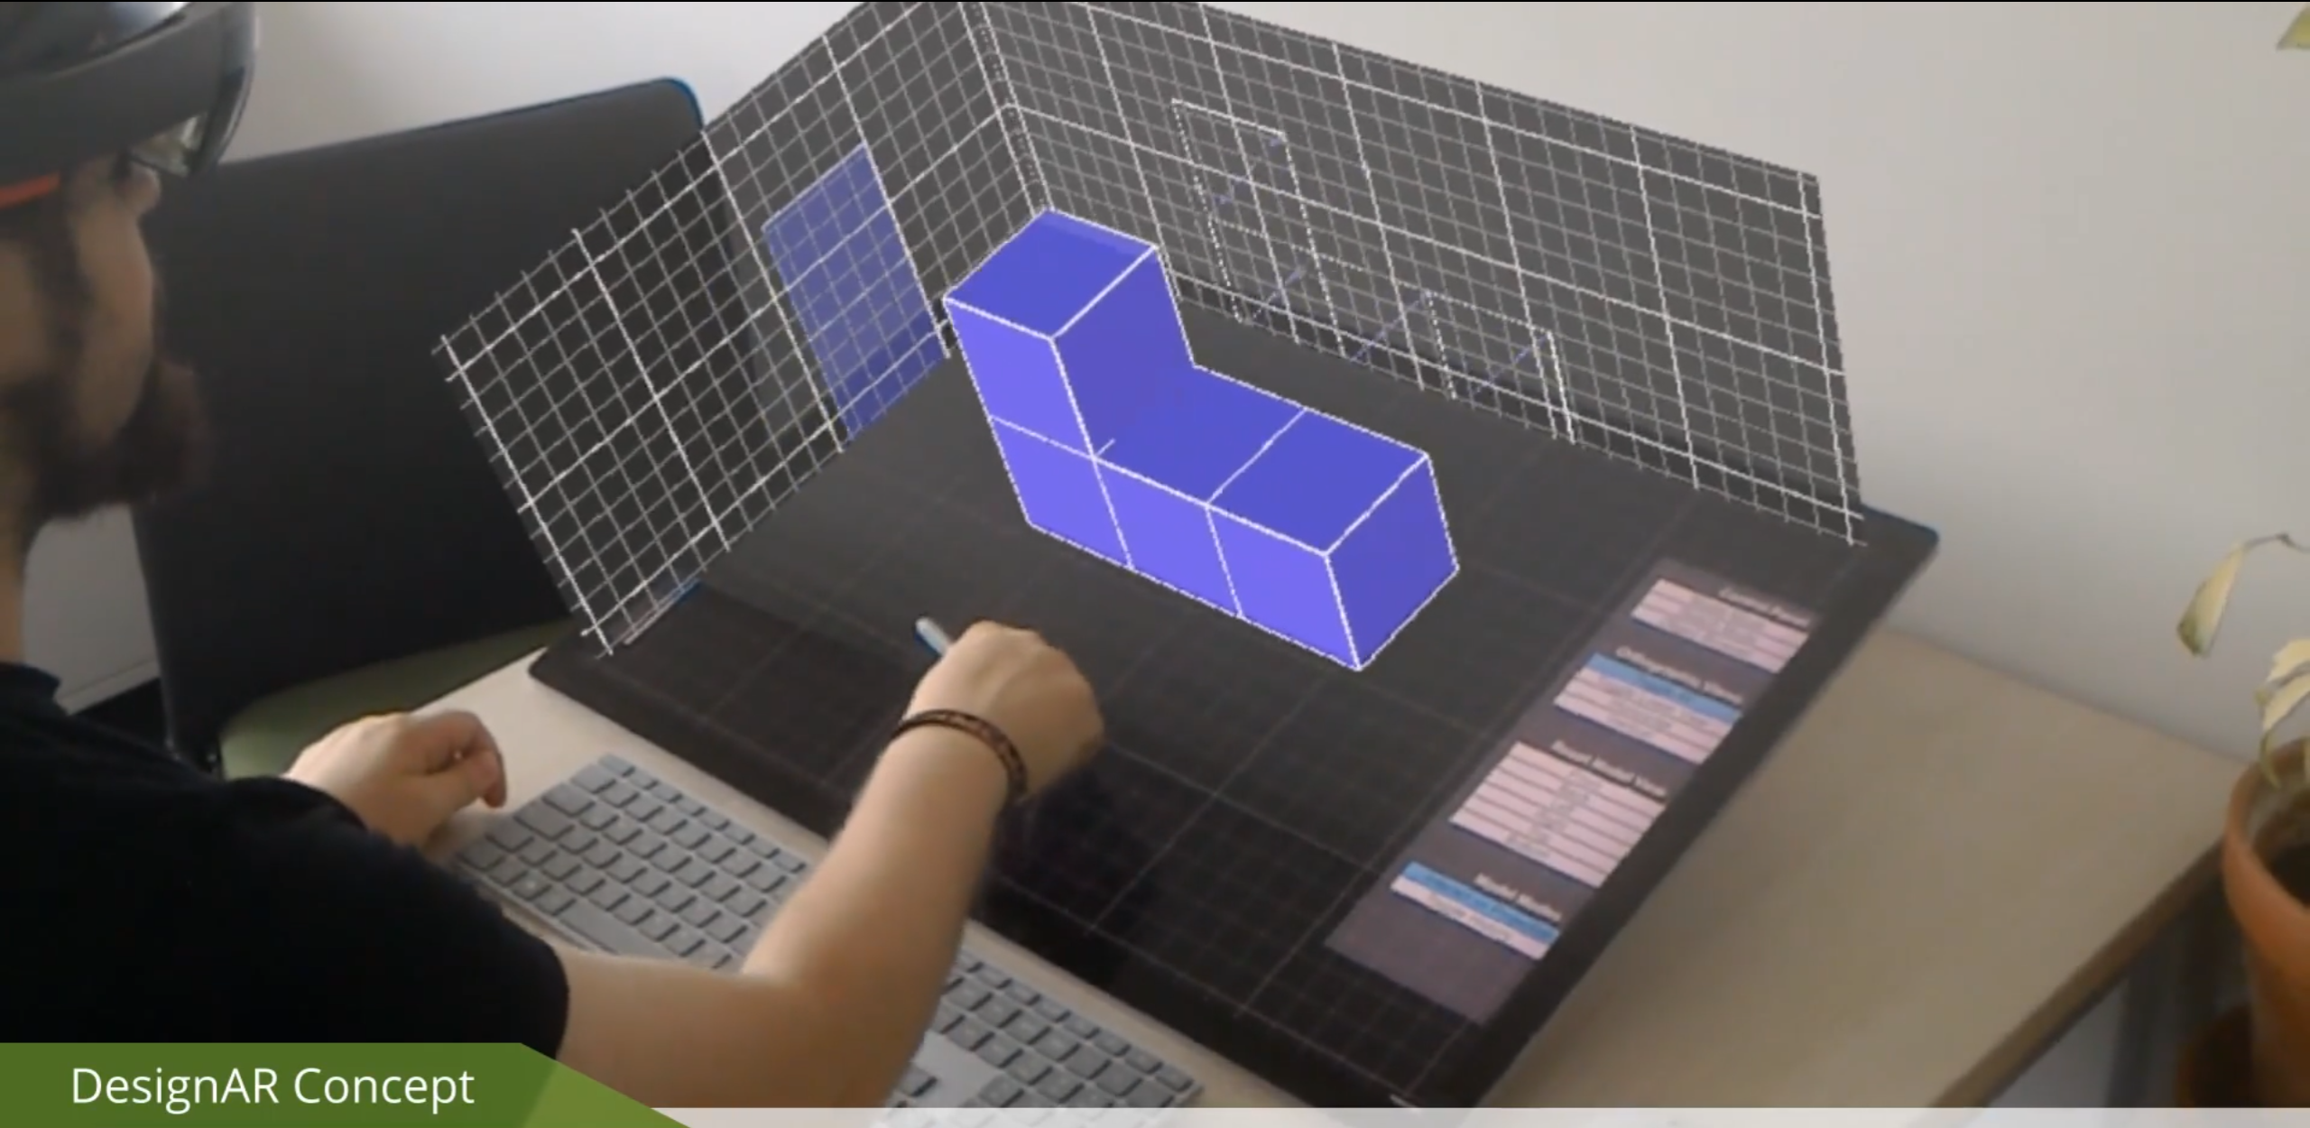
Architectural Design: Real-time 3D model overlays minimize design iteration costs.

Slide 7
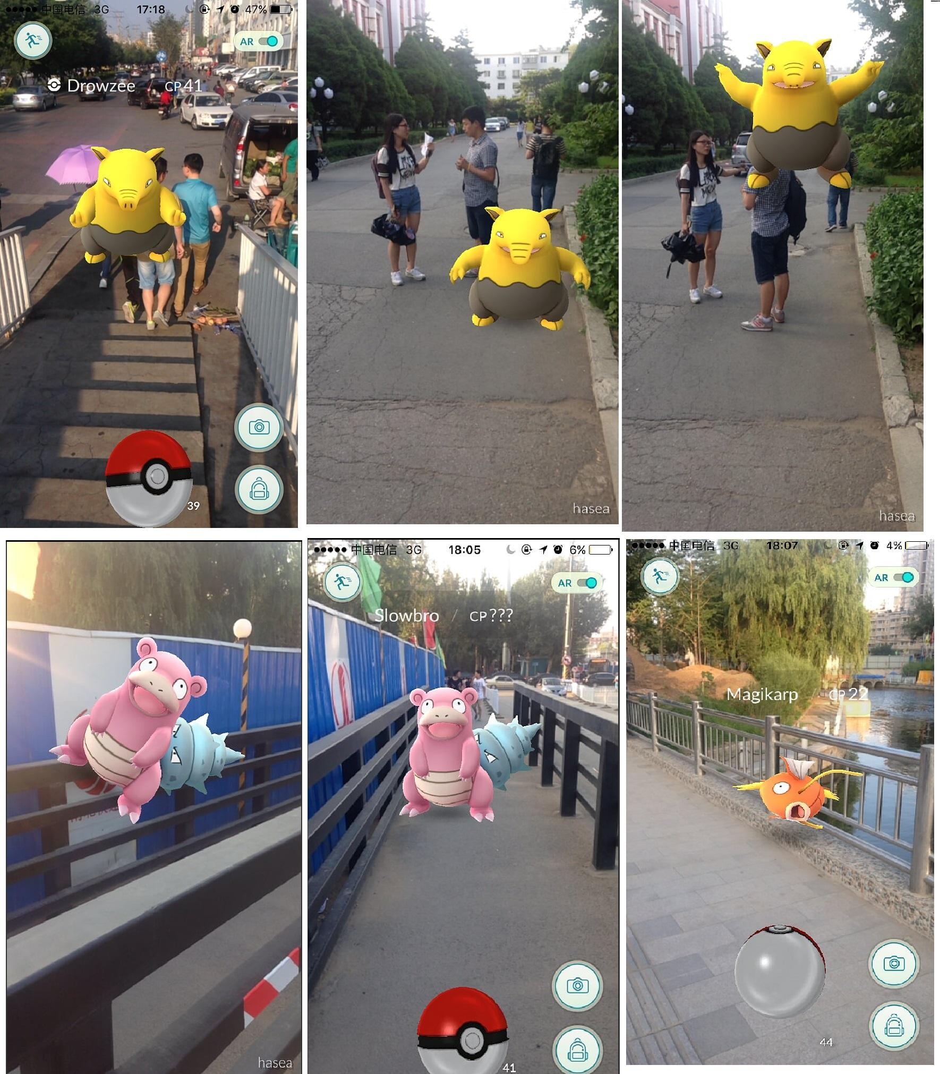
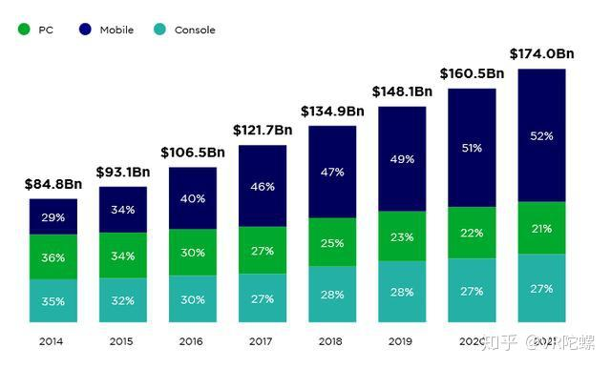
AR Gaming: Hybrid real-virtual experiences (e.g., Pokémon GO) drive multi-billion-dollar markets.

Slide 8
Future and Challenge
Future:
Lightweight glasses replacing smartphones
AI integration
Cross-industry transformation
Core Challenges:
Hardware limitations
Privacy concerns
User adoption barriers
Lack of content ecosystems.

Slide 9

Conclusion
AR will become a gigantic turning point in technology. As a cutting-edge innovation, it can cause a tremendous impact on human life.

Slide 10
Thanks
reference：
Design AR: Immersive 3D-Modeling Combining Augmented Reality with Interactive Displays | Proceedings of the 2019 ACM International Conference on Interactive Surfaces and Spaces
Navigating augmented reality: A practice-oriented guide to identifying and overcoming implementation obstacles – ScienceDirect

Slide 11
By Chen J.M

Slide 12
By Yan H.R

