Slide 1
Week 5: Database Indexing
Databases II — Lecture Slides

Slide 2
Why Indexes Matter
Full table scan costs O(n)
  B-tree indexes give O(log n) lookups
  Hash indexes give O(1) equality lookup
    but no range support
Composite indexes follow leftmost-prefix rule
Notes:
Emphasize the exam question from 2023: why not always hash indexes?

Slide 3
Index type comparison
Type | Lookup | Range
B-tree | O(log n) | Yes
Hash | O(1) | No

Slide 4
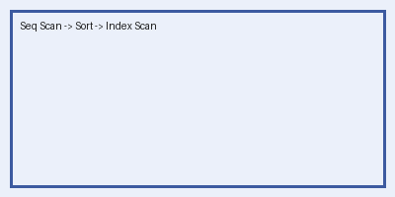
Query plan example
Notes:
Show EXPLAIN output live in demo.

