Slide 1

ClassQuest

Slide 2
Table of contents
(1)
Our team
(2)
Idea
Workflow
(3)
(4)
Technologies used
(5) Project

Slide 3
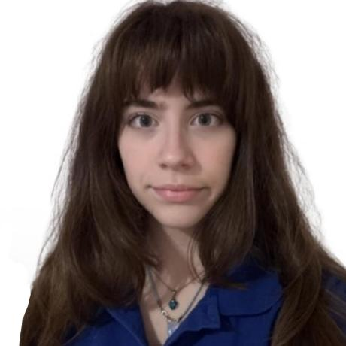
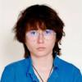

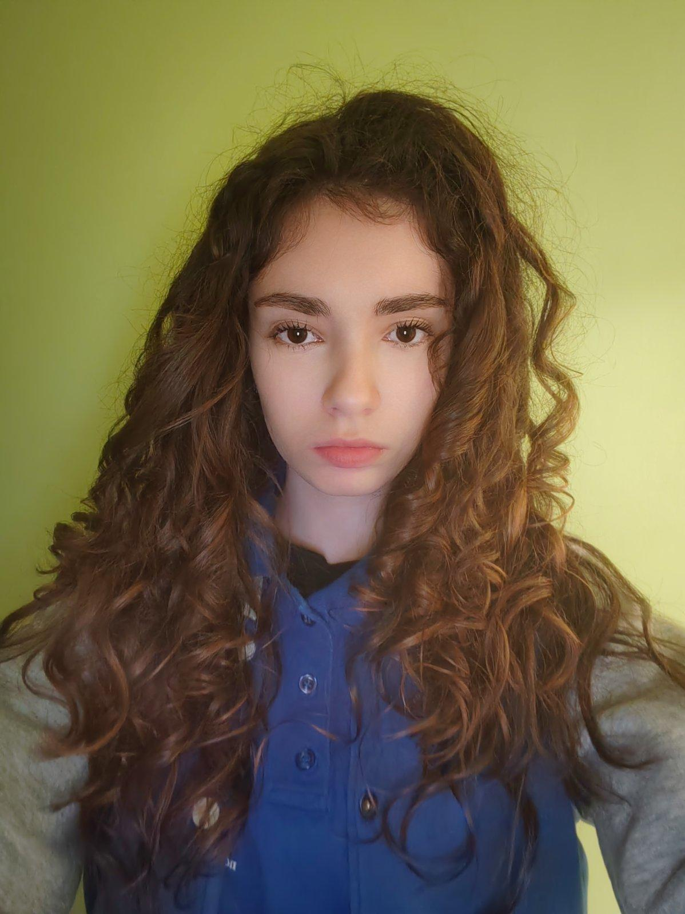
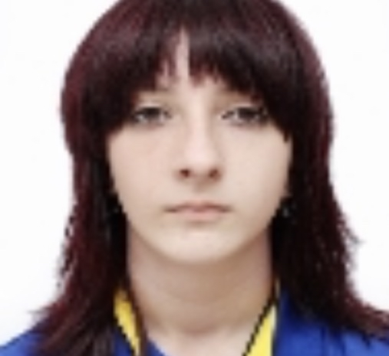
SCRUM TRAINER
Юлияна Стойкова 9в
OUR TEAM
BACKEND DEVELOPER
София Чапкина 9в
BACKEND DEVELOPER
Кристиан Динев 9б
BACKEND DEVELOPER
Николета Георгива 9а
QUALITY ENGINEER
Симона Събева 9в

Slide 4
OUR IDEA
ClassQuest is a C++ console application built to help students study science at home without the stress. It focuses on three main subjects—Chemistry, Physics, and Biology—making it easier to stay organized and get better results.
The goal of ClassQuest is to give you everything you need in one place:
- Study Planning: You can create a clear schedule so you always know what to study next and never fall behind.
- Homework Help: It provides tools to help you manage your assignments and finish your work more quickly.
- Practice Tests: You can take quizzes made specifically for each subject to see how much you’ve learned before the real exam.

Slide 5
WORKFLOW
Week 1
Assigning roles, brainstorming and sharing ideas for what we want as the final product, rough draft of our code.
Week 2
Developing the base code of the program, a lot of experimenting with the features of C++.
Week 3
Adding final touch-ups and documenting the project.

Slide 6






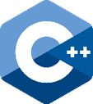

PROGRAMS AND LANGUAGES USED

