Slide 1


Energy Comsumption Predictor
Kshitij Milind Gaikwad
B.K Birla College Kalyan
5346514 / STU685790bbd2b651750569147

Slide 2

Learning Objectives
Mastered Python programming for machine learning, including data manipulation with Pandas and NumPy.
Learned Linear Regression modeling using scikit-learn, including feature extraction, training, and evaluation.
Gained experience in data preprocessing techniques, such as datetime handling, aggregation (sum/mean), and scaling for energy data.
Understood model evaluation metrics like MAE and RMSE, and their interpretation in real-world contexts.
Explored web application deployment using Streamlit for interactive user interfaces.
Applied problem-solving skills to troubleshoot issues like negative predictions and data scaling mismatches.
GOAL
Source :
www.freepik.com/

Slide 3
Tools and Technology used
Programming Language:
Python 3.11.9, chosen for its robust machine learning libraries and compatibility with the project’s requirements.
Development Environment:
Google Colab for training, leveraging its cloud-based computational resources and pre-installed libraries.
Visual Studio Code for local development, debugging, and deployment, offering an integrated terminal and extension support.
Libraries:
Pandas (1.5.3) and NumPy (1.24.3) for efficient data manipulation, aggregation (e.g., resampling to daily data, and numerical computations.
scikit-learn (1.3.2) for implementing Linear Regression, splitting data into train/test sets, and calculating evaluation metrics (MAE, RMSE).
Matplotlib (3.7.1) for exploratory data analysis visualizations, such as plotting energy trends over time.
joblib (1.3.2) for serializing and loading the trained model (energy_consumption_model.pkl) efficiently.
Streamlit (1.29.0) for creating an interactive web app with real-time predictions and user-friendly input forms.

Slide 4
Tools and Technology used
Dataset:
Household Power Consumption CSV (minute-level data from 2006-2010, aggregated to daily), sourced from a public repository like Kaggle.
Version Control:
GitHub for repository management, enabling code versioning, collaboration, and documentation via the README file.
Operating System:
Windows 11, ensuring compatibility with the local environment and file paths.

Slide 5
Methodology
Problem Statement: Identified the need to predict daily household energy consumption from historical data to support sustainability.
Data Collection: Sourced the "Household Electric Power Consumption" dataset from Kaggle, containing minute-level readings of power metrics.
Data Preparation: Parsed datetime, handled missing values with mean imputation, aggregated minute data to daily levels (sum for power, mean for voltage/intensity), and converted power to kWh by dividing by 60.
Exploratory Data Analysis (EDA): Visualized trends (e.g., daily energy over time), checked for outliers, and extracted features like Day_of_Week and Month.
Model Selection: Chose Linear Regression for its simplicity and interpretability, trained on features including Day_of_Week, Month, Voltage, Sub_metering_1, Global_intensity, and Sub_metering_2.
Evaluation: Assessed model performance with MAE (0.86 kWh, 3.3% of average) and RMSE (2.24 kWh, 8.6% of average) on test data.
Deployment: Built an interactive web app using Streamlit for user input and real-time predictions.

Slide 6
Problem Statement:
Develop an AI/ML model to forecast daily household energy consumption (in kWh) using historical data features like day of the week, month, voltage, global intensity, and sub-metered energy readings. This helps optimize consumption, reduce waste, and align with sustainable development goals by enabling data-driven energy management.

Slide 7
Solution:
The solution leverages a Linear Regression model trained on the Household Power Consumption dataset, meticulously processed to address real-world challenges.
The process began with data preprocessing, where minute-level power readings were aggregated into daily sums for energy metrics (e.g., Global_active_power, Sub_metering_1, Sub_metering_2) and means for voltage and intensity, followed by a conversion from kW-minutes to kWh by dividing by 60.
This resolved initial issues like negative (-46.93 kWh) and excessively high (6290.44 kWh) predictions, which stemmed from improper aggregation. Feature engineering extracted Day_of_Week and Month from datetime data, enhancing model input.
The model was trained in Google Colab, saved using joblib, and deployed via a Streamlit app that accepts user inputs (e.g., Day of Week, Sub-metering values) and delivers predictions like 105.04 kWh and 132.51 kWh.
The app includes input validation to ensure non-negative values and provides a clean interface for real-time forecasting, making it practical for household energy planning.
Github Repository: Repository
Google Colab: Source Code

Slide 8
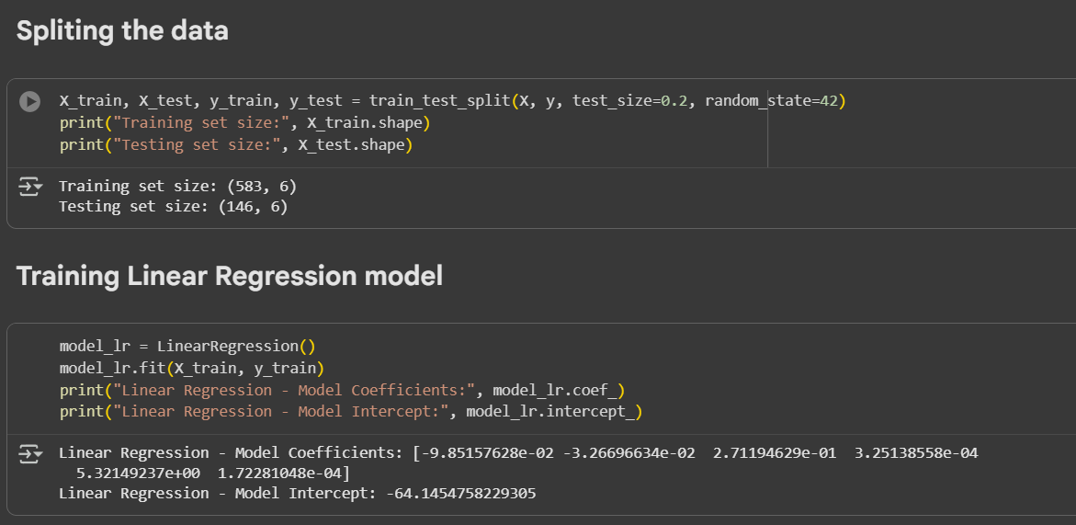
Screenshot of Output:
Data Splitting and Model Training:

Slide 9
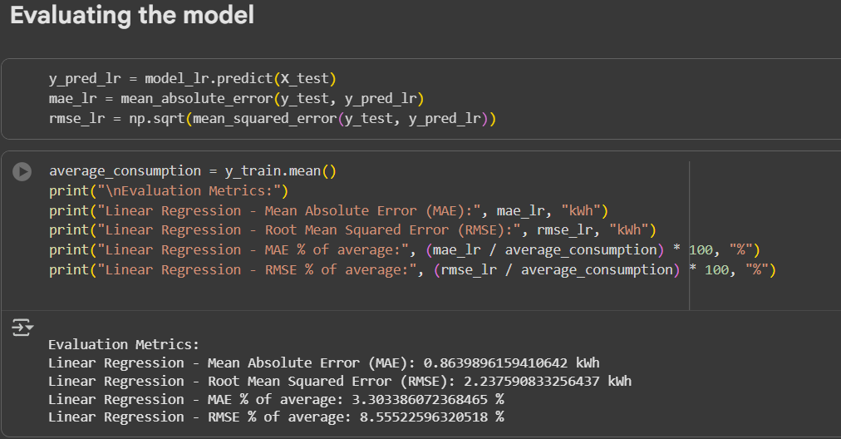
Screenshot of Output:
Evaluation of the Model:

Slide 10
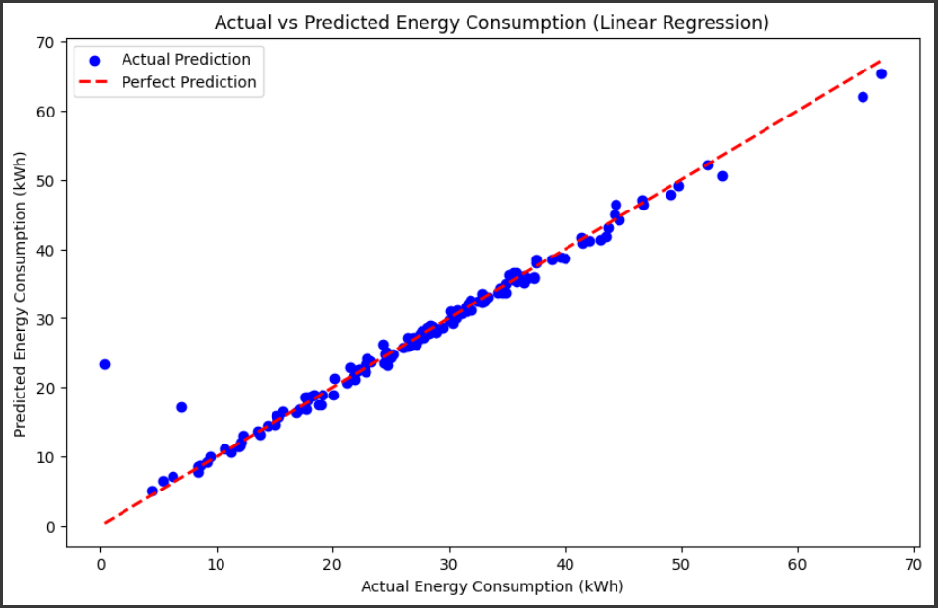
Screenshot of Output:
Visualisation of Predictions:

Slide 11
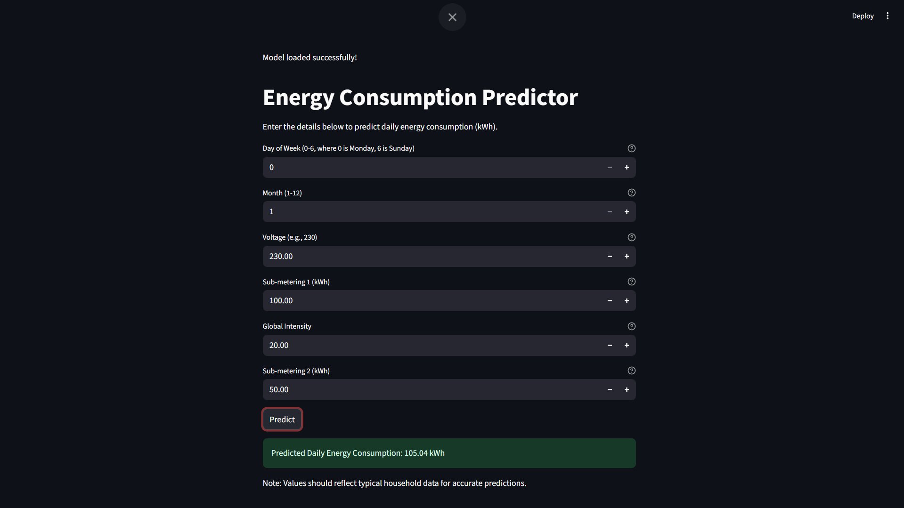
Screenshot of Output:
Model Deployment:

Slide 12
Conclusion:
Successfully developed a Linear Regression model with low error rates (MAE: 0.86 kWh, RMSE: 2.24 kWh), achieving 3.3% and 8.6% relative to average consumption, proving its reliability for daily forecasts.
Demonstrated effective data handling, from minute-level aggregation to kWh conversion, resolving issues like unrealistic predictions through proper sum/mean usage.
Deployed a user-friendly Streamlit app for real-time predictions, enabling practical energy optimization.
Highlighted the importance of feature scaling and model tuning for accurate results.
Project aligns with sustainable goals by promoting energy awareness and efficiency.
Future Scope:
Integrate external data sources like weather APIs to enhance prediction accuracy for seasonal variations.
Explore advanced models like Random Forest or LSTM for capturing non-linear patterns and time-series trends.

