Slide 1



KUET Machine Intelligence
&
Data Science Community

Slide 2
Lvl 1:
ML Starter Pack
Page |

Slide 3
“Class – 1”
Page |

Slide 4
Content
Table of Content
The Machine Learning Terminology
Page |

Slide 5
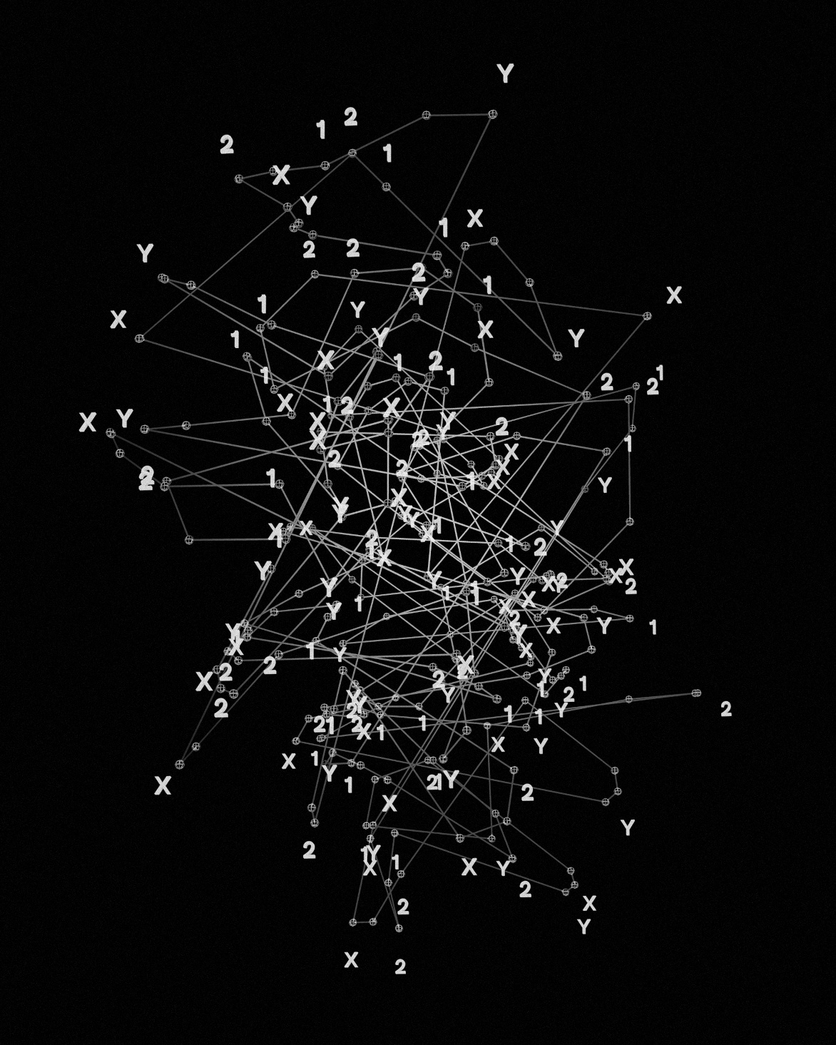
Data & Dataset
Data Fundamentals
What is Data?
  Facts and statistics collected for reference or analysis.
Page |

Slide 6
Data & Dataset
Data
Format
Structured Data
Unstructured Data
Statistical
Numerical (Quantitative)
Continuous
Discrete
Categorical (Qualitative)
Nominal
Ordinal
Page |

Slide 7
Data & Dataset
SI No. | Name | Descriptions | Example
1. | Structured Data | Organized rows and columns | Excel, SQL
2. | Unstructured Data | Messy, complex data | Image, Text, Audio
3. | Continuous Data | Infinite possibilities | Height, Price etc.
4. | Discrete Data | Whole numbers | Number of chairs, Shoe size etc.
5. | Nominal Data | Names without order | Red, Blue, Green
6. | Ordinal Data | Names with a rank | Low, Medium, High
Page |

Slide 8
Data & Dataset
Data Fundamentals
What is Dataset?
  A structured collection of data.
  Observation (Row/Sample/Instance): One specific example (e.g., one patient).
  Feature (Column/Input/Attribute): The characteristics used to describe the observation (e.g., Age, Blood Pressure).
  Target (Label/Output): The value we want to predict (e.g., Has Disease: Yes/No).
Page |

Slide 9
Data & Dataset
Dataset
Feature
Target
Id | SepalLength (Cm) | SepalWidth (Cm) | PetalLength (Cm) | PetalWidth (Cm) | Species
1 | 5.1 | 3.5 | 1.4 | 0.2 | Iris-setosa
2 | 4.9 | 3 | 1.4 | 0.2 | Iris-setosa
51 | 7 | 3.2 | 4.7 | 1.4 | Iris-versicolor
52 | 6.4 | 3.2 | 4.5 | 1.5 | Iris-versicolor
101 | 6.3 | 3.3 | 6 | 2.5 | Iris-virginica
102 | 5.8 | 2.7 | 5.1 | 1.9 | Iris-virginica
Observation
Page |

Slide 10
Data & Dataset
Dataset Management
Training Data: The data the model "sees" and learns from.
Validation Data: The data used to tune settings during the learning process.
Test Data: The "Unseen" data used only for the final evaluation.
Page |

Slide 11

ML Terminology
Learning Paradigms
How do Machines actually "Learn"?
Just like humans learn via classroom instruction, exploring a playground, or trial and error machines do the same.
The Goal: To find a mathematical function that maps input to a useful insight.
Page |

Slide 12
ML Terminology
Learning Paradigms
Learning Paradigms
Supervised Learning
Unsupervised Learning
Semi-Supervised Learning
Reinforcement Learning (RL)
Page |

Slide 13
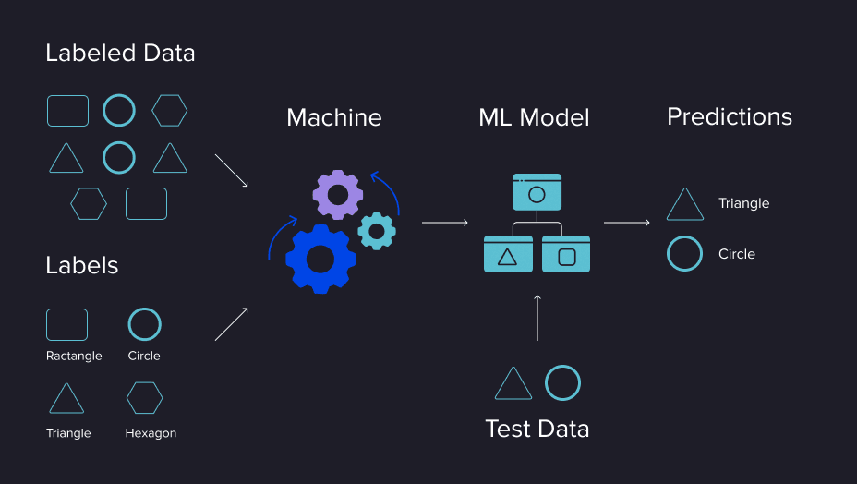
Learning Paradigms
Supervised Learning
The Core Idea: Learning with a Teacher.
The teacher has the Questions and the Answers right next to each other.
The machine's job is to study the examples until it can answer new questions on its own.
Page |

Slide 14
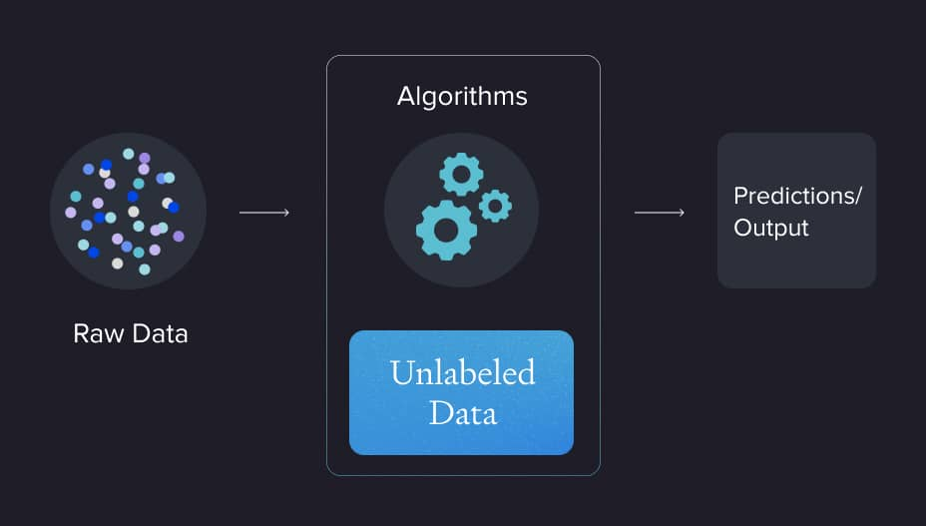
Learning Paradigms
Unsupervised Learning
The Core Idea: A student exploring a New Playground without a teacher.
The machine’s job is to look at the data and find "hidden groups" or "patterns" on its own because nobody told it what to look for.
Page |

Slide 15
Learning Paradigms
Semi-Supervised Learning
The Core Idea: A student who has a few solved examples but a huge pile of unsolved homework.
The machine uses the few "answered" questions to understand the logic and then applies that logic to organize the rest of the data.
Page |

Slide 16


Learning Paradigms
Reinforcement Learning
The Core Idea: No Teacher and No Study Guide.
The machine learns by interacting with its world and receiving Rewards for good moves and Penalties for bad ones.
Agent
Reward
Action
Environment
Page |

Slide 17
Learning Paradigms
Learning Paradigms
Learning Paradigms
Supervised Learning
Classification
Regression
Unsupervised Learning
Clustering
Association
Semi-Supervised Learning
Reinforcement Learning (RL)
Page |

Slide 18
Learning Paradigms
Classification
What is it?
You have a box of mixed shapes. You pick one up and have to name it.
How the Machine Handles it: It looks at the number of sides.
  If sides = 4, it says "Square”.
  If sides = 3, it says "Triangle“.
The Goal: To put the object into the correct Bucket.
Page |

Slide 19

Learning Paradigms
Regression
The Guesser.
Instead of naming, you need to guess its exact Area or Weight.
How the Machine Handles it: It looks at the length and height.
  It calculates a specific number, like "12.5 $cm^{2}$."
The Goal: To find the exact Value on a scale.
Page |

Slide 20
Learning Paradigms
Clustering
Finding Hidden Groups.
Sorting a bag of mystery shapes without a teacher.
How the Machine Handles it: The machine notices some have 3 corners and others have 4, so it pushes them into two separate piles.
The Goal: To discover hidden structures.
Page |

Slide 21
Thank You

