Slide 1
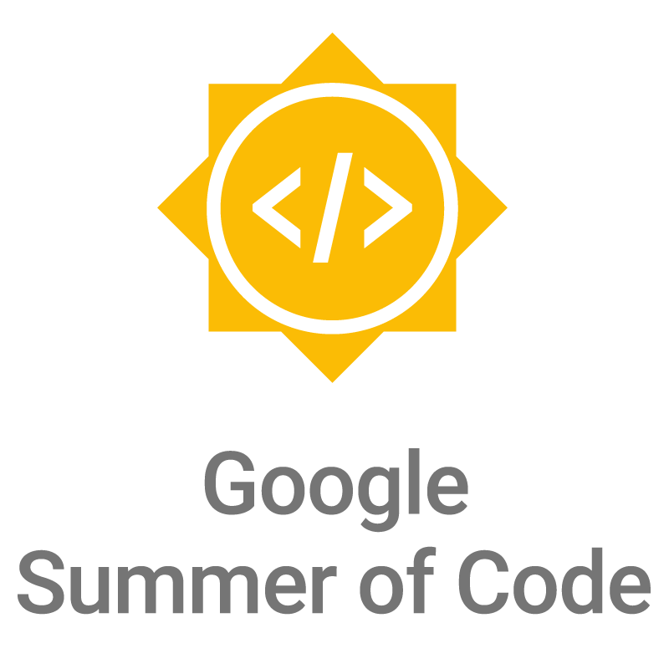

Slide 2
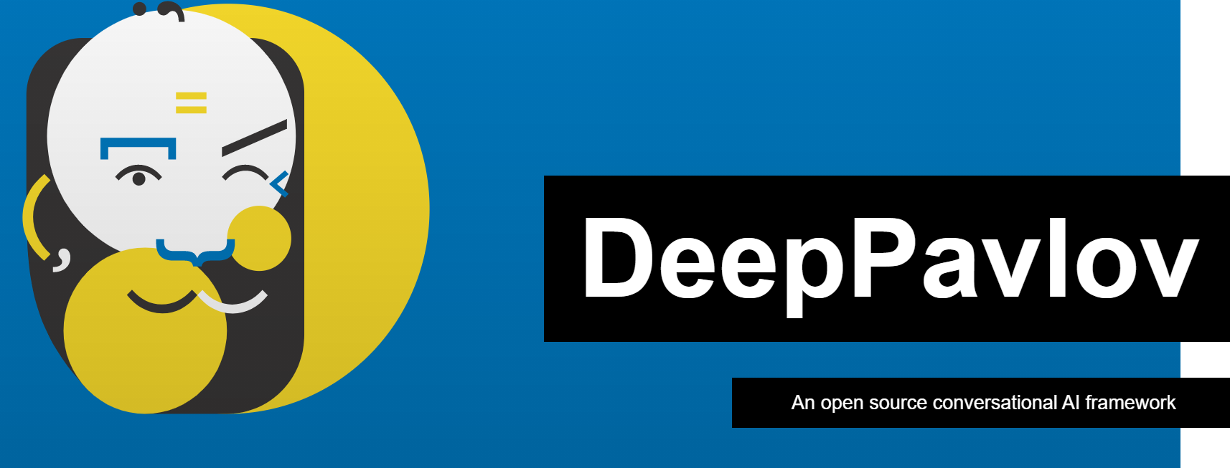

Slide 3
1. About Organization
DeepPavlov is an open-source conversational AI library built on TensorFlow, Keras and PyTorch.
DeepPavlov is designed for
development of production ready chat-bots and complex conversational systems,
research in the area of NLP and, particularly, of dialog systems.
DeepPavlov is built and maintained by Neural Networks and Deep Learning Lab at MIPT(Moscow Institute of Physics and Technology)
This year (2021) DeepPavlov participates, for the first time, in the Google Summer of Code

Slide 4
2.Projects-Technology: Projects Area
Domain:
AI(NLP)
Technologies Involved:
Python
Docker
Python Deep learning Frameworks
Tensorflow
Keras
Pytorch

Slide 5
3. Problem statement of identified project
refactor Multitask BERT :
Multi-task BERT in DeepPavlov is an implementation of BERT training algorithm published in the paper “Multi-Task Deep Neural Networks for Natural Language Understanding”.
Multi-task BERT paper: https://arxiv.org/abs/1901.11504
The idea is to share BERT body between several tasks.

Slide 6
4.overall proposed approach/mentoring philosophy
1.Make the students to be the part of the developer community.
2.Create a real interest in potential GSoC projects:
As a GSoC mentor i will be taking ownership of a project idea and seeing it through the summer.
I will make students excited about the project,. And make the students integral part of the process from project proposal to delivery.
3.willing to dedicate significant time
4. I will engage with students throughout their learning process

Slide 7
5. Approach to fill-up tech/domain gaps if any
The Reason for choosing this organization is they have lot of new project proposals to be implemented yet
They have listed their new proposals to be implemented in their organizations “idea tracker”
To fill up the domain gaps:
I will train the students on basics of NLP components
I will make them to build simple chatbots using Deep Pavlov library
I will introduce them how to use different types of BERTs

