Slide 1


Slide 2
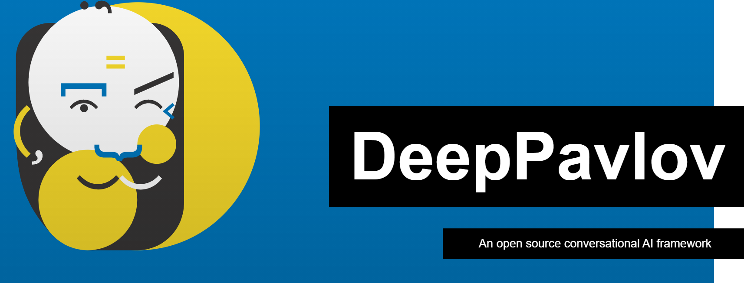

Slide 3
At DeepPavlov, work contributions are spread across 3 parts of the technology stack, including
1.DeepPavlov Library,
2. Deep Dream, and
3. Deep Agent.
All of these projects are focused on enhancing and strengthening our Conversational AI stack, with each contributing corresponding components.

Slide 4
DeepPavlov Framework
DeepPavlov is a conversational AI framework that contains all the components required for building chatbots.
It’s developed on the top open source machine learning frameworks: TensorFlow and Keras, and it’s free and easy to use.
DeepPavlov Agent
DeepPavlov Agent is an open-source framework for the development of scalable and production-ready multi-skill virtual assistants, complex dialogue systems and chatbots.

Slide 5
DeepPavlov Dream
DeepPavlov Dream is our AI Assistant and dev tools. With it, you will be able to build simple and sophisticated AI Assistants . It stays on the shoulders of both DP Library and DP Agent , and brings a plethora of custom skills, skill and response selectors, as well as the entire examples of the end to end AI assistants.
This March-2021 Deeppavlov started their fantastic journey in the Google Summer of Code program 2021

Slide 6

Technologies
Python
Docker
Python Deep Learning Frameworks
Tensorflow
Pytorch
Domain : AI (NLP)

Slide 7

Some of the most popular ideas from Deeppavlov
(PROJECT PROPOSALS FOR GSOC 2021)
Relation Extraction :
is the task of predicting attributes and relations for entities in a sentence.
For example, given a sentence “Barack Obama was born in Honolulu, Hawaii.”, a relation classifier aims at predicting the relation of “bornInCity”.
.

Slide 8
Relation Extraction is the key component for building relation knowledge graphs, and it is of crucial significance to natural language processing applications such as structured search, sentiment analysis, question answering, and summarization

Slide 9
Some of the most popular ideas from Deeppavlov
Refactor Multi Task BERT :
Implement at least one of the following tasks: PAL-BERT, CA-MTL, MT-DNN(more is better) within the DeepPavlov Library
which are described in the articles https://arxiv.org/pdf/2009.09139 https://arxiv.org/abs/1901.11504 https://arxiv.org/abs/1902.02671 at least for 1 paper (more is better) using Pytorch framework

Slide 10
Multi-task BERT in DeepPavlov
Multi-task BERT in DeepPavlov is an implementation of BERT training algorithm published in the paper “Multi-Task Deep Neural Networks for Natural Language Understanding”.
Multi-task BERT paper: https://arxiv.org/abs/1901.11504

Slide 11
Multi-task BERT in DeepPavlov
The idea is to share BERT body between several tasks. This is necessary if a model pipe has several components using BERT and the amount of GPU memory is limited. Each task has its own ‘head’ part attached to the output of the BERT encoder.

Slide 12
Multi-task BERT in DeepPavlov
If multi-task BERT has T heads, one training iteration consists of
composing T mini-batches, one for each task,
T gradient steps, one gradient step for each task.

Slide 13
Some of the most popular ideas from Deeppavlov
Integrate popular APIs into DP :
The codeless OpenAPI integration is to be published in our upcoming release.
Even though the feature is quite handy by itself, we should integrate as many APIs as possible into our pipeline.
Coding Challenge
Grab existing work on Actions in Go-Bot and integrate them into production version of Go-Bot (v0.14 of DeepPavlov Library)

Slide 14

Useful links
Organization Site: http://deeppavlov.ai/gsoc_2021
Github link: https://github.com/deepmipt/DeepPavlov/
Open Source Blog: https://Medium.com/deeppavlov

Slide 15

Questions?

