Slide 1
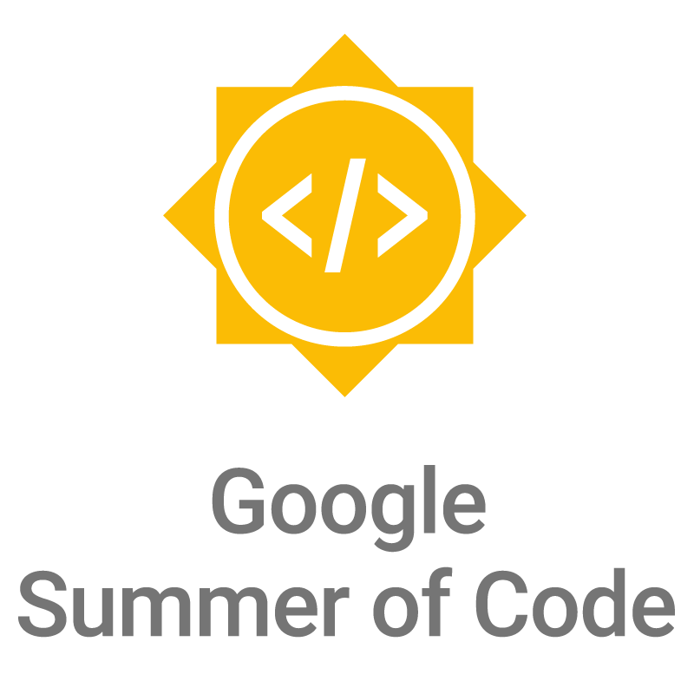

Slide 2
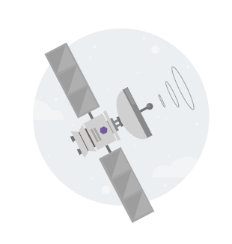

What is open source?
Computer software where the source code is distributed under an open source license that allows anyone to study, change, improve and distribute the software.
Promotes collaboration
Community of dedicated developers

Slide 3
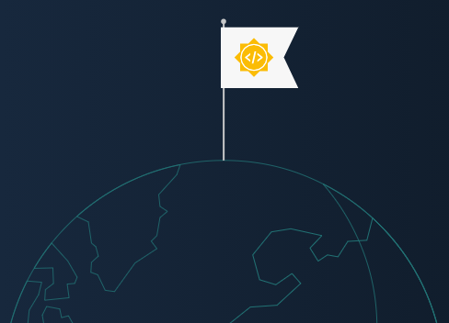
What is Google Summer of Code?
Google Summer of Code (GSoC) is an online, international program designed to encourage student participation in open source software development under the guidance of mentors from the open source community.

Slide 4

About GSoC
Students participate with an open source software organization under the guidance of a mentor while earning a stipend for successfully completing the project.
Post-secondary students use time away from their studies to gain real world experience and learn the importance of contributing and being a part of a community of dedicated developers. Students learn new skills (testing, working with large codebases, etc.) and gain confidence in their capabilities.

Slide 5
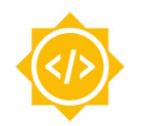
Introduce students to open source software development.
Help open source projects bring in new, excited developers who stay after the program ends.
Give students exposure to real-world software development scenarios (e.g., testing, version control, software licensing, online communications, etc.).
Create more open source code for all to use.
Goals of the Program

Slide 6
How does GSoC work?
Open source software projects apply to be mentor organizations
Google chooses the organizations to participate (198 in 2020)
Students submit project proposals to mentor organizations
Mentor organizations choose the students they’d like to accept
Students are paired with a mentor to help them throughout their project
Coding begins! Students work on their project under the guidance of their mentor over 10 weeks

Slide 7
How much time do I need to spend on the project?
The project will take ~175 hours over the 10 weeks. Some folks will spend more time and others a bit less.
I’m new to open source, can I participate?
Yes, we hope you do! As long as you are excited and ready to learn from your mentors and have some university level programming experience you can succeed in GSoC.
Frequently Asked Questions

Slide 8
Evaluations
Students must pass two (2) evaluations
Students who pass each evaluation are paid a stipend for their work
At the conclusion of GSoC, students submit the code they’ve written for their project for everyone to see and use!

Slide 9
Over 18 upon registration for program
Accepted into or enrolled in a post-secondary educational program by the student acceptance date OR graduated from a post-secondary program between December 1, 2020 and May 17, 2021.
Eligible to work in the country in which you reside
Have been accepted in no more than 1 previous GSoC
Not a resident of a US embargoed country
Eligibility

Slide 10
2021 Program Timeline
Jan 29 - Feb 19
Organization applications open
March 9
Accepted GSoC organizations announced
March 29 - April 13
Students submit their proposals
May 17
Accepted students are announced
May 17 - June 7
Community bonding period with orgs
June 7 - Aug 23
Students code the summer away
August 31
Successful student projects are announced

Slide 11
Google Summer of Code Statistics
In 16 years 16,000+ students from 111 countries have been accepted into GSoC
Countries with the most students: India (4,684), United States (2,640), and Germany (909)
Approximately 38+ million lines of code have been produced

Slide 12

Useful links
Program Site: http://g.co/gsoc
Student Guide: http://g.co/gsoc/resources/guide
Google Open Source Blog: https://opensource.googleblog.com/

Slide 13

Questions?

