Slide 1
인공지능 영상진단 개발 해커톤
Artificial intelligence in diagnostic medical imaging
경북대학교 수학부 (최적화 및 대수학 연구실)
팀장 이현우, 권민재, 김동현, 김미진

Slide 2
001
데이터 처리 및 모델
CONTENTS
002
심장비대증 모델
003
유방암 모델
004
기흉 모델
005
Future work

Slide 3
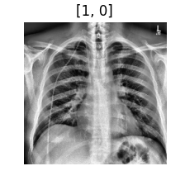
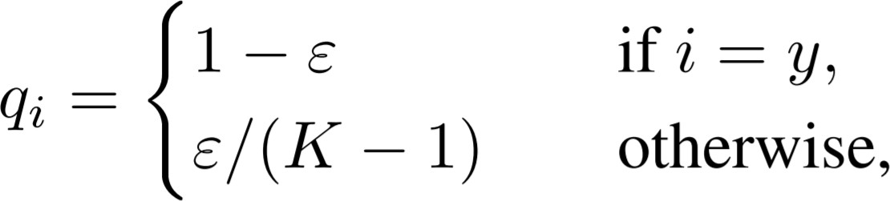
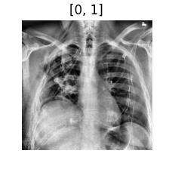
1. Label Smoothing
일반화(generalization) 성능을 높이기 위해 레이블(label)을 smoothing합니다.
정답 레이블에 대해서 100%의 확률을 부여하지 않습니다.
 | Normal | Abnormal
Image 1 | 0.90 | 0.10
Image 2 | 0.10 | 0.90
Image 1
[Table] label smoothing 예시 (𝜀 = 0.1)
Image 2
3/16

Slide 4



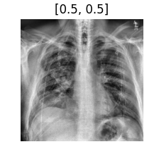
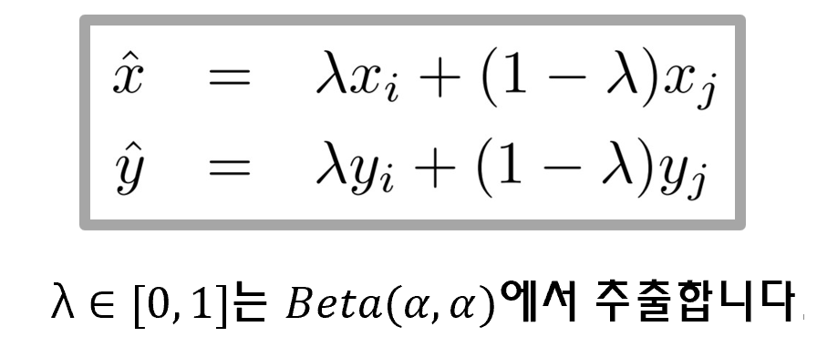
1. Mixup
학습을 진행할 때 랜덤하게 두 개의 샘플 와 를 뽑아서 를 만들어 학습에 사용합니다.
λ ∈ 0, 1 는 𝐵𝑒𝑡𝑎(𝛼, 𝛼)에서 추출합니다.
𝑙𝑎𝑚𝑏𝑑𝑎 = 0.5
4/16

Slide 5
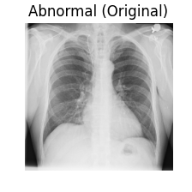
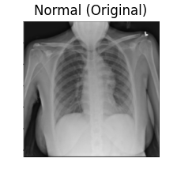
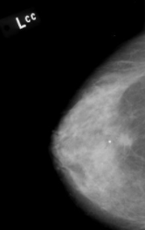
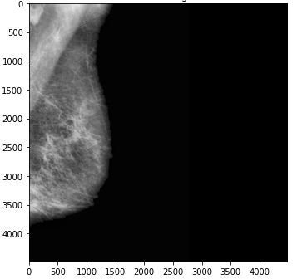
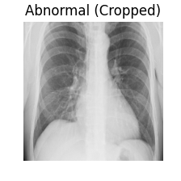
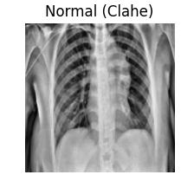
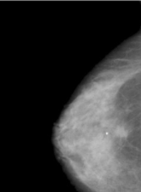
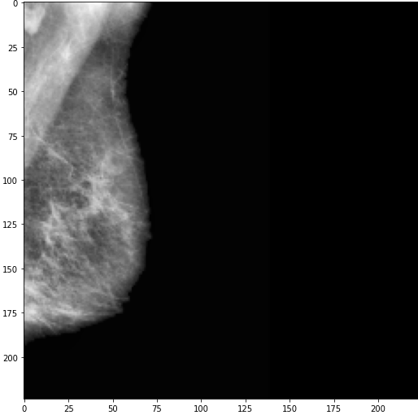
1. Preprocessing
1. Crop 2. Clahe 3.Artefacts removing 4. Resizing
5/16

Slide 6
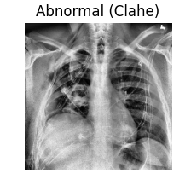
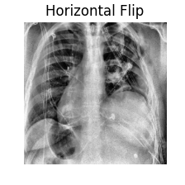
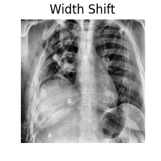
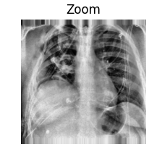
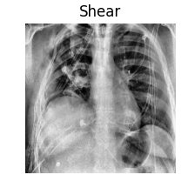
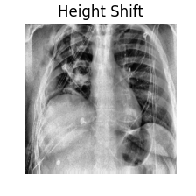
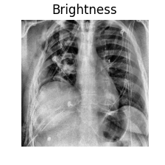
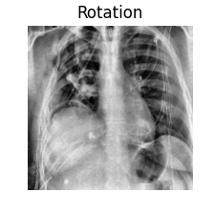
1. Augmentation
6/16

Slide 7
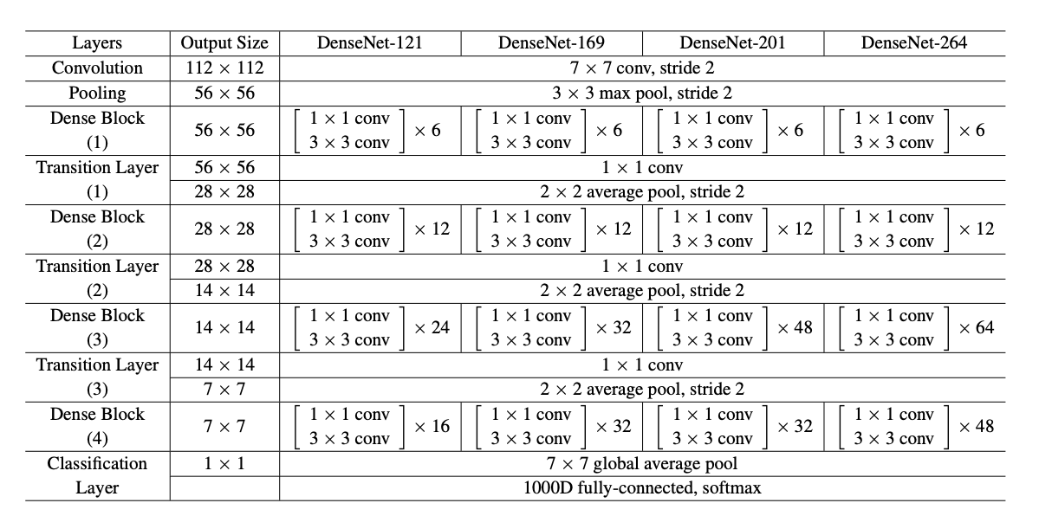
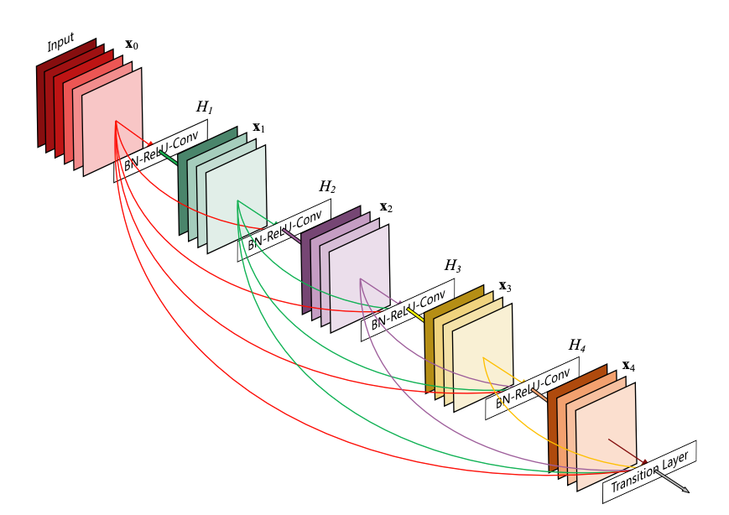
1. Densenet 121
7/16

Slide 8
2. Cardiomegaly
Preprocessing
Data Augmentation
crop
Hyper parameter
Crop rate : l = 0.06, r = 0.06
u = 0.2, d = 0.12
Learning rate : 1/200, 1/1000
1/2000, 1/10000
Batch size : 16
Optimizer : Adam, RMSProp
Class weight : [0.90, 1.1] or [0.95, 1.05]
rotation
height
clahe
width
shear
invert
flip
brightness
Rotation range=3 Height shift range=0.03
Width shift range=0.03 Shear range=0.05
Flip=True Bright range=[0.8, 1]
resize
8/16

Slide 9
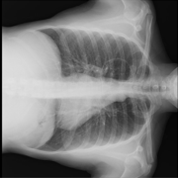
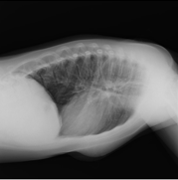
배경지식: 배치 정규화(Batch Normalization)
2. Cardiomegaly
기흉
CLASSIFICATION MODEL
Prepro-cessing
Augmen-
tation
Densenet
121
Ensemble
Prediction
Accuracy:
94.64%
Sensitivity:
100.0%
Specificity:
92.50%
Rank:5, 3(Cmc)
17% validation set out of total set
Validation accuracy: 97%
Voting model (140MB)
9/16

Slide 10
3. Mammography
Preprocessing
Data Augmentation
crop
Hyper parameter
Crop rate : l = 0.01, r = 0.01
u = 0.04, d = 0.04
Learning rate : 1/200 , 1/1000
1/2000,1/10000
Batch size : 16
Optimizer : Adam, RMSProp
rotation
height
artefacts
shear
zoom
clahe
flip
Rotation range=6 Height shift range=0.12
Shear range=0.1 Zoom range=0.1 Flip=True
resize
10/16

Slide 11
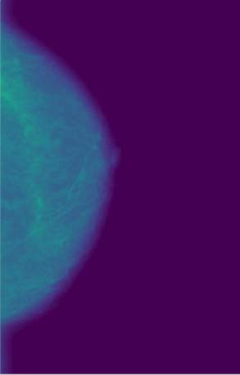
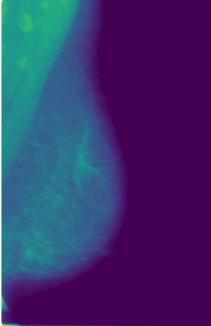

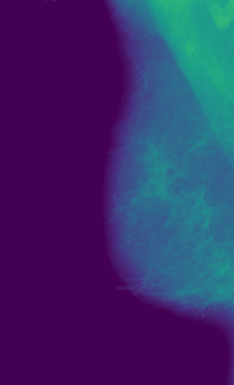
배경지식: 배치 정규화(Batch Normalization)
3. Mammography
기흉
CLASSIFICATION MODEL
Prepro-cessing
Augmen-
tation
Densenet
121
Ensemble
Prediction
Accuracy:
79.91%
Sensitivity:
78.13%
Specificity:
83.33%
Rank: 4
0% Validation set out of total set
Training accuracy: 87%
No ensemble (30MB)
Concatenate
11/16

Slide 12
4. Pneumothorax
Preprocessing
Data Augmentation
crop
Hyper parameter
Crop rate : l = 0.05, r = 0.05
u = 0.05, d = 0.17
Learning rate : 1/200, 1/1000
1/2000, 1/10000
Batch size : 16
Optimizer : Adam, RMSProp
Class weight : [0.90, 1.1] or [0.95, 1.05]
rotation
height
clahe
width
shear
invert
flip
brightness
Rotation range=5 Height shift range=0.05
Width shift range=0.05 Shear range=0.05
Flip=True Bright range=[0.8, 1]
resize
12/16

Slide 13
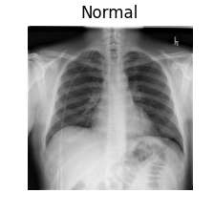
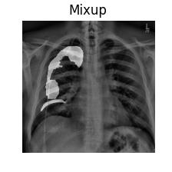
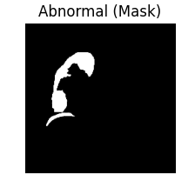
2. Pneumothorax
4. Pneumothorax
Stage 1: Training with mask
MODEL
Weights
[0.4 0.6]
13/16

Slide 14
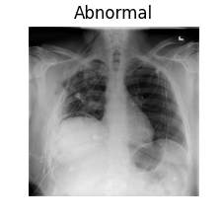
배경지식: 배치 정규화(Batch Normalization)
4. Pneumothorax
기흉
Stage 2: Transfer learning
CLASSIFICATION MODEL
Prepro-cessing
Augmen-
tation
Densenet
121
Ensemble
Prediction
Accuracy:
87.50%
Sensitivity:
97.86%
Specificity:
73.00%
Rank:1
17% validation set out of total set
Validation accuracy: 97.5%
Voting model (140MB)
14/16

Slide 15
Future Work
5. Future work
Topological Data Analysis
Wavelet Transform
Vision Transformer
15/16

Slide 16
Q&A

