Slide 1
Precision Optical Measurements Using Weak Values and Nonclassical States of Light
Kevin Lyons

Slide 2
Outline
Introduction to weak value amplification
Noise reduction with weak values
Enhancing weak value amplification with optical recycling
Squeezed states of light
Improving scaling with photon number using biphoton entanglement

Slide 3
Quantum Measurements
In a typical quantum measurement a system of interest is entangled with a pointer
The experimenter makes a direct (projective) measurement on the pointer
For measurements of a very small parameter, the final pointer state only differs from the initial by a perturbatively small term.
A motivating example: to determine the tilt of a mirror we shine a laser at it and measure the position. A small tilt yields a small shift.

Slide 4
Postselected measurements
Aharonov, Albert, and Vaidman (1988) proposed an intermediate step involving the system state.
“Preselection”: The system is prepared in some initial state (as usual)
“Postselection”: Before measuring the pointer, only probes in some given state are selected, the remainder are discarded
Surprisingly, for a judicious choice of pre and postselection states, they showed the average pointer variable can be made arbitrarily large.
This is weak value amplification

Slide 5
The AAV example – electron spins
Start with an electron beam polarized in the +x-direction (in an eigenstate of the Pauli X operator)
Induce a very small spin-dependent shift in the z-direction with a magnetic field
Postselect on the small fraction of –y polarized electrons with a strong magnetic field
The z-spin is the system and the beam position is the pointer
“How the Result of a Measurement of a Component of the Spin of a Spin-1/2 Particle Can Turn Out to be 100”

Slide 6
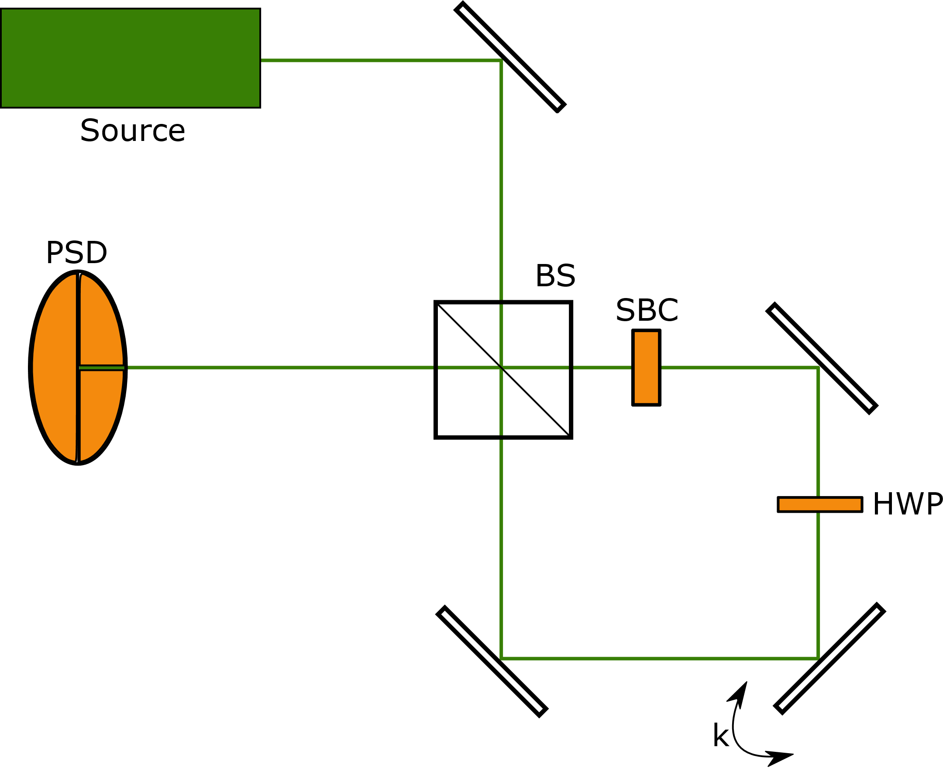
An optical equivalent – Rochester WVA setup
Dixon et al. (2009) (et al. includes Andrew & John) achieved record sensitivity with the following setup:

Slide 7
Rochester WVA setup continued
Exactly parallels the AAV experiment
Quickly extended to precision phase and frequency measurements
Matches or exceeds the precision of competing methods requiring more complicated experimental setups
At first glance, it is unclear why weak value amplification improves sensitivity at all – the amplification of the pointer variable should be exactly negated by the loss in photons to postselection

Slide 8
Technical noise
Weak value amplification allows for measurements which are robust to technical noise
This was noted first by experimentalists (e.g. the Kwiat group performed ultra-precise measurements on a non-floating table)
Theoretically we have demonstrated weak value amplification can overcome several types of technical noise in position, phase, and frequency measurements

Slide 9
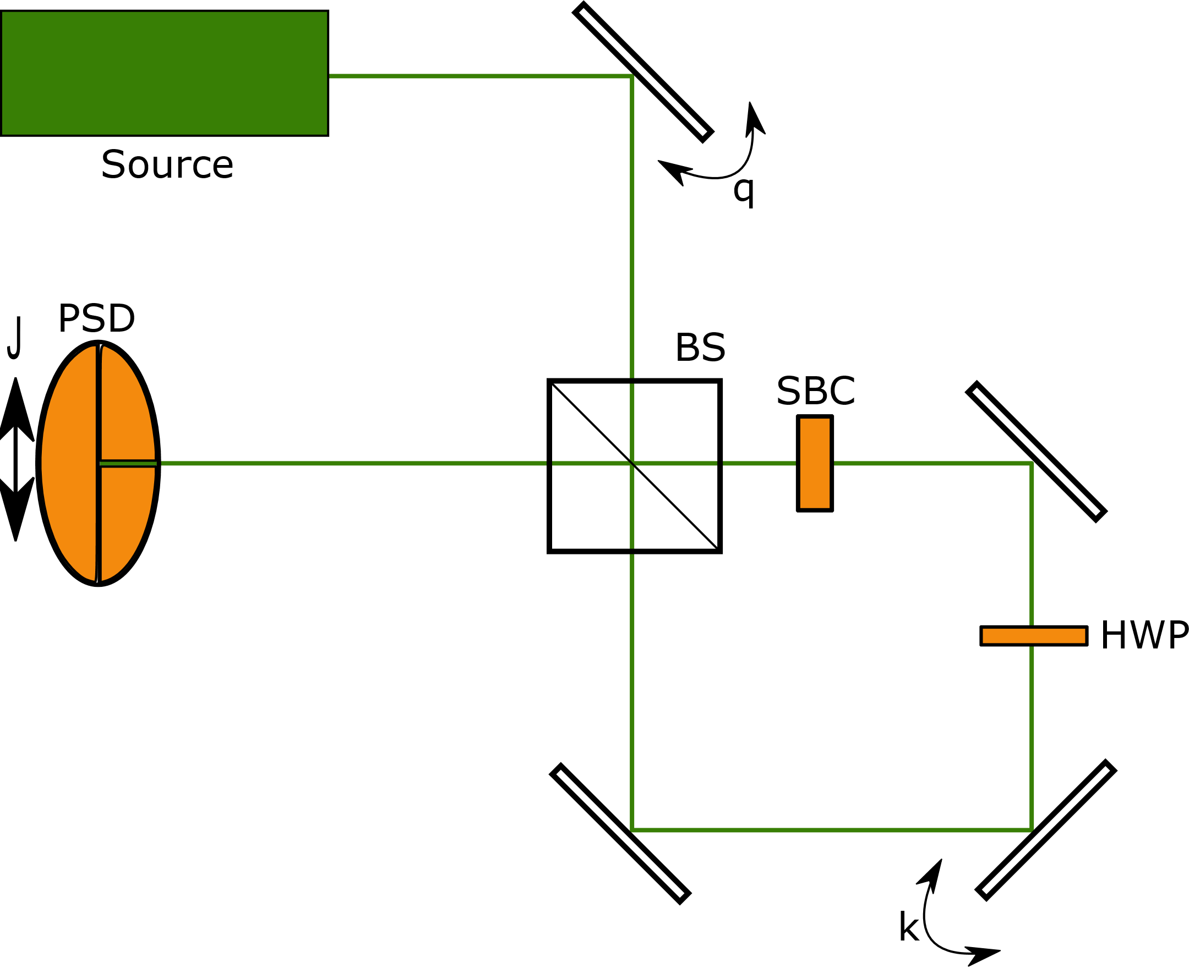
Technical noise continued
Robust to spatial beam/detector jitter, angular jitter, and time correlated noise

Slide 10
Single pass weak value summary
Weak value amplification allows us to capture all of the information (e.g. Fisher information) contained in direct measurement schemes with only a small fraction of events detected
The large pointer shift allows us to overcome certain types of technical noise
Non-postselected photons are discarded even though they must carry information about the parameter being measured
Only reduces the effect of technical noise, quantum uncertainty remains unchanged

Slide 11
Reusing non-postselected photons
Problem: postselection throws away potentially useful photons
Solution: Recycling!
Photons which don’t survive postselection can be sent back through the system for further attempts
We have considered two separate recycling schemes:
Pulsed recycling – uses a pulsed laser and precision electronics to contain the pulses
Continuous wave recycling – uses passive optics and interference to contain light in the system

Slide 12
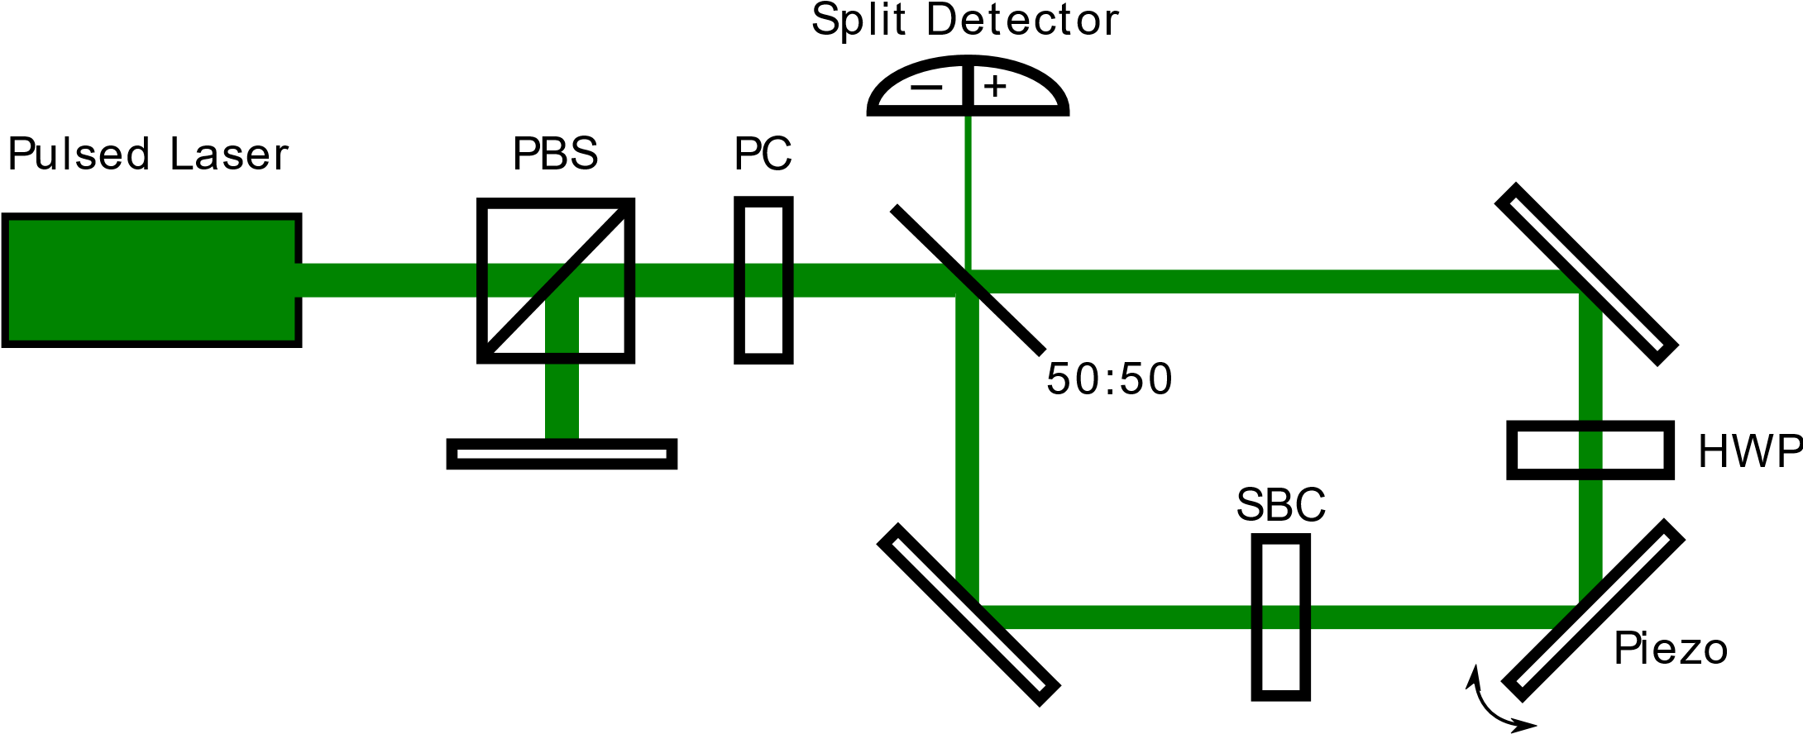
Pulsed recycling setup

Slide 13
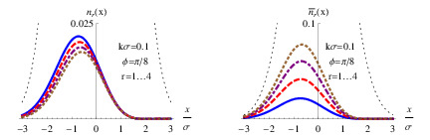
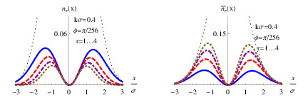
Pulsed recycling
On each pass, more of the beam is postselected and increases the net signal
On early passes, the beam profile is mostly unchanged by postselection so each pass contributes almost equally to the Fisher information
WV Regime IWV Regime

Slide 14
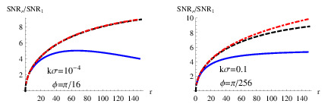
Beam degradation and SNR
After many postselections, the beam leaving and entering the bright port will not have a nice Gaussian shape
This degrades the measurement SNR
Can be fixed by flipping the beam about the optical axis on every traversal

Slide 15
Experimental considerations
This setup is fundamentally limited by the speed of the Pockels cell
No more than a few pulses (and likely only one pulse) can reasonably fit in the recycling system at once
Can be improved by increasing the length of the interferometer arms, but this makes the experiment more challenging to perform
Losses above a few percent quickly reduce the utility of recycling
More important that we expected!
Preliminary experiments show gains of a factor of less than 2 over the unrecycled case

Slide 16
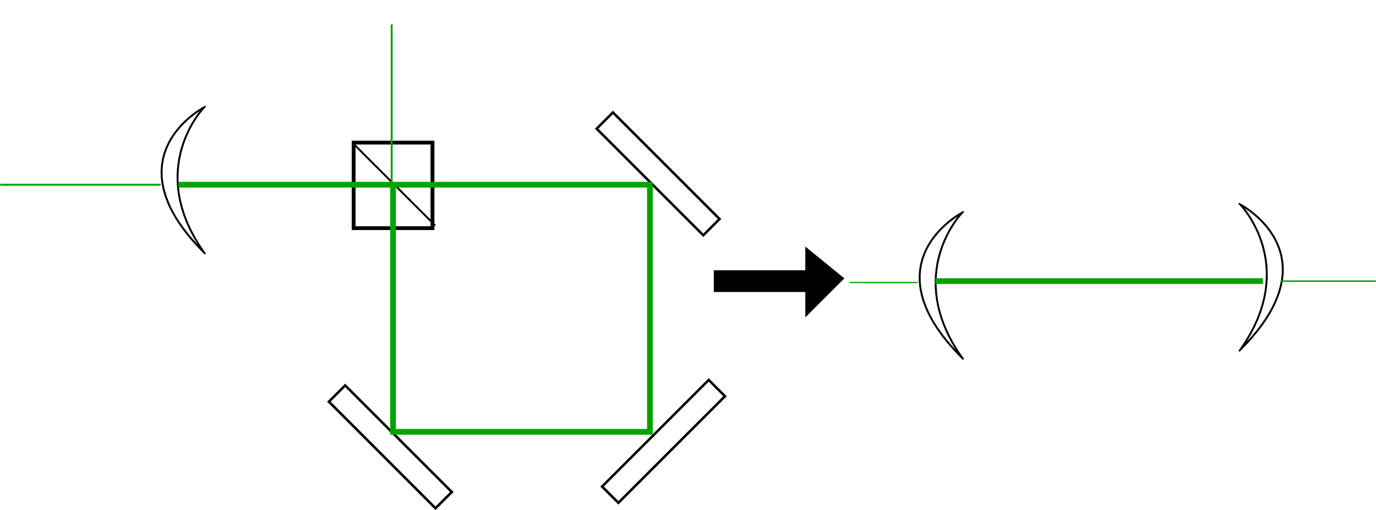
Continuous wave recycling
Drever (1983) showed that the power inside an interferometer could be dramatically increased by placing a partially transmitting mirror before the input port
Effectively places the interferometer in a cavity

