Slide 1
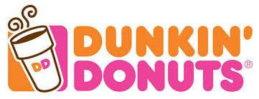
SWOT Analysis Dunkin Donuts
By Kaltoum Chetima

Slide 2

Introduction
Creation date: 1950
Founder : William Rosenberg
Place : Quincy, Massachusetts.
Initial name : Open Kettle
Rebrand name : Dunkin’ Donuts, 1955
Business : Franchise-based
Category : food and beverage industry

Slide 3
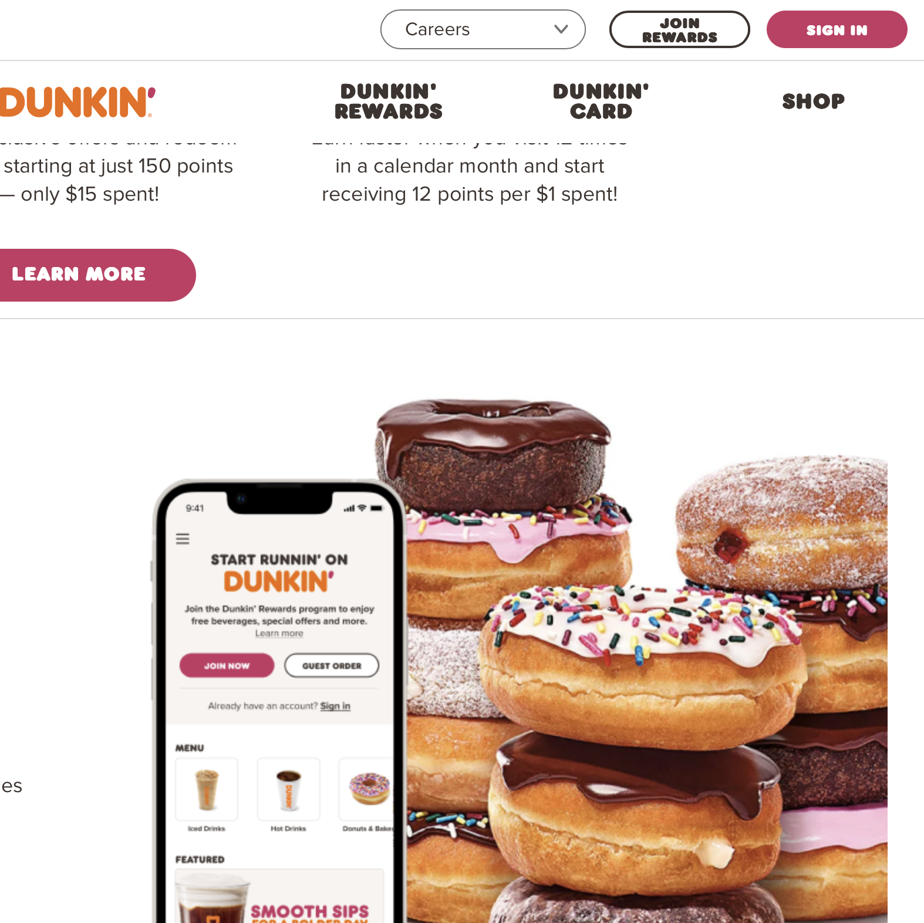
Strengths
Excellent web design staff
Franchise and royalty fees
Extensive menu

Slide 4
Weaknesses
Dependency on franchises
Beverages not bold enough

Slide 5
Opportunities
Affordable prices : meal deal $6 (bacon, egg, and cheese sandwich, hash browns, and a medium hot or iced coffee)
International expansion : in over a dozen countries

Slide 6
Threats
High competition : Starbucks, McDonald’s
Market instability : frequent closures may indicate declining demands in certain area

Slide 7
Thank you !!

