Slide 1
Systems Analysis and Design 11th Edition
Chapter 1
Introduction to Systems Analysis and Design

Slide 2
Chapter Objectives
Describe the impact of information technology
Define systems analysis and design and the role of a systems analyst
Define an information system and describe its components
Explain how to use business profiles and models
Explain Internet business strategies and relationships, including B2C and B2B

Slide 3
Chapter Objectives (Cont.)
Identify various types of information systems and explain who uses them
Distinguish among structured analysis, object-oriented analysis, and agile methods
Explain the waterfall model, and how it has evolved
Discuss the role of the information technology department and the systems analysts who work there

Slide 4


Slide 5
What is Information Technology?
Information technology(IT) refers to the combination of hardware, software, and services that people use to manage, communicate and share information.
Although fictitious, the bold headlines in previous slide illustrates the huge impact of IT on our society.
More than ever, business success depends on information technology.
IT is driving a new digital economy, where advances in hardware, software and connectivity can provide enormous benefits to businesses and individuals.

Slide 6

An employee clocking in with a punch card in 1953

Slide 7
What is Information Technology?
Previous slides shows an employee clocking in with a punch card in 1953.
Nowadays, most forward thinking IT firms do not require their employees to “punch in” at all.
Working from home and global contracting has dramatically changed the definition of “being at work”.

Slide 8
What Is Information Technology? (Cont.)
Systems Analysis and Design
Step-by-step process for developing high-quality information systems
Information systems: Combination of technology, people, and data to perform certain business functions
What Does a Systems Analyst Do?
Plans, develops, and maintains information systems
Manages IT projects, including tasks, resources, schedules, and costs
Conducts meetings, delivers presentations, and writes memos, reports, and documentation

Slide 9
System Analyst
Because systems analyst transform business requirements into IT projects, they must be business savvy as well as technically competent and be equally comfortable with managers and programmers, who sometimes have different point of view.

Slide 10
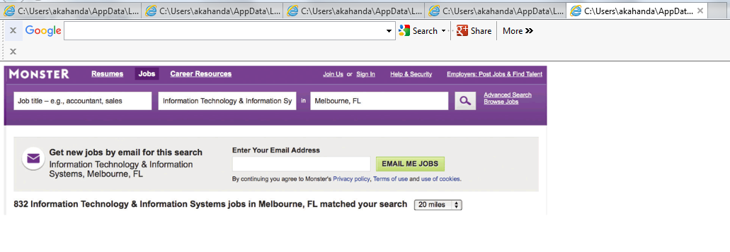
Monster.com is an example of an online job search website that IT professionals can use.

Slide 11

Consider the amazing technology that enabled the Hubble telescope to capture this image.

Slide 12
Information System Components
A system is a set of related components that produces specific results.
For example, specialized systems route Internet traffic, manufacture microchips, and control complex entities like Hubble Telescope, which took the amazing images shown in previous slide.

Slide 13
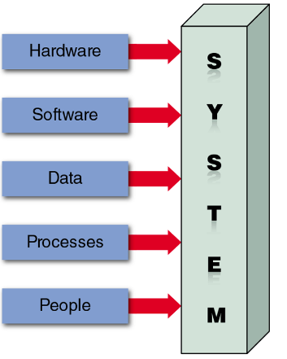
Information System Components
An information system has five key components, as shown below.

Slide 14
Information System Components
Hardware: hardware consists of everything in the physical layer of the information system.
For example, hardware can include servers, workstations, networks, telecommunication equipments and other technology.
Software: software refers to the programs that control the hardware and produce the desired information or results. Software consists of system software and application software.

Slide 15
Information System Components
Data : data is the raw material that an information system transforms into useful information.
An information system can store data in various locations, called tables. By linking the tables, the system can display the specific information that the user needs – no more, no less.
Processes : processes describes the tasks and business functions that users, managers and IT staff members perform to achieve specific results. To build a successful information system, analysts must understand business processes and document them carefully.

Slide 16
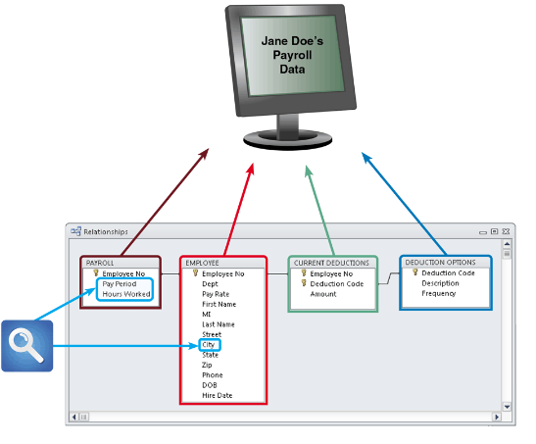
In a typical payroll system, data is stored in separate tables that are linked to form an overall database.

Slide 17
Information System Components
People : people who have an interest in an information system are called stakeholders.
Stakeholders include the management group responsible for the system, the users (sometimes called end users) inside and outside the company who will interact with the system and IT staff members such as system analysts, programmers and network administrators who develop and support the system.

Slide 18
Business Today
Business today is being shaped by three major tends :
Rapidly increasing globalization
Technology integration for seamless information access
Rapid growth of cloud-based computing and services
All trends are Internet-centric

Slide 19
Business Today (Cont.1)
The Internet Model
Ecommerce (electronic commerce) – Internet-based commerce. Typical model is a series of web pages that provides a user interface, which communicates with database management software and a web based data server.
User interface - Enables communication between a data-base management software and a web-based server
Mobile devices interact with the system using apps
Sectors
B2C (business-to-customer)
B2B (business-to-business)

Slide 20
Business Today (Cont.2)
B2C (Business-to-Customer)
In a single convenient session, customers can:
Do research and compare prices and features
Check availability and arrange delivery
Choose payment methods
B2B (Business-to-Business)
Ecommerce was initially carried out using electronic data interchange (EDI)
Most firms use supply chain management (SCM) software. A supply chain refers to all the companies who provide materials, services and functions needed to provide a product to a customer. SCM software helps businesses manage inventory levels, costs, alternate suppliers.

Slide 21
Modeling Business Operations
System analysts use modeling to represent company operations and information needs. Business process modeling involves a business profile and a set of models that document business operations
Business Profile
Overview of a company’s mission, functions, organization, products, services, customers, suppliers, competitors, constraints, and future direction
Business Process
Specific set of transactions, events, and results that can be described and documented

Slide 22
Modeling Business Operations
Business process model (BPM) - graphically displays one or more business processes, such as handling an airline reservation, filling a product order or updating a customer account.
Business process modeling notation (BPMN) - for complex models, analysts can choose computer based tools that use business process modeling notation. BPMN includes standard shapes and symbols to represent events, processes, workflows and more.
Multipurpose applications such as Microsoft Visio, CASE tools such as Visible Analyst or online diagramming tools such as drwa.io can be used to create BPMN models.

Slide 23
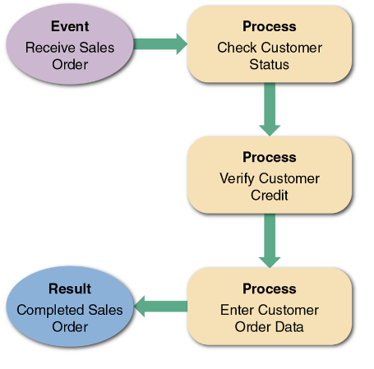
A simple business model might consist of an event, three processes and a result.

Slide 24
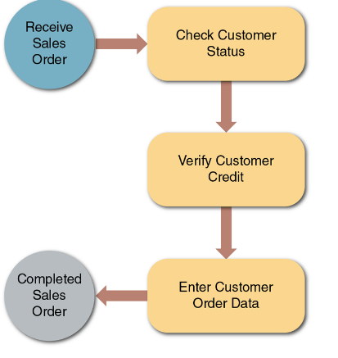
This sample uses business process modeling notation (BPMN) to represent the same events, and workflow shown in previous slide.

Slide 25
Business Information Systems
In the past, IT mangers identified an information system based on its primary users.
For example: administrative staff used office systems, operational people used operational systems, middle managers used decision support systems, and top managers used executive information systems.

Slide 26
Business Information Systems
Current Method
All employees use office productivity systems
Operations users require decision support systems to do their jobs.
Systems are defined by their functions and features
Enterprise Computing
Supports company-wide operations and data management requirements
Enterprise resource planning (ERP) systems provide cost-effective support for users and managers throughout the company

Slide 27
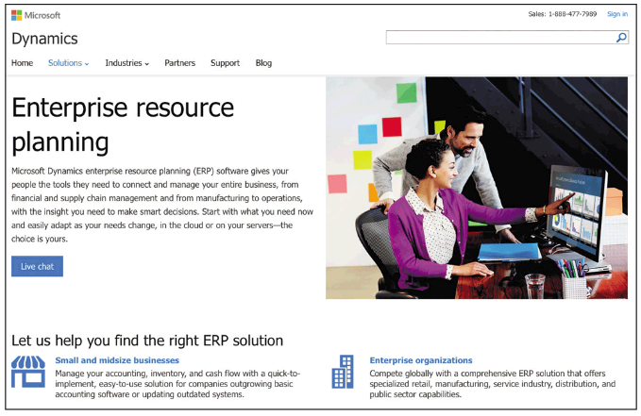

Slide 28
Transaction Processing
Transaction processing(TP) systems process data generated by day to day business operations.
Examples of TP systems include customer order processing, accounts receivable and warranty claim processing.
TP systems perform a series of tasks whenever a specific transaction occurs.

Slide 29
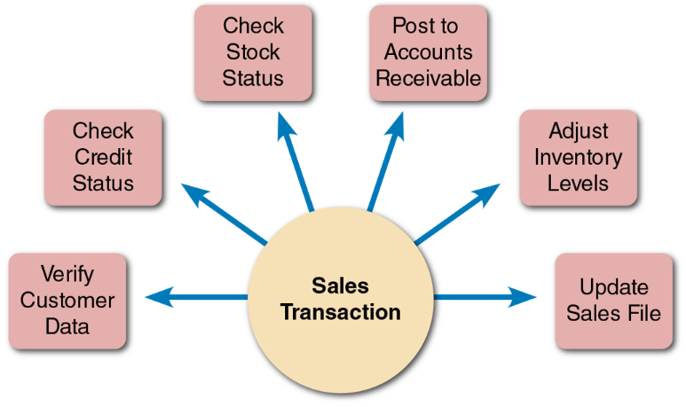
A single sales transaction consists of six separate tasks, which the TP system processes as a group.

Slide 30
Business Information Systems
User Productivity Systems
Companies provide employees at all levels with technology that improves productivity. Examples of user productivity systems include email, voice mail, video and web conferencing, word processing etc.
Groupware: Enables data sharing and coordination of efforts
Systems Integration
Most large companies require systems that combine transaction processing, business support, knowledge management and user productivity features.

Slide 31
What Information Do Users Need? (Cont.1)
Top Managers
Use IT to develop long-range strategic plans , which define the company’s overall mission and goals.
Require information such as economic forecasts, technology trends, competitive threats, and governmental issues
Middle Managers and Knowledge Workers
Middle managers provide direction, resources, and performance feedback to supervisors and team leaders
Require more detailed information than top managers
Knowledge workers provide support for the organization’s basic functions

Slide 32
What Information Do Users Need? (Cont.2)
Supervisors and Team Leaders
Oversee operational employees and carry out day-to-day functions
Require decision support information, knowledge management systems, and user productivity systems
Operational Employees
Rely on TP systems to enter and receive data they need to perform their jobs
Empowered to handle tasks and make decisions that were assigned previously to supervisors

Slide 33
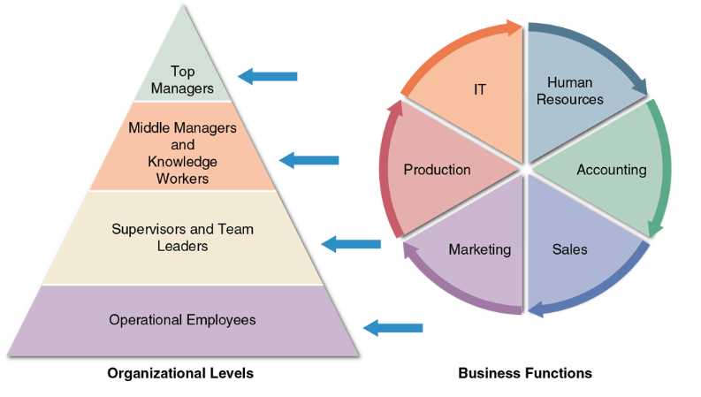
A typical organizational model identifies business functions and organizational levels

Slide 34
Systems Development Tools
In addition to understanding business operations, systems analysts must know how to use a variety of techniques, such as modeling, prototyping and computer-aided-systems engineering tools to plan, design and implement information systems.
Systems analyst work with these tools in a team environment, where input from users, managers and IT staff contributes to the system design.

Slide 35
Systems Development Tools (Cont.1)
Modeling : modeling produces a graphical representation of a concept or process that systems developers can analyze, test and modify.
A business model describes the information that a system must provide. Analysts also creates models to represents data, objects, networks and other system components.
System developers often use multipurpose charting tools such as Microsoft Visio to display business-related models.

Slide 36
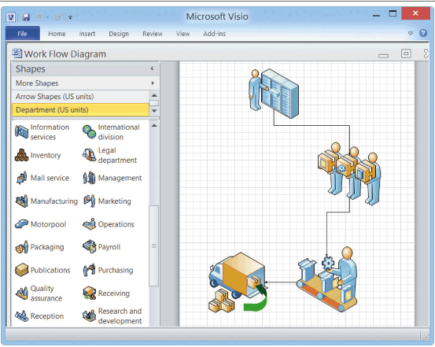
Microsoft Visio allows you to drag and drop various symbols and connect them to model a business process

Slide 37
Systems Development Tools (Cont.2)
Prototyping : Prototyping tests system concepts and provides an opportunity to examine input, output and user interfaces before final decisions are made.
A prototype is an early working version of an information system
Disadvantage - Important decisions might be made before business or IT issues are thoroughly understood
A prototype based on careful fact-finding and modeling techniques can be an extremely valuable tool

Slide 38
Systems Development Tools (Cont.3)
Computer-Aided Systems Engineering (CASE) Tools
Known as computer-aided software engineering
CASE is a technique that uses powerful software called CASE tools , to help systems analysts develop and maintain information systems.
Provide an overall framework for systems development
Support design methodologies
Structured analysis
Object-oriented analysis
Generate program code
Speeds the implementation process

Slide 39
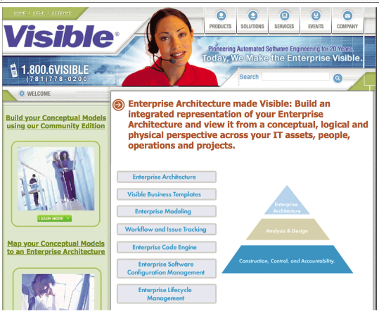
Visible Systems Corporation offers several software engineering tools , including visible analyst, a popular CASE tool

Slide 40
Systems Development Methods
Many options exists for developing information systems, but the most popular alternatives are :
Structured analysis, which is a traditional method that still is widely used.
Object oriented(O-O) analysis, which is a more recent approach that many analysts prefer.
Agile methods, also called adaptive method, which include the latest trends in software development.

Slide 41
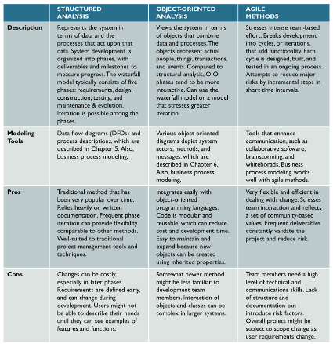

Slide 42
Systems Development Methods (Cont.1)
Structured Analysis : is a traditional systems development technique that is time-tested and easy to understand.
Structured analysis uses a series of phases, called systems development life cycle (SDLC), to plan, analyze, design, implement and support an information system.
Addresses data organization and structure, relational database design, and user interface issues
The SDLC describes activities and functions that all systems developers perform, regardless of which approach they use

Slide 43
Systems Development Methods (Cont.2)
Structured analysis uses a set of process models to describe a system graphically.
A process model shows that data that flows in and out of system processes. Inside each process, input data is transformed by business rules that generate the output.
In the waterfall model, the result of each phase is called a deliverable, which flows into the next phase.

Slide 44
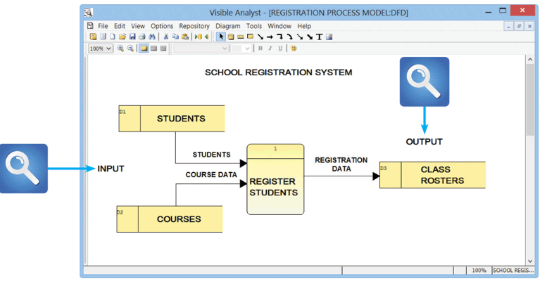
Data Flow Diagram :This Visible Analyst screen shows a process model for a school registration system. The REGISTER STUDENT process accepts input data from two sources and transform it into output information.

Slide 45
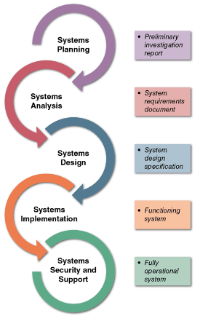
Development phases and deliverables are shown in the waterfall model. The circular symbols indicate interaction among the phases.

Slide 46
Systems Development Methods (Cont.4)
Steps in the SDLC Model
Systems planning
Initiated by a systems request
Goal - To perform a preliminary investigation
Feasibility study: Reviews anticipated costs and benefits and recommends a course of action
Systems analysis
Goal – To build a logical model of the new system
Requirements modeling: Analyst investigates business processes and documents the functions to be performed by the new system
Deliverable - System requirements document

Slide 47
Systems Development Methods (Cont.5)
Systems design
Goal – To create a physical model that satisfies all documented requirements
User interface is designed and application architecture is determined
Outputs, inputs, and processes are identified
Deliverable - System design specification
Management and user involvement is critical

Slide 48
Systems Development Methods (Cont.6)
Systems implementation
New system is constructed, programs are written, tested, and documented, and the system is installed
Deliverable - A completely functional and documented information system
Includes systems evaluation
Systems support and security
IT staff maintains, enhances, and protects the system
A well-designed system must be secure, reliable, maintainable, and scalable

Slide 49
Object-Oriented Analysis
Whereas structured analysis treats processes and data as separate components, object-oriented analysis combines data and the processes that act on the data into things called objects.
Systems analysts use O-O to model real-world business processes and operations.
The result is a set of software objects that represents actual people, things, transactions and events.
Using an O-O programming language, a programmer then writes the code that creates the objects.

Slide 50
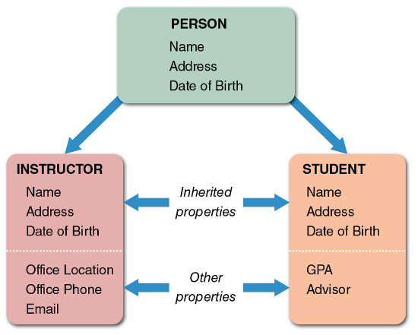
The PERSON class includes INSTRUCTOR and STUDENT objects, which have their own properties and inherited properties.

Slide 51
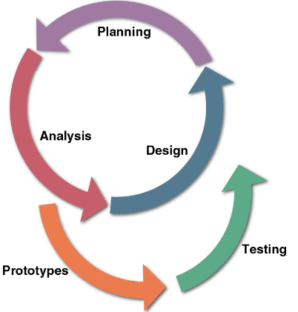
In a typical O-O development model, planning, analysis and design tasks interact continuously to generate prototypes that can be tested.

Slide 52
Systems Development Methods (Cont.9)
Agile Methods
Development techniques change over time. For example, structured analysis is a traditional approach and agile methods are the newest development.
Structured analysis builds an overall plan for the information system, just as a contractor might use a blue print for constructing a building.
Agile method, in contrast, attempt to develop a system incrementally, by building a series of prototypes and constantly adjusting them to user requirements.
As the agile process continues, developers revise, extend, and merger earlier versions into the final product.

Slide 53
Systems Development Methods (Cont.9)
Agile Methods
Involve building and constantly adjusting a series of prototypes to user requirements
Agile methods typically uses a spiral model, which represents a series of iterations or revisions, based on user feedbacks.
Spiral model: Series of iterations based on user feedback
Feedback from prior steps is incorporated in each incremental step
Advantages: allow developers to be more flexible and responsive.
Disadvantages: riskier than more traditional methods. Weak documentation, blurred lines of accountability, and too little emphasis on the larger business picture.

Slide 54
Systems Development Methods (Cont.10)
Other Development Methods
Joint application development (JAD)
Focuses on team-based fact-finding
Rapid application development (RAD)
A compressed version of the entire development process
Both JAD and RAD use teams composed of users, managers, and IT staff.
The difference is that JAD focuses on team-based fact-finding, which is only one phase of the development process, whereas RAD is more like a compressed version of the entire process.

Slide 55
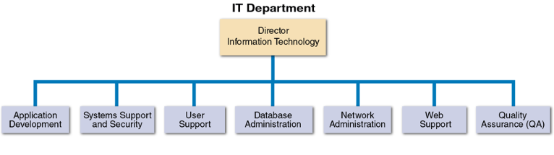
Depending on its size, an IT department might have separate organization units for these functions, or they might be combined into a smaller number of teams.

Slide 56
The Information Technology Department (Cont.1)
Application Development
Systems are developed by teams consisting of users, managers, and IT staff members
Systems Support and Security
Provides vital protection and maintenance services
User Support
Provides users with technical information, training, and productivity support
Known as a help desk

Slide 57
The Information Technology Department (Cont.2)
Database Administration
Involves data design, management, security, backup, and access systems
Network Administration
Includes hardware and software maintenance, support, and security
Web Support
Web support specialists design and construct Web pages
Monitor traffic and manage hardware and software
Link Web-based applications information systems to the company’s information systems

Slide 58
The Information Technology Department (Cont.3)
Quality Assurance (QA)
QA team reviews and tests all applications and systems changes to verify specifications and software quality standards

Slide 59
The Systems Analyst
A system analyst helps develop IT systems that support business requirements. To succeed, analysts often must act as translators.
A system analyst Investigates, analyzes, designs, develops, installs, evaluates, and maintains a company’s information systems.
Constantly interacts with users and managers within and outside the organization.

Slide 60
The Systems Analyst (Cont.1)
Roles
Acts a translators to managers and programmers
A company’s best line of defense in an IT disaster
Most valuable skill - The ability to listen
Seeks feedback from users to ensure that systems do not deviate from accomplishing set objectives
Knowledge, Skills, and Education
Technical knowledge
Communication and business skills
Critical thinking skills

Slide 61
The Systems Analyst (Cont.2)
Education - A college degree in information systems, science, or business
Some IT experience is required
Certification
Helps IT professionals learn new skills and gain recognition for their efforts

Slide 62
The Systems Analyst (Cont.3)
Career Opportunities
Companies will need systems analysts to apply new information technology
Explosion in e-commerce will fuel IT job growth
Important factors
Job titles
Company organization
Company size
Salary, location and future Growth
Corporate culture

Slide 63
Trends in Information Technology
IT is one of the fastest evolving industries
Knowledge of current trends is vital to a systems analyst
Key trends
Agile methods
Cloud computing
Mobile devices and apps
IT firms now offer a mix of products, services, and support
Social media

Slide 64
Chapter Summary
IT - Combination of hardware and software resources
Used by companies to manage, access, communicate, and share information
Essential components of an information system
Hardware, software, data, processes, and people
Successful companies offer a mix of products, technical and financial services, consulting, and customer support

Slide 65
Chapter Summary (Cont.1)
Types of information systems
Enterprise computing systems, transaction processing systems, business support systems, knowledge management systems, or user productivity systems
Organization structure includes top managers, middle managers and knowledge workers, supervisors and team leaders, and operational employees

Slide 66
Chapter Summary (Cont.2)
Systems analysts use modelling, prototyping, and computer-aided systems engineering (CASE) tools
Popular system development approaches
Structured analysis, object-oriented analysis, and agile methods
In addition to technical knowledge, a systems analyst must understand the business, think critically, and communicate effectively

