Slide 1
Systems Analysis and Design 11th Edition
Chapter 2
Analyzing the Business Case

Slide 2
Chapter Objectives
Explain the concept of a business case and how a business case affects an IT project
Describe the strategic planning process and why it is important to the IT team
Explain the purpose of a mission statement
Conduct a SWOT analysis and describe the four factors involved
Explain how the SDLC serves as a framework for systems development

Slide 3
Chapter Objectives (Cont.)
List reasons for systems projects and factors that affect such projects
Describe systems requests and the role of the systems review committee
Define operational, technical, economic, and schedule feasibility
Explain the factors that affect project priorities
Describe the steps and the end product of a preliminary investigation

Slide 4
Introduction
Business case: the term business case refers to the reasons, or justification for a proposal
To analyze the business case for a specific proposal the analyst must consider the organization’s:
Overall mission
Objectives
IT needs
Systems development process
Systems development typically starts with a system request.
Preliminary investigation, which includes a feasibility study
Findings are submitted to management

Slide 5
A Framework for IT Systems Development
Strategic Planning Overview
Strategic planning: Process of identifying long-term organizational goals, strategies, and resources
A strategic plan looks beyond day to day activities and focuses on a horizon that is five, ten or more years in the future.
Starts with a mission statement
Must reflect the firm’s vision, purpose, and values
Mission statements usually focus on long term challenges and goals, the importance of the firm’s stakeholders and a commitment to the firm’s role as a corporate citizen.
Critical success factor: High-priority objective

Slide 6
Mission Vs Vision
What is the difference between mission and vision?
A mission statement defines the organization's business, its objectives, and how it will reach these objectives.
A vision statement details where the organization aspires to go.

Slide 7
What is SWOT Analysis?
What Is SWOT Analysis?
Strengths, weaknesses, opportunities, and threats
Examines a firm’s technical, human, and financial resources
Ex : Strengths:
Excellent web design staff
Low system analyst turnover
Weaknesses:
Budget increase were turned down
Documentation needs updating
Opportunities:
Can be first with new software
High potential for B2B growth
Threats
Aggressive new web competition
Impact of new FCC rules
Other firms offer better benefits

Slide 8
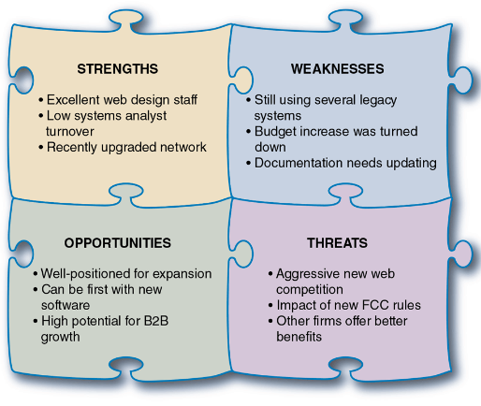
A SWOT analysis might produce results similar to those shown here

Slide 9
A Framework for IT Systems Development (Cont. 3)
Strategic Planning for IT Projects
Careful planning can help assure that:
The project supports overall business strategy and operational needs
The project scope is well-defined and clearly stated
The project goals are realistic, and tied to specific statements, assumptions, constraints, factors, and other inputs
Planning tools
Microsoft Word and Excel
CASE tools
Visible Analyst

Slide 10
A Framework for IT Systems Development (Cont. 5)
The Changing Role of the IT Department
Management and IT are linked closely
Remarkable changes have occurred in both areas
Today, systems development is much more team- oriented (managers, IT staff etc.)
The IT department is responsible for screening and evaluating systems requests
Larger firms may use an evaluation team or systems review committee

Slide 11
What Is a Business Case?
The term business case refers to the reasons, or justifications, for a proposal.
A business case should:
Be comprehensive and easy to understand
Describe the project clearly, provide the justification to proceed, and estimate the project’s financial impact
Questions answered by a business case
Why are we doing this project?
How much will it cost and how long will it take?
Are there any risks involved?
How will we measure success?
What alternatives exist?

Slide 12
Information Systems Projects
Main reasons for Systems Projects:
The starting point for most projects is called a systems request, which is a formal way of asking for IT support.
The six main reasons for systems request are:
Stronger controls
Reduced cost
More information
Better performance
Improved services
More support for new products and services

Slide 13
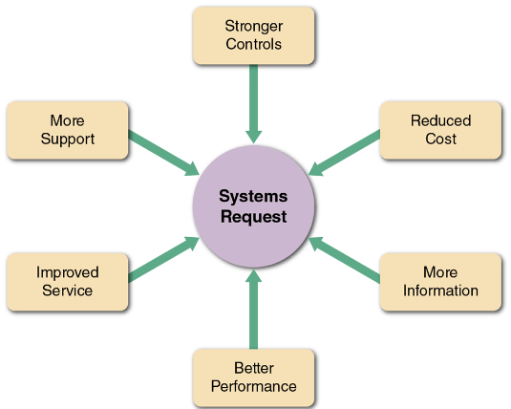
Six main reasons for systems requests

Slide 14
Six Main Reasons for Systems Requests
Stronger controls : A system must have effective controls to ensure that data is secure and accurate. Some common security controls include passwords, various levels of user access and encryption.
Reduced cost : The current system could be expensive to operate or maintain as a result of technical problems, design weaknesses or the changing demands of the businesses.

Slide 15
Six Main Reasons for Systems Requests
More information : The system might produce information that is insufficient, incomplete or unable to support the company’s changing information needs. For example, a system that tracks customer order might not be capable of analyzing and predicting marketing trends.
Better performance : The current system might not meet performance requirements. For example, it might respond slowly to data inquiries at certain times or it might be unable to support company growth.

Slide 16
Six Main Reasons for Systems Requests
Improved services : Systems requests often are aimed at improving services to customers or users within the company. For instance, allowing mutual fund investors to check their account balances on a website.
More support for new products and services : New products and services often require new types or levels of IT support. For example, a software vendor might offer an automatic upgrade service for subscribers, or a package delivery company might add a special service for radio frequency identification(RFID)-tagged shipments.

Slide 17
Factors That Affect Systems Projects
Internal and external factors affect every business decision that a company makes, and IT projects are no exception.
Internal factors :
Strategic plan : a company’s strategic plan sets the overall direction for the firm and has an important impact on IT projects. Company goals and objectives that need IT support will generate systems requests and influence IT priorities.
Top mangers : because significant resources are required, top management usually initiates large-scale projects.

Slide 18
Factors That Affect Systems Projects
Internal factors:
User requests : as users rely more heavily on information systems to perform their jobs, they are likely to requests even more IT services and support. For example, sales reps might request improvements to the company’s website, a more powerful sales analysis report.
Information technology department : system projects requests also come from the IT department itself. IT staff members often make recommendations based on their knowledge of business operations and technology trends.

Slide 19
Factors That Affect Systems Projects
Internal factors:
Existing systems and data : errors or problems in existing systems can trigger requests for system projects, When dealing with older systems, analysts sometimes spend too much time reacting to day-to-day problems without looking at underlying causes.
Company finances: a company’s financial status can affect system projects. If the company is going through a difficult time, the project may be postponed until there is more cash available to finance the effort.

Slide 20
Factors That Affect Systems Projects
External factors:
Technology : changing technology is a major force affecting business and society in general. For example, the rapid growth of telecommunication, coupled with increased computing power, has created entire new industries and technologies.
Suppliers : with the growth of electronic data interchange(EDI), relationships with suppliers are critically important. For example, an automobile company might require that suppliers code their parts in a certain manner to match the auto company’s inventory control system.

Slide 21
Factors That Affect Systems Projects
External factors:
Customers: customers are vitally important to any business. Information systems that interact with customers usually receive top priority .Many companies implement customer relationship management (CRM) systems that integrate all customer-related events and transactions.
Competitors : competition drives many information systems decisions. For example, if one cellular telephone provider offers a new type of digital service, other firms then plan in order to remain competitive.

Slide 22
Factors That Affect Systems Projects
External factors:
The Economy : economic activity has a powerful influence on corporate information management. In a period of economic expansion, firms need to be ready with scalable systems that can handle additional volume and growth. Predicting the business cycle is not an exact science and careful research and planning are important.
Government : federal, state and local government regulations directly affect the design of corporate information systems. For example, up-to-date IRS reporting requirement must be designed into a payroll package.

Slide 23
Evaluation of Systems Requirements
Systems requests are evaluated by a systems review committee or a computer resources committee
Systems Request Forms : Many organizations use a special form for system requests.
Streamline the request process
Ensure consistency
Easy to understand
Include clear instructions
Indicate the required supporting documents
Submitted electronically

Slide 24
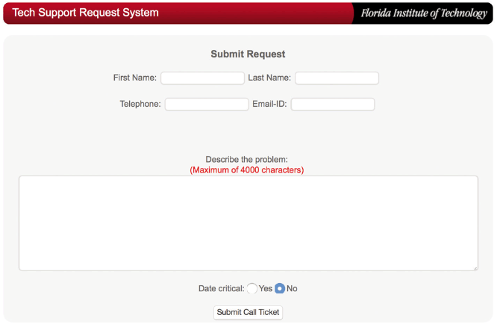
Example of an Online Systems Request Form

Slide 25
Evaluation of Systems Requirements (Cont. 2)
Systems Review Committee
Most large companies use a systems review committee to evaluate systems requests. A broader viewpoint enables a committee to establish priorities more effectively than an individual
One person’s bias is less likely to affect decisions
Disadvantages
Action on requests must wait until the committee meets
Members might favor projects requested by their own departments
Internal political differences could delay important decisions

Slide 26
Evaluation of Systems Requirements (Cont. 3)
Whether one person or a committee is responsible, the goal is to evaluate the requests and set priorities. Suppose four requests must be reviewed:
The marketing group wants to analyze current customer spending habits and forecast future trends.
The technical support group wants a cellular link so service representatives can download technical data instantly.
The accounting department wants to redesign customer statements and allow Internet access.
The production staff wants an inventory control system that can exchange data with major suppliers.
Which project should the firm pursue? What criteria should be applied? How should priorities be determined?

Slide 27
Overview of Feasibility
Feasibility studies can be simple or exhaustive
Effort required depends on the nature of the request
Initial fact-finding involves:
Studying organizational charts
Performing interviews
Reviewing current documentation
Observing operations
Surveying users
A feasibility study uses four main yardsticks to measure a proposal: operational feasibility, economic feasibility, technical feasibility and schedule feasibility.

Slide 28
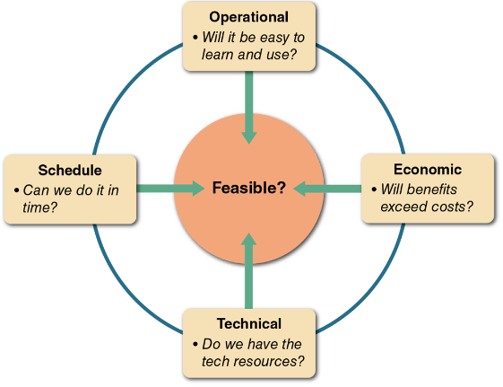
A feasibility study examines operational, technical, economic, and schedule factors.

Slide 29
Overview of Feasibility (Cont. 2)
Operational Feasibility
Operational feasibility means that a proposed system will be used effectively after it has been developed. If users have difficulty with a new system, it will not produce the expected benefit.
Can be affected by organizational culture
Cannot be accurately measured but requires careful study
Questions that can help predict a system’s operational feasibility :
Is the project supported by management and users?
Will the new system result in a workforce reduction?
Do legal or ethical issues need to be considered?

Slide 30
Overview of Feasibility (Cont. 3)
Economic Feasibility
Projected benefits of a proposed system out-weigh total cost of ownership (TCO), which includes ongoing support and maintenance costs, as well as acquisition costs.
Determination of TCO requires cost analysis of:
People, including IT staff and users
Hardware and equipment
Software
Formal and informal training
Licenses and fees
Consulting expenses
Facility costs

Slide 31
Overview of Feasibility (Cont. 4)
Tangible costs, such as listed above, are measured in dollars
Intangible costs can significantly affect organizational performance. For an example, low employee morale might not have an immediate dollar impact, but certainly will affect the company’s performance.
Tangible benefits can result from a decrease in expenses or an increase in revenues.
Ex: A new scheduling system that reduces overtime.
Intangible benefits are important to the company despite the inability to measure them in dollars.
Ex: A user-friendly system that improves employee job satisfaction
A sales tracking system that supplies better information for marketing.

Slide 32
Overview of Feasibility (Cont. 5)
Technical Feasibility
Technical feasibility refers to the technical resources required to acquire and use the system
When assessing technical feasibility, an analyst should consider the following points:
Does the company have the necessary hardware, software, and network resources?
Does the company have the required technical expertise?
Does the proposed platform have sufficient capacity for future needs?
Will a prototype be required?

Slide 33
Overview of Feasibility (Cont. 6)
Schedule Feasibility
Schedule feasibility means that a project can be implemented in an acceptable time frame.
Issues that can affect schedule feasibility
Interaction between time and costs
Can the company or the IT team control the factors that affect schedule feasibility?
Has management established a firm timetable for the project?
What conditions must be satisfied during the development of the system?
Will an accelerated schedule pose any risks?
Will a project manager be appointed?

Slide 34
Evaluating Feasibility
The first step in evaluating feasibility is to identify and weed out systems requests that are not feasible
Some feasible requests may not be necessary
Requests that are not currently feasible can be resubmitted as new hardware, software, or expertise becomes available.
As the project progresses, conditions often change. Acquisition costs might increase and the project might become more expensive than anticipated.

Slide 35
Setting Priorities
Factors that Affect Priority
Will the proposed system reduce costs?
Will the system increase revenue for the company?
Will the systems project result in more information or produce better results?
Will the system serve customers better?
Will the system serve the organization better?
Can the project be implemented in a reasonable time period?
Are the necessary financial, human, and technical resources available?

Slide 36
Setting Priorities (Cont.)
Discretionary and Nondiscretionary Projects
Discretionary projects: Projects where management has a choice in implementing them
Nondiscretionary projects: Management has no choice in implementing a project
Most of these projects are predictable
Annual updates to payroll
Tax percentages
Quarterly changes

Slide 37
Preliminary Investigation Overview
Interaction with Managers and Users
Meet with key managers, users, and IT staff to describe the project, explain responsibilities, answer questions, and invite comments
Focus on improvements and enhancements, not problems

Slide 38
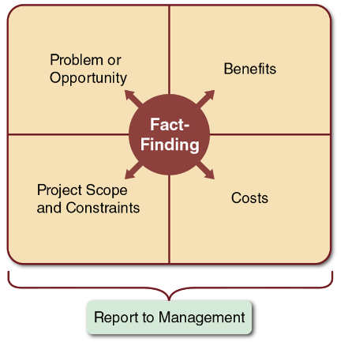
Model of a preliminary investigation. Note the importance of fact-finding in each of the four areas.

Slide 39
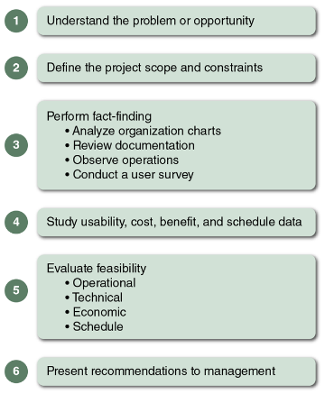
Six main steps in a typical preliminary investigation

Slide 40
Preliminary Investigation Overview (Cont. 2)
Planning the Preliminary Investigation
Step 1- Understand the problem or opportunity
Develop a business profile that describes current business processes and functions
Understand how modifications will affect business operations and other information systems
Identify the departments, users, and business processes involved
Consider using a fishbone diagram ( is an analysis tool that represents the possible causes of a problem as a graphical outline)

Slide 41
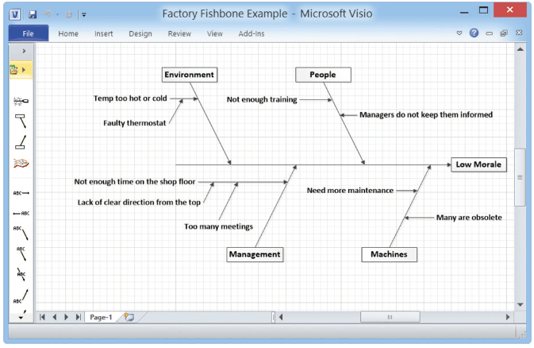
A fishbone diagram displays the causes of a problem. Typically, you must dig deeper to identify actual causes rather than just symptoms.

Slide 42
Preliminary Investigation Overview (Cont. 4)
Planning the Preliminary Investigation (Cont.)
Step 2 - Define the project scope and constraints
Define the specific boundaries, or extent, of the project
Define project scope by creating a list with sections called must do, should do, could do, and won’t do
Avoid project creep
Project creep: Process by which projects with very general scope definitions expand gradually, without specific authorization
Identify constraints
Constraint: A requirement or condition that the system must satisfy or an outcome that the system must achieve

Slide 43
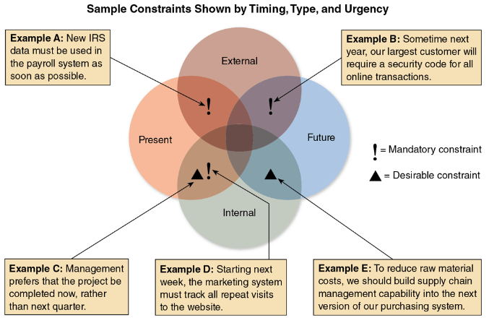
Example of various types of constraints

Slide 44
Preliminary Investigation Overview (Cont. 6)
Planning the Preliminary Investigation (Cont.)
Step 3 - Perform fact-finding
Gather data about project usability, costs, benefits, and schedules
Analyze organization charts, conduct interviews, review documentation, observe operations, and conduct a user survey
Analyze the data
Pareto chart (displays the causes of a problem in priority order)
XY chart (scatter diagram)

Slide 45
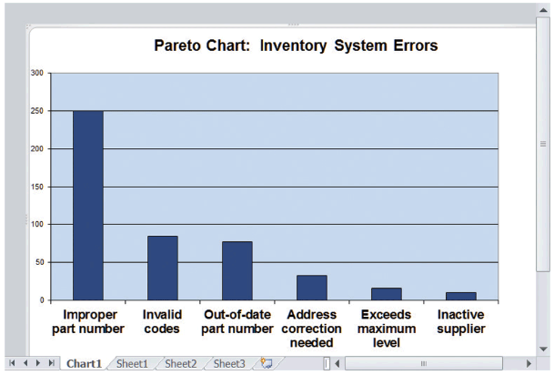
A Pareto chart displays the causes of a problem, in priority order, so an analyst can tackle the most important cases first.

Slide 46
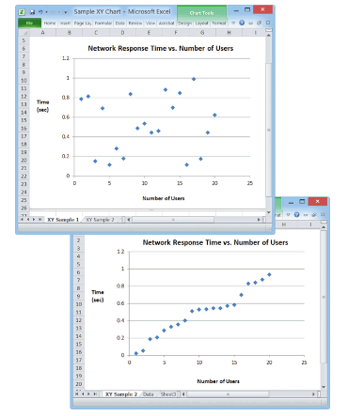
An XY chart shows correlation between variables, which is very important in problem solving. Conversely, a lack of correlation suggests that the variables are independent and you should look somewhere else for the cause

Slide 47
Preliminary Investigation Overview (Cont. 8)
Planning the Preliminary Investigation (Cont.)
Step 4 - Analyze project usability, cost, benefit, and schedule data
Factors to consider
What information must be obtained, and how will it be gathered and analyzed?
Who will conduct the interviews? How many people will be interviewed?
Will a survey be conducted? Who will be involved? How much time will it take to tabulate the results?
How much will it cost to analyze the information and prepare a report with findings and recommendations?

Slide 48
Preliminary Investigation Overview (Cont. 9)
Planning the Preliminary Investigation (Cont.)
Step 5 - Evaluate feasibility
Operational feasibility (Whether the proposed system will be used after it has been developed)
Technical feasibility (Do we have enough technical resources needed to develop, purchase or operate the system ?)
Economic feasibility (will the projected benefits of the proposed system out-weigh the total cost)
Schedule feasibility( can the project be implemented in an acceptable time frame?)
Step 6 - Present results and recommendations to management
Prepare a report that includes:
An evaluation of the systems request
An estimate of costs and benefits
A case for action, which is a summary of the project request and a specific recommendations.

Slide 49
Preliminary Investigation Overview (Cont. 10)
Planning the Preliminary Investigation (Cont.)
Format of a report
Introduction – contains the brief description of the system
Systems request summary- the summary describes the basis of the systems request
Findings- the findings section contains the results of the preliminary investigation, including a project’s scope, constraints and feasibility.
Recommendations- a summary of the project request and a specific recommendations.
Project roles – this section lists the people who will participate in the project and describes each person’s role
Time and costs estimates – includes cost of acquiring and installing the system and the total cost of ownership
Expected benefits – includes anticipated tangible and intangible benefit and a timetable that shows when they are to occur
Appendix – attach all reports of supporting information

Slide 50
Chapter Summary
Systems planning is the first phase of the systems development life cycle
A business case should:
Describe the project clearly
Provide the justification to proceed
Estimate the project’s financial impact
Factors that affect systems projects
User requests, top management directives, existing systems, the IT department, software and hardware vendors, technology, customers, competitors, the economy, and government

Slide 51
Chapter Summary (Cont.)
Analysts evaluate the systems request and determine whether the project is feasible from an operational, technical, economic, and schedule standpoint
Steps in the preliminary investigation
Understand the problem or opportunity
Define the project scope and constraints
Perform fact-finding and analyze project usability, cost, benefit, and schedule data
Evaluate feasibility and present results and recommendations to management

Slide 52
Case Study
Trent college is a private school in a small Maryland town. The college has outgrown its computerized registration system and is considering a new system. Althea Riddick, the college president, has asked you to list the reasons for systems projects and assign a relative weight to each reason, using a scale of 1-10, low to high. She said to use your best judgment and support your conclusions in a brief memo to her. She also wants you to create a Microsoft Excel spreadsheet that will calculate the weighted values automatically for each reason.

