Slide 1
Systems Analysis and Design 11th Edition
Chapter 3
Managing Systems Projects

Slide 2
Chapter Objectives
Explain project planning, scheduling, monitoring, and reporting
Draw a project triangle that shows the relationship among project cost, scope, and time
Create a work breakdown structure, identify task patterns, and calculate a critical path
Explain techniques for estimating task completion times and costs
Describe various scheduling tools, including Gantt charts and PERT/CPM charts

Slide 3
Chapter Objectives (Cont.)
Analyze task dependencies, durations, start dates, and end dates
Describe project management software and how it can be of assistance
Control and manage project changes as they occur
Discuss the importance of managing project risks
Understand why projects sometimes fail

Slide 4
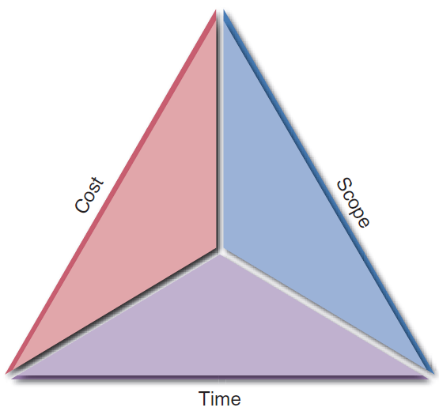
Overview of Project Management
Project Management: Planning, scheduling, monitoring and controlling, and reporting on information system development
What Shapes a Project?
Successful projects must be completed on time, within budget, meet requirements, and satisfy users
What Is a Project Triangle?
Challenge – To find optimal balance among the factors
Any change in one leg of the triangle will affect the other legs
FIGURE 3-2 A typical project triangle includes cost, scope, and time.

Slide 5
Overview of Project Management (Cont.)
What Does a Project Manager Do?
Project planning: Identifying all project tasks and estimating the completion time and cost of each
Project scheduling: Creating a specific timetable showing tasks, task dependencies, and critical tasks that might delay the project
Project monitoring: Guiding, supervising, and coordinating the project team’s workload
Project reporting: Creating regular progress reports for management, users, and the project team itself

Slide 6
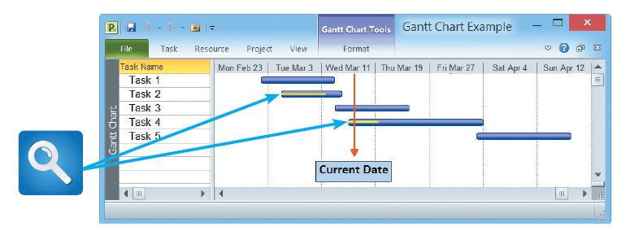
Creating a Work Breakdown Structure
Work breakdown structure (WBS): Breaking down a project into a series of smaller tasks
Gantt Chart
A horizontal bar chart representing a set of tasks
Shows planned and actual progress on a project
Simplifies complex projects using a task group
FIGURE 3-3 In this Gantt chart, notice the yellow bars that show the percentage of task completion.

Slide 7
Creating a Work Breakdown Structure (Cont. 1)
PERT/CPM Charts
Program Evaluation Review Technique (PERT)
Developed by the U.S. Navy to manage complex projects
Critical Path Method (CPM)
Developed by private industry
Utilizes a bottom-up technique
Useful for scheduling, monitoring, and controlling actual work
Displays complex task patterns and relationships

Slide 8
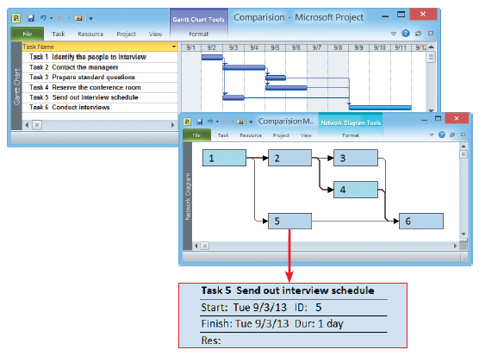
Creating a Work Breakdown Structure (Cont. 2)
FIGURE 3-4 The top screen shows a Gantt chart with six tasks. The PERT chart in the bottom screen displays an easy-to-follow task pattern for the same project. When the user mouses over the summary box for Task 5, the details become visible.

Slide 9
Creating a Work Breakdown Structure (Cont. 3)
Identifying Tasks in a WBS
Task or activity: Any work that has a beginning and an end
Requires the use of company resources such as people, time, or money
Should be small and manageable
Projects have events or milestones
Events or milestones: Recognizable reference points used to monitor progress

Slide 10
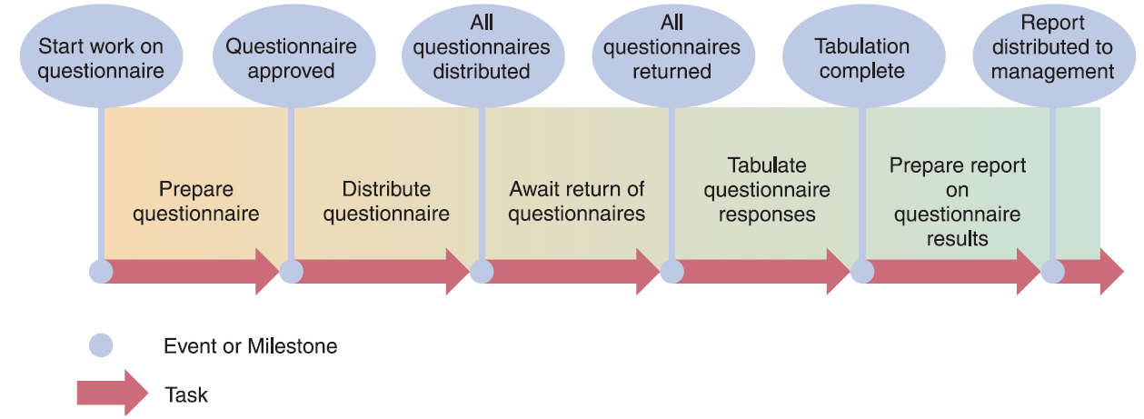
Creating a Work Breakdown Structure (Cont. 4)
FIGURE 3-5 Using a questionnaire requires a series of tasks and events to track the progress. The illustration shows the relationship between the tasks and the events, or milestones, that mark the beginning and end of each task.

Slide 11
Creating a Work Breakdown Structure (Cont. 5)
Identifying Tasks in a Work Breakdown Structure (WBS)
Listing the tasks
Estimating task duration - Can be hours, days, or weeks
Time estimates made by project managers
Best case-estimate (B), probable-case estimate (P), and worst-case estimate (W)
After making estimates, the manager assigns a weight to each estimate and calculates the task duration
actual duration = (B + 4P + W)/6

Slide 12
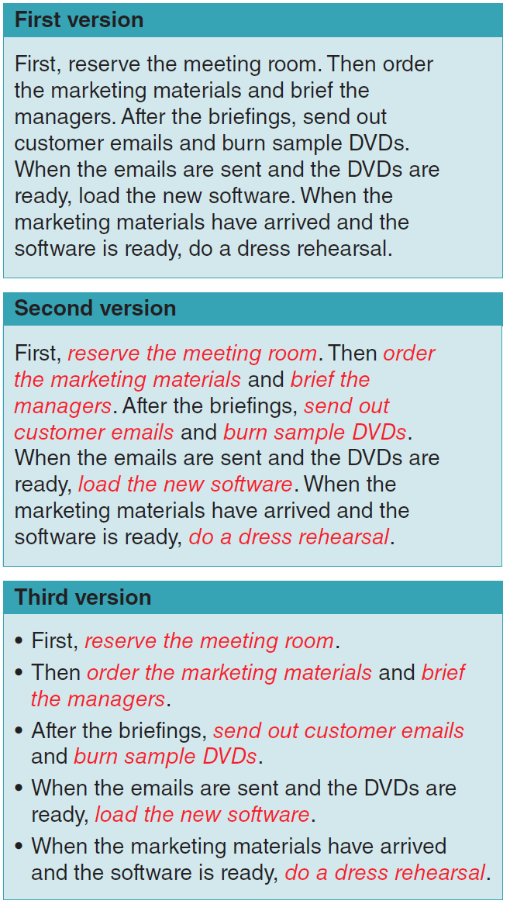
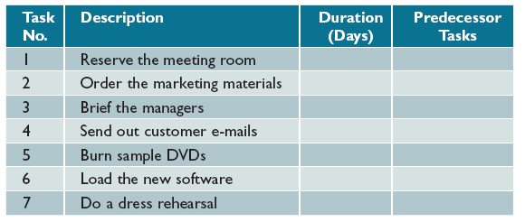
Creating a Work Breakdown Structure (Cont. 6)
FIGURE 3-7 In this table, columns have been added for task number, description, duration, and predecessor tasks, which must be completed before another task can start.
FIGURE 3-6 The three versions show how to transform a task statement into a list of specific tasks for a work breakdown structure.

Slide 13
Creating a Work Breakdown Structure (Cont. 7)
Factors Affecting Duration
Project size
Identify all project tasks and the time required for each
Consider time taken for events affecting productivity
Human resources
Assemble and guide a development team that has the skill and experience to handle the project
Deal with factors that could affect the project’s timeline

Slide 14
Creating a Work Breakdown Structure (Cont. 8)
Factors Affecting Duration
Experience with similar projects
Develop time and cost estimates based on the resources used for similar, previously developed information systems
Constraints
Define system requirements that can be achieved realistically within the required constraints
Calculate resources needed in the absence of constraints

Slide 15
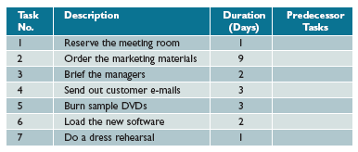
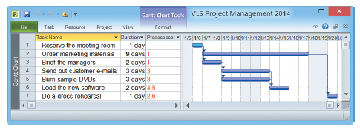
Creating a Work Breakdown Structure (Cont. 9)
FIGURE 3-8 Task durations have been added, and the WBS is complete except for predecessor task information. The predecessor tasks will determine task patterns and sequence of performance.
FIGURE 3-9 This Microsoft Project screen displays the same WBS, including task number, task name, duration, and predecessor tasks.

Slide 16
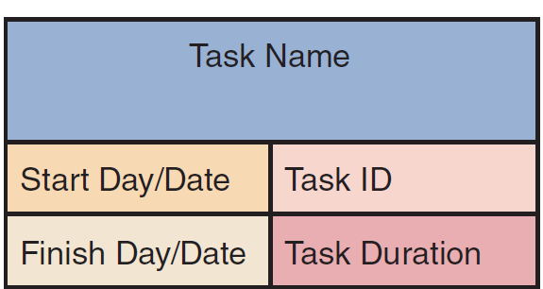
Identifying Task Patterns
Task Patterns
Arrangement of tasks in a logical sequence
Can involve dependent tasks, multiple successor tasks, and multiple predecessor tasks
Using Task Boxes to Create a Model
FIGURE 3-10 Each section of the task box contains important information about the task, including the Task Name, Task ID, Task Duration, Start Day/Date, and Finish Day/Date.
Notes:
Arrangement of tasks in a logical sequence

Slide 17
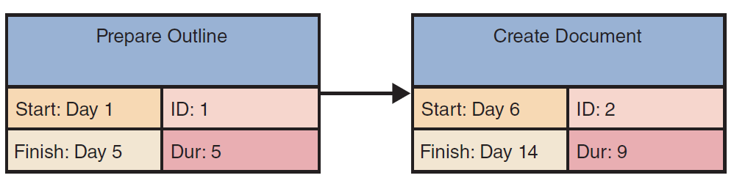
Identifying Task Patterns (Cont. 1)
Task Patterns
Dependent Tasks
Tasks that need to be completed in a sequence
One task can be initiated only after the prior task has
been completed
FIGURE 3-12 This example of a dependent task shows that the finish time of Task 1, Day 5, controls the start date of Task 2, which is Day 6.

Slide 18
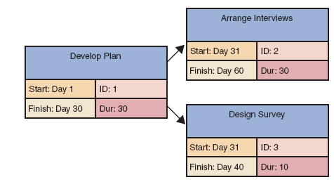
Identifying Task Patterns (Cont. 2)
Task Patterns
Multiple Successor Tasks
Tasks that can be
initiated simultaneously
Tasks are termed concurrent
Often, two or more concurrent tasks depend on a predecessor task
FIGURE 3-13 This example of multiple successor tasks shows that the finish time for Task 1 determines the start time for both Tasks 2 and 3.

Slide 19
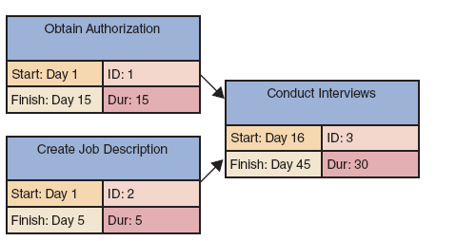
Identifying Task Patterns (Cont. 3)
Task Patterns
Multiple Predecessor Tasks
When the initiation of
a task depends on the
completion of two or
more prior tasks
FIGURE 3-14 This example of multiple predecessor tasks shows that the start time for a successor task must be the latest (largest) finish time for any of its preceding tasks. In the example shown, Task 1 ends on Day 15, while Task 2 ends on Day 5, so Task 1 controls the start time for Task 3.

Slide 20
Identifying Task Patterns (Cont. 4)
Identifying Task Patterns
Words like then, when, or and signal a sequence of events
Do Task 1, then do Task 2
Describes dependent tasks that must be completed one after the other
When Task 2 is finished, start two tasks
Task 3 and Task 4 describe multiple successor tasks that can both start as soon as Task 2 is finished
When Tasks 5 and 6 are done, start Task 7
Indicates that Task 7 is a multiple predecessor task

Slide 21
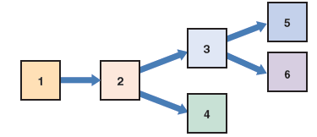

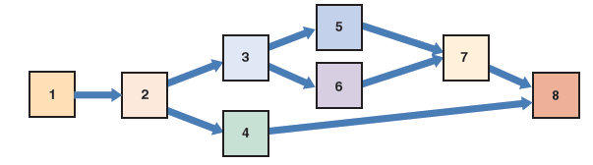
Identifying Task Patterns (Cont. 5)
Working with Complex Task Patterns
Study the facts very carefully to understand the logic and sequence of task patterns
Schedule will be wrong if task patterns are incorrect
FIGURE 3-16 Dependent tasks and multiple successor tasks
FIGURE 3-15 Dependent tasks
FIGURE 3-17 Dependent tasks, multiple successor tasks, and multiple predecessor tasks

Slide 22
Calculating the Critical Path
Critical Path: Series of tasks which, if delayed, will affect the completion date of the overall project
If any task on the critical path falls behind schedule, the entire project will be delayed
Calculating the Critical Path
Review patterns
Determine start and finish dates, which will define the critical path

Slide 23
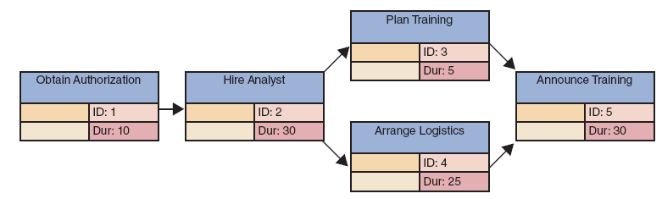
Calculating the Critical Path (Cont. 1)
FIGURE 3-18 Example of a PERT/CPM chart with five tasks. Task 2 is a dependent task that has multiple successor tasks. Task 5 has multiple predecessor tasks. In this figure, the analyst has arranged the tasks and entered task names, IDs, and durations.

Slide 24
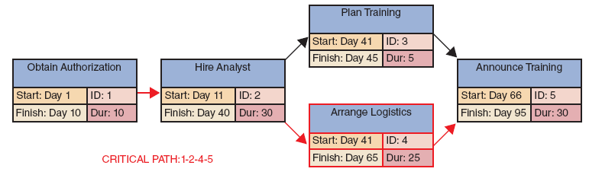
Calculating the Critical Path (Cont. 2)
FIGURE 3-19 Now the analyst has entered the start and finish times, using the rules explained in this section. Notice that the overall project has a duration of 95 days.

Slide 25
Project Monitoring and Control
Monitoring and Control Techniques
Structured walk-through: Review of a project team member’s work by other team members
Takes place throughout the SDLC
Known as design, code, or testing reviews based on the phase in which they occur

Slide 26
Project Monitoring and Control (Cont.)
Maintaining a Schedule
Most projects run into some problems or delays
Projects managers monitor and control the work by:
Anticipating problems, avoiding them, and minimizing their impact
Identifying potential solutions and selecting the best way to solve the problem

Slide 27
Reporting
Project Status Meetings
Project managers schedule regular meetings to share updates, discuss common problems, and explain new techniques
Help collect data from team members and conduct brainstorming sessions
Project Status Reports
Regularly communicated by project managers to supervisors, upper management, or users
Managers must communicate potential problems to the management at the right time

Slide 28
Project Management Examples
PERT/CPM Examples
Step 1 - Display the tasks and task patterns
Identify the tasks
Determine task dependencies
Enter the task name, ID, and duration
Step 2 - Enter start and finish times
In case of more than one predecessor tasks for a successor task, use the latest finish time of the predecessor tasks to determine the start time for the successor task

Slide 29
Project Management Examples (Cont. 1)
PERT/CPM Examples
In case of more than one successor task for the predecessor task, use the predecessor task’s finish time to determine the start time for all successor tasks
Continuing from left to right, add the task duration for each task to its start time to determine and enter its finish time

Slide 30
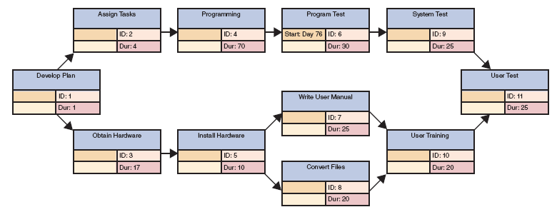
Project Management Examples (Cont. 2)
FIGURE 3-22 To transform a task list into a PERT/CPM chart, you first enter the task name, ID, duration, and predecessors for each task. Notice that this example includes dependent tasks, tasks with multiple successors, and tasks with multiple predecessors.

Slide 31
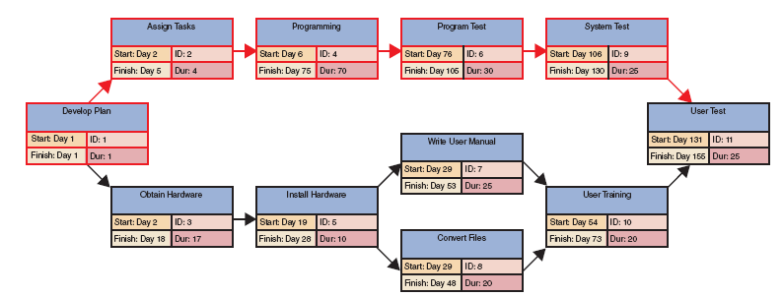
Project Management Examples (Cont. 3)
FIGURE 3-23 To complete the PERT/CPM chart, you apply the guidelines explained in this section. For example, Task 1 has a one-day duration, so you enter the start and finish for Task 1 as Day 1. Then you enter Day 2 as the start for successor Tasks 2 and 3.

Slide 32
Project Management Software
Microsoft Project
Full-featured program that holds the dominant share of the market
GanttProject
Free, open source program
Gantter
Free cloud-based project management tool
Apptivo and smartsheet
Paid Web-based project management tools

Slide 33
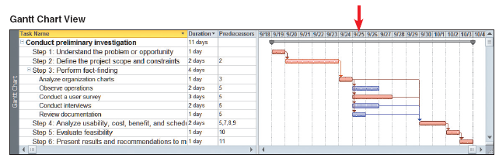
Project Management Software (Cont. 1)
FIGURE 3-26 Notice how each view displays the project and highlights the critical path. If you were the project manager on September 25, your primary concern should be conducting the user survey.

Slide 34
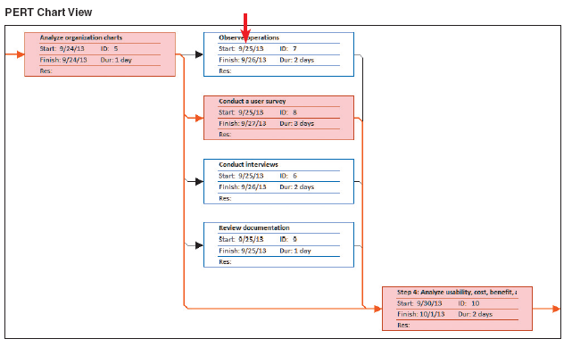
Project Management Software (Cont. 2)
FIGURE 3-26 Notice how each view displays the project and highlights the critical path. If you were the project manager on September 25, your primary concern should be conducting the user survey.

Slide 35
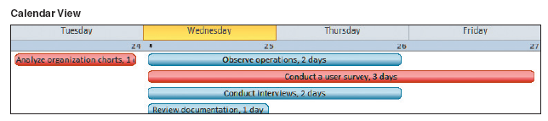
Project Management Software (Cont. 3)
FIGURE 3-26 Notice how each view displays the project and highlights the critical path. If you were the project manager on September 25, your primary concern should be conducting the user survey.

Slide 36
Risk Management
Steps in Risk Management
Develop a risk management plan
Review the project’s scope, stakeholders, budget, schedule, and any other internal or external factors that might affect the project
Define project roles and responsibilities, risk management methods and procedures, categories of risks, and contingency plans
Identify the risks
List each risk and assess the likelihood that it could affect the project

Slide 37
Risk Management (Cont. 1)
Steps in Risk Management
Analyze the risks
Qualitative risk analysis: Evaluates each risk by estimating the probability that it will occur and the degree of impact
Quantitative risk analysis: Helps understand the actual impact in terms of dollars, time, project scope, or quality
Create a risk response plan
Risk response plan: Proactive effort to anticipate a risk and describe an action plan to deal with it
Monitor risks - Conduct a continuous tracking process

Slide 38
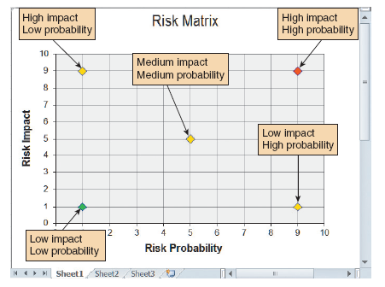
Risk Management (Cont. 2)
FIGURE 3-29 You can use a Microsoft Excel XY chart type to display a risk matrix that shows risk probability and potential impact.

Slide 39
Risk Management (Cont. 3)
Risk Management Software
Assigns specific dates as constraints
Aligns task dependencies
Notes external factors that might affect a task
Tracks progress
Displays tasks that are behind schedule

Slide 40
Managing for Success
Business Issues
Every system is to provide a solution to a business problem or opportunity
Budget Issues
Cost overruns result from:
Unrealistic estimates
Failure to develop an accurate forecast
Poor monitoring of progress and slow response to early warning signs of problems
Schedule delays due to unforeseen factors
Human resource issues

Slide 41
Managing for Success (Cont.)
Schedule Issues
Problems with timetables and project milestones can indicate:
Failure to recognize task dependencies
Confusion between effort and progress
Poor monitoring and control methods
Personality conflicts among team members
Turnover of project personnel
Failure of an IT project

Slide 42
The Bottom Line
Project managers must be alert, technically competent, and highly resourceful
Strong communication and human resource skills are necessary
When problems occur, the project manager’s ability to handle the situation becomes the critical factor

Slide 43
Chapter Summary
Project management is the process of planning, scheduling, monitoring, and reporting on the development of an information system
A successful project must be completed on time, within its budget, and deliver a quality product that satisfies users and meets requirements
A project triangle shows three legs that require balancing— project cost, scope, and time

Slide 44
Chapter Summary (Cont. 1)
Planning, scheduling, monitoring, and reporting all take place within a larger project development framework, which includes three key steps—creating a work breakdown structure, identifying task patterns, and calculating the critical path
Task patterns establish the sequence of work in a project
A critical path is a series of tasks that, if delayed, would affect the completion date of the overall project

Slide 45
Chapter Summary (Cont. 2)
A Gantt chart is a horizontal bar chart that represents the project schedule with time on the horizontal axis and tasks arranged vertically
A PERT/CPM chart shows the project as a network diagram with tasks connected by arrows
Most project managers use powerful software such as Microsoft Project to plan, schedule, and monitor projects

