Slide 1
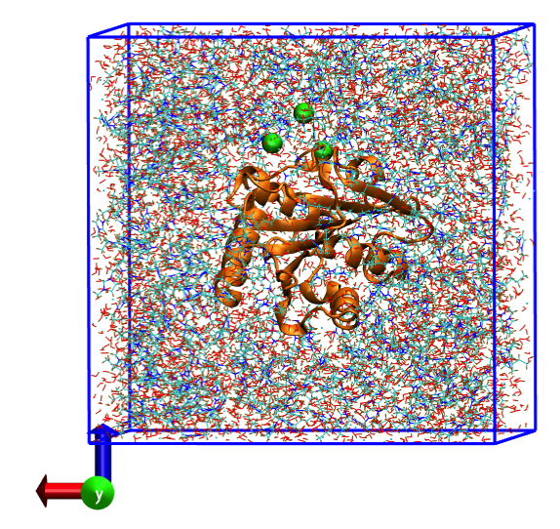

Creating systems of proteins and enzymes in ionic liquid/water mixtures
Kayla Sprenger
PRG Group Meeting
2.13.2015
Knowledge and solutions for a changing world

Slide 2
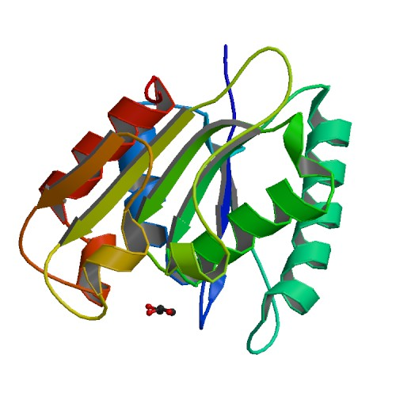
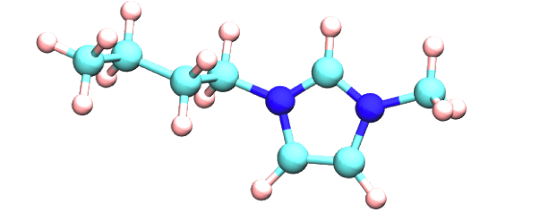
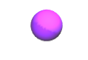
Model System
Solute: Bacillus subtilis lipase (BsL)
Solvent: 50% [BMI][CHL] in TIP3P water
Notes:
+3 charge, 3 CL ions added for neutralization → distinguish between CHL/CL (scaling at 0.8)
bacterium found in soil and water, and in association with plants. The organism is of substantial commercial interest because of its highly efficient protein secretion system.
a protein ligand is an atom, a molecule or an ion which can bind to a specific site (the binding site) on a protein. also deleted crystallographic waters.

Slide 3
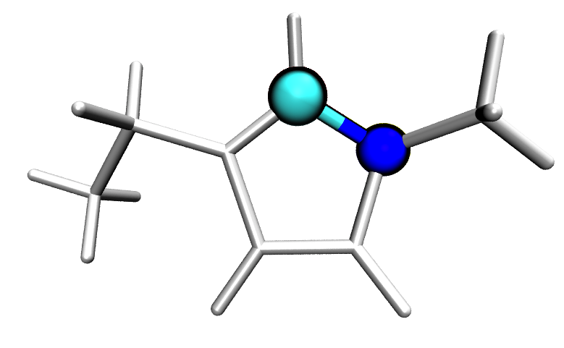
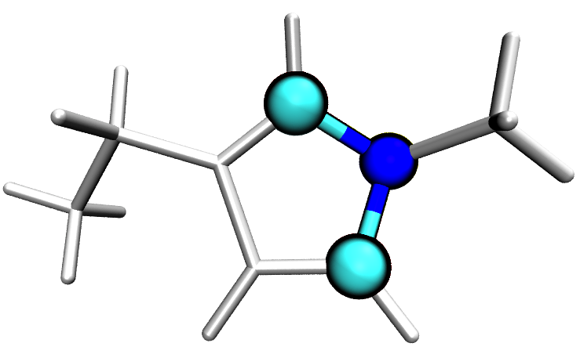
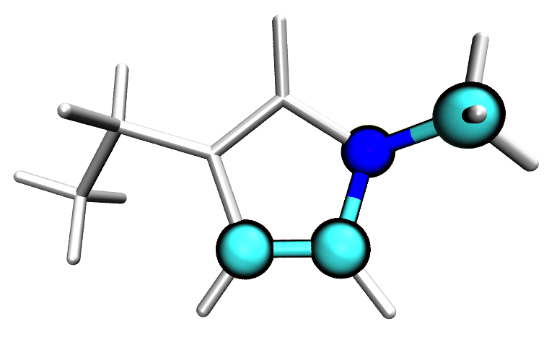
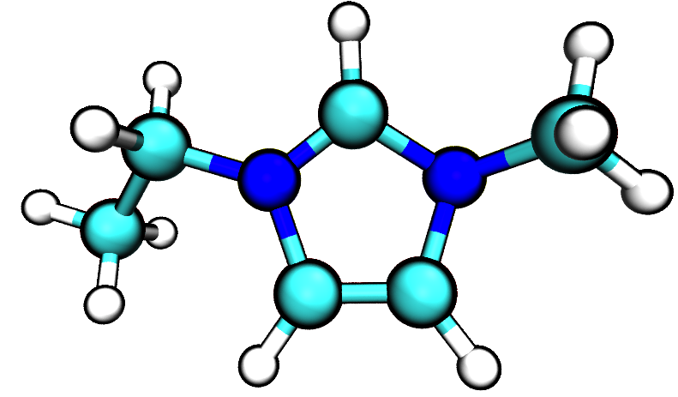
General Amber Force Field (GAFF)
0.25
-0.1
0.25
-0.1
-0.1
Need to do quantum calculations
Notes:
originally created for rational drug design, and thus is a great choice for simulating organic molecules.
GAFF has bonded and LJ parameters, and we are really looking for the electrostatic parameters here.

Slide 4
Process for creating systems of proteins/enzymes in IL/water mixtures
Part 1: parameterize ionic liquid ions
6 steps
Part 2: create box of solute in IL/water
6 steps
(Part 3: proteins at the air/IL+water interface)
3 steps

Slide 5
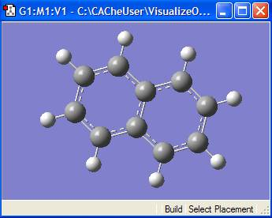
Step 1: create pdb file of cation
Gaussview
Inputs: none
Outputs: BMI.pdb

Slide 6
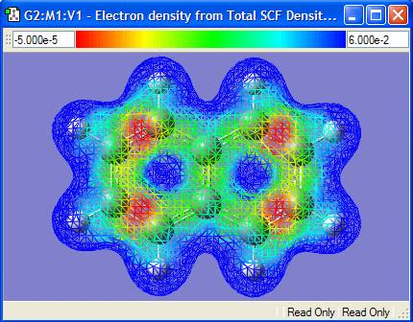
Step 2: optimize geometry & calculate electrostatic potential around molecule
Gaussian
Inputs: BMI.pdb
Outputs: BMI.log
Notes:
coordinates of points and values of quantum chemically-generated electrostatic potential around the molecule, or “density” or “cloud” → vance?
as shown here, you can actually visualize this electron potential in Gaussview.
main input for geometry optimization and single point energy calculations: level of theory: HF/6-31G* for amber99sb. other force fields require other levels of theory. (basis set: set of functions (called basis functions) which are combined in linear combinations (generally as part of a quantum chemical calculation) to create molecular orbitals. For convenience these functions are typically atomic orbitals centered on atoms, but can theoretically be any function; plane waves are frequently used in materials calculations.)

Slide 7
Step 4: create parameter file for tLEaP with a list of missing parameters
Parmchk
Inputs: BMI.mol2
force field files
Outputs:
BMI.frcmod
“ATTN: needs revision”
“Calculated with empirical approach”
Notes:
This step represents another use of a program in the antechamber tools package. This program takes the file from antechamber, along with a force field file (gaff.dat) and writes out an additional force field file with information about any missing parameters.
If it can antechamber will fill in these missing parameters by analogy to a similar parameter. You should check these parameters carefully before running a simulation. If antechamber can't empirically calculate a value or has no analogy it will either add a default value that it thinks is reasonable or alternatively insert a place holder (with zeros everywhere) and the comment "ATTN: needs revision". In this case you will have to manually parameterize this yourself.

Slide 8
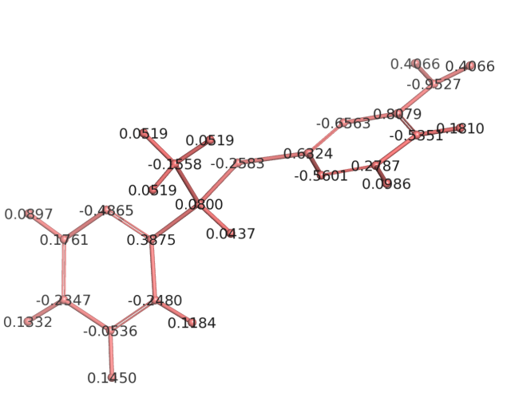
Step 3: assign GAFF atom types and calculate RESP charges on each atom
Antechamber
Inputs: BMI.log
Outputs: BMI.mol2
Notes:
antechamber is the most important (i.e. main) program within the set of programs in Antechamber Tools, which is a toolkit, along with GAFF, that helps us run AMBER more efficiently (part of AmberTools), and thus gromacs. can do all kinds of things, like assign atom types, file conversions, and charge generations. We use it here to take that electrostatic potential generated by gaussian and calculate the electrostatic point charge of each individual atom.

Slide 9
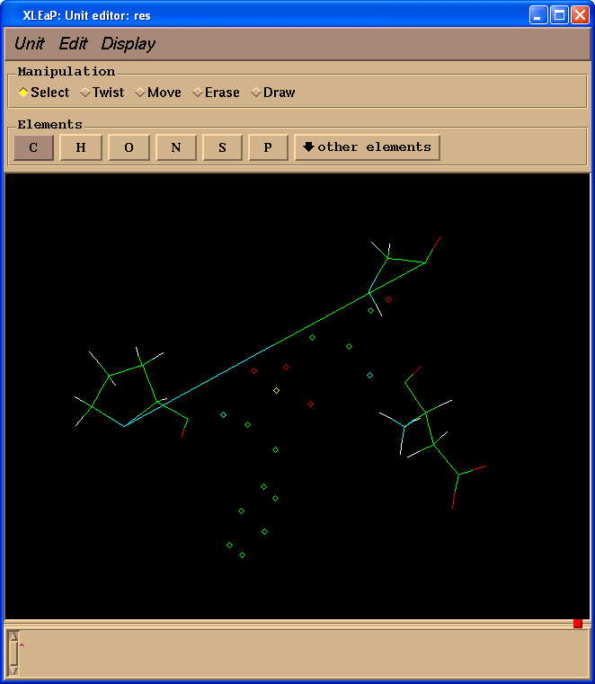
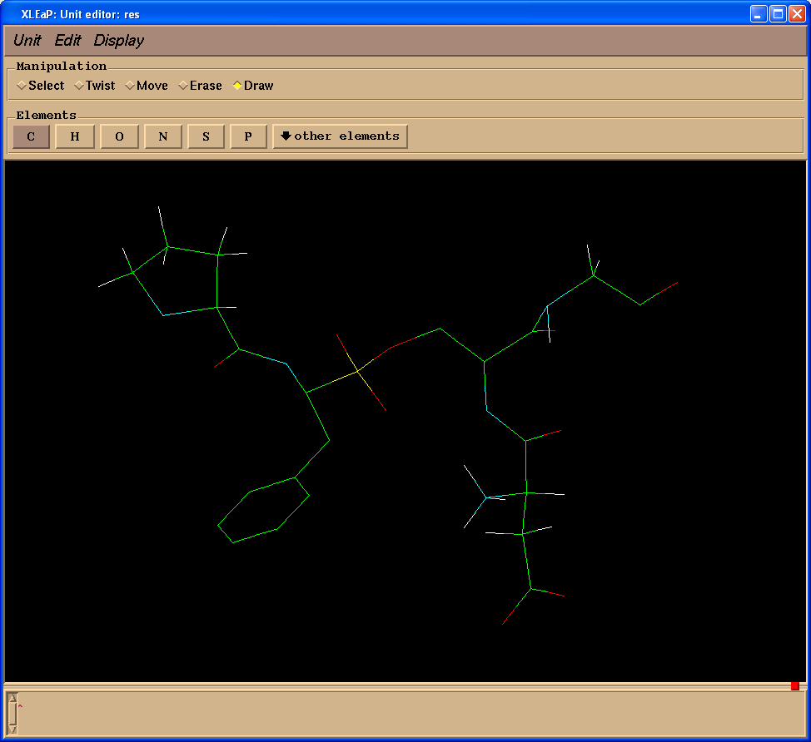
Step 5: produce files necessary for production calculations (i.e. EM, MD, …)
(t)LEaP
Inputs:
BMI.mol2
BMI.frcmod
force field files
Outputs: BMI.lib
Notes:
t in parenthesis b/c main program is leap, a basic preparation program for Amber simulations – tleap is terminal version, xleap is graphical version. reads in ff, topology, and coordinates, and produces files necessary for production calcs. can add missing parameters, i.e. add bonds like these depictions show in xleap.
when ready, save out library file for new residue/molecule.
(lib file is scaled, backup lib has full charges)

Slide 10
Step 6: repeat Steps 1-5 for anion
Inputs:
none
Gaussview
Gaussian
Antechamber
Parmchk
tLEaP
Outputs: CHL.lib
(CHL.frcmod)

Slide 11
Easier route: ffmaker!
BMI.pdb
ffmaker.inp
CHL.pdb
ffmaker.inp
ffmaker.bash
BMI.lib
BMI.frcmod
CHL.lib
CHL.frcmod

Slide 12
Process for creating systems of proteins/enzymes in IL/water mixtures
Part 1: parameterize ionic liquid ions
6 steps
Part 2: create box of solute in IL/water
6 steps
(Part 3: proteins at the air/IL+water interface)
3 steps

Slide 13
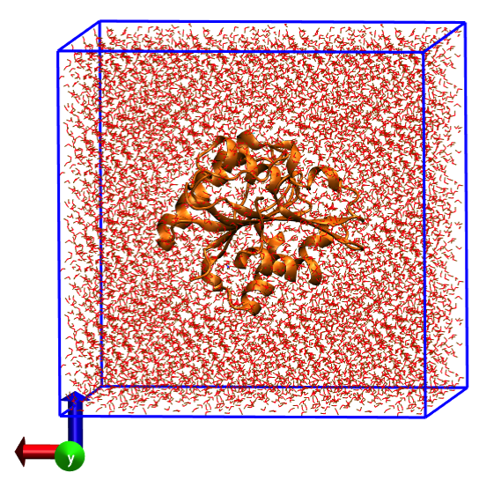
Step 1: make generic box of protein in water
tLEaP
Inputs: protein.pdb
force field files
Outputs: solvated.pdb
leap.log
Notes:
remove crystallographic waters and ligand. easy to make box of protein/water b/c program knows density/mass of water molecules, etc., but doesn’t know that for ILs.
solvate with tleap. amber force field files this time.
white space → set buffer.

Slide 14
Step 2: create Packmol input file
leap.log
Get box dimensions
Find number of waters in box
With number/total mass of waters, and with specified %/ρ IL, calculate number of IL ions/waters in new box
packmol.inp
Notes:
Packmol is a program that packs molecules in defined regions of space and guarantees that short range repulsive interactions do not disrupt the simulations.

Slide 15
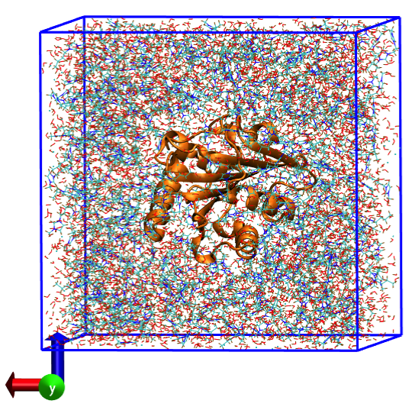
Step 3: “pack” system with protein and IL/water molecules
Packmol
Inputs: packmol.inp
BMI.pdb
CHL.pdb
protein.pdb
wat.pdb
Outputs: packed.pdb
Notes:
The user must provide only the coordinates of one molecule of each type, the number of molecules of each type and the spatial constraints that each type of molecule must satisfy.
Spatial constraints are easy to implement in Packmol, so you can do all kinds of things with packmol, such as spherical or tubular lipid bilayers, etc.

Slide 16
Step 4: produce files necessary for production calculations (i.e. EM, MD, …)
tLEaP
Inputs: packed.pdb
BMI.lib
BMI.frcmod
CHL.lib
CHL.frcmod
force field files
Outputs: solvated.pdb
solvated.prmtop
solvated.inpcrd
Notes:
parameter topology files and input coordinate files. almost what you need for an md sim w/ gromacs…coordinates and topology.

Slide 17
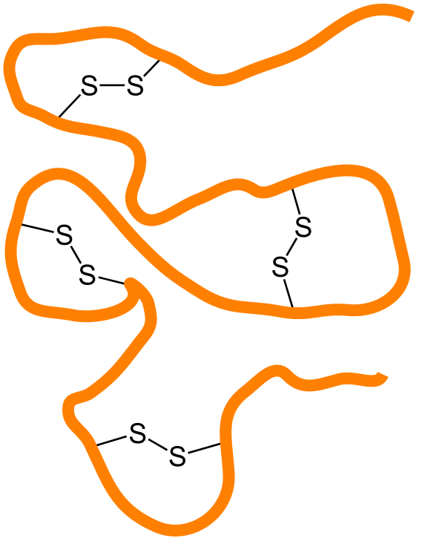
Step 5: neutralize and account for disulfide bonds
tLEaP
Inputs: solvated.pdb
BMI.lib
BMI.frcmod
CHL.lib
CHL.frcmod
force field files
Outputs: system.pdb
system.prmtop
system.inpcrd
Notes:
In chemistry, a disulfide bond is a covalent bond, usually derived by the coupling of two thiol groups. The linkage is also called an SS-bond or disulfide bridge. If there are any of these bonds, it’ll say so in the pdb file that you download directly from the PDB.

Slide 18

Step 6: generate GROMACS input files for EM, MD, etc.
ACPYPE
Inputs: system.prmtop
system.inpcrd
Outputs: topol.top
conf.gro
“AnteChamber PYthon Parser interfacE”
Notes:
tool based on Python to use Antechamber to generate topologies for chemical compounds

Slide 19
Easier route: boxmaker!
BMI.lib
BMI.frcmod
BMI.pdb
CHL.lib
CHL.frcmod
CHL.pdb
protein.pdb
boxmaker.inp
acpype.py
boxmaker.bash
topol.top
conf.gro

Slide 20
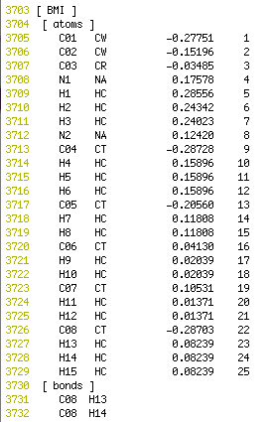
Alternative route to ffmaker/boxmaker: manual insertion into force field
Pdb2gmx
Outputs: topol.top
Notes:
direct insertion into force field, then can use gromacs tools, i.e. pdb2gmx, etc., to create toopology files.

Slide 21
Process for creating systems of proteins/enzymes in IL/water mixtures
Part 1: parameterize ionic liquid ions
6 steps
Part 2: create box of solute in IL/water
6 steps
(Part 3: proteins at the air/IL+water interface)
3 steps

Slide 22
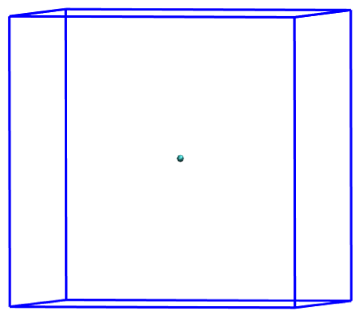
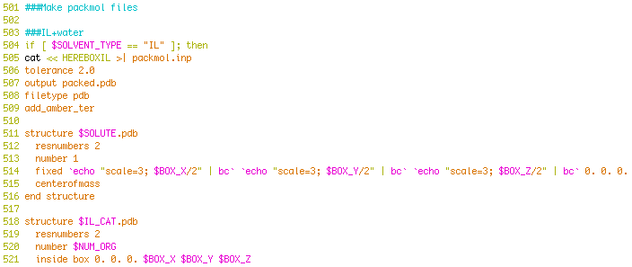
Step 1: complete Parts 1 and 2 but with an alteration to boxmaker.bash
y/2
x/2
z/2
…

Slide 23
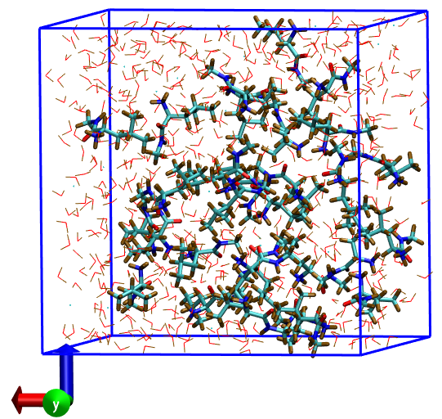
Step 2: EM/NPT before adding interface
EM
NPT
x=y=z=3.0nm
x=y=z=2.95nm

Slide 24
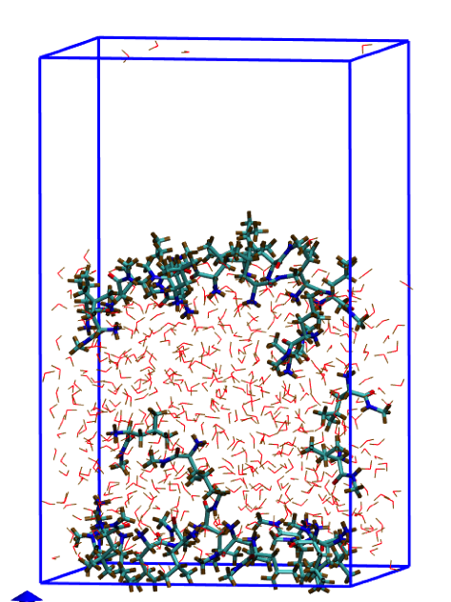
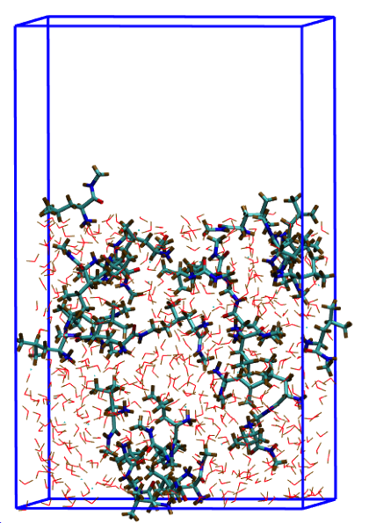
Step 3: make broken molecules whole and add vacuum space
Notes:
trjconv tool of GROMACS. add air. let interface form itself. or, put the molecules at the interface to start.

