Slide 1
Clustering on chemical network, theory and tutorial
Nitesh KM
PhD Candidate (WSU-Chemistry)
Aurora Clark Group
The University of Utah

Slide 2
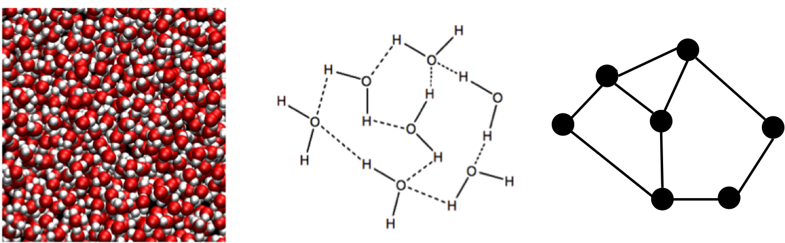
Graph Theory Based Analysis
Cartesian coordinates → Geometric/Energetic Criterions → graph/network

Slide 3
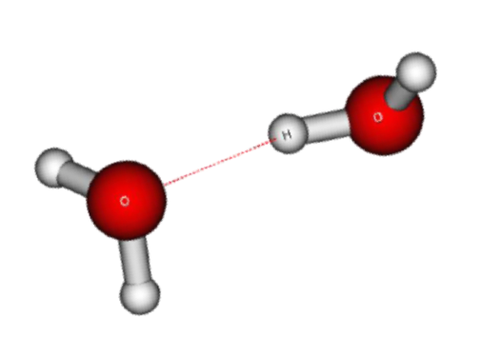
Interfacial Analysis Methods: 3. Topological analysis using Graph Theoretical approach
Criteria : Two water molecules O..O or O..H are hydrogen bonded if: - interaction distance less than 2.50Å and/or - the O..O-H angle is greater than 150
(O..H) < 2.50Å
Donor water molecule
Acceptor water molecule
Clark, A. Intermolecular Network Theory: A General Approach for Understanding the Structural and Dynamic Properties of Liquids and Solutions. In Annual Reports in Computational Chemistry; Dixon, D.A., Ed.; Elsevier: Massachusetts, 2015; 318.

Slide 4
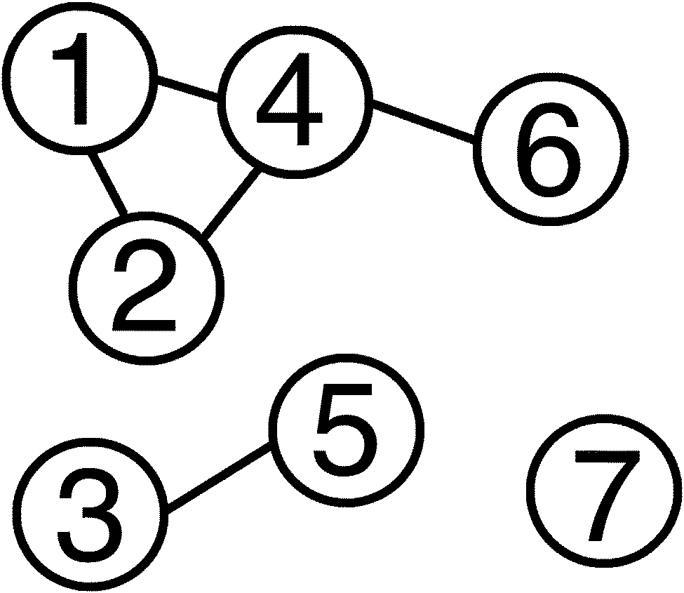
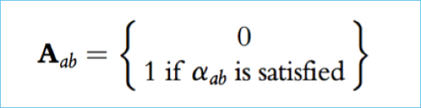
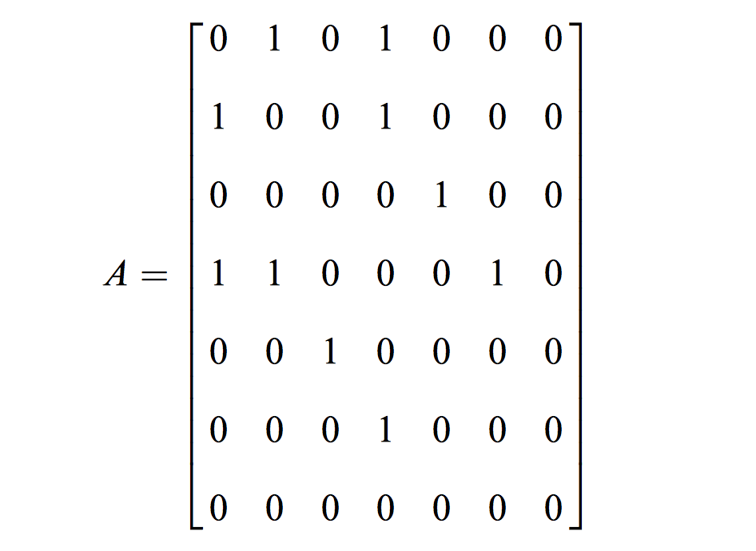
Interfacial Analysis Methods: 3. Topological analysis using Graph Theoretical approach
N x N adjacency matrix A
Where N = total # vertices in a network
α_{ab}= defines the edge between vertices a and b (edge exists = 1 and no edge = 0)
Criteria : Two water molecules O..O or O..H are hydrogen bonded if: - interaction distance less than 2.50Å and/or - the O..O-H angle is greater than 150
(O..H) < 2.50Å
Donor water molecule
Adjacency Matrix
Acceptor water molecule
Matrix A is symmetrical for an undirected simple graph
Eigenvalues and eigenvectors can be obtained after diagonalization
Two networks are isomorphic if vertices can be renumbered or after transformation
Clark, A. Intermolecular Network Theory: A General Approach for Understanding the Structural and Dynamic Properties of Liquids and Solutions. In Annual Reports in Computational Chemistry; Dixon, D.A., Ed.; Elsevier: Massachusetts, 2015; 318.

Slide 5
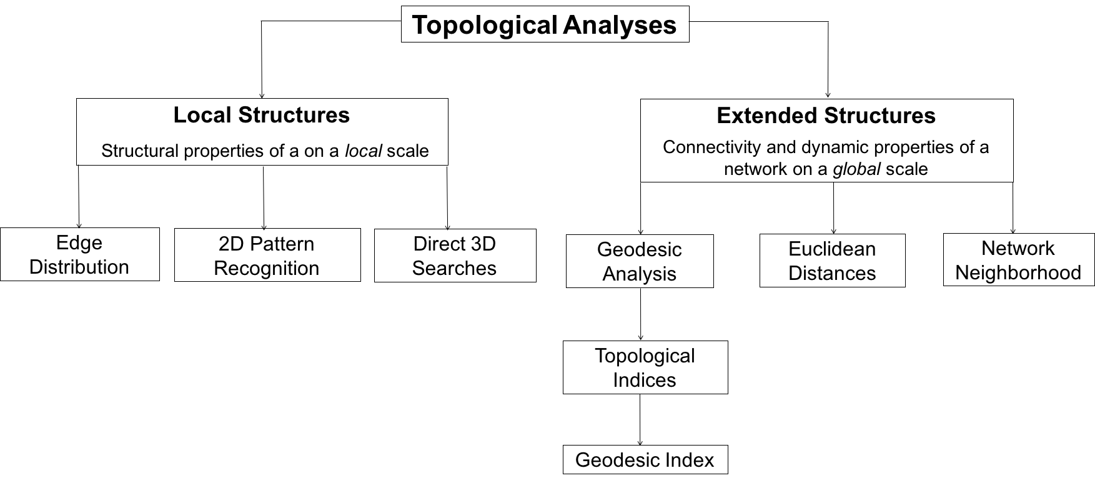
Analyzing the Graph of Hydrogen Bonds: Edge distribution
Using Adjacency matrix the edge distribution or the hydrogen bonding distribution within a specific part of the simulation system can be calculated.
Used to study interfacial structure

Slide 6
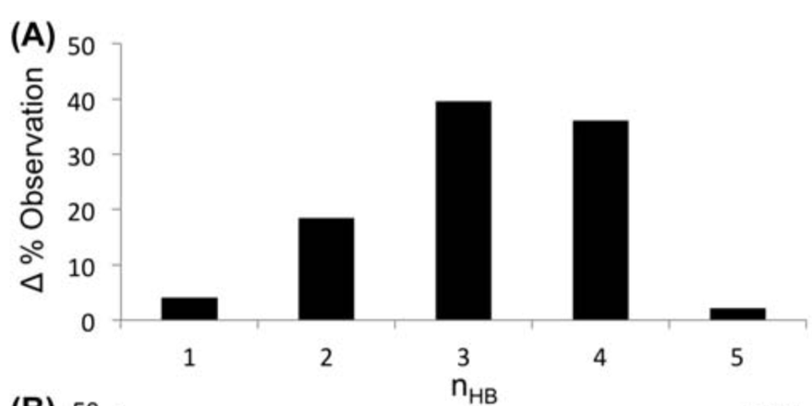
Analyzing the Graph of Hydrogen Bonds: Edge distribution
Using Adjacency matrix the edge distribution or the hydrogen bonding distribution within a specific part of the simulation system can be calculated.
Figure (A).The edge distribution of Tip3p/eW water.
Used to study bulk coordination

Slide 7
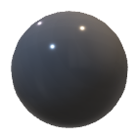


Coordination within primary coordination shell
n(r)
g(r)
solvent
cation
r(Å)

Slide 8
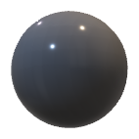
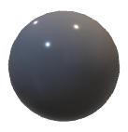
Beyond primary coordination shell

Slide 9
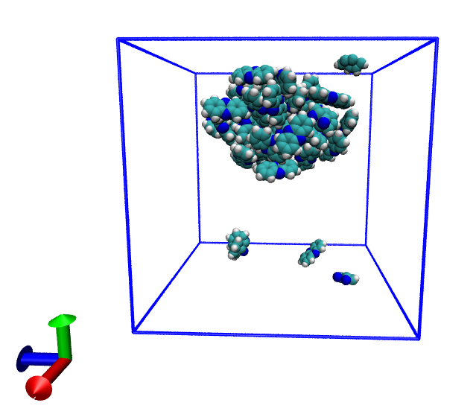
Ligand clustering on test data
Pure deprotonated phenazine
is showing clustering, which
agrees with the experimental observation
that phenazine
has a low solubility in water, will compare the exact value with exp. to benchmark the force fields.

Slide 10
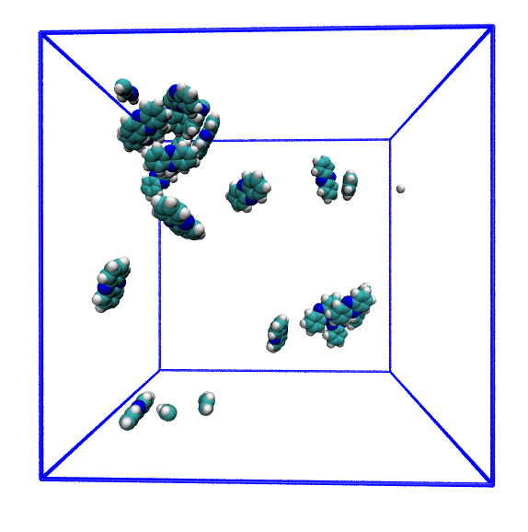
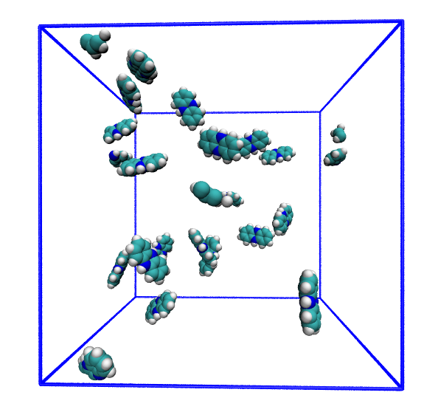
Ligand clustering on test data
deprotonated
protonated

Slide 11
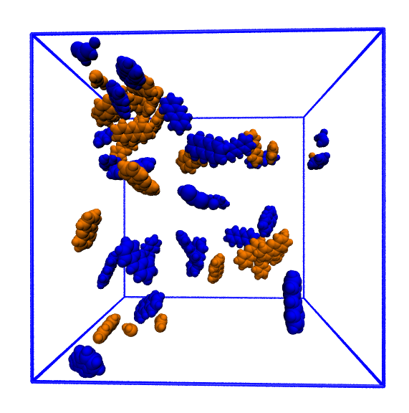
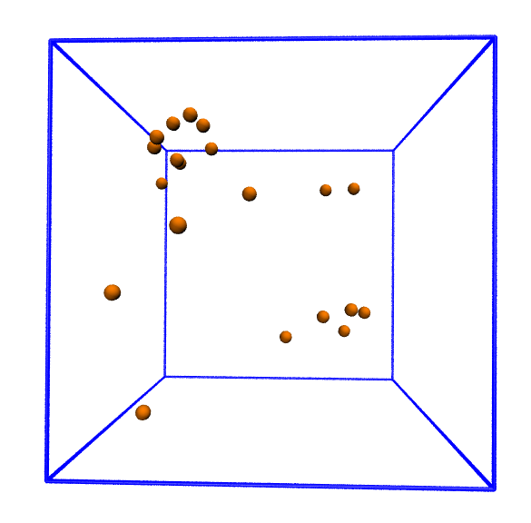
Ligand clustering on test data
Combined (50% by number)
N1 atoms to perform clustering

Slide 12
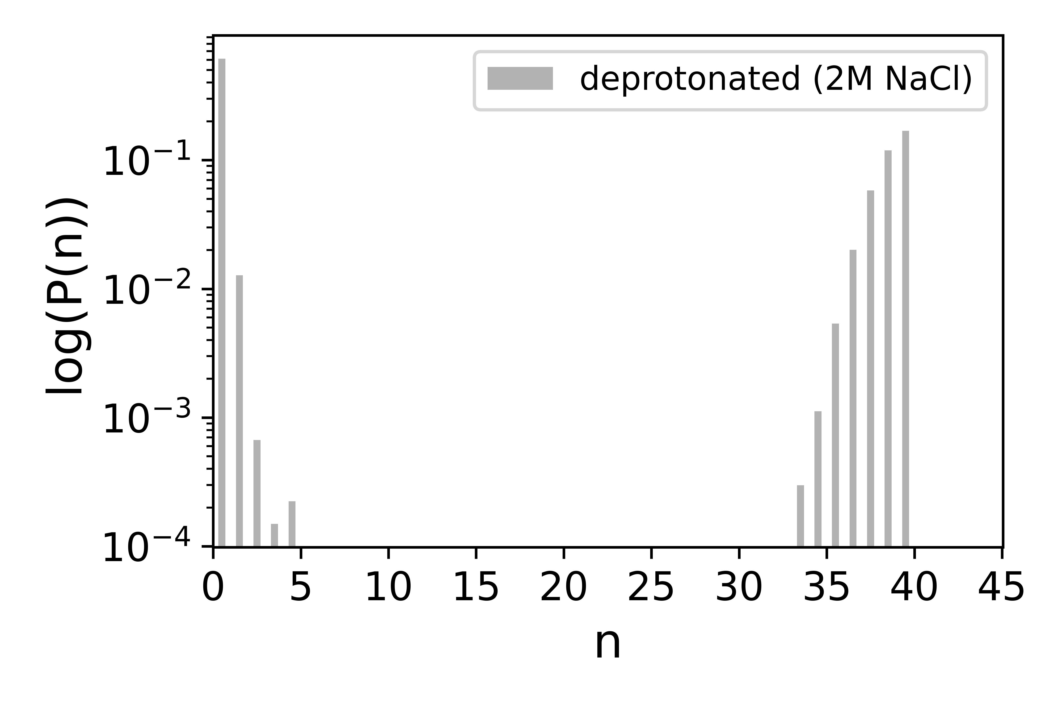
Ligand clustering on test data

Slide 13
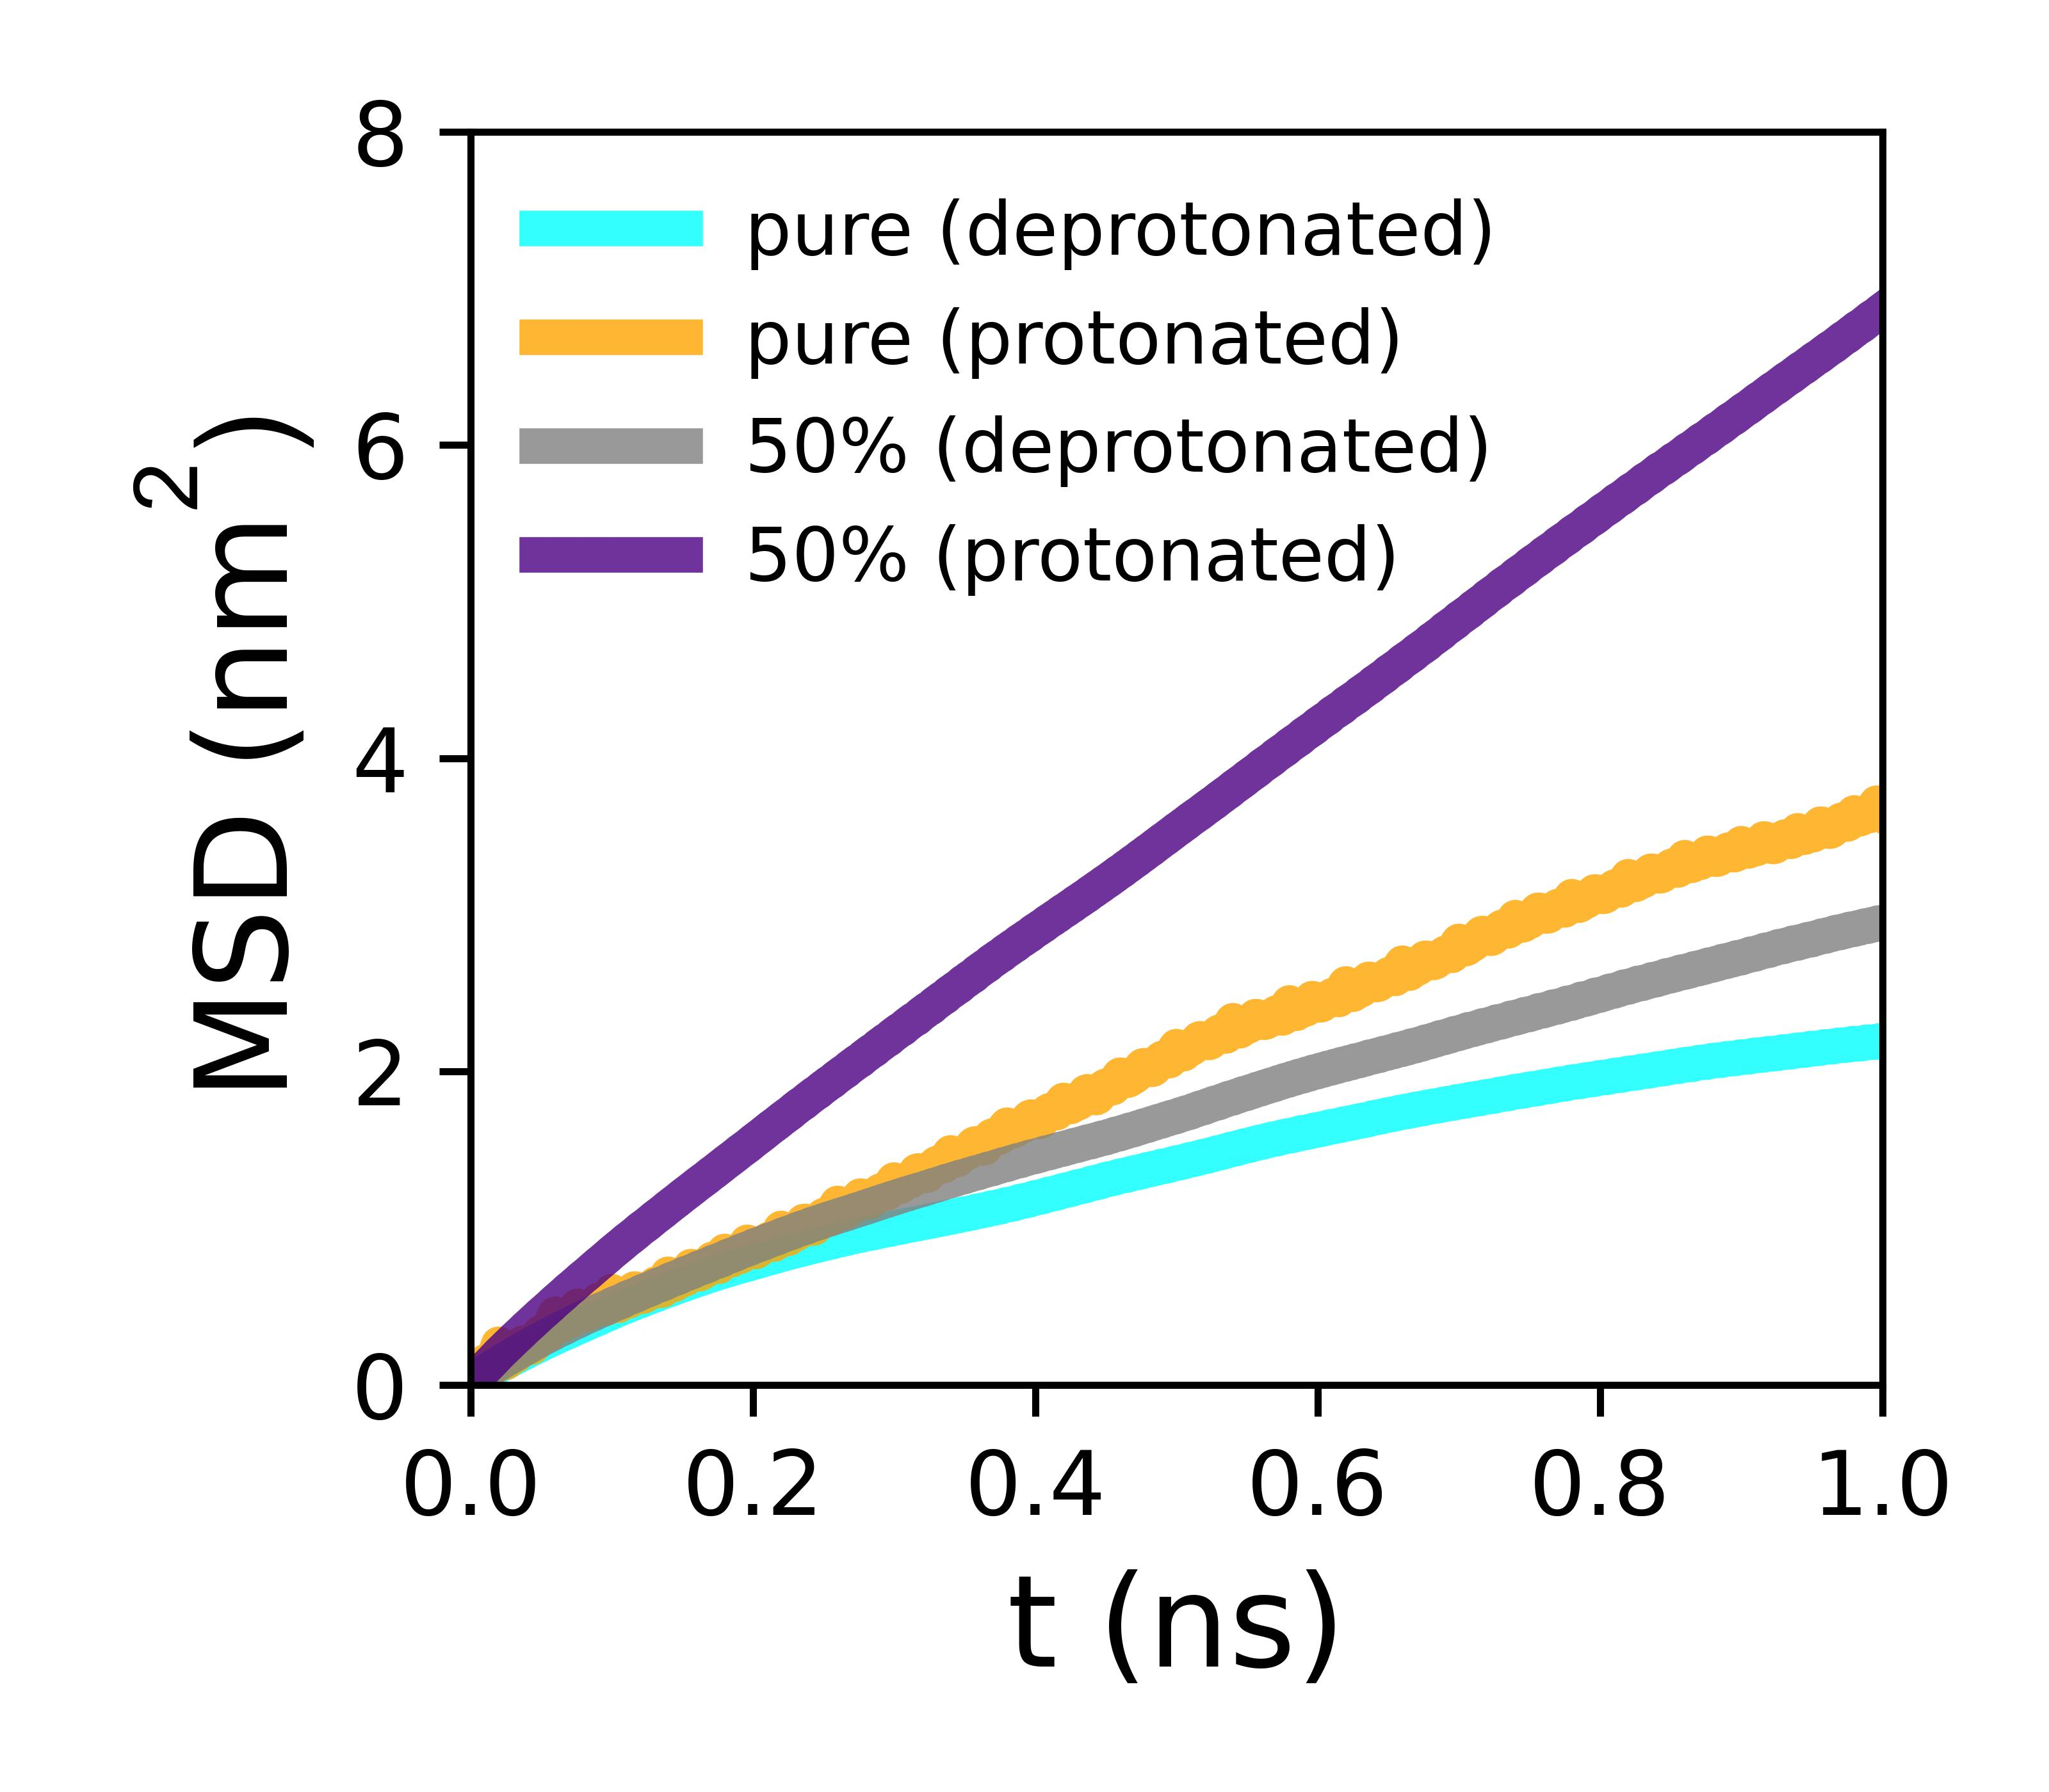
MSD (phenazine)

Slide 14
Methodology
Atomic Coordinates
Generate graph based on RDF first minima
Use Networkx to count connected components
Check the variations of connected components
as a function of time and the total distribution

Slide 15
Future goals
Search for descriptors for studying the topology of clusters
Degree centrality as a connectivity descriptors
Patterns like cycles within the clusters
Variations in cluster size as a function of ligand concentration

