Slide 1
Traffic Safety App
Kotthagattu Meher Sai (21MCME07)
Manikanta Sunkara (21MCME20)

Slide 2
Problem Statement:
Around the world, there are more than 1.3 million fatal car collisions each year. The total includes vulnerable road users such as cyclists, pedestrians and motorcyclists. IEEE Member Bilin Aksun-Guvenc believes that these numbers can be significantly reduced, and pedestrian safety increased, with a device that most people carry in their pockets: the smartphone.
This project is aimed at developing a mobile app useful for drivers and pedestrians to help keep safe in traffic using smartphone sensor data of pedestrians to track user motion and broadcast it to the vehicles.

Slide 3
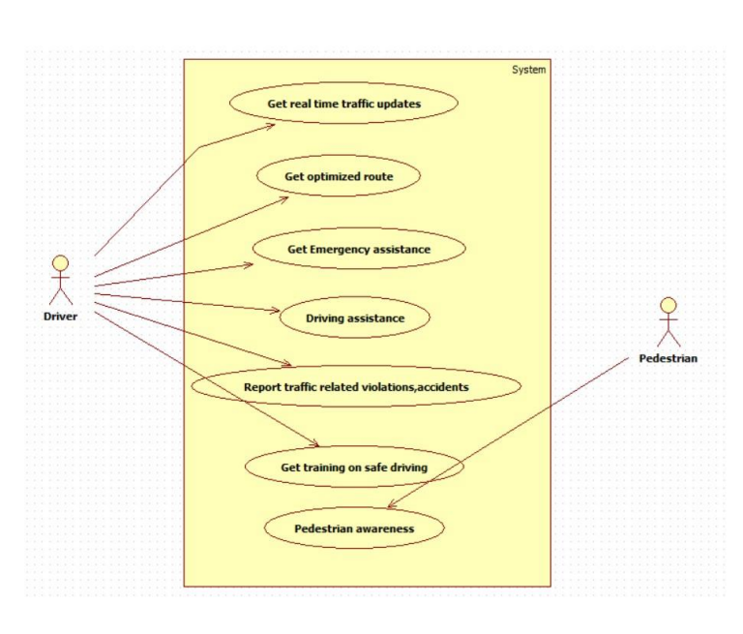
Use Cases:

Slide 4
Technologies used
Flutter
Google maps
Firebase Authentication

Slide 5
Outcomes:
Provides safety to drivers and pedestrians.
Provides alert to drivers when the pedestrians are near than 20m, also pedestrains will get alert.
There are additional features like Route opt, emergency assistance….

Slide 6
THANK YOU

